Slide 1
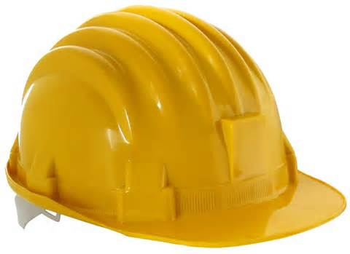
Head Protection (Hard Hats)
Bureau of Workers’ Compensation
PA Training for Health & Safety (PATHS)
OSHA 29 CFR 1910.135
Notes:
29 CFR 1910.135 provides information on standards related to head protection.

Slide 2
Objectives
Identify head hazards
Identify types of hard hats
Discuss the limitations of hard hats
Discuss the proper use and care of hard hats
Notes:
Objectives for this program include:
Identifying head hazards
Identifying types of hard hats
Discussing the limitations of hard hats
Discussing the proper use and care of hard hats

Slide 3
Your Head
Injuries to the brain can be life-threatening. Normally the skull protects the brain from damage through its hard unyieldingness; the skull is one of the least deformable structures found in nature, but it has its limits.
The force of a golf ball hitting your head at moderate speed, or simply walking into a hard object can fracture your skull. A stronger force can cause more severe injuries.
Since head injuries can be very serious, head protection is required on certain kinds of jobs.
Notes:
Injuries to the brain can be life-threatening. Normally the skull protects the brain from damage through its hard unyieldingness; the skull is one of the least deformable structures found in nature, but it has its limits.
The force of a golf ball hitting your head at moderate speed, or simply walking into a hard object can fracture your skull. A stronger force can cause more severe injuries.
Since head injuries can be very serious, head protection is required on certain kinds of jobs.

Slide 4
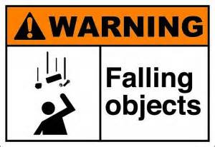
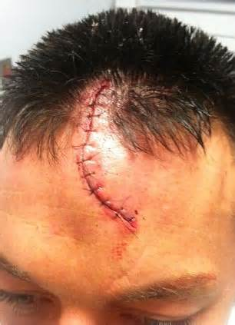
Head Injuries
Falling or flying objects are a common cause of head injuries.
Also, falling onto or walking into hard objects can cause serious head injuries.
These injuries can include scalp lacerations, neck sprains, concussions, skull fractures, brain damage or even death.
Notes:
Head injuries can be caused by
Falling or flying objects are a common cause of head injuries.
Also, falling onto or walking into hard objects can cause serious head injuries.
These injuries can include scalp lacerations, neck sprains, concussions, skull fractures, brain damage or even death.

Slide 5
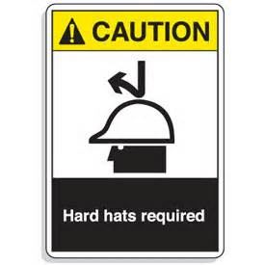
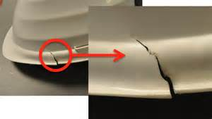
Protection
Hard hats protect you with the following:
A rigid shell that resists and deflects blows to the head,
A suspension system inside the hat that acts as a shock absorber
A shield for your scalp, face, neck, and shoulders against overhead splashes, spills, and drips of hot or caustic liquids;
Some hats serve as an insulator against electrical shocks
Notes:
Hard hats protect you with the following:
A rigid shell that resists and deflects blows to the head,
A suspension system inside the hat that acts as a shock absorber
A shield for your scalp, face, neck, and shoulders against overhead splashes, spills, and drips of hot or caustic liquids;
Some hats serve as an insulator against electrical shocks

Slide 6
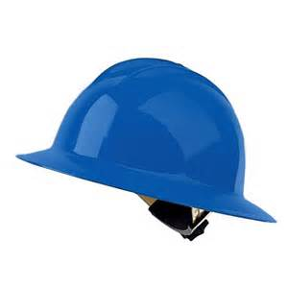
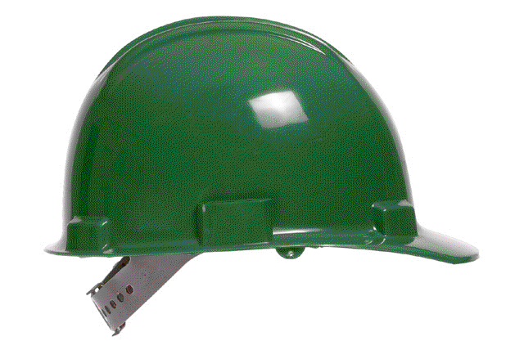
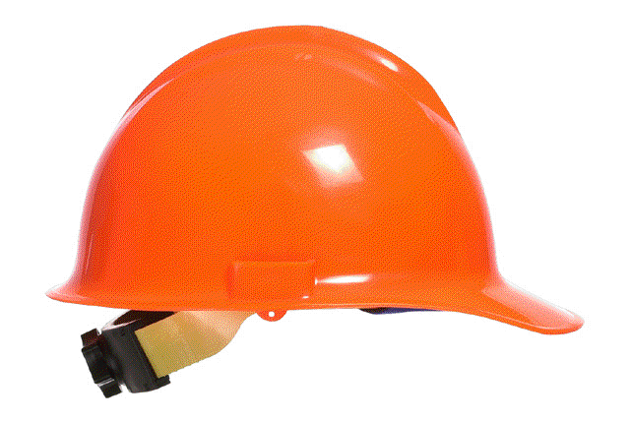
Types of Hard Hats
Impact Hard Hats
Most hard hats provide protection from impact or penetration only.
Some hard hats are designed to protect from lateral impact as well as top impact.
Some hats have a full brim for rain protection.
Notes:
Impact Hard Hats
Most hard hats provide protection from impact or penetration only.
Some hard hats are designed to protect from lateral impact as well as top impact.
Some hats have a full brim for rain protection.

Slide 7
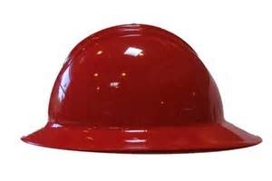
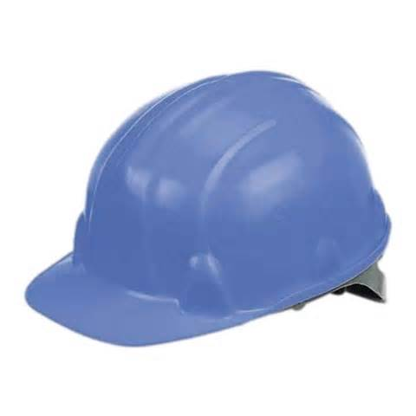
Types of Hard Hats
Electrical Hard Hats
This special type provides both impact protection and protection from either high or low voltage electricity.
Electrically insulating hardhats are labeled “Class E or G” and are used by workers doing electrical work.
Notes:
Electrical Hard Hats
This special type provides both impact protection and protection from either high or low voltage electricity.
Electrically insulating hardhats are labeled “Class E or G” and are used by workers doing electrical work.

Slide 8
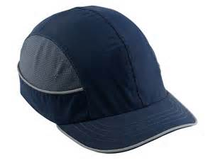
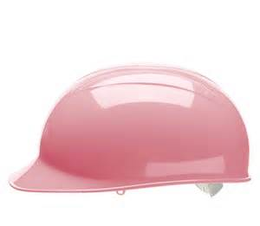
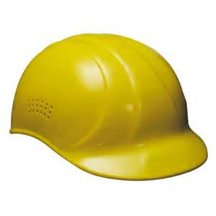
Bump Caps
Bump caps are made from lightweight plastic and are designed only to protect you from bumping your head on protruding objects.
Bump caps do not have a suspension system to protect you from falling objects nor do they protect you from electrical shocks.
WARNING: You can never substitute a bump cap for a hard hat.
Notes:
Bump caps are made from lightweight plastic and are designed only to protect you from bumping your head on protruding objects.
Bump caps do not have a suspension system to protect you from falling objects nor do they protect you from electrical shocks.
WARNING: You can never substitute a bump cap for a hard hat.

Slide 9
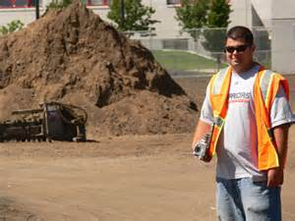
Where are hard hats required?
Any worksite where you are potentially exposed to flying or falling objects,
Around or under scaffolds or other overhead structures,
Any demolition work with overhead hazards,
Any other locations required by company policy.
?
Notes:
Hard hats are required during the following instances:
Any worksite where you are potentially exposed to flying or falling objects,
Around or under scaffolds or other overhead structures,
Any demolition work with overhead hazards,
Any other locations required by company policy.

Slide 10
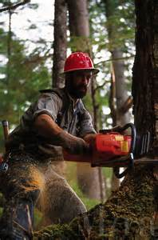
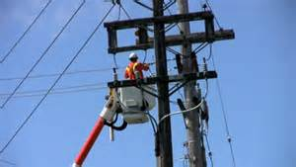
Where are hard hats required?
All logging operations,
While working as a flagger,
Work near live electrical conductors that could contact your head.
Notes:
Also required at,
All logging operations,
While working as a flagger,
Work near live electrical conductors that could contact your head.

Slide 11
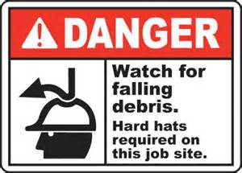
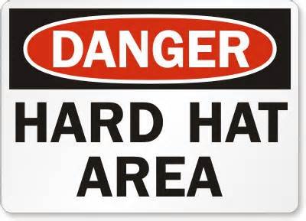
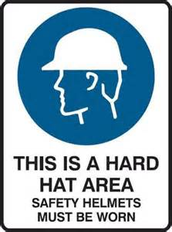
Where are hard hats required?
List your specific locations, jobs or tasks where hard hats are required at the worksite.
Notes:
List your specific locations, jobs or tasks where hard hats are required at the worksite.

Slide 12
Wearing a Hard Hat
Adjust the suspension inside your hard hat so that the hat sits comfortably, but securely on your head.
Notes:
Hard hats must be worn properly to take full advantage of the shock absorbing suspension system.
Adjust the suspension inside your hard hat so that the hat sits comfortably, but securely on your head.

Slide 13
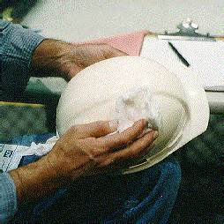
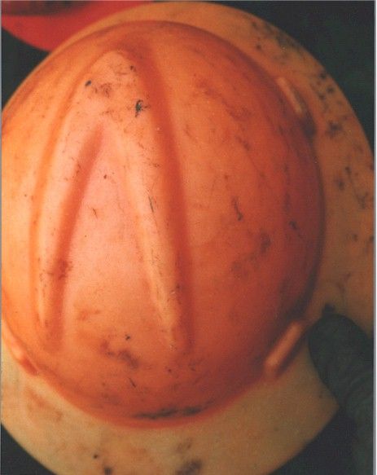
Hard Hat Care
Clean your hard hat as needed to remove oil, grease, chemicals, and sweat that can collect in and around your hat.
You can clean your hat with mild soap and hot water for 5-10 minutes. Rinse with clear water, wipe, and let air dry.
Because prolonged exposure to sunlight and heat can damage your hat, store it in a clean, dry, and cool location out of direct sunlight.
Notes:
As with any other PPE, hard hats must be properly cared for.
Clean your hard hat as needed to remove oil, grease, chemicals, and sweat that can collect in and around your hat.
You can clean your hat with mild soap and hot water for 5-10 minutes. Rinse with clear water, wipe, and let air dry.
Because prolonged exposure to sunlight and heat can damage your hat, store it in a clean, dry, and cool location out of direct sunlight.

Slide 14
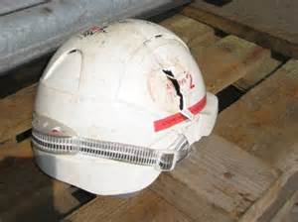
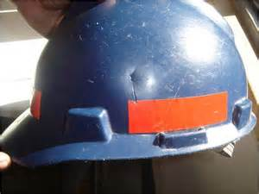
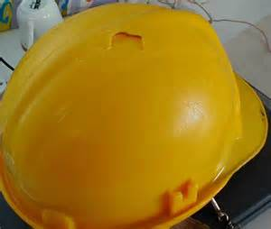
Replacement
Inspect headwear before each use for any visible signs of dents, cracks, gouges, penetration, chalking, loss of gloss or any other signs of damage that might reduce the degree of safety originally provided.
Replace hat when hairline cracks start to appear.
Replace hat that has been struck by a forceful object, even if no damage is obvious.
Notes:
Replace your hard hat when it’s needed-don’t wait!
Inspect headwear before each use for any visible signs of dents, cracks, gouges, penetration, chalking, loss of gloss or any other signs of damage that might reduce the degree of safety originally provided.
Replace hat when hairline cracks start to appear.
Replace hat that has been struck by a forceful object, even if no damage is obvious.

Slide 15
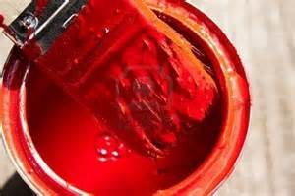
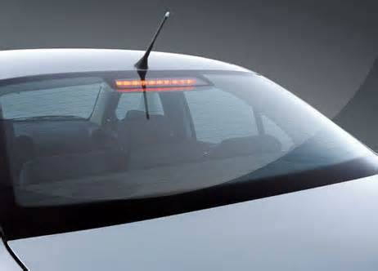
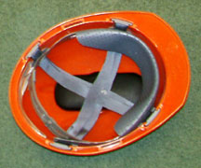
Hard Hat Use
Don’t use paint, solvents, gasoline, chemicals, or harsh cleaning materials on the shell.
Don’t transport headwear in rear windows of vehicles since sunlight and extreme heat will weaken it.
Don’t put anything in the space between the suspension and the shell.
Notes:
Prohibitions to hard hat use or storage are also in order.
Don’t use paint, solvents, gasoline, chemicals, or harsh cleaning materials on the shell.
Don’t transport headwear in rear windows of vehicles since sunlight and extreme heat will weaken it.
Don’t put anything in the space between the suspension and the shell.

Slide 16
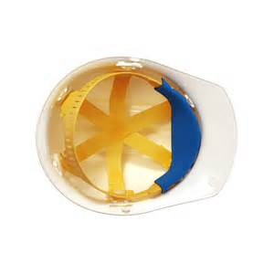
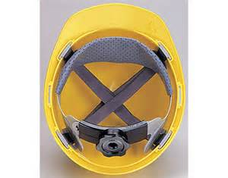
Hard Hat Suspension
Inspect suspension before every use.
Look for cracked, torn or frayed straps.
Replace suspension when damage or defects are detected.
Notes:
When inspecting the hard hat,
Inspect suspension before every use.
Look for cracked, torn or frayed straps.
Replace suspension when damage or defects are detected.

Slide 17
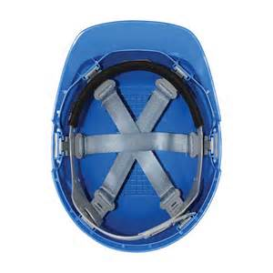
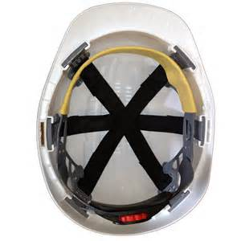
Hard Hat Suspension
Suspensions will deteriorate over time from exposure to sunlight and chemicals, perspiration and hair oils.
The normal service life of the suspension is about one year of regular use. The suspension may last longer with intermittent use.
Notes:
Suspensions will deteriorate over time from exposure to sunlight and chemicals, perspiration and hair oils.
The normal service life of the suspension is about one year of regular use. The suspension may last longer with intermittent use

Slide 18
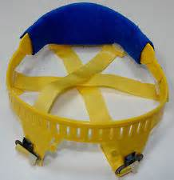
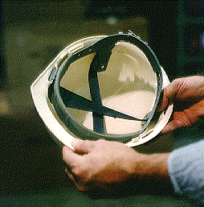
Hard Hat Suspension
Don’t mix different manufacturer suspension types and hard hats.
Replacement suspension harnesses must be from the same manufacturer and for the same model of hard hat.
Don’t wear a hard hat backwards unless you rotate the suspension.
Notes:
Don’t mix different manufacturer suspension types and hard hats.
Replacement suspension harnesses must be from the same manufacturer and for the same model of hard hat.
Don’t wear a hard hat backwards unless you rotate the suspension.
Always check manufacturer’s specifications to verify adaptations may be made and that safety will be ensured.

Slide 19
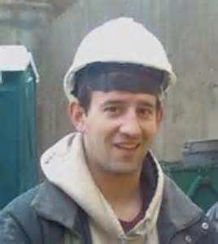
Summary
Make sure you have the right hard hat for the job at hand.
Wear hard hats properly.
Care for your hard hat.
Replace your hard hat when necessary.
Notes:
In Summary,
Make sure you have the right hard hat for the job at hand.
Wear hard hats properly.
Care for your hard hat.
Replace your hard hat when necessary.

Slide 20
Questions

Slide 21
Contact Information
Health & Safety Training Specialists
1171 South Cameron Street, Room 324
Harrisburg, PA 17104-2501
(717) 772-1635
RA-LI-BWC-PATHS@pa.gov
Like us on Facebook! - https://www.facebook.com/BWCPATHS

