Slide 1
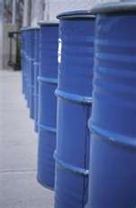
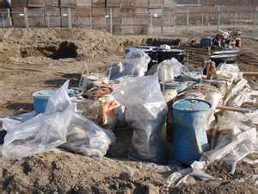
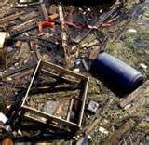
Hazardous Waste Management
Bureau of Workers’ Comp PA Training for Health & Safety (PATHS)
For compliance with:
40 CFR 260-279
and
25 Pa. Code 260a-270a
PPT-048-01
1
Notes:
The old method adopted by some of just “throwing materials in the dumpster” is gone forever. Depending upon the classification of waste materials, strict and specific methods of disposal are required.

Slide 2
Topics Addressed
Regulatory background
Hazardous waste identification and characterization
Hazardous waste generator requirements
Container storage and tank requirements
Storage areas
Pre-transportation requirements
Recordkeeping and reporting
Emergency response
Waste minimization
PPT-048-01
2
Notes:
The topics viewed will provide an overview of the regulatory requirements, based on the categorization of a waste generator, to storage, transportation, recordkeeping, emergency response to releases as well as waste minimization.

Slide 3
Hazardous Waste Management
RCRA – The Federal Solid Waste Disposal Act, as amended by the Resource Conservation and Recovery Act of 1976 (42 U.S.C.A. §§ 6901-6986)
Federal Environmental Protection Agency, (EPA) Hazardous Waste Management 40 CFR Parts 260 – 279 and
PA Department of Environmental Protection, (PA DEP) 25 Pa. Code Article VII: Hazardous Waste Management, Chapters 260a – 270a
PPT-048-01
3
Notes:
Depending upon the classification of waste and the agency requirements under which a facility (generator) operates, guidance toward compliance may be found in the cited regulations.

Slide 4
Hazardous Waste Regulations
Pennsylvania utilizes the following to govern hazardous waste management:
Federal Regulations (40 CFR Parts 260 – 279)
25 Pa. Code Article VII: Hazardous Waste Management
Hazardous
Waste
Regulations
PPT-048-01
4
Notes:
The stated regulations are used to govern hazardous waste management in Pennsylvania.

Slide 5
PA Regulations
25 Pa. Code Article VII: Hazardous Waste Management
Chapters 260a – 270a
Incorporates federal regulations by reference (“a” after the PA chapter number)
PA changed its numbering system in 1990 to be more compatible with federal hazardous waste regulations
PA assigned the same numbers in the Pa. Code as exist in the CFR provisions
Example: 40 CFR 261.3 = 25 Pa. Code 261a.3
PPT-048-01
5
Notes:
The PA regulations incorporate federal regulations by reference. There’s an “A” after the PA Chapter Number.
PA changed its numbering system in 1990 to be more compatible with federal hazardous waste regulations
PA assigned the same numbers in the Pa. Code as exist in the CFR provisions
Example: 40 CFR 261.3 = 25 Pa. Code 261a.3

Slide 6
Consider…
Due to the dual use of these regulations, when establishing your program, be mindful of two conditions in the regulations:
Where 40 CFR and 25 Pa. Code are cited, often the more stringent requirement will apply, and
Federal regulations incorporated by reference are substituted with Pennsylvania procedures
This will help you recognize the governing regulations and sections with which you should comply.
PPT-048-01
6
Notes:
Where 40 CFR and 25 Pa. Code are cited, often the more stringent requirement will apply, and
Federal regulations incorporated by reference are substituted with Pennsylvania procedures.

Slide 7
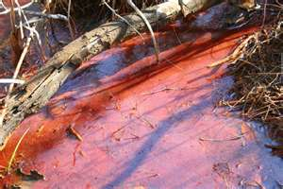
(RCRA)- Federal Regulations
Federal Regulations (40 CFR Parts 260 – 279) and
25 Pa. Code Title VII
Cradle To Grave Management (Generation, Transportation, Disposal)
RCRA – The Federal Solid Waste Disposal Act, as amended by the Resource Conservation and Recovery Act of 1976 (42 U.S.C.A. 6901 et seq.)
Regulates hazardous waste from generation to disposal
PPT-048-01
7
Notes:
The Resource Conservation and Recovery Act (RCRA) regulates hazardous waste from generation to disposal.

Slide 8
Why We Need to Comply With the RCRA
Violation of the regulation: civil or criminal penalty
Civil penalties and administrative actions
Depends on the potential for harm (major, moderate, minor)
Depends on the deviation from compliance (major, moderate, minor)
Fines range from $100s to $1,000s PER DAY
Each day is a separate occurrence
Criminal penalties
Knowing or willful violations
PPT-048-01
8
Notes:
Compliance with RCRA can eliminate civil or criminal penalties which reduces losses to a company in monetary terms as well as lost revenue due to a negative reputation.

Slide 9
“Generator”
Anyone who creates waste:
Has responsibility to determine if waste is hazardous or nonhazardous
Must take proper steps to handle waste
Generators are categorized as:
CESQG-Conditionally exempt small quantity generator
SQG-Small quantity generator
LQG-Large quantity generator
PPT-048-01
9
Notes:
A company needs to determine if they are a “Generator” of waste.
After this determination they then need to determine into which category generation of such waste fits. This will determine requirements to which the company must comply.

Slide 10
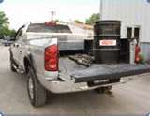
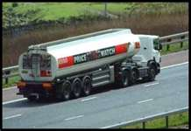
Transporter
The licensed party in charge of offsite removal of solid waste at any time after generation
PPT-048-01
10
Notes:
“Transporters” of waste are included in the regulations. These would be the licensed party in charge of offsite removal of solid waste at any time after generation.

Slide 11
Treatment
Method, technique or process, including neutralization
Designed to change physical, chemical or biological character or composition of waste
Render it nonhazardous, safer for transport, suitable for recovery (storage, or reduced in volume)
Includes activity or processing designed to change the physical or chemical composition (render it neutral or nonhazardous)
PPT-048-01
11
Notes:
“Treatment” of waste includes:
Method, technique or process, including neutralization
Designed to change physical, chemical or biological character or composition of waste
Render it nonhazardous, safer for transport, suitable for recovery (storage, or reduced in volume)
Includes activity or processing designed to change the physical or chemical composition (render it neutral or nonhazardous)

Slide 12
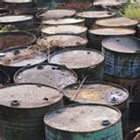
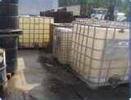
Storage
Containment of a waste
Temporary basis
Presumption: containment of a waste in excess of one year constitutes disposal
PPT-048-01
12
Notes:
“Storage” is also regulated to ensure the hazardous waste is not subject to commingling, contamination or release into the environment.
Storage views:
The containment of the waste.
Temporary basis of storage, whether for 90 or 120 days from beginning of storage to disposal.
The presumption of long term containment translating into disposal is also viewed.

Slide 13
Disposal Defined
Incineration, deposition, injection, dumping, spilling, leaking or placing of solid waste into or on the land or water that the solid waste or a constituent enters the environment, is emitted into the air or is discharged to the waters of the commonwealth.
PPT-048-01
13
Notes:
“Disposal” is defined as:
Incineration, deposition, injection, dumping, spilling, leaking or placing of solid waste into or on the land or water that the solid waste or a constituent enters the environment, is emitted into the air or is discharged to the waters of the commonwealth.

Slide 14
What is Solid Waste?
Does not depend on the physical state of the material (solid, liquid, gas)
Solid Waste:
Any garbage
Refuse
Sludge from a waste water treatment plant, water supply treatment plant or air pollution control facility
Other discarded material including solid, liquid, semi-solid or contained gaseous material
Results from industrial, commercial, mining and agricultural operations and from community activities
PPT-048-01
14
Notes:
A “solid waste” does not depend on the physical state of the material; whether solid, liquid or gas. Solid waste is defined as:
Any garbage
Refuse
Sludge from a waste water treatment plant, water supply treatment plant or air pollution control facility
Other discarded material including solid, liquid, semi-solid or contained gaseous material
Results from industrial, commercial, mining and agricultural operations and from community activities

Slide 15
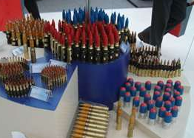
Solid Waste
Solid waste: any discarded material
Discarded: abandoned, considered inherently waste-like, military munitions, recycled (with exceptions)
PPT-048-01
15
Notes:
“Solid Waste” is also any discarded material. “Discarded” being:
Abandoned,
Considered inherently waste-like,
Military munitions, and
Recycled (with exceptions)

Slide 16
Some Solid Waste Exemptions
Domestic sewage
Industrial wastewater point source discharges
Irrigation return flows
Byproducts defined by Atomic Energy Act
Some mining materials
PPT-048-01
16
Notes:
Exemptions exist within the regulations. Some solid waste exemptions are:
Domestic sewage
Industrial wastewater point source discharges
Irrigation return flows
Byproducts defined by Atomic Energy Act
Some mining materials

Slide 17
Some Solid Waste Exemptions
Reclaimed/reused pulping liquors.
Spent sulfuric acid used to make new sulfuric
acid.
Materials that are reclaimed/returned into
original process.
Spent wood preserving solutions that are
reclaimed/reused for treating wood.
PPT-048-01
17
Notes:
Additional solid waste exemptions would be:
Reclaimed/reused pulping liquors.
Spent sulfuric acid used to make new sulfuric acid.
Materials that are reclaimed/returned into original process.
Spent wood preserving solutions that are reclaimed/reused for treating wood.

Slide 18
What is Hazardous Waste?
Determine: is the waste a solid waste?
All hazardous wastes are solid wastes
Not all solid wastes are hazardous waste
Solid Waste
Hazardous waste
PPT-048-01
18
Notes:
First, a company needs to determine if they have hazardous waste. All hazardous wastes are solid wastes, however, not all solid wastes are hazardous waste.

Slide 19
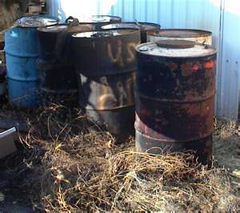
Hazardous Waste
RCRA: A solid waste, or combination of solid wastes, which because of its:
quantity,
concentration,
physical,
chemical,
infectious characteristics may pose a hazard to human health or the environment.
PPT-048-01
19
Notes:
The items listed are definitive characteristics of hazardous waste.

Slide 20
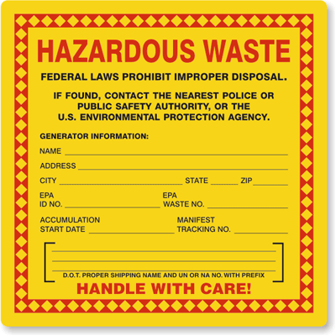
Hazardous Waste Identification
Known to be fatal to humans in low doses.
Exceeds toxicity data in rats with serious irreversible effects.
Universal waste.
PPT-048-01
20
Notes:
Hazardous waste is:
Known to be fatal to humans in low does,
Exceeds toxicity data in rats with serious irreversible effects.
Determine if your waste is classified as Universal Waste.

Slide 21
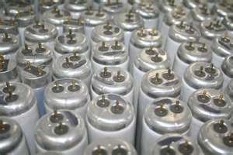
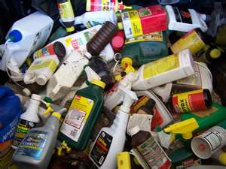
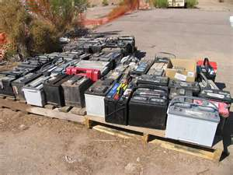
Universal Waste
Mercury-containing devices (e.g., thermostats, switches, barometers)
Lamps (e.g., neon, fluorescent, etc.)
Agricultural chemicals (pesticides/herbicides)
Batteries (e.g., Lead-acid, NiMH, Li-ion, NiCd)
PPT-048-01
21
Notes:
Examples of Universal Waste would be such items as:
Mercury-containing devices (e.g., thermostats, switches, barometers)
Lamps (e.g., neon, fluorescent, etc.)
Agricultural chemicals (pesticides/herbicides)
Batteries (e.g., Lead-acid, NiMH, Li-ion, NiCd)

Slide 22
Determine if Waste is Hazardous
First: Is waste excluded from 40 CFR 262.11?
Listed? Check 40 CFR 261, Subpart D
Characteristic? 40 CFR 261, Subpart C to determine ignitability, corrosivity, reactivity, toxicity.
40 CFR 261-265
PPT-048-01
22
Notes:
Determine if the waste generated is Hazardous:
First, determine if the waste is excluded from the regulation by checking 40 CFR 262.11
Determine if the waste is Listed by looking at 40 CFR 261, Subpart D
Determine if the waste is classified due to a Characteristic in 40 CR 261, Subpart C based on:
Ignitability
Corrosivity
Reactivity or
Toxicity.

Slide 23
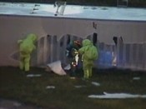
Determine if Waste is Hazardous
Explicitly named on one of the lists in the regulations (bearing F, P, K, U Codes).
Exhibits hazardous characteristics on standardized test procedures specified in the regulations (flammable, corrosive, reactive, toxic) (D Codes).
PPT-048-01
23
Notes:
If the regulatory lists name the waste generated, the names will be preceded by either an F, P, K or U code.
D Codes will indicate if the waste exhibits hazardous characteristics on standardized test procedures specified in the regulations (flammable, corrosive, reactive, toxic).

Slide 24
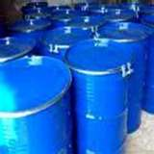
Listed Hazardous Waste
F List – Hazardous waste from non-specific sources.
Example: spent solvents, F001 – F005
40 CFR 261.31
PPT-048-01
24
Notes:
Listed Hazardous Waste.
The “F” List deals with hazardous waste from non-specific sources.
Example: spent solvents, F001 – F005
40 CFR 261.31

Slide 25
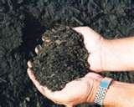
Listed Hazardous Waste
K List – Hazardous wastes from specific sources, process wastes
Example: wastewater treatment sludges
40 CFR 261.32
PPT-048-01
25
Notes:
K List – Hazardous wastes from specific sources, process wastes
Example: wastewater treatment sludge
40 CFR 261.32

Slide 26
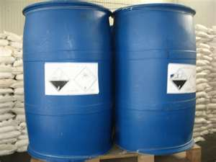
Listed Hazardous Waste
P List – Acutely toxic discarded commercial chemical products or manufacturing chemical intermediates.
Example: Unused hydrofluoric acid to be discarded; phosgene.
40 CFR 261.33
PPT-048-01
26
Notes:
P List – Acutely toxic discarded commercial chemical products or manufacturing chemical intermediates
Example: Unused hydrofluoric acid to be discarded; phosgene
40 CFR 261.33

Slide 27
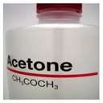
Listed Hazardous Waste
U List – Systemically toxic; discarded commercial chemical products or manufacturing intermediates, such as acetone.
40 CFR 261.33: Primary hazards are ignitability, reactivity, corrosivity or toxicity.
PPT-048-01
27
Notes:
U List – Systemically toxic; discarded commercial chemical products or manufacturing intermediates, such as acetone.
40 CFR 261.33: Primary hazards are ignitability, reactivity, corrosivity or toxicity.

Slide 28
Characteristics Hazardous Waste (D codes)
Wastes that have not been listed by the EPA.
Still have to be reviewed to determine if they exhibit certain characteristics.
EPA chose four characteristics that could be measured by an available standardized test method.
40 CFR 261, Subpart C.
PPT-048-01
28
Notes:
D Code List Characteristics.
Wastes that have not been listed by the EPA.
Still have to be reviewed to determine if they exhibit certain characteristics.
EPA chose four characteristics that could be measured by an available standardized test method.
40 CFR 261, Subpart C.

Slide 29
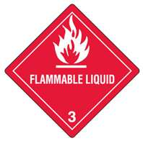
Four Traits of Hazardous Waste
Ignitability (D001)
Corrosivity (D002)
Reactivity (D003)
Toxicity (D004 – D043)
PPT-048-01
29
Notes:
The slide shows four (4) traits of hazardous waste. It may be either:
Ignitable,
Corrosive,
Reactive, and/or
Toxic
You cannot treat a waste to reduce its characteristic. If you do, then you would have to comply with regulations governing Treatment Storage and Disposal Facilities.

Slide 30
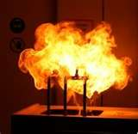
Ignitability (D001)
Liquid with a flash point less than 140ºF
Not a liquid, but is capable of causing vigorous, persistent and hazardous fire through friction, spontaneous chemical changes
PPT-048-01
30
Notes:
D Code: D001, Ignitability would include:
A liquid with a flash point less than 140ºF
Not a liquid, but is capable of causing vigorous, persistent and hazardous fire through friction, spontaneous chemical changes.

Slide 31
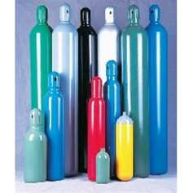
Ignitability (D001)
Ignitable compressed gas
Oxidizer
PPT-048-01
31
Notes:
D Code, Ignitability also includes:
Ignitable compressed gas and Oxidizers

Slide 32
Corrosivity (D002)
Aqueous pH range:
<2 (acidic) or > 12.5 (basic)
(pH 1 – 6=acid;
pH 7=neutral;
pH 8 – 14=base)
Liquid that corrodes steel greater than 6.35 mm (0.250 inches) per year at 130ºF.
PPT-048-01
32
Notes:
D code, D002, Corrosivity.
Aqueous pH range:
<2 (acidic) or > 12.5 (basic)
(pH 1 – 6=acid;
pH 7=neutral;
pH 8 – 14=base)
Liquid that corrodes steel greater than 6.35 mm (0.250 inches) per year at 130ºF.

Slide 33
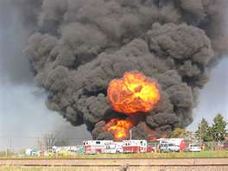
Reactivity (D003)
Normally unstable; readily undergoes violent changes without detonating.
Reacts violently with water, forming potentially explosive mixtures or generating toxic gases, vapors or fumes sufficient to present a danger to human health or the environment.
PPT-048-01
33
Notes:
D Code, D003, Reactivity is for a waste:
Normally unstable; readily undergoes violent changes without detonating.
Reacts violently with water, forming potentially explosive mixtures or generating toxic gases, vapors or fumes sufficient to present a danger to human health or the environment.

Slide 34
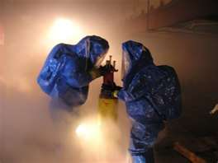
Reactivity (D003)
Cyanide or sulfide containing waste that, when exposed to pH conditions between 2 – 12.5, can generate toxic gases, vapors or fumes in quantities sufficient to present a danger to human health or the environment.
PPT-048-01
34
Notes:
D Code, D003, Reactivity includes:
Cyanide or sulfide containing waste that, when exposed to pH conditions between 2 – 12.5, can generate toxic gases, vapors or fumes in quantities sufficient to present a danger to human health or the environment.

Slide 35
Reactivity (D003)
Capable of detonation or explosive reaction at standard temperature-pressure (STP) if subjected to strong initiating source or heated under confinement.
PPT-048-01
35
Notes:
D Code, D003, Reactivity:
Capable of detonation or explosive reaction at standard temperature-pressure (STP) if subjected to strong initiating source or heated under confinement

Slide 36
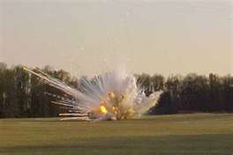
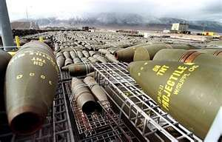
Reactivity (D003)
Forbidden explosive, Division 1.1, 1.2 or 1.3 (per 49 CFR 173.50 and 173.53)
PPT-048-01
36
Notes:
D003, Reactivity:
Forbidden explosive, Division 1.1, 1.2 or 1.3 (per 49 CFR 173.50 and 173.53)

Slide 37
Toxicity (D004-D043)
Wastes likely to leach dangerous concentrations of toxic chemicals into the groundwater.
40 CFR 261.24 Table 1
Toxic Characteristic Leaching Procedure (TCLP) Method 1311.
PPT-048-01
37
Notes:
D Code, D004 through D043, Toxicity are those wastes:
Likely to leach dangerous concentrations of toxic chemicals into the groundwater.
40 CFR 261.24 Table 1
Toxic Characteristic Leaching Procedure (TCLP) Method 1311.

Slide 38
Characterizing Hazardous Waste
To determine if a waste is hazardous, subject a sample to:
Analytical testing
MSDS
Generator knowledge
Field testing
PPT-048-01
38
Notes:
To determine if a waste is hazardous, subject a sample to:
Analytical testing
MSDS
Generator knowledge
Field testing

Slide 39
Mixture Rule
Mixtures of nonhazardous waste and listed hazardous waste: treat as hazardous waste, (unless hazardous portion is a “characteristic” hazardous waste and no longer exhibits a hazardous characteristic).
Note: Mixture exceptions do not apply when the wastes are intentionally mixed to achieve dilution (would be considered “treatment” and require a special permit).
PPT-048-01
39
Notes:
Mixture Rule:
Mixtures of nonhazardous waste and listed hazardous waste: treat as hazardous waste, (unless hazardous portion is a “characteristic” hazardous waste and no longer exhibits a hazardous characteristic).
Note: Mixture exceptions do not apply when the wastes are intentionally mixed to achieve dilution (would be considered “treatment” and require a special permit).

Slide 40
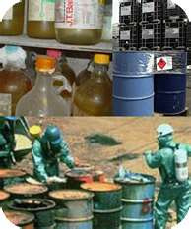
Hazardous Waste Generator Requirements
Once facility determines it generates hazardous waste, it must:
determine generator status.
understand requirements associated with that status.
PPT-048-01
40
Notes:
Once a facility determines it generates hazardous waste, it must:
Determine its generator status.
Understand the requirements associated with that status.

Slide 41
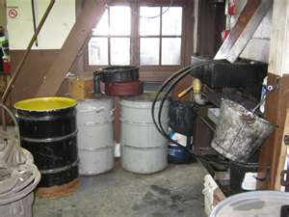
Hazardous Waste Generator Categories
Conditionally Exempt Small Quantity Generator (CESQG):
Generates up to 100 kg (220 lbs) of hazardous waste per month or up to 1 kg of acutely hazardous waste per month.
PPT-048-01
41
Notes:
The Conditionally Exempt Small Quantity Generator (CESQG) is one which:
Generates up to 100 kg (220 lbs) of hazardous waste per month or up to 1 kg of acutely hazardous waste per month.

Slide 42
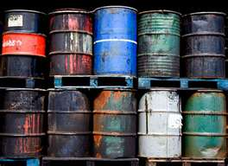
SQG
Small Quantity Generator (SQG):
Generates more than 100 kg (220 lbs) but less than 1,000 kg (2,200 lbs) of hazardous waste per month & not more than 1 kg of acutely hazardous waste per month.
PPT-048-01
42
Notes:
The Small Quantity Generator (SQG):
Generates more than 100 kg (220 lbs) but less than 1,000 kg (2,200 lbs) of hazardous waste per month & not more than 1 kg of acutely hazardous waste per month.

Slide 43
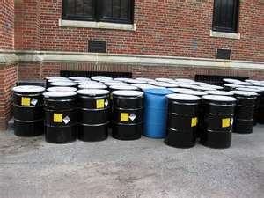
LQG
Large Quantity Generator (LQG):
Generates over 1,000 kg (2,200 lbs) of hazardous waste per month; or more than 1 kg of acutely hazardous waste a month.
PPT-048-01
43
Notes:
The Large Quantity Generator (LQG) is one which:
Generates over 1,000 kg (2,200 lbs) of hazardous waste per month; or more than 1 kg of acutely hazardous waste a month.

Slide 44
General HW Generator Requirements
Identify/characterize hazardous waste streams.
Obtain EPA identification number (EPA Form 8700-12).
Accumulate waste on site according to specified standards.
Properly prepare hazardous waste shipments.
PPT-048-01
44
Notes:
The Hazardous Waste Generator must:
Identify/characterize hazardous waste streams.
Obtain EPA identification number (EPA Form 8700-12).
Accumulate waste on site according to specified standards.
Properly prepare hazardous waste shipments.

Slide 45
General HW Generator Requirements
Determine land disposal restrictions (LDR).
Recordkeeping of manifests, training, regulatory reports, etc.
Source reduction strategies.
Training.
HW Manifests
PPT-048-01
45
Notes:
The Hazardous Waste Generator must also:
Determine land disposal restrictions (LDR).
Recordkeeping of manifests, training, regulatory reports, etc.
Implement source reduction strategies.
Provide training consistent with the category of hazardous waste generation.

Slide 46
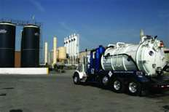
General HW Generator Requirements
Use uniform hazardous waste manifest for shipment of wastes.
Use only transporters and treatment, storage and disposal facilities (TSDF) that:
have an EPA ID number and
are licensed and permitted to accept specific waste.
PPT-048-01
46
Notes:
General Hazardous Waste Generator Requirements include:
Use uniform hazardous waste manifest for shipment of wastes.
Use only transporters and treatment, storage and disposal facilities (TSDF) that:
Have an EPA ID number and
Are licensed and permitted to accept specific waste.

Slide 47
CESQG Requirements
Determine if waste is hazardous.
Generate in a calendar month no more than:
100 kg of any hazardous waste
1kg of acute hazardous waste
No accumulation time restrictions.
Post required emergency contact information next to telephone.
PPT-048-01
47
Notes:
Conditionally Exempt Small Quantity Generators:
Determine if waste is hazardous.
Generate in a calendar month no more than:
100 kg of any hazardous waste
1kg of acute hazardous waste
No accumulation time restrictions.
Post required emergency contact information next to telephone.

Slide 48
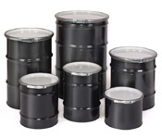
CESQG Requirements
Comply with container rules.
Dispose of at an approved site.
PPT-048-01
48
Notes:
Conditionally Exempt Small Quantity Generators must:
Comply with container rules and
Dispose of hazardous waste at an approved site.

Slide 49
SQG Requirements
Determine if waste is hazardous.
Obtain an EPA identification number.
Accumulate more than 100 but less than 1,000 kgs (2,200 lbs) of hazardous waste a month.
And up to a total of 1 kg of acutely hazardous waste a month.
Store HW for up to 180 days (except in satellite accumulation areas).
PPT-048-01
49
Notes:
Small Quantity Generators:
Determine if waste is hazardous.
Obtain an EPA identification number.
Accumulate more than 100 but less than 1,000 kgs (2,200 lbs) of hazardous waste a month.
And up to a total of 1 kg of acutely hazardous waste a month.
Store HW for up to 180 days (except in satellite accumulation areas).

Slide 50
SQG Requirements
Provide notice to EPA required (Form 8700-12).
Appoint an Emergency Response Coordinator.
Are subject to manifest rules.
Must comply with container rules.
PPT-048-01
50
Notes:
Small Quantity Generators must:
Provide notice to EPA on Form 8700-12
Appoint an Emergency Response Coordinator
They are subject to manifest rules and
Must comply with container rules.

Slide 51
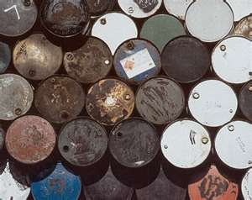
LQG
Accumulate more than 1,000 kg of hazardous waste a month; or
More than 1 kg of acutely hazardous waste a month
Requirements are same as for SQG
PPT-048-01
51
Notes:
Large Quantity Generators are those which:
Accumulate more than 1,000 kg of hazardous waste a month; or
More than 1 kg of acutely hazardous waste a month.
Requirements are the same as for SQG.

Slide 52
LQG Requirements
In addition….
Can only store HW for up to 90 days.
Preparedness and prevention contingency plan (PPC plan).
Formal emergency response plan.
Formal training program.
Biennial report required.
Have communication or alarm systems in HW storage areas.
Source reduction strategy (updated every five years).
PPT-048-01
52
Notes:
In addition, Large Quantity Generators:
Can only store HW for up to 90 days.
Preparedness and prevention contingency plan (PPC plan).
Formal emergency response plan.
Formal training program.
Biennial report required.
Have communication or alarm systems in HW storage areas.
Source reduction strategy (updated every five years).

Slide 53
EPA Form 8700-12
Who needs one?
If you generate more than 100 kg of hazardous waste or more than 1 kg of acutely hazardous waste a month (SQG and LQG qualify; SQG for HW; LQG for both).
A hazardous waste transporter, or
TSD owner or operator.
EPA Identification numbers:
One number per site; multiple sites-a number for each.
Complete two-page form #8700-12, “Notification of Hazardous Waste Activity Form” obtained from PA Department of Environmental Protection.
PPT-048-01
53
Notes:
Concerning the EPA Form 8700-12, several questions are always asked. The information is provided below.
When to use the form:
If you generate more than 100 kg of hazardous waste or more than 1 kg of acutely hazardous waste a month (SQG and LQG qualify; SQG for HW; LQG for both).
A hazardous waste transporter, or
TSD owner or operator.
EPA Identification numbers:
One number per site; multiple sites-a number for each.
Complete two-page form #8700-12, “Notification of Hazardous Waste Activity Form” obtained from PA Department of Environmental Protection.

Slide 54
EPA Form
Generator shall provide a subsequent notification to the PA DEP if:
Activity moves to another location,
Facility’s contact person changes,
Facility ownership changes,
Type of regulated activity changes,
Generator status changes,
Facility name changes.
PPT-048-01
54
Notes:
Concerning this EPA Form, the Generator shall provide a subsequent notification to the PA DEP if:
Activity moves to another location,
Facility’s contact person changes,
Facility ownership changes,
Type of regulated activity changes,
Generator status changes,
Facility name changes.

Slide 55
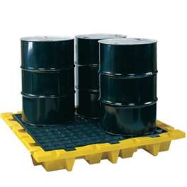
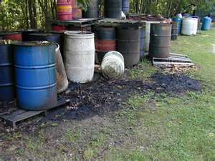
Container Storage
This?
Or This?
Very unsafe – and illegal!
PPT-048-01
55
Notes:
Review containers and containment for hazardous waste. Update relative methods. Doing this is definitely cheaper than paying a fine!

Slide 56
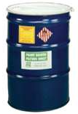
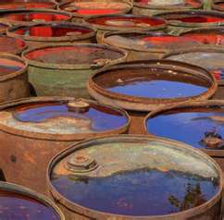
Container Storage Requirements
Kept closed except when adding or removing waste.
Good condition.
Containers have appropriate labels/markings:
Accumulation start date
Labeled clearly with the words “HAZARDOUS WASTE”
Contents.
PPT-048-01
56
Notes:
Storage containers for hazardous waste:
Keep closed except when adding or removing waste. This eliminates the chance of commingling of materials and escape to the environment.
Be in good condition.
Containers have appropriate labels/markings:
Accumulation start date (to which you can at the end date based on whether you are a Small- or Large-Quantity generator.
Labeled clearly with the words “HAZARDOUS WASTE”
Contents. To enable proper disposal by your contracted waste disposal firm.

Slide 57
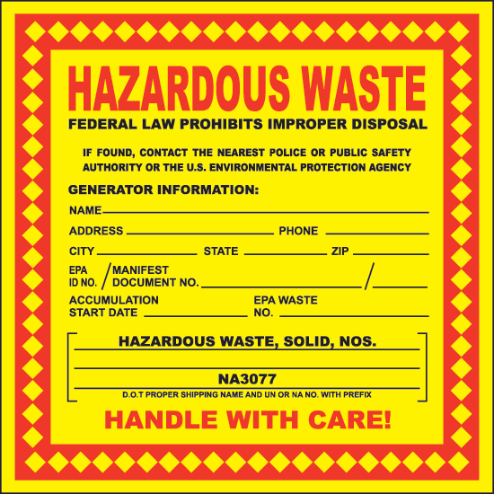
Hazardous Waste Label
Name:
Address:
City, State,
EPA ID No.:
EPA Waste No.: D003
Accumulation Start Date: accumulation starts in SAA (satellite accumulation area) or at 90/180 day storage area)
Manifest Document/ Tracking Number: (provided by vendor)
PPT-048-01
57
Notes:
The information shown here is required on the Hazardous Waste label.

Slide 58
HW Storage Area Requirements (90/180 day)
Inspect weekly for leaks and deterioration caused by corrosion or other factors.
Inspection date and time.
Remedial action taken as necessary to correct problems noted.
Document remedial action.
Maintain inspection logs for three years.
PPT-048-01
58
Notes:
Storage for 90 day or 180 day storage requires:
Inspect weekly for leaks and deterioration caused by corrosion or other factors.
Inspection date and time.
Remedial action taken as necessary to correct problems noted.
Document remedial action.
Maintain inspection logs for three years.

Slide 59
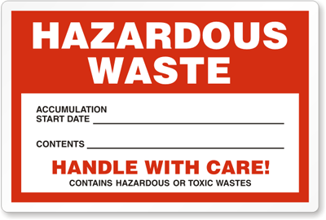
Hazardous Waste
Appropriate emergency and spill-control equipment is provided and maintained.
All drums must identify contents, a start accumulation date and marked “Hazardous Waste.”
PPT-048-01
59
Notes:
When storing hazardous waste:
Appropriate emergency and spill-control equipment is provided and maintained.
All drums must identify contents, a start accumulation date and marked “Hazardous Waste.”

Slide 60
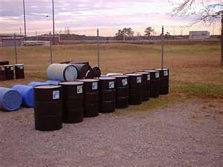
HW Storage Area Requirements
Container storage area must be maintained and operated to minimize the possibility of fire, explosion or any exposure to water.
All containers must be within containment.
Anything wrong with this picture?
No containment, stored on ground, exposed to elements, drums on side (are they empty?)
PPT-048-01
60
Notes:
Hazardous Waste Storage Area Requirements:
Container storage areas must be maintained and operated to minimize the possibility of fire, explosion or any exposure to water.
All containers must be within containment. As seen in the slide, the drum storage is not within containment. A release will contaminate the ground.

Slide 61
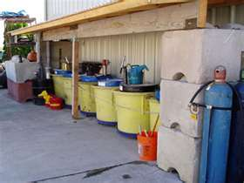
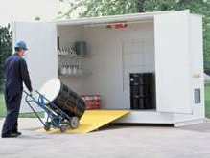
HW Storage Area Requirements
Requirements for flammable, incompatible, reactive hazardous wastes.
Immediate access is provided to emergency communication devices.
PPT-048-01
61
Notes:
There are additional requirements for Hazardous Waste storage:
There are requirements for flammable, incompatible, reactive hazardous wastes.
Immediate access must be provided to emergency communication devices.

Slide 62
Accumulation Requirements
SQGs may only accumulate waste on site for 180 days (270 days if the waste must be transported 200 miles or more to a TSD facility).
SQGs stored quantity of HW cannot exceed 6,000 kg at any time.
LQGs may only accumulate waste on site for 90 days.
LQGs do not have a limit on the amount of hazardous waste accumulated on site.
PPT-048-01
62
Notes:
There are restrictions on accumulations of Hazardous Waste depending upon the classification of Generator:
SQGs may only accumulate waste on site for 180 days (270 days if the waste must be transported 200 miles or more to a TSD facility).
SQGs stored quantity of HW cannot exceed 6,000 kg at any time.
LQGs may only accumulate waste on site for 90 days.
LQGs do not have a limit on the amount of hazardous waste accumulated on site.

Slide 63
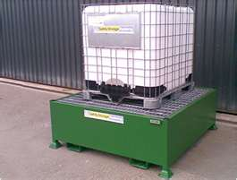
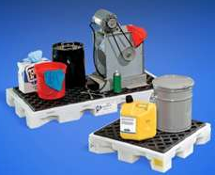
Hazardous Waste
Tank: stationary storage container.
Container must be under the control of the operator of the process that generates the HW.
Satellite Accumulation Areas (SAA) must be marked as such.
SAA designation not required for CESQGs.
PPT-048-01
63
Notes:
Hazardous Waste can be kept in a tank (tote) which is a stationary storage container.
Container must be under the control of the operator of the process that generates the HW.
Satellite Accumulation Areas (SAA) must be marked as such.
SAA designation not required for CESQGs.

Slide 64
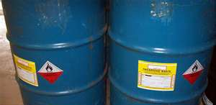
Hazardous Waste
Containers must be marked “Hazardous Waste.”
Cannot store more than 55 gallons of HW or one quart of acutely HW in SAA.
Move full containers to the hazardous waste storage area within three days.
Would this qualify as an SAA?
NO
Why not?
More than 55 gallons stored
PPT-048-01
64
Notes:
Additional requirements include:
Containers must be marked “Hazardous Waste.”
Cannot store more than 55 gallons of HW or one quart of acutely HW in SAA (Satellite Accumulation Areas).
Move full containers to the hazardous waste storage area within three days.

Slide 65
Satellite Accumulation Areas (SAA)
Mark date on container label when container becomes full.
Should transfer HW from SAA to 90/180 day storage area within one year.
No limit to the number of satellite accumulation areas that can be operated at the facility.
PPT-048-01
65
Notes:
At Satellite Accumulation Areas (SAA):
Mark date on container label when container becomes full.
Should transfer HW from SAA to 90/180 day storage area within one year.
No limit to the number of satellite accumulation areas that can be operated at the facility.

Slide 66
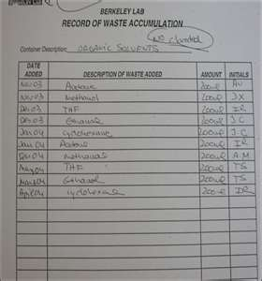
Satellite Accumulation Areas
Each of these areas is subject to generator closure requirements.
Generator should minimize the number of locations at a plant site where hazardous wastes are accumulated.
PPT-048-01
66
Notes:
Satellite Accumulation Areas are subject to generator closure requirements:
The Generator should minimize the number of locations at a plant site where hazardous wastes are accumulated.

Slide 67
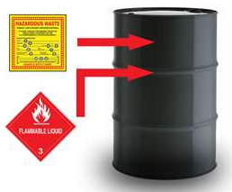
Satellite Accumulation Areas
Containers are kept closed and maintained in good condition.
Containers are constructed of material compatible with waste being stored.
Area is free of spilled/leaked wastes.
PPT-048-01
67
Notes:
At Satellite Accumulation Areas:
Containers are kept closed and maintained in good condition.
Containers are constructed of material compatible with waste being stored.
Area is free of spilled/leaked wastes.

Slide 68
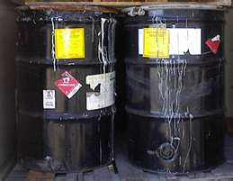
Residues of Empty Containers
A container is empty if:
All wastes, inner liner or residues have been removed using accepted removal methods (pouring, pumping, aspirating, etc.).
No more than 2.5 cm (or one inch) of residue remains in the bottom of the container or
PPT-048-01
68
Notes:
Residues of Empty Containers.
A container is empty if:
All wastes, inner liner or residues have been removed using accepted removal methods (pouring, pumping, aspirating, etc.).
No more than 2.5 cm (or one inch) of residue remains in the bottom of the container or

Slide 69
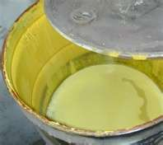
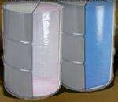
Residues of Empty Containers
No more than 3 percent, by weight, remains for capacities of 119 gallons or less, or
0.3 percent for containers greater than 119 gallons.
Liner has been removed.
PPT-048-01
69
Notes:
The container is considered empty if:
No more than 3 percent, by weight, remains for capacities of 119 gallons or less, or
0.3 percent for containers greater than 119 gallons.
Liner has been removed.

Slide 70
Residues of Empty Containers
Gas containers:
Hazardous waste compressed gas is considered empty when container pressure approaches atmospheric (14.7 psi at sea level).
Remove container or liner from acute hazardous waste container.
PPT-048-01
70
Notes:
Concerning Gas containers:
Hazardous waste compressed gas is considered empty when container pressure approaches atmospheric (14.7 psi at sea level).
Remove container or liner from acute hazardous waste container.

Slide 71
Empty Drum Handling
All openings on the empty container must be closed.
All markings and labels must be in place as if drum was full with its original contents.
PPT-048-01
71
Notes:
Empty Drum Handling:
All openings on the empty container must be closed.
All markings and labels must be in place as if drum was full with its original contents.

Slide 72
Universal Waste
40 CFR 273 and
25 Pa. Code 266b.
Generated by large cross section of regulated community.
More innocuous than other hazardous wastes.
More likely to recycle.
No manifest required.
PPT-048-01
72
Notes:
Universal Waste is addressed in:
40 CFR 273 and
25 Pa. Code 266b.
Universal Waste is:
Generated by large cross section of regulated community.
More innocuous than other hazardous wastes.
More likely to recycle.
No manifest required.

Slide 73
Universal Waste
Small Quantity Handler Universal Waste (SQHUW): accumulates less than 5,000 kg (~11,000 lbs) of universal waste at one time.
Large Quantity Handler Universal Waste (LQHUW): accumulates greater than 5,000 kg of universal waste at one time.
PPT-048-01
73
Notes:
Universal Waste:
Small Quantity Handler Universal Waste (SQHUW): accumulates less than 5,000 kg (~11,000 lbs) of universal waste at one time.
Large Quantity Handler Universal Waste (LQHUW): accumulates greater than 5,000 kg of universal waste at one time.

Slide 74
Small Quantity HUW Requirements
Can accumulate universal waste for up to one year from the date the waste is generated.
Train employees in proper handling and emergency procedures.
Labeling (Universal waste – lamps, waste lamps, used lamps).
Containers:
Closed
Structurally sound
Compatible with the contents
No evidence of leaks, spills or damage
PPT-048-01
74
Notes:
Small Quantity Handler Universal Waste requirements:
Can accumulate universal waste for up to one year from the date the waste is generated.
Train employees in proper handling and emergency procedures.
Labeling (Universal waste – lamps, waste lamps, used lamps).
Containers:
closed
structurally sound
compatible with the contents
no evidence of leaks, spills or damage

Slide 75
HW Pre-Transport Requirements
Package in accordance with US DOT transportation regulations under 49 CFR parts 173, 178 & 179 (e.g. compatibility, security, filling limits, venting).
Label each package of hazardous waste in accordance with the US DOT regulations under 49 CFR part 172 (e.g. hazard labels).
PPT-048-01
75
Notes:
Hazardous Waste Pre-Transport requirements:
Package in accordance with US DOT transportation regulations under 49 CFR parts 173, 178 & 179 (e.g. compatibility, security, filling limits, venting).
Label each package of hazardous waste in accordance with the US DOT regulations under 49 CFR part 172 (e.g. hazard labels).

Slide 76
HW Pre-Transport Requirements
Mark each package of hazardous waste in accordance with US DOT regulations under 49 CFR part 172 (e.g., shipping name, identification number, orientation arrows, marine pollutants, radiation, “Hazardous Waste”).
PPT-048-01
76
Notes:
Hazardous Waste Pre-Transport requirements:
Mark each package of hazardous waste in accordance with US DOT regulations under 49 CFR part 172 (e.g., shipping name, identification number, orientation arrows, marine pollutants, radiation, “Hazardous Waste”).

Slide 77
Shipping Placard
Placard each shipping vehicle in accordance with US DOT regulations under 49 CFR Part 172, Subchapter F.
PPT-048-01
77
Notes:
Placard each shipping vehicle in accordance with US DOT regulations under 49 CFR Part 172, Subchapter F.

Slide 78
Manifesting
Manifest must accompany each shipment of hazardous waste sent off-site.
Properly complete the manifest form (DOT certified shipper).
PPT-048-01
78
Notes:
A manifest is a very important document that needs to be completed and accurate before the items are shipped off-site:
A Manifest must accompany each shipment of hazardous waste sent off-site.
Properly complete the manifest form (DOT certified shipper).

Slide 79
Manifesting
Any changes to the manifest should be initialed and dated by the generator.
Ensure that each manifest has a unique manifest document/tracking number (provided by transporter).
PPT-048-01
79
Notes:
Manifesting:
Any changes to the manifest should be initialed and dated by the generator.
Ensure that each manifest has a unique manifest document/tracking number (provided by transporter).

Slide 80
Manifesting
Identify a permitted hazardous waste or recycling facility as the designated disposal facility on each manifest.
Generator and the initial transporter have signed each original (generator copy) of the manifest (DOT certified shipper).
PPT-048-01
80
Notes:
Manifests are a method of tracking shipments of hazardous waste from the generator to the disposal site.
Identify a permitted hazardous waste or recycling facility as the designated disposal facility on each manifest.
Generator and the initial transporter have signed each original (generator copy) of the manifest (DOT certified shipper).

Slide 81
Manifesting
Signature of a representative of the designated treatment, storage and disposal facility receiving the waste (generator should get signed copy back from disposal facility).
Maintain a copy of each manifest with the date of receipt.
PPT-048-01
81
Notes:
Manifesting:
Generator gets the signature of a representative of the designated treatment, storage and disposal facility receiving the waste (generator should get signed copy back from disposal facility).
Maintain a copy of each manifest with the date of receipt.

Slide 82
Manifesting
Do not use abbreviations other than those accepted.
Print legibly.
Continuation sheets (more than two transporters or for lab packs with more than four different waste streams in one shipment).
Keep signed manifests for three (3) years.
PPT-048-01
82
Notes:
Manifesting:
Do not use abbreviations other than those accepted.
Print legibly.
Continuation sheets (more than two transporters or for lab packs with more than four different waste streams in one shipment).
Keep signed manifests for three (3) years.

Slide 83
Land Disposal Requirements (LDRs) 40 CFR Part 268
Land disposal: Examples- landfills, waste piles, surface impoundments, injection well, land treatment facility, salt dome formation, mine or cave, concrete vault or bunker.
Determine if your waste meets LDR treatment standards for acceptance.
PPT-048-01
83
Notes:
Land Disposal Requirements (LDRs) are covered in 40 CFR Part 268.
Land disposal: Examples- landfills, waste piles, surface impoundments, injection well, land treatment facility, salt dome formation, mine or cave, concrete vault or bunker.
Determine if your waste meets LDR treatment standards for acceptance.

Slide 84
Land Disposal Requirements
EPA prohibits land disposal of hazardous waste unless:
Wastes are treated to specific treatment standards or
It can be demonstrated that waste can’t release any hazardous components
when placed in a land
disposal unit.
PPT-048-01
84
Notes:
The EPA prohibits land disposal of hazardous waste unless:
Wastes are treated to specific treatment standards or
It can be demonstrated that waste can’t release any hazardous components
when placed in a land disposal unit.

Slide 85
Land Disposal Requirements
Attach LDR forms to manifest for each waste stream the first time waste is sent for disposal.
Keep LDR forms in files for three (3) years.
LDRs are not required for CESQGs or for universal waste.
PPT-048-01
85
Notes:
Land Disposal Requirements include:
Attach LDR forms to manifest for each waste stream the first time waste is sent for disposal.
Keep LDR forms in files for three (3) years.
LDRs are not required for CESQGs or for universal waste.

Slide 86
Records & Reports Kept
Notification of regulated activities (EPA Form 8700 – 12).
Hazardous waste determinations (test results, waste analysis, waste profiles).
Signed manifests (generator, transporter, disposal facility) and LDRs.
Inspection checklists (emergency equipment, waste storage areas).
PPT-048-01
86
Notes:
Records and reports which are kept include:
Notification of regulated activities (EPA Form 8700 – 12).
Hazardous waste determinations (test results, waste analysis, waste profiles).
Signed manifests (generator, transporter, disposal facility) and LDRs.
Inspection checklists (emergency equipment, waste storage areas).

Slide 87
Contingency Plan
Preparation, prevention and contingency plan
- Required for LQGs
Indicates requirements for responding to fires, explosions or releases
Actions include:
- Emergency Duty Assignments.
- Emergency Response Procedures.
- Posting emergency information
next to telephone.
Contingency
Plan
PPT-048-01
87
Notes:
A Contingency Plan is required for Large Quantity Generators (LQGs).
This will indicate requirements for responding to fires, explosions or releases.
Actions include:
Emergency Duty Assignments.
Emergency Response Procedures.
Posting of emergency information next to the telephone.

Slide 88
HW Training Requirements
Employees working with or around HW:
- Hazard Communication (29 CFR 1910.1200)
- Training related to their specific tasks.
PPT-048-01
88
Notes:
Training requirements are specific to the classification of Generator.
Employees working with or around Hazardous Waste shall receive training on:
Hazard Communication (29 CFR 1910.1200) and
Training related to their specific tasks.

Slide 89
Training –Site Employees
OSHA HW Worker (on sites)
29 CFR 1910.120(p)
40 hours + three days field or equivalent and
Annual refresher
PPT-048-01
89
Notes:
Training for Site Employees includes:
OSHA HW Worker (on sites)
29 CFR 1910.120(p)
40 hours + three days field or equivalent and
Annual refresher

Slide 90
Training – Emergency Responders
Emergency Responders (on-site/off-site)
OSHA 29 CFR 1910.120 (q) Hazardous Waste Operations & Emergency Response (HAZWOPER):
Awareness
Operations
Technician
Specialist
Incident Command
PPT-048-01
90
Notes:
Training for Emergency Responders:
Emergency Responders (on-site/off-site)
OSHA 29 CFR 1910.120 (q) Hazardous Waste Operations & Emergency Response (HAZWOPER):
Awareness
Operations
Technician
Specialist
Incident Command

Slide 91
Reportable Quantities (RQ)
Spills/Discharges less than reportable quantities (not into waterways) and managed per approved contingency plan need not be reported.
Spill or discharge into commonwealth waters shall be reported regardless of quantity spilled or discharged.
PPT-048-01
91
Notes:
Reportable Quantities (RQs) exist for materials which may be released to the environment.
Spills/Discharges less than reportable quantities (not into waterways) and managed per approved contingency plan need not be reported.
Spill or discharge into commonwealth waters shall be reported regardless of quantity spilled or discharged.

Slide 92
Reportable Quantities
Liquid hazardous waste spills shall be reported to DEP when amount meets or exceeds the RQ for waste contained in 40 CFR 302.4 or 10 gallons (whichever is more stringent).
Liquids are “flowable” containing less than 20 percent solids by dry weight.
PPT-048-01
92
Notes:
Reportable Quantities:
Liquid hazardous waste spills shall be reported to DEP when amount meets or exceeds the RQ for waste contained in 40 CFR 302.4 or 10 gallons (whichever is more stringent).
Liquids are “flowable” containing less than 20 percent solids by dry weight.

Slide 93
Reportable Quantities
Solid hazardous waste/solids that become hazardous wastes when spilled or discharged shall be reported:
• When quantity equals or exceeds the RQ for the waste contained in 40 CFR 302.4 or 500 pounds, whichever is more stringent.
• Where the amount in RQ may differ, go with lowest amount for reporting purposes.
PPT-048-01
93
Notes:
Reportable Quantities:
Solid hazardous waste/solids that become hazardous wastes when spilled or discharged shall be reported:
• When quantity equals or exceeds the RQ for the waste contained in 40 CFR 302.4 or 500 pounds, whichever is more stringent.
• Where the amount in RQ may differ, go with lowest amount for reporting purposes.

Slide 94
Examples of Emergency Equipment
Absorbent materials
Oil dry
Broom
Shovel
Gloves
Goggles
PPT-048-01
94
Notes:
Examples of emergency equipment which should be on-hand depending upon an anticipated event are:
Absorbent materials
Oil dry
Brooms
Shovels
Gloves
Goggles
Any other equipment which may be determined.

Slide 95
Emergency Equipment
Internal communications telephones (LQGs only).
Portable fire equipment and extinguishers.
Spill control equipment.
Water in adequate volumes and pressure for fire control.
PPT-048-01
95
Notes:
Other emergency equipment:
Internal communications telephones (LQGs only).
Portable fire equipment and extinguishers.
Spill control equipment.
Water in adequate volumes and pressure for fire control.

Slide 96
Spill Response Procedures
Resist rushing in - Safety First!!
NO!
Approach incident from upwind.
Stay clear of all spills, vapors, fumes and smoke.
Contact emergency personnel (internal and external) as needed.
PPT-048-01
96
Notes:
Spill response procedures should include recommended actions and prohibitions to response:
Resist rushing in - Safety First!!
Approach incident from upwind.
Stay clear of all spills, vapors, fumes and smoke.
Contact emergency personnel (internal and external) as needed.

Slide 97
Spill Response Procedures
Notify the emergency coordinator
- Name of material
- Amount spilled
Location
Determine source and nature of spill.
PPT-048-01
97
Notes:
During an Emergency:
Notify the Emergency Coordinator and provide:
- Name of material
- Amount spilled
Location
Determine source and nature of spill.

Slide 98
Spill Response Procedures
Wear appropriate PPE (if trained to do so).
Establish zones: hot, warm, cold.
Contain the spill (if trained to do so).
PPT-048-01
98
Notes:
Responders will:
Wear appropriate PPE if trained to do so.
Establish zones:
Hot
Warm
Cold
Contain the spill if trained to do so.

Slide 99
Internal Emergency Contacts
Contact your building’s Emergency Coordinator.
Contact facility manager.
Contact facilities EHS manager.
PPT-048-01
99
Notes:
Activate Internal Emergency Contacts:
Contact your building’s Emergency Coordinator.
Contact facility manager.
Contact facilities EHS manager.

Slide 100
External Emergency Contacts
Dial 911 for local emergency group (fire, police, ambulance).
Initiate evacuation of facility as necessary.
Provide the following information:
- Location (street address and plant location)
- Type of emergency
- Extent of injuries
- Severity of situation
Facilities EHS manager will notify regulatory agencies and make arrangements with emergency response contractor.
PPT-048-01
100
Notes:
External Emergency Contacts:
Dial 911 for local emergency group (fire, police, ambulance).
Initiate evacuation of facility as necessary.
Provide the following information:
- location (street address and plant location)
- type of emergency
- extent of injuries
- severity of situation
Facilities EHS manager will notify regulatory agencies and make arrangements with emergency response contractor.

Slide 101
Spill Information
If the spill meets or exceeds RQ, generator shall:
- call the PA Department of Environmental Protection (PA DEP) at 800-541-2050
protect health and safety of the public and the environment.
Provide DEP with:
- name of person reporting spill
- name and identification number of generator
- phone number where person reporting can be contacted
- date, time, location of spill
PPT-048-01
101
Notes:
Spill Information:
If the spill meets or exceeds RQ, generator shall:
- call the PA Department of Environmental Protection (PA DEP) at 800-541-2050
protect health and safety of the public and the environment.
Provide DEP with:
- name of person reporting spill
- name and identification number of generator
- phone number where person reporting can be contacted
- date, time, location of spill

Slide 102
Reported Spill Information
Brief description of incident for each material involved in the spill:
Shipping name, hazard class and U.N. number.
Estimated quantity of spilled material.
Extent of known contamination of land, water or air.
PPT-048-01
102
Notes:
Provide a brief description of incident for each material involved in the spill:
Shipping name, hazard class and U.N. number.
Estimated quantity of spilled material.
Extent of known contamination of land, water or air.

Slide 103
Immediate Removal
If a discharge or spill requires immediate removal to protect the public or environment:
- PA DEP official may authorize in writing removal of material by transporters without an identification number, license or preparation of a manifest.
PPT-048-01
103
Notes:
If a discharge or spill requires immediate removal to protect the public or environment, the PA DEP official may authorize in writing removal of material by transporters without an identification number, license or preparation of a manifest.

Slide 104
Immediate Removal
Generator shall clean up spill and take actions approved by PA DEP then file a written report within 15 days of incident.
PPT-048-01
104
Notes:
The Generator shall clean up spill and take actions approved by the PA DEP then file a written report within 15 days of incident.

Slide 105
Removal Report
Report titled, “Hazardous Waste Spill Report” must contain:
Name, address and identification number of generator
Date, time and location of incident
Brief description of cause
Description of each of the hazardous wastes or materials involved including estimated quantity
Legible copy of manifest, if applicable
Description of land, water or air that was contaminated
Actions generator intends to prevent future similar incident
PPT-048-01
105
Notes:
Removal Report titled, “Hazardous Waste Spill Report” must contain the following information:
Name, address and identification number of generator
Date, time and location of incident
Brief description of cause
Description of each of the hazardous wastes or materials involved including estimated quantity
Legible copy of manifest, if applicable
Description of land, water or air that was contaminated
Actions generator intends to prevent future similar incident

Slide 106
Waste Minimization
Concentrate on operations, processes, procedures and production units that generate waste.
Don’t focus on off-site treatment and disposal.
Source reduction
- Process/product modifications.
Chemical substitution.
Recycling
- Returning material to the original process.
- Solvent reclamation.
PPT-048-01
106
Notes:
In Waste Minimization:
Concentrate on operations, processes, procedures and production units that generate waste.
Don’t focus on off-site treatment and disposal.
Source reduction
- Process/product modifications.
Chemical substitution.
Recycling
- Returning material to the original process.
- Solvent reclamation.

Slide 107
Waste Minimization
Environmental benefits
- No dwindling landfill space
- No depletion of ozone layer
- Acid rain reduction
- Global warming reduction
Economic benefits
- Raw material cost savings
- Waste disposal
- Insurance costs
PPT-048-01
107
Notes:
There are many benefits to waste minimization:
Environmental benefits
- No dwindling landfill space
- No depletion of ozone layer
- Acid rain reduction
- Global warming reduction
Economic benefits
- Raw material cost savings
- Waste disposal
- Insurance costs

Slide 108
Academic Laboratories
Academic laboratories (colleges and universities) can benefit by implementing measures in 40 CFR 262.200-216, Subpart K:
“Alternative Requirements for HW Determination and Accumulation of Unwanted Materials for Laboratories Owned by Eligible Academic Entities.”
PPT-048-01
108
Notes:
Academic laboratories (colleges and universities) can benefit by implementing measures in 40 CFR 262.200-216, Subpart K:
“Alternative Requirements for HW Determination and Accumulation of Unwanted Materials for Laboratories Owned by Eligible Academic Entities.”

Slide 109
Additional Information
The following slides deal with the regulations referenced in the preceding program.
Citations within the federal and state regulations are provided should you decide to research your facility’s requirements and develop a required plan or to refine an existing program.
PPT-048-01
109
Notes:
It is important for any company generating hazardous waste to be familiar with and understand those regulations that apply.

Slide 110
Regulations
40 CFR Part 261.5(c)(d): Identification and listing of hazardous waste
25 Pa. Code 261a: Identification and listing of hazardous waste
40 CFR 261.5: Special requirements for CESQG
40 CFR 262.10(b): HW quantity determination
25 Pa. Code 261a.5: HW quantity determination
PPT-048-01
110
Notes:
Regulations of extreme importance include those listed here as well as others. It is the responsibility of the generator to comply with applicable regulations.

Slide 111
Regulations
40 CFR Part 262: Standards applicable to generators of hazardous waste as well as
25 Pa. Code 262a.10: HW determination, EPA ID number, SQG and LQG accumulation time, satellite accumulation, personnel training, record-keeping and reporting, PPC plan developed and implemented, use and management of containers, pre-transport requirements
PPT-048-01
111
Notes:
Both 40 CFR Part 262 and 25 Pa. Code 262a.10 are regulations that apply to the generators of hazardous waste.

Slide 112
Regulations
40 CFR 262.34.(a): Accumulation time, LQG
40 CFR 262.34(d)(e)(f): Accumulation time, SQG
40 CFR 262, Subpart C: Pre-transport requirements
25 Pa. Code 262a.10: Pre-transport requirements
PPT-048-01
112
Notes:
Accumulation time as well as pre-transport requirements are included in the regulations/standards listed.

Slide 113
Regulations
40 CFR Part 265 Subpart I: Use and management of containers
25 Pa. Code 262a.10 & chapter 265a, Subchapter I: Use and management of containers
40 CFR 262.34: Use and management of containers
40 CFR 262.34.(a)(4) and (d): Personnel training
25 Pa. Code 262a.10: Personnel training
40 CFR 265.16: Personnel training
PPT-048-01
113
Notes:
These are additional regulations that generators should be familiar with and understand.

Slide 114
Regulations
40 CFR 262.34(a): PPC plan developed and implemented
25 Pa. Code 262a.10: PPC plan developed and implemented
40 CFR 262.34.(c): Satellite accumulation requirements.
25 Pa. Code 262a.100: Source reduction strategy
PPT-048-01
114
Notes:
All generators must keep in mind that it is their responsibility to be familiar with, understand and comply with the related regulations. As the old saying goes, “ignorance of the law is no excuse.”

Slide 115
Regulations
40 CFR 262.20-262.23: Manifest
25 Pa. Code 262a.23: Manifest
40 CFR 262.40: Recordkeeping and reporting
40 CFR 262.42: Exception reporting
25 Pa. Code 262a.42: Exception reporting
40 CFR 263.43: Additional reporting
PPT-048-01
115
Notes:
Questions concerning the regulations can be directed to the PA Department of Environmental Protection (PADEP) and/or the Environmental Protection Agency (EPA).

Slide 116
Regulations
25 Pa. Code 262a.43: Additional reporting
25 Pa. Code 262a.100: Source reduction strategy
25 Pa. Code 263a: Transporter licensing
PPT-048-01
116
Notes:
In addition to being familiar with/understanding applicable Federal regulations all hazardous waste generators in PA should be familiar with/understand those related regulations as well.

Slide 117
Regulations
40 CFR 265 Part J: Tank systems
25 Pa. Code 265a, Subchapter J: Tank systems
25 Pa. Code 265a, Subchapter I: Use and management of containers
40 CFR 265.178: Air emissions
25 Pa. Code 265a.1: Air emission standards
25 Pa. Code 265a.179: Containment
PPT-048-01
117
Notes:
Many questions can be answered by simply consulting the related regulations.

Slide 118
Regulations
40 CFR 266, Subpart G: Spent lead-acid batteries being reclaimed
25 Pa. Code 266, Subchapter G: Spent lead-acid batteries being reclaimed
40 CFR 266, Subpart N: Conditional exemption for low level mixed waste storage and disposal
25 Pa. Code 266a.20: Conditional exemption for low level mixed waste storage and disposal
PPT-048-01
118

Slide 119
Regulations
40 CFR Part 268: Land disposal restrictions
25 Pa. Code 268a: Land disposal restrictions
40 CFR 270.1 (c): Scope of RCRA permit requirements
25 Pa. Code 270a.1: Scope of RCRA permit requirements
25 Pa. Code 270a.60: Permits by rule
PPT-048-01
119
Notes:
It’s important to keep in mind that there are strict regulations in place for the land disposal of hazardous waste.

Slide 120
Regulations
40 CFR part 273: Universal Waste
25 Pa. Code 266b.1: Universal Waste
40 CFR part 279: Management of used oil
“Regulations Applicable to Waste Management (hazardous waste)”
http://www.dep.state.pa.us/dep/deputate/pollprev/BPManual/DHaz.htm
PPT-048-01
120
Notes:
The PADEP has a website that can prove instrumental in assisting companies in complying with the related regulations.

Slide 121
Contact Information
Health & Safety Training Specialists
1171 South Cameron Street, Room 324
Harrisburg, PA 17104-2501
(717) 772-1635
RA-LI-BWC-PATHS@pa.gov
Like us on Facebook! - https://www.facebook.com/BWCPATHS
PPT-048-01
121

Slide 122
Questions
PPT-048-01
122

