Slide 1
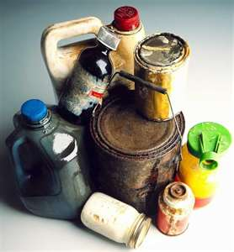
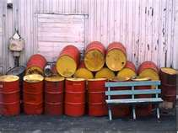
Hazardous Materials Awareness
Bureau of Workers’ Comp
PA Training for Health & Safety (PATHS)
OSHA:
29 CFR 1910.1200
29 CFR 1910.120
PA Right-to-Know Act
EPA: 40 CFR 311
NFPA Standard 472
PPT-044-01AP
1
Notes:
Hazardous Materials Awareness is addressed in multiple Standards and regulations to ensure the safety of personnel who may work with various types.

Slide 2
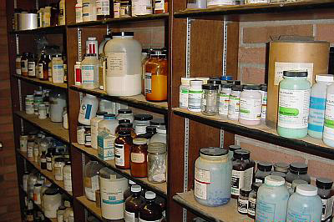
Topics
Main program topics
Overview and history of:
Hazard Communication Standard
Right-to-know
Globally Harmonized System (GHS)
DOT hazardous materials
labels
placards
materials of trade
International symbols
Emergency response guidebook
Safety Data Sheets (under the Globally Harmonized System)
PPT-044-01AP
2
Notes:
This presentation will cover the following:
Overview and history of:
Hazard Communication Standard
Right-to-know
Globally Harmonized System (GHS)
DOT hazardous materials
labels
placards
materials of trade
International symbols
Emergency response guidebook
Safety Data Sheets (under the Globally Harmonized System)

Slide 3
Hazard Communication Standard
• 29 CFR 1910.1200 requirements:
Evaluate hazards of produced or imported chemicals
Transmit hazards to employees
Training
Container labeling
Hazardous substance survey forms
Safety Data Sheets (formerly MSDS)
PPT-044-01AP
3
Notes:
Intent of each regulation is to provide employees with information to help them make knowledgeable decisions about chemical hazards in their workplace and take the proper precautions.
A public entity under PA Right to Know can still benefit by adopting OSHA regulations as a guideline. This serves as “Best Practices” where “Due Diligence” is enacted when implementing a program.
OSHA anticipates the revised standard (with the adoption of the GHS) will prevent 43 fatalities and 585 injuries annually, with a net annualized saving of over $500 million a year.
The new labeling requirements under GHS will also be found applicable to PA’s Right to Know program.

Slide 4
PA Right to Know Act
•Act No. 1984-159 requires:
Chemical identification of substances in the
community and on employer premises
Posting of identity of same by employers
Labeling of chemicals
Information and safety data to be given to
Department of Labor & Industry
Complaint procedures
Investigations
Compliance orders and enforcement
Penalties
PPT-044-01AP
4
Notes:
This PA “Right to Know” program
Chemical identification of substances in the community and on employer premises
Posting of identity of same by employers
Labeling of chemicals
Information and safety data to be given to Department of Labor & Industry
Complaint procedures
Investigations
Compliance orders and enforcement
Penalties

Slide 5
Right to Know (HCS)
Comparison of PA Right-to-Know program and OSHA hazard communication standard
Required by:
HCS Topic Areas OSHA PA
Written program and
chemical inventory Yes No
(PA law does not require a written program; employers not covered by OSHA should consider developing a written hazard communication program as a “best practice.”)
PPT-044-01AP
5
Notes:
Differences and similarities can be found between the OSHA HazComm program and the PA Right to Know program.

Slide 6
Right to Know (HCS)
Required by:
HCS Topic Areas OSHA PA
Safety data sheets (SDS) for:
Employees, contractors
and consultants Yes Yes
Informed of labeling system Yes Yes
Product labeling by:
Manufacturer, distributor
and importer Yes Yes
PPT-044-01AP
6
Notes:
The HCS (Hazard Communication Standard) encompasses the use of Safety Data Sheets to inform employees, contractors, consultants and visitors of hazards associated with different hazardous chemicals; the PA Right to Know Law also has this requirement.
In addition, the HCS requires employees to be informed of the labeling system used on hazardous chemicals as does the PA Right to Know Law.
The HCS also requires that manufacturers, distributors and importers properly label all containers being shipped to different users; the PA Right to Know Law also has this requirement.

Slide 7
PA Right to Know (HCS)
Required by:
HCS Topic Areas OSHA PA
Labeling of pipes and piping
containing hazardous
substances No Yes
Every employer must obtain
an SDS Yes Yes
Employee information training Yes Yes
Hazardous substance survey form:
Posted No Yes
Retained No Yes
PPT-044-01AP
7
Notes:
The PA Right to Know Law, in addition to chemical identification requires the labeling of pipes and piping containing hazardous substances.
The posting of the Hazardous Substance Survey Form by April 1st of each year (looking back at the preceding year) is also required.

Slide 8
PA Right to Know (HCS)
Required by:
HCS Topic Areas OSHA PA
Public access request for SDS No Yes
Employee access to medical and
exposure records Yes* Yes
*As stipulated in 29 CFR 1910.1020
PPT-044-01AP
8
Notes:
The PA Right to Know law also provides for making available copies of SDSs upon request by the public.

Slide 9
GHS
Globally Harmonized System (GHS)
United Nations sponsored
Upon adoption, has
changed:
Classification of chemicals
Labeling
MSDSs to SDSs
(safety data sheets)
Final standard was published in the Federal Register March 26, 2012, and will become effective, in part, on June 26, 2012, with a built-in transition period and a fully effective date of June 1, 2016.
PPT-044-01AP
9
Notes:
The rationale for GHS is
“To provide a single, harmonized system to classify chemicals, labels and SDS with the primary benefit of increasing the quality and consistency of information provided to workers, employers and chemical users”*
Effective, in part, on June 26, 2012, with a built-in
transition period and a fully effective date of
June 1,2016
*Ruth Mayo, EHS Today, “GHS: The Power of One,” December 1, 2009
Identification of chemical hazards utilized by both the federal Haz Comm and PA Right to Know program is found in the Globally Harmonized System. This system, also known as “GHS” created by the UN, was adopted by the federal government (OSHA) in 2012. By inference, the state Right to Know program also uses it.
The GHS is a system for standardizing chemical classification and labeling for world-wide implementation. Requirements on labels include:
Signal words of either Danger or Warning
Hazard statements
Precautionary statements
Pictograms (9 variations)
Safety Data Sheets (SDS) with 16 categories rather than the previous MSDS with only 8 categories
Training required for employees

Slide 10
Hazardous Materials Awareness
OSHA: 29 CFR 1910.120(q):
Hazardous waste
operations and emergency response (HAZWOPER)
EPA: 40 CFR 311
Title 40: Protection of environment
Part 311: Worker protection
PPT-044-01AP
10
Notes:
Several Standards require training for personnel depending upon the expectations of response by their management.
OSHA has its standards governing those entities which fall under OSHA requirements.
EPA, likewise, has standards for those under their governance. PA is an EPA state with regards to “Hazardous Waste” operations.
Each of these documents has parallel requirements toward consistency of training and education of responders.

Slide 11
OSHA 29 CFR 1910.120(q)
SARA (Superfund Amendments and Reauthorization Act) Section 126 mandated OSHA and EPA address injuries to workers at hazardous waste operations
Where no OSHA-approved state plan for private sector employees, OSHA has authority
OSHA: 29 CFR 1910.120, Hazardous Waste Operations and Emergency Response (HAZWOPER)
OSHA interprets HAZWOPER standard for EPA to maintain consistency
PPT-044-01AP
11
Notes:
SARA (Superfund Amendments and Reauthorization Act) Section 126 mandated OSHA and EPA address injuries to workers at hazardous waste operations
Where no OSHA-approved state plan for private sector employees, OSHA has authority
OSHA: 29 CFR 1910.120, Hazardous Waste Operations and Emergency Response (HAZWOPER)
OSHA interprets HAZWOPER standard for EPA to maintain consistency

Slide 12
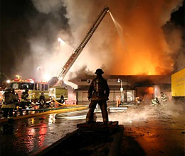
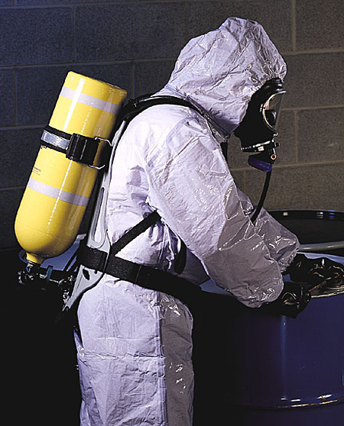
EPA 40 CFR 311
To protect public sector employees
Includes volunteers who work for a governmental agency during emergency response (e.g., volunteer firefighters
State and local employees of states without an OSHA-approved plan
Matches OSHA HAZWOPER requirements
PPT-044-01AP
12
Notes:
EPA 40 CFR 311
To protect public sector employees
Includes volunteers who work for a governmental agency during emergency response (e.g., volunteer firefighters)
State and local employees of states without an OSHA-approved plan
Matches OSHA HAZWOPER requirements

Slide 13
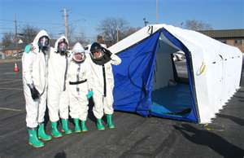
Assist Standards
• NFPA 472:National Fire Protection Association, Standard 472:
“Standard for professional competence of responders to hazardous materials incidents”
PPT-044-01AP
13
Notes:
Assist standards can also be found such as
NFPA 472:National Fire Protection Association, Standard 472:
“Standard for professional competence of responders to hazardous materials incidents”

Slide 14
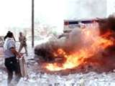
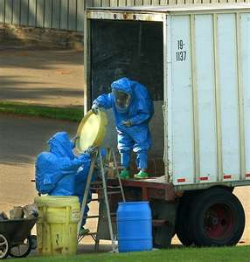
NFPA 472
Delineates the levels of hazardous material (HazMat) responders
Also details training required for each action level
Determines if actions are defensive or offensive
Equates PPE for each level of responder
PPT-044-01AP
14
Notes:
The National Fire Protection Association (NFPA) Standard 472 is a consensus standard meant for adoption.
It delineates the levels of hazardous material (HazMat) responders
Also details training required for each action level
Determines if actions are defensive or offensive
Equates PPE for each level of responder

Slide 15
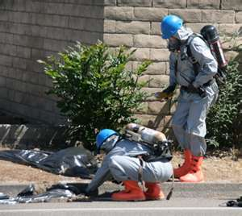
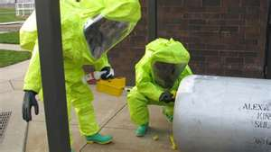
29 CFR 1910.120(q)
HAZWOPER adopted NFPA emergency responder categories for responders:
Awareness
Operations
Technician
Specialist
Incident commander (IC)
PPT-044-01AP
15
Notes:
29 CFR 1910.120(q) HAZWOPER adopted NFPA emergency responder categories for responders:
Awareness
Operations
Technician
Specialist
Incident commander (IC)

Slide 16
Level 1: Awareness
General employees and responders at the awareness level are trained to:
1. Recognize the presence of hazardous materials
2. Notify proper authorities to respond:
In-house spill team
Off-site emergency services
Contracted clean-up personnel
PPT-044-01AP
16
Notes:
Level 1: Awareness
Strictly Defensive in response mode. Do not get into close proximity to the threat.
General employees and responders at the awareness level are trained to:
1. Recognize the presence of hazardous materials
2. Notify proper authorities to respond:
In-house spill team
Off-site emergency services
Contracted clean-up personnel

Slide 17
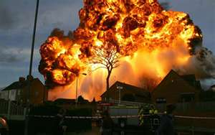
Hazardous Materials Defined
Ludwig Benner Jr.:
“Something that jumps out of its container when something goes wrong and hurts the things it touches”
Rob Schnepp and Paul W. Gantt, “Hazardous
Materials: Regulations, Response, and Site
Operations,” Delmar, 1998
PPT-044-01AP
17
Notes:
Many definitions exist for “Hazardous Materials.” Ludwig Benner, Jr. indicated in the 1970’s that a HazMat was
“Something that jumps out of its container when something goes wrong and hurts the things it touches”

Slide 18
Haz Mat Defined
EPA:
“Chemical that, if released into the environment, could be potentially harmful to the public’s health or welfare.”
•OSHA:
“Chemicals that would be a risk to employees if they are exposed to the substances in the workplace.”
PPT-044-01AP
18
Notes:
Other definitions exist from other agencies for purposes of identifying and taking the proper action against the material during either emergency response or disposal.
EPA:
“Chemical that, if released into the environment, could be potentially harmful to the public’s health or welfare.”
•OSHA:
“Chemicals that would be a risk to employees if they are exposed to the substances in the workplace.”

Slide 19
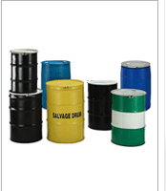
Haz Mat: DOT
DOT (Dept. of Transportation):
“Any substance or material in any form or quantity that poses an unreasonable risk to the safety and health and to property when transported in commerce.”
PPT-044-01AP
19
Notes:
DOT (Department of Transportation):
“Any substance or material in any form or quantity that poses an unreasonable risk to the safety and health and to property when transported in commerce.”

Slide 20
Hazardous Materials Locations
Found everywhere
Department of Transportation categorizes
materials according to potential hazard during
shipment for purposes of:
Labeling
Placarding
Packaging requirements
PPT-044-01AP
20
Notes:
HazMat locations:
Found everywhere
Department of Transportation categorizes materials according to potential hazard during shipment for purposes of:
Labeling
Placarding
Packaging requirements

Slide 21
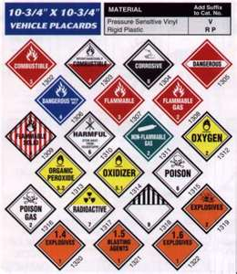
DOT 9 Classes of Hazardous Materials
DOT classifications include the following:
Class 1 Explosives
Class 2 Gases
Class 3 Flammable liquids
Class 4 Flammable solid
Class 5 Oxidizer
Class 6 Poison
Class 7 Radioactive
Class 8 Corrosive
Class 9 Miscellaneous
PPT-044-01AP
21
Notes:
These are the 9 classes of DOT identified Hazardous Materials for purposes of labeling, placarding and other special attention during shipping.

Slide 22
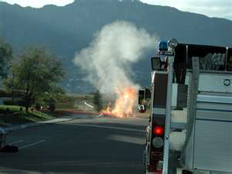
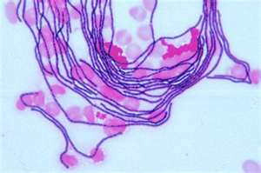
Recognizing Hazardous Materials
Methods include:
Markings
Containers
Visual clues
Smells
Sounds of material escaping from its container
Type of process may indicate HM presence
PPT-044-01AP
22
Notes:
Various methods exist to recognize the presence of a hazardous material. These include:
Markings
Containers
Visual clues
Smells
Sounds of material escaping from its container
Type of process may indicate HM presence

Slide 23
Other Hazards
ORM-D
-Other Regulated
Material-D
-Consumer commodities
-Limited quantities
No placard
PPT-044-01AP
23
Notes:
ORMs are “Other Regulated Materials” which for purposes of shipping do not fit into any one of the 9 DOT classes.
Generally “Consumer Commodities-Limited Quantities” although they will be labeled, no placard is required.

Slide 24
Extremely Hazardous Substances
366 designated substances per Section 302 of 40 CFR 355, U.S. Emergency Planning and Community Right-to-Know Act (42 U.S.C. 11002)
PPT-044-01AP
24
Notes:
Extremely hazardous substances.
366 designated substances per Section 302 of 40 CFR 355, U.S. Emergency Planning and Community Right-to-Know Act (42 U.S.C. 11002)

Slide 25
49 CFR, Part 172
Contains specifics for:
Marking-Subpart D
Labeling-Subpart E
Placarding-Subpart F
PPT-044-01AP
25
Notes:
Transportation requirements for labeling, placarding, shipping of materials can be found in
49 CFR, Part 172, et. al.
Marking-Subpart D
Labeling-Subpart E
Placarding-Subpart

Slide 26
DOT Chart 14
Contains DOT shipping
requirements concerning
labeling and placarding
Obtainable from U.S.
Department of Transportation
PPT-044-01AP
26
Notes:
DOT Chart 14
Contains DOT shipping requirements concerning labeling and placarding
Obtainable from U.S. Department of Transportation
A comparison between the GHS system and DOT system will show distinct differences in hazard categorization.

Slide 27
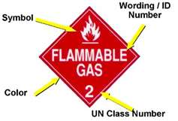
Reading a Label
Labels go on packages
Each label (and placard)
has its own:
Color
Symbol
Wording or ID number
UN hazard class number
PPT-044-01AP
27
Notes:
Labels go on packages
Each label (and placard)
has its own:
Color
Symbol
Wording or ID number
UN hazard class number

Slide 28
Class 1: Explosives
Hazard: rapid rate of pressure rise within short time interval
Examples/hazard:
1.1 TNT, mass explosion
1.2 Detonating cord, projection hazard, fragments
1.3 Ammunition, fire, blast or projection hazard
PPT-044-01AP
28
Notes:
Hazard: rapid rate of pressure rise within short time interval.
Class 1 Examples/hazard:
1.1 TNT, mass explosion
1.2 Detonating cord, projection hazard, fragments
1.3 Ammunition, fire, blast or projection hazard
Other hazards are identified in the DOT regulations

Slide 29
Class 1: Explosives
1.4 Detonating material, minor explosion hazard
1.5 Blasting agents i.e. ANFO (ammonium nitrate and fuel oil mixtures), mass explosion but very insensitive
1.6 Articles, explosive, extremely insensitive
PPT-044-01AP
29
Notes:
Class 1:
1.4 Detonating material, minor explosion hazard
1.5 Blasting agents i.e. ANFO (ammonium nitrate and fuel oil mixtures), mass explosion but very insensitive
1.6 Articles, explosive, extremely insensitive

Slide 30
Class 2: Gases
2.1 Flammable, propane
2.2 Non-flammable, nitrogen, argon, helium
2.3 Poison (toxic), chlorine and hydrogen cyanide; may also have other hazardous properties
PPT-044-01AP
30
Notes:
Class 2
2.1 Flammable, propane
2.2 Non-flammable, nitrogen, argon, helium
2.3 Poison (toxic), chlorine and hydrogen cyanide; may also have other hazardous properties

Slide 31
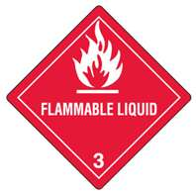
Class 3: Flammable/Combustible Liquids
Class 3: Flammable liquids may easily ignite (e.g., gasoline and alcohol)
Class 3: Combustible liquids will not readily ignite and may have to be pre-heated (e.g., kerosene and fuel oil)
PPT-044-01AP
31
Notes:
Class 3
Class 3: Flammable liquids may easily ignite (e.g., gasoline and alcohol)
Class 3: Combustible liquids will not readily ignite and may have to be pre-heated (e.g., kerosene and fuel oil)

Slide 32
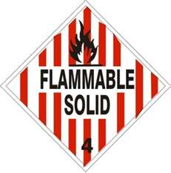
Class 4: Flammable Solid
4.1 Burn readily and violently; aluminum powder, coated
4.2 Air-reactive, barium alloys, pyrophoric
4.3 Water-reactive with possible poisonous fumes, barium
PPT-044-01AP
32
Notes:
Class 4
4.1 Burn readily and violently; aluminum powder, coated
4.2 Air-reactive, barium alloys, pyrophoric
4.3 Water-reactive with possible poisonous fumes, barium

Slide 33
Class 5: Oxidizer
5.1 Provide oxygen to the combustion process; potassium superoxide
5.2 Also enhances burning and may be heat, shock and friction sensitive; organic peroxide
PPT-044-01AP
33
Notes:
Class 5
5.1 Provide oxygen to the combustion process; potassium superoxide
5.2 Also enhances burning and may be heat, shock and friction sensitive; organic peroxide

Slide 34
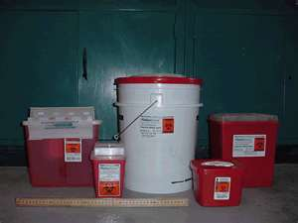
Class 6: Poison (Toxic)
6.1 Solid or liquid state with poisonous properties (e.g., chloropicrin)
6.2 Infectious substances like biological and organic materials that may cause disease (e.g., live micro-organisms) inhalation hazard also used for materials listed as poison inhalation hazard (PIH)
PPT-044-01AP
34
Notes:
Class 6
6.1 Solid or liquid state with poisonous properties (e.g., chloropicrin)
6.2 Infectious substances like biological and organic materials that may cause disease (e.g., live micro-organisms) inhalation hazard also used for materials listed as poison inhalation hazard (PIH)

Slide 35
Class 7: Radioactive
Used to denote emitters of alpha or beta particles of radiation or gamma radiation
Radioactive I:
Least hazardous
Radioactive II:
Moderate hazard
Radioactive III:
More serious hazard comparatively
PPT-044-01AP
35
Notes:
Class 7 Radioactive
Used to denote emitters of alpha or beta particles of radiation or gamma radiation
Radioactive I: Least hazardous
Radioactive II: Moderate hazard
Radioactive III: More serious hazard comparatively

Slide 36
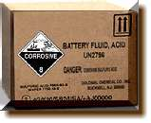
Class 8: Corrosive
Damage to skin; may corrode steel or aluminum as well as some may be water-reactive
Nitric acid and hydrochloric acid in addition to sodium hydroxide are examples
PPT-044-01AP
36
Notes:
Class 8 Corrosive
Damage to skin; may corrode steel or aluminum as well as some may be water-reactive
Nitric acid and hydrochloric acid in addition to sodium hydroxide are examples

Slide 37
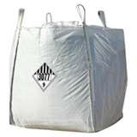
Class 9: Miscellaneous
Mildly hazardous and may be physically solid, liquid or gas state
Extremely annoying due to producing vapors which may interfere with flight crews
PPT-044-01AP
37
Notes:
Class 9 Miscellaneous
Mildly hazardous and may be physically solid, liquid or gas state
Extremely annoying due to producing vapors which may interfere with flight crews (castor beans)

Slide 38
ORM-D
Other Regulated
Materials-D
Consumer commodities
Presents limited hazard due to form, quantity and packaging
Each ORM-D material and category is listed in 49 CFR 172.101 Table and 173.144
PPT-044-01AP
38
Notes:
ORM-D
Other Regulated Materials-D
Consumer commodities
Presents limited hazard due to form, quantity and packaging
Each ORM-D material and category is listed in 49 CFR 172.101Table and 173.144

Slide 39
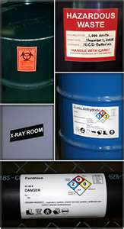
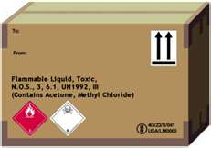
Additional Labels and Markings
Subsidiary risk labels indicating secondary hazards: 49 CFR 172.411
Additional labels will be hazard-dependent
PPT-044-01AP
39
Notes:
Subsidiary risk labels indicating secondary hazards: 49 CFR 172.411
Additional labels will be hazard-dependent

Slide 40
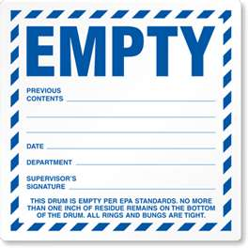
Empty Label
Empty
Per 49 CFR 172.450
PPT-044-01AP
40
Notes:
Empty Labels per 49 CFR 172.450

Slide 41
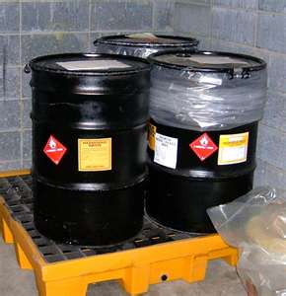
Labeling Example
Drum as example:
1-Orientation label
2-Hazardous waste
3-Hazard class 8 Corrosive material
PPT-044-01AP
41
Notes:
Labels need to contain certain information as indicated by this example of a drum of hazardous waste.

Slide 42
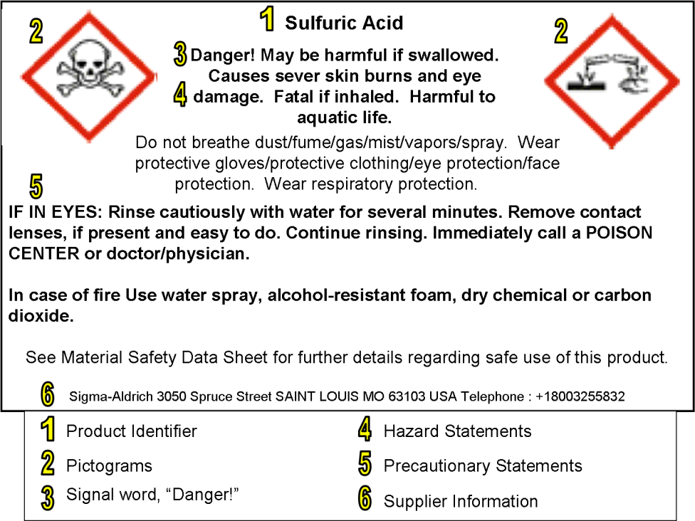
New GHS Label Requirements
Information required on a GHS label:
1-Product identifier
2-Pictograms
3-Signal word
4-Hazard statement
5-Precautionary statement
6-Supplier information
PPT-044-01AP
42
Notes:
New GHS Label Requirements
Information required on a GHS label on material packages:
1-Product identifier
2-Pictograms
3-Signal word
4-Hazard statement
5-Precautionary statement
6-Supplier information

Slide 43
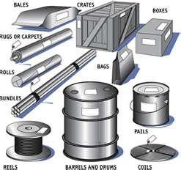
Packing Groups
Packing group: degree of material’s danger
Shipper determines packing group
More than one packing group: use 49 CFR, Part 173, Subpart D criteria
PPT-044-01AP
43
Notes:
Packing group: degree of material’s danger
I – Great Danger
II – Moderate Danger
III – Minor Danger
Shipper determines packing group
More than one packing group: use 49 CFR, Part 173, Subpart D criteria

Slide 44
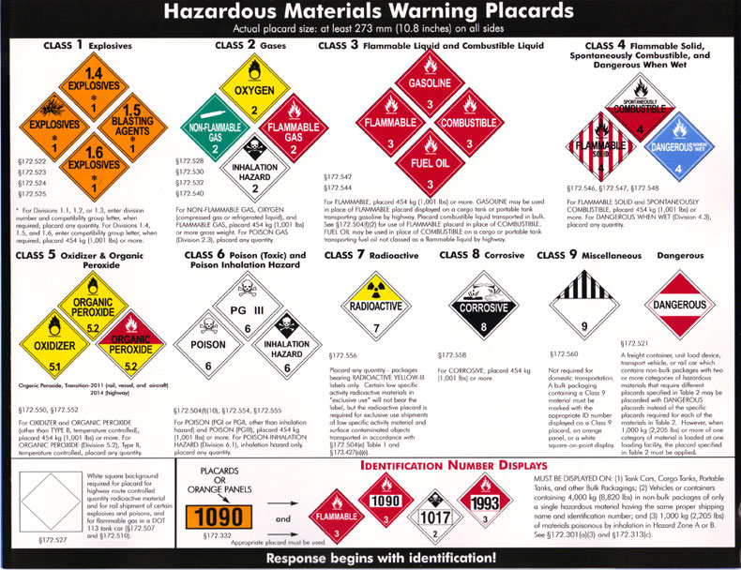
Placards
Depending upon the type and amount of material carried, placards are applied to the outside of the vehicle
Check 49 CFR Part 172 for specifics regarding placarding
PPT-044-01AP
44
Notes:
Placards go on the outside of a conveyance:
Depending upon the type and amount of material carried, placards are applied to the outside of the vehicle
Check 49 CFR Part 172 for specifics regarding placarding.
“As part of the rollout of the GHS rule, OSHA explicitly forbids a package from having a GHS pictogram when the package is already required to have a DOT hazmat label” (29 CFR 1910.1200, Appendix C.2.3.3)

Slide 45
DOT Table 1 Materials
Table 1
1.1, 1.2, 1.3 Explosives
2.3 Poison gas
4.3 Dangerous when wet
5.2 Organic peroxide (type B
temperature controlled)
6.1 Poison inhalation hazard
7 Radioactive Label III only
Any amount of Table 1 materials will require a label for each package as well as having to be placarded
PPT-044-01AP
45
Notes:
DOT Table 1 Materials indicates that
“Any amount of the Table 1 materials will require a label for each page as well as having to be placarded.”

Slide 46
DOT Table 2 Materials
Placard Name
1.4, 1.5, 1.6 Explosives
2.1 Flammable Gas
2.2 Non-Flammable Gas
Flammable or
Combustible Liquid
4.1 Flammable Solid
4.2 Spontaneously Combustible
5.1 Oxidizer
Placard 1,001 pounds or more
PPT-044-01AP
46
Notes:
DOT Table 2 Materials require a placard for 1,001 pounds or more of the identified materials.
Check DOT requirements for amounts on-loaded from one location which may stipulate an individual placard.
This may be the reason multiple placards may be seen on trailers of tractor-trailers.

Slide 47
DOT Table 2 Materials
Placard Name
5.2 Organic Peroxide (other than type B temperature controlled)
6.1 Poison (other than materials poisonous by inhalation)
6.2 Infectious substance
Corrosive
9 Class 9 miscellaneous
ORM-D No Name
Placard 1,001
pounds or more
PPT-044-01AP
47
Notes:
DOT Table 2 Materials require a placard for 1,001 pounds or more of the identified materials.
Check DOT requirements for amounts on-loaded from one location which may stipulate an individual placard.
This may be the reason multiple placards may be seen on trailers of tractor-trailers.

Slide 48
Reading a Numbered Placard
Numbered placards may better identify contents by using the United Nations, or UN, ID number
For:
Tank cars
Cargo tanks
Portable tanks
Other bulk packaging
PPT-044-01AP
48
Notes:
Numbered placards may better identify contents by using the United Nations, Identification Number (or UN, ID number).
For:
Tank cars
Cargo tanks
Portable tanks
Other bulk packaging

Slide 49
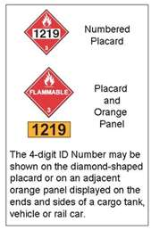
Reading a Numbered Placard
Transport vehicles or freight containers with 8,820 lbs in non-bulk packages
Transport vehicles or freight containers with 2,205 lbs of non-bulk packages of poisonous by inhalation in Hazard Zone A or B
PPT-044-01AP
49
Notes:
Requiring Placards.
Transport vehicles or freight containers with 8,820 lbs in non-bulk packages
Transport vehicles or freight containers with 2,205 lbs of non-bulk packages of poisonous by inhalation in Hazard Zone A or B

Slide 50
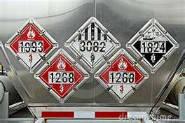
Example: UN #1993
The Emergency Response Guidebook (ERG) indicates UN #1993 could be:
Combustible liquid, or
Flammable liquid, n.o.s, or
Fuel oil, or
Medicines, or
Refrigerating machine
PPT-044-01AP
50
Notes:
The Emergency Response Guidebook (ERG) can be used for identifying actions for various materials. Materials can be isolated by name or by UN ID numbers.
In this case UN #1993 indicates it could be any of the following hazards. Such diverse possibilities would require further identification.
Combustible liquid, or
Flammable liquid, n.o.s, (Not Otherwise Specified), or
Fuel oil, or
Medicines, or
Refrigerating machine

Slide 51
Class 1: Explosive Placards
The hazard to you is:
Blast overpressure
Shrapnel effects
Keep your distance and handle a required.
PPT-044-01AP
51
Notes:
Class 1
The hazard to you is:
Blast overpressure
Shrapnel effects
Keep your distance and handle a required.
Be mindful that although not classified as an Explosive, cylinderized materials can result in over pressure rupture incidents.

Slide 52
Class 2: Gas Placards
Placard 1,001 pounds or more gross weight:
Oxygen,
Non-flammable gas,
Flammable gas
Poison gas, Division 2.3, placard any amount
PPT-044-01AP
52
Notes:
Class 2: Gas Placards
Placard 1,001 pounds or more gross weight:
Oxygen,
Non-flammable gas,
Flammable gas
Poison gas, Division 2.3, placard any amount
GHS does not make a distinction for a Poison Gas.

Slide 53
Class 3: Flammable Liquids
Placard 1,001 pounds or more
49 CFR 172.504(f)(2):
For use of Flammable placard in place of Combustible
PPT-044-01AP
53
Notes:
Class 3: Flammable Liquids
Placard 1,001 pounds or more
49 CFR 172.504(f)(2): For use of Flammable placard in place of Combustible

Slide 54
Class 4: Flammable Solid Placard
Placard 1,001 pounds or more of:
Flammable solid, and
Spontaneously combustible
Placard any amount of Dangerous When Wet
PPT-044-01AP
54
Notes:
Class 4: Flammable Solid Placard
Placard 1,001 pounds or more of:
Flammable solid, and
Spontaneously combustible
Placard any amount of Dangerous When Wet

Slide 55
Class 5: Oxidizer Placard
New Organic Peroxide placard became mandatory Jan. 1, 2011, when transported by:
Rail
Vessel
Aircraft
Mandatory Jan. 1, 2014, for transportation by highway
PPT-044-01AP
55
Notes:
Class 5: Oxidizer Placard
New Organic Peroxide placard became mandatory Jan. 1, 2011, when transported by:
Rail
Vessel
Aircraft
Mandatory Jan. 1, 2014, for transportation by highway.

Slide 56
Class 6: Poison (Toxic) Placard
Placard 1,001 pounds or more of:
Poison (PGI or PGII other
than inhalation hazard)
Placard any quantity of Poison-Inhalation Hazard, (Division 6.1), inhalation hazard only
PPT-044-01AP
56
Notes:
Class 6: Poison (Toxic) Placard
Placard 1,001 pounds or more of: Poison (PGI or PGII other than inhalation hazard)
Placard any quantity of Poison-Inhalation Hazard, (Division 6.1), inhalation hazard only

Slide 57
Class 7: Radioactive Placard
Placard is required for exclusive use shipments of low specific activity and surface contaminated objects, per 49 CFR 172.504(e) Table 1 and 49 CFR 173.427(a)(6)
Placard any quantity of packages bearing Radioactive Yellow-III labels only
PPT-044-01AP
57
Notes:
Class 7: Radioactive Placard
A Placard is required for exclusive use shipments of low specific activity and surface contaminated objects (SCOs), per 49 CFR 172.504(e) Table 1 and 49 CFR 173.427(a)(6)
Placard any quantity of packages bearing Radioactive Yellow-III labels only

Slide 58
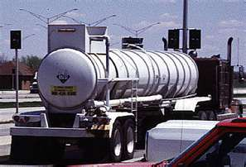
Class 8: Corrosive Placard
Placard 1,001 pounds or more
for Corrosive
Per 49 CFR 172.558
PPT-044-01AP
58
Notes:
Class 8: Corrosive Placard
Placard 1,001 pounds or more for Corrosive
Per 49 CFR 172.558

Slide 59
Class 9: Miscellaneous
Not required for domestic transportation
Bulk packaging containing Class 9 material must be marked with appropriate identification number on:
A Class 9 placard,
On orange panel, or
A white square-on-point display
PPT-044-01AP
59
Notes:
Class 9: Miscellaneous
NOT required for domestic transportation
Bulk packaging containing Class 9 material must be marked with appropriate identification number on:
A Class 9 placard,
On orange panel, or
A white square-on-point display

Slide 60
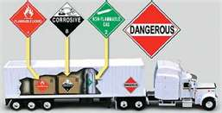
Dangerous Placard
•Non-bulk packages requiring different table 2 placards due to aggregate weight at 1,001 lbs or more
When 2,205 lbs or more of one category are loaded at one loading facility, the table 2 placard must be applied
PPT-044-01AP
60
Notes:
Dangerous Placard
Required for non-bulk packages requiring different table 2 placards due to aggregate weight at 1,001 lbs or more.
When 2,205 lbs or more of one category are loaded at one loading facility, the table 2 placard must be applied.

Slide 61
No Placard
49 CFR, Subpart 172.504(c):
When aggregate gross weight of all hazardous materials in non-bulk packages in table 2 is less than 1,001 lbs, no placard is required on transport vehicle/freight container when transported by highway or rail.
PPT-044-01AP
61
Notes:
No Placard Required per 49 CFR, Subpart 172.504(c):
When aggregate gross weight of all hazardous materials in non-bulk packages in table 2 is less than 1,001 lbs, no placard is required on transport vehicle/freight container when transported by highway or rail.

Slide 62
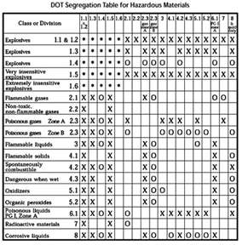
Compatibility
For safety of cargo and vehicle, materials shipped together must not react with each other.
Check compatibility before shipping or storing products.
PPT-044-01AP
62
Notes:
Compatibility of materials being shipped together must be considered.
For safety of cargo and vehicle, materials shipped together must not react with each other.
Check compatibility before shipping or storing products.

Slide 63
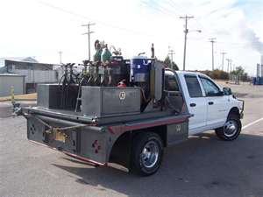
Materials of Trade (MOT)
49 CFR 173.6
Materials of trade means a hazardous material, other than hazardous waste, that is carried on a motor vehicle
(1) For the purpose of protecting health and safety of motor vehicle operator or passengers;
PPT-044-01AP
63
Notes:
What if there is a work truck with a variety of materials that is needed to do different jobs? By their very nature, these materials can be classified as Hazardous Materials. What needs to be done?
49 CFR 173.6 should be viewed for Materials of Trade (MOT) requirements.
Materials of trade means a hazardous material, other than hazardous waste, that is carried on a motor vehicle
(1) For the purpose of protecting health and safety of motor vehicle operator or passengers;

Slide 64
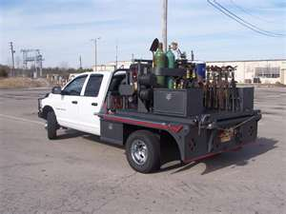
Materials of Trade (MOT)
(2) Purpose of supporting operation of a motor vehicle (including its auxiliary equipment) or;
(3) By a private motor carrier (including vehicles operated by rail carrier) in direct support of a principal business other than transportation by a motor vehicle.
PPT-044-01AP
64
Notes:
Materials of Trade:
(2) Purpose of supporting operation of a motor vehicle (including its auxiliary equipment) or;
(3) By a private motor carrier (including vehicles operated by rail carrier) in direct support of a principal business other than transportation by a motor vehicle.

Slide 65
Materials of Trade: Examples
Class/
Name Division Examples
Flammable gases 2.1 Acetylene
Non-flammable gases 2.2 Nitrogen
Flammable/combustible 3 Paint, thinner, gasoline
liquids
Flammable solids 4.1 Charcoal
Dangerous when wet 4.3 Some fumigants
Oxidizers 5.1 Bleaching compounds
Organic peroxides 5.2 Benzoyl peroxide
Poisons 6.1 Pesticides
Some infectious 6.2 Diagnostic specimens substances
PPT-044-01AP
65
Notes:
A “Ticket” is usually used listing the Name (category of hazard) in the left column, with the Class or Division in the center column.
The person transporting the MOT would then specify the name of the material in the right column corresponding to the Name.
Upon request of a Law Enforcement Officer, this “ticket” must be produced in a timely fashion. (It is suggested the driver dismount the vehicle with this ticket in hand. There have been stories where the driver needed only to open the cab door, reach in and retrieve this ticket but it was not “timely” enough in the officer’s opinion.)

Slide 66
Materials of Trade: Examples
Class/
Name Division Examples
Corrosive material 8 Muriatic acid,
drain cleaner,
battery acid
Miscellaneous 9 Asbestos
hazardous materials
Consumer ORM-D Hair spray,
commodities spray paints
PPT-044-01AP
66
Notes:
Here are some examples of MOT.

Slide 67
MOT: Quantity Limits
No more than a combined gross weight of 440 lbs of MOT can be transported on any one vehicle (exception: tanks containing diluted mixtures of Class 9 materials)
Diluted mixture of Class 9 material not exceeding 2 percent concentration may be transported in tank with a capacity up to 400 gallons
High hazard material (Packing Group I); maximum amount in one package:
1 pound for solids
1 pint for liquids
PPT-044-01AP
67
Notes:
MOT: Quantity Limits
No more than a combined gross weight of 440 lbs of MOT can be transported on any one vehicle (exception: tanks containing diluted mixtures of Class 9 materials)
Diluted mixture of Class 9 material not exceeding 2 percent concentration may be transported in tank with a capacity up to 400 gallons
High hazard material (Packing Group I); maximum amount in one package:
1 pound for solids
1 pint for liquids

Slide 68
MOT: Quantity Limits
Medium or lower hazard (Packing Group II or III), other than Division 4.3 or ORM-D, maximum amount in each package:
66 pounds for solids
8 gallons for liquids
Division 4.3 (only Packing Group II and III materials are allowed) maximum amount in each package is one ounce
Each gas cylinder (Division 2.1 or 2.2) may not weigh more than 220 pounds
PPT-044-01AP
68
Notes:
MOT: Quantity Limits
Medium or lower hazard (Packing Group II or III), other than Division 4.3 or ORM-D, maximum amount in each package:
66 pounds for solids
8 gallons for liquids
Division 4.3 (only Packing Group II and III materials are allowed) maximum amount in each package is one ounce
Each gas cylinder (Division 2.1 or 2.2) may not weigh more than 220 pounds

Slide 69
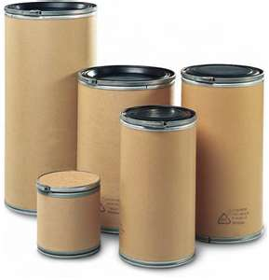
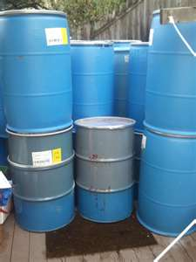
MOT: Packaging/Marking
Packaging:
Leak-proof for liquids,
Sift-proof for solids
Outer packaging not required for cans or bottles secured against movement in:
Cages
Bins
Boxes
Compartments
PPT-044-01AP
69
Notes:
MOT: Packaging and Marking
Packaging:
Leak-proof for liquids,
Sift-proof for solids
Outer packaging not required for cans or bottles secured against movement in:
Cages
Bins
Boxes
Compartments

Slide 70
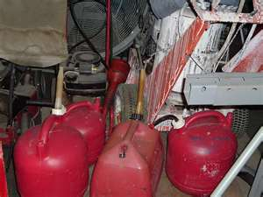
MOT: Packaging/Marking
• Gasoline: Must be transported in metal or plastic container meeting DOT or OSHA requirements:
49 CFR 173.6(b)(4)
49 CFR 173.202
PPT-044-01AP
70
Notes:
MOT: Packaging and Marking
Gasoline: Must be transported in a metal or plastic container meeting DOT or OSHA requirements:
49 CFR 173.6(b)(4)
49 CFR 173.202

Slide 71
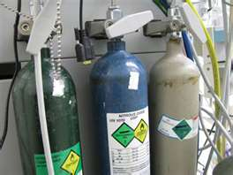
MOT: Packaging/Marking
Cylinders and pressure vessels:
Outer packaging not required
Marked with proper shipping name and identification number
Have a hazard class warning label
PPT-044-01AP
71
Notes:
MOT: Packaging and Marking
Cylinders and pressure vessels:
Outer packaging not required
Marked with proper shipping name and identification number
Have a hazard class warning label

Slide 72
MOT: Packaging/Marking
If package contains a reportable quantity:
Must be marked “RQ”
Reportable quantities are found in 49 CFR 173.101, Appendix A
PPT-044-01AP
72
Notes:
MOT: Packaging and Marking
If package contains a reportable quantity:
Must be marked “RQ”
Reportable quantities for various materials are found in 49 CFR 173.101, Appendix A

Slide 73
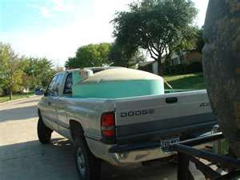
MOT: Packaging/Marking
Tank containing diluted mixture of not more than 2 percent concentration of Class 9 material must be marked on two opposing sides with the identification number
DOT Pamphlet, “What Are Materials of Trade?” Washington, D.C., 20590
Email: training@dot.gov
PPT-044-01AP
73
Notes:
MOT: Packaging and Marking
Tank containing diluted mixture of not more than 2 percent concentration of Class 9 material must be marked on two opposing sides with the identification number.

Slide 74
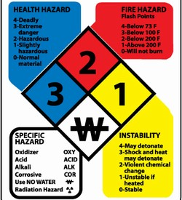
Other Identification Means
NFPA 704 system
Four categories:
Health
Flammability
Reactivity (instability)
Special remarks
Hazard Rating:
0, 1, 2, 3 or 4 - with 4 being most severe rating for that category
PPT-044-01AP
74
Notes:
Other Identification Means
NFPA 704 system
Four categories:
Health
Flammability
Reactivity (instability)
Special remarks
Hazard Rating:
0, 1, 2, 3 or 4 - with 4 being most severe rating for that category

Slide 75
New GHS Identification Means
NFPA 704 system
Four categories retained:
Health
Flammability
Reactivity (instability)
Special remarks
However, the GHS hazard rating:
5, 4, 3, 2, 1 - with 1 being most severe rating for each category
PPT-044-01AP
75
Notes:
New GHS Identification Means and Hazard Rating
NFPA 704 system
Four categories retained:
Health
Flammability
Reactivity (instability)
Special remarks
However, the GHS hazard rating: 5, 4, 3, 2, 1 - with 1 being most severe rating for each category

Slide 76
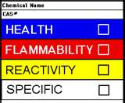
HMIS Safety
Hazardous materials
information system, or HMIS
Hazard rating similar to 704 system:
0,1,2,3 or 4 with 4 being most severe hazard in that category
CAS#: Chemical abstract service number; unique to a specific chemical
PPT-044-01AP
76
Notes:
HMIS (Hazardous Materials Information System)
Hazard rating similar to 704 system:
0,1,2,3 or 4 with 4 being most severe hazard in that category
CAS#: Chemical abstract service number; unique to a specific chemical

Slide 77
International Hazard Symbols
Top row; left to right
Poison/toxic
Radioactivity
High voltage
Caution
Bottom row; left to right
Corrosive
Ultraviolet
Low temperature
Explosion hazard
PPT-044-01AP
77
Notes:
Symbols shown will eventually not be used-substitutions will phase-in.

Slide 78
International Hazard Symbols
Top row; left to right
Laser hazard
Irritant/sensitizer
Optical radiation
Environmental hazard
Bottom row; left to right
Flammable
Biohazard
Chemical weapon
Oxidizer
PPT-044-01AP
78
Notes:
Symbols shown will eventually not be used-substitutions will phase-in.

Slide 79
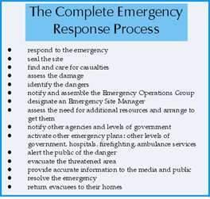
Response Capability
Based on a total program to include:
Trained staff/team
Incident command
Safety officer
PPE
Air monitoring
Decontamination
EMS
Spill recovery
PPT-044-01AP
79
Notes:
Your Response Capability to a release of a designated Hazardous Material will be based on a total program which will include:
Trained staff/team
Incident command
Safety officer
PPE
Air monitoring
Decontamination
EMS
Spill recovery

Slide 80
Incident Reporting
Carrier required to report HazMat transportation incident at earliest practical moment for:
Person killed
Injury requiring admittance to hospital
General public evacuation of one hour or more
Major transportation artery or facility closed or shut down for one hour or more
Fire, breakage, spillage or suspected radioactive contamination occurs involving radioactive material
PPT-044-01AP
80
Notes:
Incident reporting is required if a designated “Hazardous Material” is involved in an incident.
Carrier is required to report HazMat transportation incident at earliest practical moment for:
Person killed
Injury requiring admittance to hospital
General public evacuation of one hour or more
Major transportation artery or facility closed or shut down for one hour or more
Fire, breakage, spillage or suspected radioactive contamination occurs involving radioactive material

Slide 81
Incident Reporting
Fire, breakage, spillage or suspected contamination occurs involving infectious substance other than a diagnostic specimen or regulated medical waste
Release of a marine pollutant occurs in a quantity exceeding 119 gallons for a liquid or 882 pounds for a solid
Situation exists so that in judgment of the person in possession of hazardous material, it should be reported to the National Response Center even though it does not meet the other criteria
PPT-044-01AP
81
Notes:
Incident reporting is also required for the following:
Fire, breakage, spillage or suspected contamination occurs involving infectious substance other than a diagnostic specimen or regulated medical waste.
Release of a marine pollutant occurs in a quantity exceeding 119 gallons for a liquid or 882 pounds for a solid.
Situation exists so that in judgment of the person in possession of hazardous material, it should be reported to the National Response Center even though it does not meet the other criteria.

Slide 82
Incident Reporting
Call National Response Center 800-424-8802
Etiologic agents, call CDC 800-232-0124
Written report where required, submit DOT Form F 5800.1
PPT-044-01AP
82
Notes:
Additional Incident Reporting may be required depending upon agency-specific criteria or locations threatened by the release.

Slide 83
Emergency Response Guidebook
Divided into colored sections:
White: User instructions
Yellow: Materials listed by UN identification number
Blue: Materials listed by name
Orange: Guide pages with response instructions
Green: Matrix of protective action distances
PPT-044-01AP
83
Notes:
The Emergency Response Guidebook can be used by First Responders as well as facility response teams. The above categories indicate information contained in each colored page section.

Slide 84
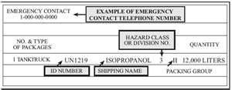
White Pages
User instructions
Shipping papers containing as a minimum:
Emergency phone number
Type of packages
UN identification number
Proper shipping name
Hazard class/division
Packing group
Quantity
PPT-044-01AP
84
Notes:
White Pages
User instructions
Shipping papers containing as a minimum:
Emergency phone number
Type of packages
UN identification number
Proper shipping name
Hazard class/division
Packing group
Quantity

Slide 85
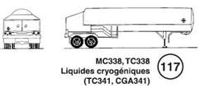
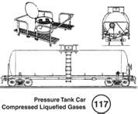
White Pages
Label/Placard information
Railcar and tank truck
information
Intermodal containers
Pipeline information
Circled number adjacent to label or vehicle indicates orange guide page used if no other information is available on material
PPT-044-01AP
85
Notes:
White Pages
Label/Placard information
Railcar and tank truck information
Intermodal containers
Pipeline information
Circled number adjacent to label or vehicle indicates orange guide page used if no other information is available on material

Slide 86
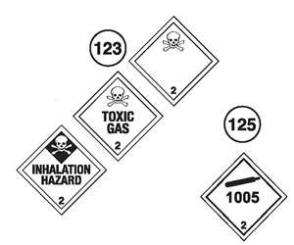
White Pages
Label/Placard information
Circled number adjacent to the label or placard on Table of Placards indicates orange guide page used if no other information available on material
PPT-044-01AP
86
Notes:
White Pages
Label/Placard information
Circled number adjacent to the label or placard on Table of Placards indicates orange guide page used if no other information available on material

Slide 87
Yellow Pages
Lists materials by UN number
Page example:
ID Guide
No. No. Name of Material
120 Carbon Dioxide, refrigerated
liquid
2188 119 Arsine
PPT-044-01AP
87
Notes:
Yellow Pages
Lists materials by their UN Number.
This may be obtained from placards or SDSs

Slide 88
Yellow Pages
2188: United Nations identification number
119: Orange guide page number
Arsine: Material name
Since Arsine is highlighted, if no fire, go directly to green pages and determine isolation distance from the material.
If fire is involved, go to orange guide page 119 and determine safest actions.
If not highlighted, go directly to orange guide page 119.
PPT-044-01AP
88
Notes:
Yellow Pages
2188: United Nations identification number
119: Orange guide page number
Arsine: Material name
Since Arsine is highlighted, if no fire, go directly to green pages and determine isolation distance from the material.
If fire is involved, go to orange guide page 119 and determine safest actions.
If not highlighted, go directly to orange guide page 119.

Slide 89
Blue Pages
If material name is known, find in blue pages alphabetically.
Once found, use same sequence:
If not highlighted, go directly to orange guide page.
If highlighted, go first to green pages using UN ID# to determine isolation distances.
Then go to orange guide page for further actions.
PPT-044-01AP
89
Notes:
Blue Pages
If material name is known, find in blue pages alphabetically.
Once found, use same sequence:
If not highlighted, go directly to orange guide page.
If highlighted, go first to green pages using UN ID# to determine isolation distances.
Then go to orange guide page for further actions.

Slide 90
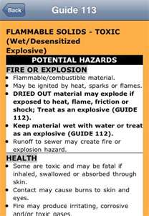
Orange Guide Pages: Response Categories
Potential Hazards
Fire or explosion
Health
Public Safety
Initial actions
Protective clothing
Evacuation
Emergency Response
Fire/spill or leak
First aid
PPT-044-01AP
90
Notes:
Orange Guide Pages: Response Categories.
Potential Hazards. Allows you to determine if you can match the hazard with your response capabilities.
Fire or explosion
Health
Public Safety. Those initial actions to promote the highest level of safety.
Initial actions
Protective clothing
Evacuation
Emergency Response. Suggestions on response and possible First Aid requirements.
Fire/spill or leak
First aid

Slide 91
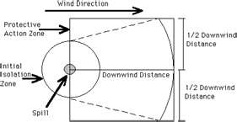
Green Pages
Table 1 – Initial isolation and protective action distances
Distances regarding:
Small spills
Large spills
First isolate in all directions (distances given) Protect downwind
Day
Night
PPT-044-01AP
91
Notes:
Green Pages
Table 1 – Initial isolation and protective action distances. THESE ARE NOT EVACUATION DISTANCES!! Evacuation distances will need to be plotted based on multiple issues.
Distances regarding:
Small spills
Large spills
First isolate in all directions (distances given) Protect downwind
Day
Night

Slide 92
Safety Data Sheets
SDS* Information Categories:
1.Product and company identification
2.Hazards identification
3.Composition/information on
ingredients
4.First-aid measures
5.Fire-fighting measures
6.Accidental release measures
7.Handling and storage
8.Exposure controls/personal protection
*These were the MSDSs but under the Globally Harmonized System, SDS
(Safety Data Sheet) will have 16 categories.
PPT-044-01AP
92
Notes:
The SDSs (Safety Data Sheets) will replace the MSDSs (Material Safety Data Sheets).
The MSDS had 8 categories of information;
The SDS has 16 categories of information upon which to make decisions with the first eight being:
1. Product and company identification
2. Hazards identification
3. Composition/information on ingredients
4. First-aid measures
5. Fire-fighting measures
6. Accidental release measures
7. Handling and storage
8. Exposure controls/personal protection

Slide 93
Safety Data Sheets
9. Physical and chemical properties
10. Stability and reactivity
11. Toxicological information
12. Ecological information
13. Disposal considerations
14. Transport information
15. Regulatory information
16. Other information
PPT-044-01AP
93
Notes:
These are the remaining categories on the Safety Data Sheet:
9. Physical and chemical properties
10. Stability and reactivity
11. Toxicological information
12. Ecological information
13. Disposal considerations
14. Transport information
15. Regulatory information
16. Other information

Slide 94
Section 1: Identification
Product identifier used on label
Other means of identification
Recommended use of chemical and restrictions on use
Name, address, telephone number of manufacturer, importer or other responsible party
Emergency phone number
PPT-044-01AP
94
Notes:
Section 1: Identification. Here you will find:
Product identifier used on label
Other means of identification
Recommended use of chemical and restrictions on use
Name, address, telephone number of manufacturer, importer or other responsible party
Emergency phone number

Slide 95
Section 2: Hazard Identification
Instead of hazard determination, employer must classify a hazardous chemical according to changed conditions provided in Appendix A and B, 29 CFR 1910.1200
Pictograms are a new requirement
Standardized hazard statements
Signal words
Precautionary statements are now required
Separate SDS required for each mixture rather than one for each chemical comprising a mixture
PPT-044-01AP
95
Notes:
Section 2: Hazard Identification
Instead of hazard determination, employer must classify a hazardous chemical according to changed conditions provided in Appendices A and B
Pictograms are a new requirement
Standardized hazard statements
Signal words
Precautionary statements are now required
SDS required for each mixture rather than one for each chemical comprising a mixture
If one study in 10 indicates material is carcinogenic, but others don’t, must list the one carcinogenic study

Slide 96
Section 2
Classification of chemical
Signal word, hazard statement(s), symbol(s) and precautionary statement(s) in accordance with paragraph (f) of this section. (Hazard symbols may be provided as graphical reproductions or the name of the symbol, e.g., flame, skull and crossbones)
Unclassified hazards (e.g., combustible dust or dust explosion hazard)
Where an ingredient with unknown acute toxicity is used in a mixture at a concentration > 1 percent, a statement that x percent of mixture consists of ingredient(s) of unknown toxicity is required
PPT-044-01AP
96
Notes:
Section 2: Hazard Identification (cont.)
Classification of chemical
Signal word, hazard statement(s), symbol(s) and precautionary statement(s) in accordance with paragraph (f) of this section (hazard symbols may
be provided as graphical reproductions or the name of the symbol, e.g. flame, skull and crossbones)
Unclassified hazards (e.g., combustible dust or dust explosion hazard)
Where an ingredient with unknown acute toxicity is used in a mixture at a concentration > 1 percent, a statement that x percent of mixture
consists of ingredient(s) of unknown toxicity is required

Slide 97
Section 3: Composition
No new requirements other than:
Format and
A separate SDS will be required for each mixture rather than one SDS for each chemical comprising the mixture.
PPT-044-01AP
97
Notes:
Section 3: Composition
No new requirements other than:
Format
A separate SDS will be required for each mixture rather than one for each chemical comprising the mixture

Slide 98
Section 3
Except as provided in (i) this section on trade secrets:
For Substances
Chemical name
Common name and synonyms
CAS number and other unique identifiers
Impurities and stabilizing additives that are themselves classified and that contribute to the classification of the substance
PPT-044-01AP
98
Notes:
Section 3: Composition (cont.)
Except as provided in (i) this section on trade secrets
For Substances
Chemical name
Common name and synonyms
CAS number and other unique identifiers
Impurities and stabilizing additives which are themselves classified and which contribute to the classification of the substance

Slide 99
Section 3
The chemical name and concentration or concentration ranges of all ingredients that are classified as health hazards in accordance with (d)
of this section
For all chemicals where a trade secret is claimed
Trade Secret per (i) of this section, a statement that the specific chemical identity and/or percentage of composition has been withheld as a trade secret is required
PPT-044-01AP
99
Notes:
Section 3: Composition (cont.)
The chemical name and concentration or concentration ranges of all ingredients, which are classified as health hazards in accordance with (d)
this section
For all chemicals where a trade secret is claimed
Trade Secret per (i) this section, a statement that the specific chemical identity and/or percent of
composition has been withheld as a trade secret is required

Slide 100
Section 4: First Aid
No new requirements other than format
Description of necessary measures, subdivided according to the different routes of exposure, i.e., inhalation, skin and eye contact and ingestion
Most important symptoms/effects, acute and delayed
Indication of immediate medical attention and special treatment needed, if necessary
PPT-044-01AP
100
Notes:
Section 4: First Aid
No new requirements other than format
Description of necessary measures, subdivided according to the different routes of exposure, i.e. inhalation, skin and eye contact, ingestion
Most important symptoms/effects, acute and delayed are provided
Indication of immediate medical attention and special treatment needed, if necessary

Slide 101
Section 5: Fire-fighting
No new requirements other than format
Suitable (and unsuitable) extinguishing media
Specific hazards arising from the chemical (e.g., nature of any hazardous combustion products)
Special protective equipment and
precautions for fire fighters
PPT-044-01AP
101
Notes:
Section 5: Fire-fighting
No new requirements other than format
Suitable (and unsuitable) extinguishing media
Specific hazards arising from the chemical (e.g. nature of any hazardous combustion products)
Special protective equipment and precautions for firefighters

Slide 102
Section 6: Accidental Release
No new requirements other than format
Personal precautions, protective equipment and emergency procedures
Methods and materials for containment and cleaning up
PPT-044-01AP
102
Notes:
Section 6: Accidental Release
No new requirements other than format
Personal precautions, protective equipment, emergency procedures
Methods and materials for containment and clean up

Slide 103
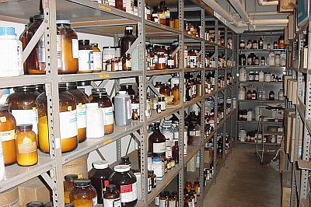
Section 7: Handling and Storage
No new requirements other than format
Precautions for safe handling
Conditions for safe storage, including any incompatibilities
PPT-044-01AP
103
Notes:
Section 7: Handling & Storage
No new requirements other than format
Precautions for safe handling
Conditions for safe storage, including any incompatibilities are indicated.

Slide 104
Section 8: Exposure Controls/ PPE
No new requirements other than format
OSHA PEL (permissible exposure limit) and any other exposure limit used or recommended by the chemical manufacturer, importer or employer preparing the SDS
Appropriate engineering controls
Individual protection measures, such as PPE
PPT-044-01AP
104
Notes:
Section 8: Exposure Controls/PPE
No new requirements other than format
OSHA PEL (permissible exposure limit) and any other exposure limit used or recommended by the chemical manufacturer, importer or employer
preparing the SDS
Appropriate engineering controls
Individual protection measures, such as PPE

Slide 105
Section 9: Physical, Chemical Properties
No new requirements other than format
Appearance (physical state, color, etc)
Odor
pH
Melting point/freezing point
Initial boiling point and boiling range
Flash point
Evaporation rate
Flammability (solid, liquid, gas)
Upper/lower flammability or explosive limits
Vapor pressure
Vapor density
Relative density
Solubility
PPT-044-01AP
105
Notes:
Section 9: Physical, Chemical Properties
No new requirements other than format:
Appearance (physical state, color, etc.)
Odor (NOT a recommended method to detect the presence of a material)
pH (How acidic or alkaline: A pH of 7 is neutral; a pH between 1 and 6 is acidic; a pH between 8 and 14 is caustic, basic or alkaline)
Melting point/freezing point
Initial boiling point and boiling range
Flash point
Evaporation rate
Flammability (solid, liquid, gas)
Upper/lower flammability or explosive limits
Vapor pressure
Vapor density
Relative density
Solubility

Slide 106
Section 9: Physical, Chemical Properties
Partition coefficient: n-octanol/water
Auto-ignition temperature
Decomposition temperature
Viscosity
PPT-044-01AP
106
Notes:
Section 9: Physical, Chemical Properties (cont.)
Partition coefficient: n-octanol/water (the ratio of the concentrations of a substance in two heterogenous phases in equilibrium with each other.)
Auto-ignition temperature (also known as autogenious ignition temperature. The ignition temperature required without an outside flaming ignition
source.)
Decomposition temperature
Viscosity (resistance to flow)

Slide 107
Section 10: Stability and Reactivity
Conditions to avoid
New to HCS (as has been required in ANSI Z400.1 standard)
Reactivity
Chemical stability
Possibility of hazardous reactions
Conditions to avoid (static discharge, shock or vibration)
Incompatible materials
Hazardous decomposition products
PPT-044-01AP
107
Notes:
Section 10: Stability and Reactivity
Hazardous Conditions:
New to HCS (as has been required in ANSI Z400.1 standard)
Reactivity
Chemical stability
Possibility of hazardous reactions
Conditions to avoid (static discharge, shock or vibration)
Incompatible materials
Hazardous decomposition products

Slide 108
Section 11: Toxicological Information
No new requirements other than format
Description of various toxicological effects and available data used to identify those effects, including:
Likely exposure routes (inhalation, ingestion, skin and eye contact)
Symptoms related to the physical, chemical and toxicological characteristics
Delayed and immediate effects and chronic effects from short- and long-term exposure
Numerical measures of toxicity (such as acute toxicity estimates)
PPT-044-01AP
108
Notes:
Section 11: Toxicological Information
No new requirements other than format:
Description of various toxicological effects and available data used to identify those effects, including:
Likely exposure routes (inhalation, ingestion, skin and eye contact)
Symptoms related to the physical, chemical and toxicological characteristics
Delayed and immediate effects and chronic effects from short and long term exposure
Numerical measures of toxicity (such as acute toxicity estimates)

Slide 109
Section 12: Ecological Information
Non-mandatory
To be GHS-compliant the requirements for this section would be:
Ecotoxicity (aquatic and terrestrial, where available)
Persistence and degradability
Bioaccumulative potential
Mobility in soil
Other adverse effects
PPT-044-01AP
109
Notes:
Section 12: Ecological Information
Non-mandatory. Although OSHA will not enforce, to be GHS-compliant, the requirements for this section would be:
Ecotoxicity (aquatic and terrestrial, where available)
Persistence and degradability
Bioaccumulative potential
Mobility in soil
Other adverse effects

Slide 110
Section 13: Disposal Considerations
To be GHS compliant, this section is provided, but
compliance is outside OSHA jurisdiction.
However, OSHA may enforce provisions associated with safe handling and use, including appropriate hygienic practices (see Section 7, above)
Description of waste residues
Information on their safe handling
Methods of disposal
Disposal of any contaminated packaging
PPT-044-01AP
110
Notes:
Section 13: Disposal Considerations
To be GHS compliant, this section is provided, but compliance is outside OSHA jurisdiction
However, OSHA may enforce provisions associated with safe handling and use, including appropriate hygienic practices (see Section 7, above)
Description of waste residues and information on their safe handling
Methods of disposal
Disposal of any contaminated packaging

Slide 111
Section 14: Transport Information
To be GHS compliant, this section is provided, but compliance is outside OSHA jurisdiction.
UN number
UN proper shipping name
Transport hazard classes
Packing group, if applicable
Environmental hazards such as marine pollutant (yes/no)
Transport in bulk (per Annex II of MARPOL 73/78 and
IBC Code)
Special precautions that a user needs to be aware of or needs to comply with, in connection with transport or conveyance either within or outside their premises
PPT-044-01AP
111
Notes:
Section 14: Transportation Information
To be GHS compliant, this section is provided, but compliance is outside OSHA jurisdiction.
UN number
UN proper shipping name
Transport hazard classes
Packing group, if applicable
Environmental hazards such as marine pollutant (yes/no)
Transport in bulk (per Annex II of MARPOL 73/78 and IBC Code)
Special precautions which a user needs to be aware of or needs to comply with, in connection with transport or conveyance either within or outside
their premises

Slide 112
Section 15: Regulatory Information
To be GHS compliant, this section is provided, but compliance is outside OSHA jurisdiction.
1. Safety
2. Health
3. Environmental regulations specific to
product
PPT-044-01AP
112
Notes:
Section 15: Regulatory Information
To be GHS compliant, this section is provided, but compliance is outside OSHA jurisdiction
Safety
Health
Environmental regulations specific to product

Slide 113
Section 16: Other Information
No new requirements other than format
Date of preparation of SDS or last revision date
PPT-044-01AP
113
Notes:
Section 16: Other Information
No new requirements other than format
Date of preparation of SDS or last revision date

Slide 114
Review the SDS
Review for job planning purposes as well for emergency response
Select the “needed to know” information and create a card or “ticket” to assemble PPE and the equipment for both:
Routine work planning
Emergency needs
PPT-044-01AP
114
Notes:
Review the SDS
For job planning purposes as well for emergency response
Select the “needed to know” information and create a card or “ticket” to assemble PPE and the equipment for both:
Routine work planning
Emergency needs

Slide 115
Summary
This program provided:
Insight regarding the new regulations affecting the safety of the workplace, and
Methods to research material hazards for job-planning and emergency purposes, and
An understanding of the need for safety in the workplace and the means to obtain it
PPT-044-01AP
115
Notes:
Summary
This program provided:
Insight regarding the new regulations affecting the safety of the workplace, and
Methods to research material hazards for job-planning and emergency purposes, and
An understanding of the need for safety in the workplace and the means to obtain it

Slide 116
Bibliography
U.S. Department of Transportation, Pipeline and Hazardous Materials Safety Administration. Email: training@dot.gov
OSHA Handbook, Pennsylvania Chamber of Business and Industry, 2011/2012 edition. Email: www.pachamber.org
Emergency Response Guidebook, 2012 edition, J.J. Keller and Associates Inc., Neenah, WI. Email: www.jjkeller.com
Rob Schnepp and Paul W. Gantt, “Hazardous Materials:
Regulations, Response, and Site Operations,” Delmar, 1998
PPT-044-01AP
116

Slide 117
Bibliography
Health & Safety Training Specialists
1171 South Cameron Street, Room 324
Harrisburg, PA 17104-2501
(717) 772-1635
RA-LI-BWC-PATHS@pa.gov
Like us on Facebook! - https://www.facebook.com/BWCPATHS
PPT-044-01AP
117
Notes:
We invite you to contact us for information on other free training programs available to you.

Slide 118
Questions
PPT-044-01AP
118

