Slide 1
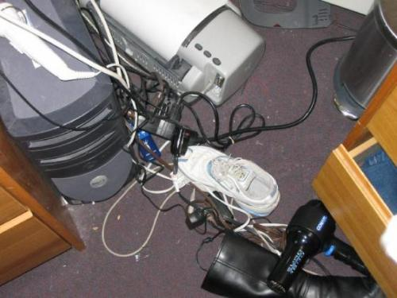
Hazard Identification
Bureau of Workers’ Comp
PA Training for Health & Safety
(PATHS)
PPT-072-01
1
Notes:
To ensure safety of all concerned, an active program of identifying and correcting hazards within the work environment should be put in place. This can include but is not limited to daily “walk around inspections” as well as more formal periodic “safety/hazard inspections.” A safety committee should be involved with the inspections whether it is to actually conduct them or at least review the results of each inspection and become instrumental in the correction of those hazards. Hazard identification provides the means for hazard remediation equating to an effective safety program.

Slide 2
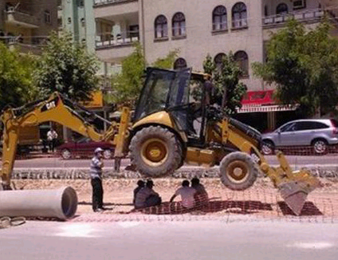
Hazard Detection & Inspection
What is a hazard?
What should I look for?
How do I perform the inspection?
How do I document the inspection?
How do I evaluate the hazards?
What type of control measure(s) should I use?
What standards do I reference?
PPT-072-01
2
Notes:
Detection and inspection requires us to ask particulars about a hazard:
What is it?
What should I be looking for?
How do I perform the inspection and properly?
How do I document my findings?
Is there a way to measure or evaluate the magnitude of the hazard?
What are the recommended and acceptable control measures for what I find?
Are there particular standards which can be cited for my identifying the particulars as hazards?

Slide 3
Hazard vs. Near Miss
Hazard - An act or a condition in the workplace that has the potential to cause injury, illness, or death to a person and/or damage to company property, equipment and materials
Near Miss - is an unplanned event that did not result in injury, illness, or damage – but had the potential to do so. Only a fortunate break in the chain of events prevented an injury, fatality or damage
PPT-072-01
3
Notes:
There are hazards and near misses that can exist in the workplace and all employees should know the difference as well as understand the importance of reporting both.
To understand the difference between a hazard and a near miss employees should know the definitions of each as follows:
Hazard - An act or a condition in the workplace that has the potential to cause injury, illness, or death to a person and/or damage to company property, equipment and materials.
Near Miss - is an unplanned event that did not result in injury, illness, or damage – but had the potential to do so. Only a fortunate break in the chain of events prevented an injury, fatality or damage.

Slide 4
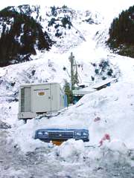
Risk vs. Hazard
Risk: The measure of the probability and severity of an adverse effect caused by a hazard
Hazard: What causes the risk; administrative or physical (causes or has the potential to cause a loss)
PPT-072-01
4
Notes:
Risk: The measure of the probability and severity of an adverse effect caused by a hazard
Hazard: What causes the risk; administrative or physical (causes or has the potential to cause a loss)

Slide 5
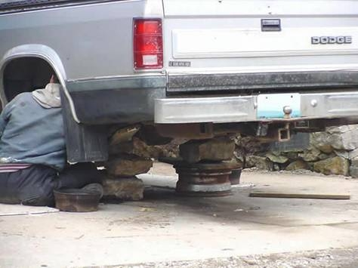
Identifying Hazards
It takes a hazard & someone exposed to the hazard to produce an incident.
Hazard + Exposure = Incident
Is this an Incident waiting to happen?
PPT-072-01
5
Notes:
It takes a hazard and someone exposed to the hazard to produce an incident.
Hazard + Exposure = Incident

Slide 6
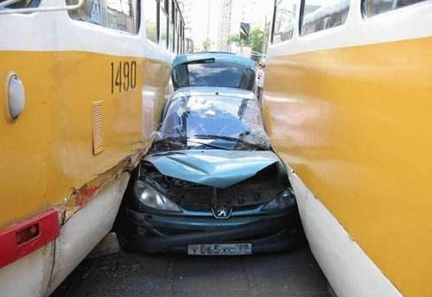
What is “Exposure?”
How close are you to the “danger zone”?
Physical exposure – generally arm’s length
Environmental exposure – could be everyone in facility
PPT-072-01
6
Notes:
What is an “Exposure?”
How close are you to the “danger zone?” Hazards outside the immediate area may serve as “proximate” harm.
Physical exposure – generally arm’s length.
Environmental exposure – everyone in facility might be affected ,e.g. explosive ruptures of vessels, vapor clouds due to releases of gases as examples.

Slide 7
Hazard Identification
HAZID process must be ongoing to ensure existing hazards are known, and
New hazards recognized before they are introduced:
Prior to modification of facility
Prior to change in workforce
Before and during abnormal operations, troubleshooting
Facility early warning signals
Employee feedback
After an incident
PPT-072-01
7
Notes:
Hazard Identification (or HAZID)
HAZID process must be ongoing to ensure existing hazards are known, and
New hazards recognized before they are introduced:
Prior to modification of facility
Prior to change in workforce
Before and during abnormal operations, troubleshooting
Facility early warning signals
Employee feedback
After an incident

Slide 8
Hazard Identification
A systematic, transparent and comprehensive
HAZID process should be used based on a
comprehensive and accurate description of the
facility
Hazards should not be disregarded simply because:
They appear to be very unlikely
They have not happened previously
They are considered to be adequately controlled by existing measures
PPT-072-01
8
Notes:
A systematic, transparent and comprehensive HAZID process should be used based on a
comprehensive and accurate description of the facility.
Hazards should not be disregarded simply because:
They appear to be very unlikely.
They have not happened previously.
They are considered to be adequately controlled by existing measures.

Slide 9
Hazard Identification
The HAZID should:
Be team-based
Use a process that is systematic
Be pro-active in searching for hazards
Assess all hazards
Analyze existing controls and barriers - preventative and mitigative
Consideration needs to be given in selecting the HAZID technique (checklist, JSA, walkthrough, etc.)
PPT-072-01
9
Notes:
The HAZID should:
Be team-based. The more talents viewing the situation-the more input to identify possibilities.
Use a process that is systematic.
Be pro-active in searching for hazards.
Assess all hazards.
Analyze existing controls and barriers - preventative and mitigative
Consideration needs to be given in selecting the HAZID technique (checklist, Job Safety Analysis (JSA), walkthrough, etc.)

Slide 10
Hazard Identification
Conducting the HAZID – Consider the Past, Present and Future
What has gone wrong in the past?
Root Cause
Historical Records
Process Experience
Near Misses
Historical conditions
What could go wrong currently?
HAZID Workshop
HAZOP Study
Scenario Definitions
Checklists
Identified Hazards
Existing conditions
Future conditions
What could go wrong?
Change Management
What-If Judgment
Prediction
Unforeseeable
PPT-072-01
10
Notes:
When conducting the HAZID, consider the Past, Present and Future concerning hazards.
Past: What occurred in your agency or in other similar industries.
Present: existing conditions.
Future: conditions which could indicate things to go wrong.

Slide 11
Hazard Identification
It is tempting to disregard “Non-Credible” Scenarios BUT:
“Non-credible” scenarios have happened to others
Worst cases are important to emergency planning
PPT-072-01
11
Notes:
It is tempting to disregard “Non-Credible” Scenarios BUT:
“Non-credible” scenarios have happened to others.
Worst cases are important to emergency planning.
Look at your type of industry to determine incidents which have occurred to others. Learn from their incidents.
What can happen? If you have a water hazard on your facility, there is always the possibility of water-type incidents; drowning.

Slide 12
Hazard Identification
Issues for consideration
Equipment can be off-line
Safety devices can be disabled or fail to operate
Several tasks may be concurrent
Procedures are not always followed
People are not always available
How we act is not always how we plan to act
Things can take twice as long as planned
Abnormal conditions
- Power failure
PPT-072-01
12
Notes:
Issues for consideration
Equipment can be off-line. Without lockout/tagout programs, restarts may be attempted.
Safety devices can be disabled or fail to operate. Once locked-out, try to restart to ensure out of service.
Several tasks may be concurrent.
Procedures are not always followed.
People are not always available.
How we act is not always how we plan to act.
Things can take twice as long as planned.
Abnormal conditions may arise;
Power failure.
Impact from neighboring facilities which intrude your location.

Slide 13
Hazard Detection & Identification
The following list shows the main ways to identify hazards:
→ Walkthrough Surveys
→ Inspection Checklists
→ Past Records
→ Accident Investigations
→ Consultation
→ Documentation
PPT-072-01
13
Notes:
The following list shows the main ways to identify hazards:
→ Walkthrough Surveys
→ Inspection Checklists
→ Past Records
→ Accident Investigations
→ Consultation
→ Documentation

Slide 14
HAZID Techniques
Checklists - questions to assist in hazard identification
Brainstorming - whatever anyone can think of
“What If” Analysis - possible outcomes of change
HAZOP - identifies “process plant” type incidents
Job Safety Analysis – procedures
Fault Tree Analysis - combinations of failures
PPT-072-01
14
Notes:
HAZID Techniques
Checklists - questions to assist in hazard identification.
Brainstorming - whatever anyone can think of along with solutions contributed.
“What If” Analysis - possible outcomes of change and alternate solutions.
HAZOP - identifies “process plant” type incidents.
Job Safety Analysis – procedures which exist or must be created.
Fault Tree Analysis - combinations of failures and results to plan for.

Slide 15
Checklists
Advantages
Highly valuable as a cross check review tool following the use of other techniques
Useful tool to review continued compliance with Safety Management Systems
Disadvantages
Tends to limit creative thinking
Used alone introduces the potential of limiting to already known hazards - no new hazard types are identified
On their own will rarely be able to satisfy regulatory requirements
PPT-072-01
15
Notes:
A checklist, as the term implies, is used for various aspects of the process under view. Checklists can be used for:
Audit of operators. Is their training current; performance checked.
Equipment and construction issues. How will these impact your operation.
Maintenance records. Do they indicate a periodicity required for continued operations?
Others as determined.

Slide 16
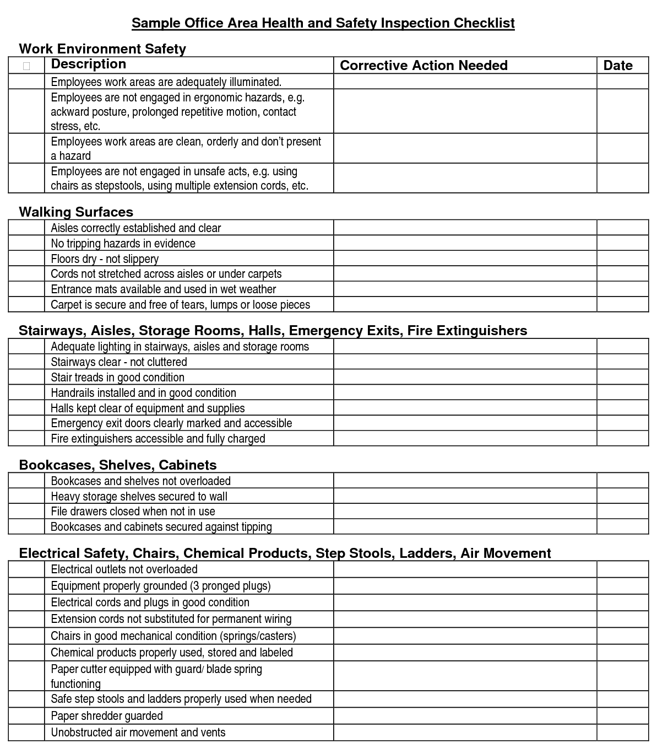
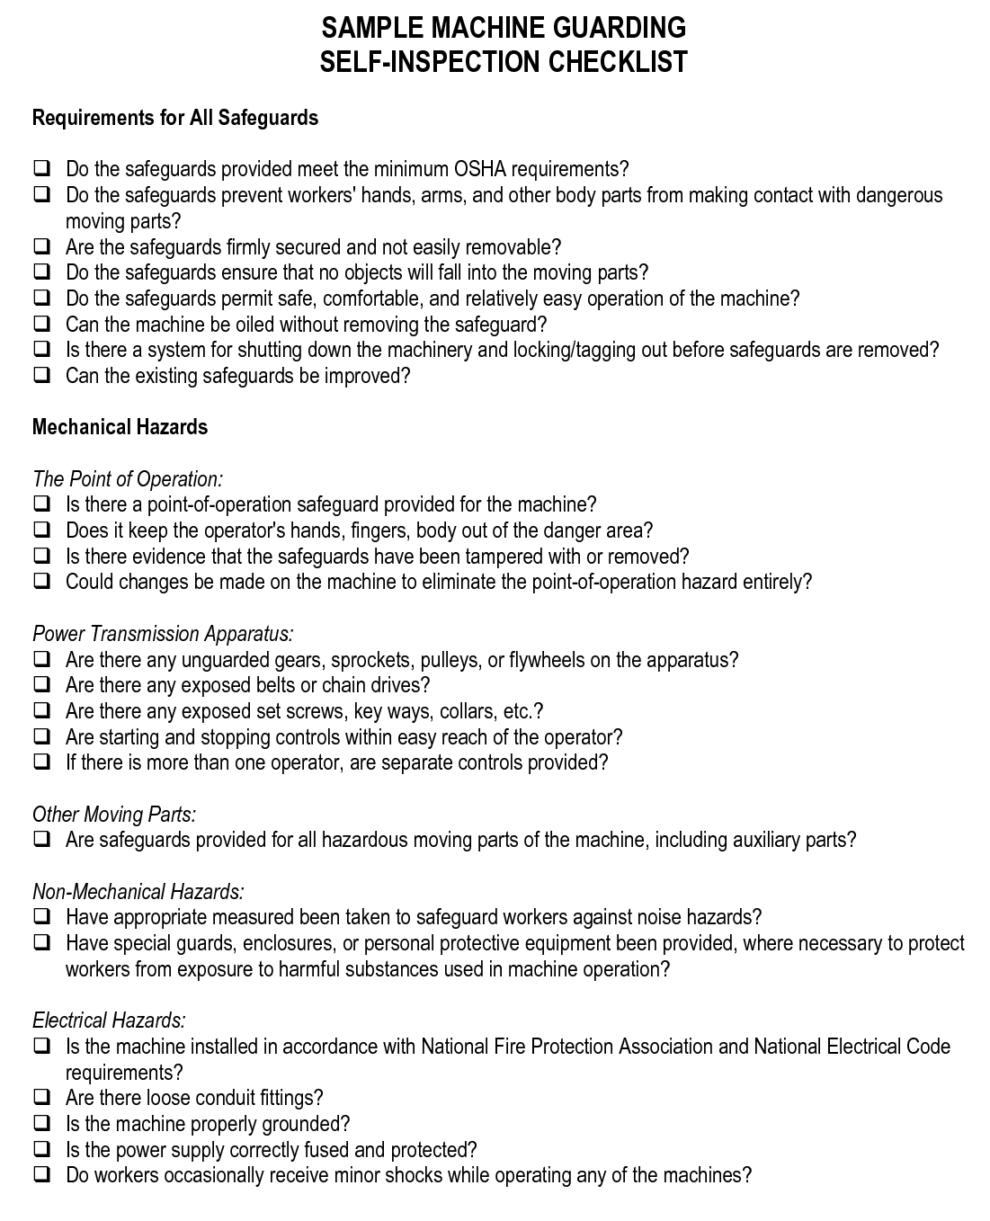
Safety Inspection Checklist
PPT-
PPT-072-01
16
17
Notes:
Develop your own unique checklist for various areas within your facility. Do NOT have tunnel vision, however, when you use the checklist. Look at those conditions which are not on the checklist. Add to future checklists.
Check the manufacturer’s “turn-over package” to determine frequency of inspections for various operating periods.

Slide 17
Brainstorming
Advantages
Useful starting point for many HAZID techniques to focus a group’s ideas, especially at the concept phase
Facilitates active participation and input
Allows employees experience to surface
Enables “thinking outside the box”
Very useful at early stages hazard identification
Disadvantages
Less rigorous and systematic than other techniques
High risk of missing hazards unless combined with other tools
Relies on experience and competency of facilitator
PPT-072-01
17
Notes:
Brainstorming
Advantages
Useful starting point for many HAZID techniques to focus a group’s ideas, especially at the concept phase
Facilitates active participation and input
Allows employees experience to surface
Enables “thinking outside the box”
Very useful at early stages hazard identification
Disadvantages
Less rigorous and systematic than other techniques
High risk of missing hazards unless combined with other tools
Relies on experience and competency of facilitator

Slide 18
What If Analysis
Advantages
Useful for an early method of identifying hazards
It can be used for almost every type of analysis situation
Disadvantages
Checklists are used extensively which can provide tunnel vision, running the risk of overlooking possible causal factors
PPT-072-01
18
Notes:
The “What If” method.
Through developed questions and answers, the effects of component failures or process errors are evaluated.
Shutdown logics and restart methods are determined.

Slide 19
Hazard & Operability Study (HAZOP)
Advantages
Will identify hazards, and events leading to an accident or other undesired event
Systematic and rigorous process
The systematic approach goes some way to ensuring all hazards are considered
Disadvantages
Requires significant resource commitment
HAZOPs are time consuming
The HAZOP process is quite monotonous and maintaining participant interest can be a challenge
PPT-072-01
19
Notes:
The Hazard and Operability Study, also called HAZOP,
Makes a determination of deviation from their design basis.
Diagrams of the facility’s piping, electrical system and instrumentation can be used.

Slide 20
Job Safety Analysis
Advantages
Provides first hand job related information
Helps to create job-employee fit
Helps in analysing training needs
Disadvantages
Time consuming
Mental abilities cannot be directly observed
Does not always address process deviations
PPT-072-01
20
Notes:
Job Safety Analysis
Advantages
Provides first hand job related information
Helps to create job-employee fit
Helps in analysing training needs
Disadvantages
Time consuming
Mental abilities cannot be directly observed
Does not always address process deviations

Slide 21
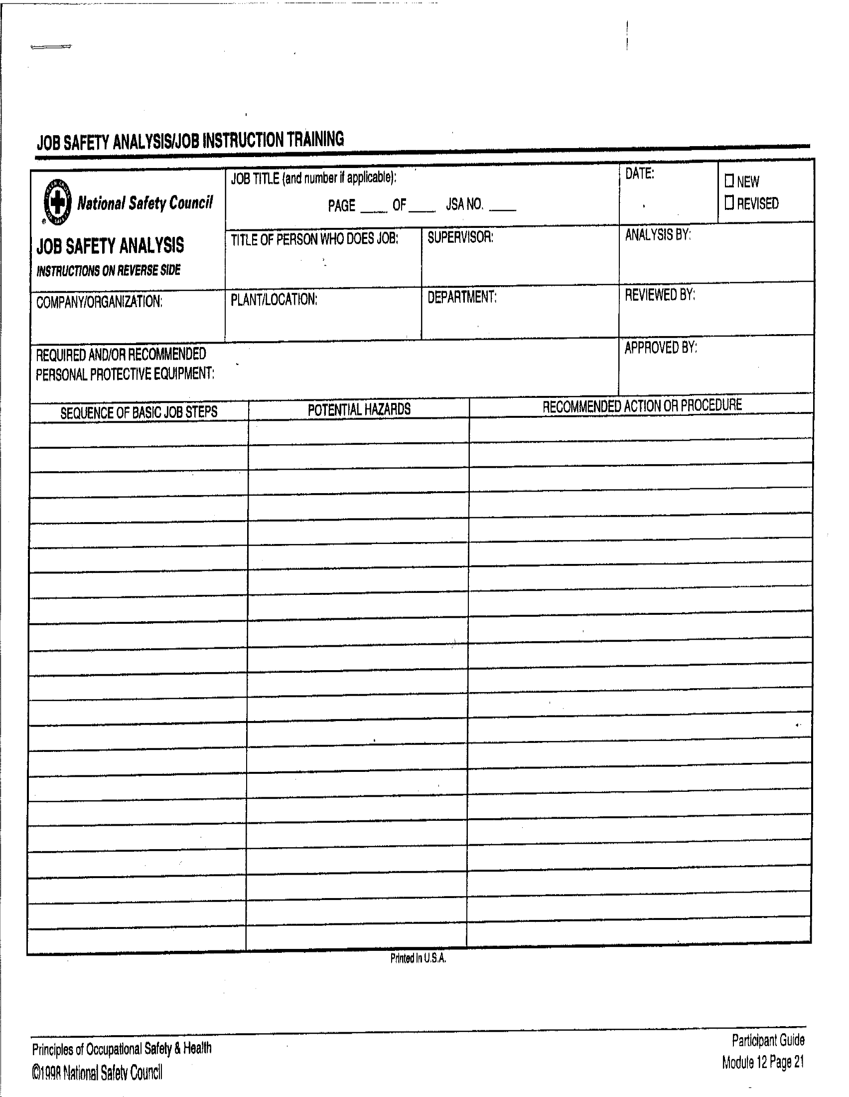
Job Safety Analysis
PPT-072-01
21
Notes:
The National Safety Council has a formatted method to perform this function.
Create your own or “buy-in” to another agency’s method.

Slide 22
Fault Tree Analysis
Advantages
Quantitative - defines probabilities to each event which can be used to calculate the probability of the top event
Easy to read and understand
Disadvantages
Need to have identified the top event first
More difficult than other techniques to document
Complex and time consuming
Quantitative data needed to perform properly
PPT-072-01
22
Notes:
The Fault Tree Analysis includes all segments which may cause, contribute to or be effected by an incident.
Advantages
Quantitative - defines probabilities to each event which can be used to calculate the probability of the top event.
Easy to read and understand.
Disadvantages
Need to have identified the top event first.
More difficult than other techniques to document.
Complex and time consuming.
Quantitative data needed to perform properly.

Slide 23
Fault Tree Analysis
Fail To Get To Work On Time
Collision:
Major
Damage
to Bike
Collision:
Minor
Damage
to Bike
Bike
Stolen
Flat Tire
Cyclist
Cannot
Avoid Car
Ride
Bike To
Work
Driver
Hits Cyclist
With Door
Driver cuts
Off Cyclist
Potential
Calamity
PPT-072-01
23
Notes:
The Fault Tree Analysis views potential event sequences which may result in an incident.
Diagram looks like a tree.
Each branch lists sequence of events (failures) for different paths to the end event.
Probabilities assigned to each event then used to determine the statistical probability to the end event which is posed.
An appropriate equivalent methodology may also be adopted for use.

Slide 24
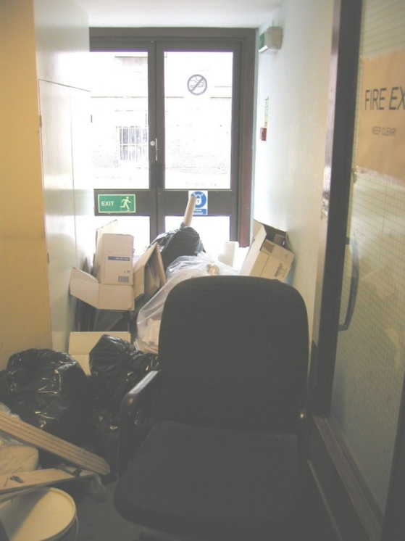
Purpose of Safety Inspections
Identify potential hazards so they are corrected before an injury occurs
Implement or improve safety programs
Increase safety awareness
Display concern for workers’ safety
Communicate safety standards of performance
PPT-072-01
24
Notes:
The purpose of safety inspections:
Identify potential hazards so they are corrected before an injury occurs
Implement or improve safety programs
Increase safety awareness
Display concern for workers’ safety
Communicate safety standards of performance

Slide 25
Hazard Inspections
Individual(s) conducting the inspection:
Experienced with the facility & operation
Knowledgeable of relevant regulations, codes & company policies
Competent regarding the inspection steps
Capable of collecting, evaluating & reporting the data
PPT-072-01
25
Notes:
The person conducting the hazard inspections should
Be thoroughly-versed in the facility’s operation
Knowledgeable of relevant regulations, codes & company policies
Competent regarding the inspection steps
Capable of collecting, evaluating & reporting the data
A dedicated person can be educated and trained to successfully assume this task.

Slide 26
Hazard Inspections
Individual(s) conducting the inspection:
Must be equipped with the proper PPE
Knowledgeable on how to locate safety & health hazards
Should have the authority to act and make recommendations
PPT-072-01
26
Notes:
The person conducting the inspection,
Must have the requisite PPE to safely perform the job
They must be knowledgeable on how to locate safety and health hazards
They should have the authority, given by management, to act and make recommendations.
If unsafe conditions are revealed, this person should also have the authority to shutdown an operation and notify management. Consider giving this authority to all personnel, re: operation shutdowns which are unsafe.

Slide 27
Hazard Inspection Guidelines
Decide what to inspect
Prepare an inspection sequence
Use a checklist
Ask employees in area for input
Record observations – location & nature of hazards
Document the inspection participants
PPT-072-01
27
Notes:
Hazard inspection guidelines will be determined prior to conducting field inspections.
Decide what to inspect (as well as what will NOT be inspected, i.e. those aspects outside the scope of the safety inspection).
Prepare an inspection sequence
Use a checklist
Ask employees in area for input
Record observations – location & nature of hazards
Document the inspection participants

Slide 28
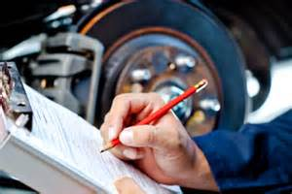
Safety Inspections Steps
Research
Organize
Analyze
Record
Follow Up
PPT-072-01
28
Notes:
Steps in a Safety Inspection are generally:
Research of the area and/or operation to be viewed.
Organize the documents and PPE which will be required
Analyze findings of the inspection
Record the findings and recommendations
Follow-up with reporting-out the final report to proper committees

Slide 29
Safety Inspections
Research
Identify incident potential through research
Look at workplace layout
Look at all operations
Consider standards, policies and procedures
Analyze past losses and trends
Understand the safety concerns of employees
PPT-072-01
29
Notes:
Research. Identify incident potential through research
Look at workplace layout
Look at all operations
Consider standards, policies and procedures
Analyze past losses and trends
Understand the safety concerns of employees

Slide 30
What to Look for
High Hazard Areas: Equipment and operations
that involve energy transfer including: chemical, mechanical, pneumatic, physical, electrical, gravitational, etc. (Unsafe Conditions)
Procedures and behaviors, including: Use of protective equipment, safe operating speeds, following proper procedures, horseplay,
inattentive behavior, etc. (Unsafe Acts)
PPT-072-01
30
Notes:
Look at the following:
High Hazard Areas: Equipment and operations that involve energy transfer including: chemical, mechanical, pneumatic, physical, electrical, gravitational, etc. (Unsafe Conditions)
Procedures and behaviors, including: Use of protective equipment, safe operating speeds, following proper procedures, horseplay, inattentive behavior, etc. (Unsafe Acts)

Slide 31
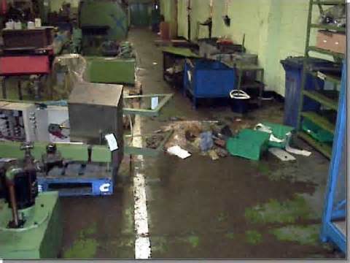
Hazards
Person affected by:
Inhalation (breathing)
Contact with person
Ingestion (eating)
PPT-072-01
31
Notes:
Hazards. Person(s) affected by
Inhalation (breathing)
Contact with person
Ingestion (eating)

Slide 32
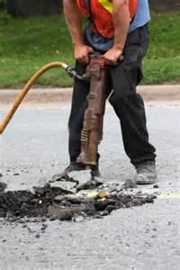
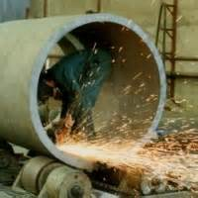
Hazards
Physical Hazards
Noise
▫ Loudness and Pitch
Radiation
Temperature
Pressures
Vibration
PPT-072-01
32
Notes:
Physical Hazards
Noise: Loudness and Pitch
Radiation
Temperature
Pressures
Vibration

Slide 33
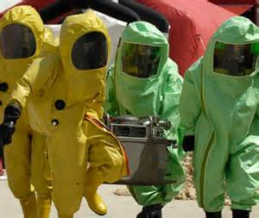
Hazards
Biological Hazards
Associated with living organisms
Bacteria
Viruses
Dust Mites
Pollens
Molds & other fungus
PPT-072-01
33
Notes:
Biological Hazards. Associated with living organisms
Bacteria
Viruses
Dust Mites
Pollens
Molds & other fungus

Slide 34
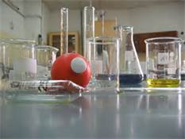
Hazards
Chemical Hazards
Gases
Vapors
Fumes
Mists
Solids
Liquids
PPT-072-01
34
Notes:
Chemical Hazards. Also view the main characteristics of materials; flammable, toxic, etc.
Gases
Vapors
Fumes
Mists
Solids
Liquids

Slide 35
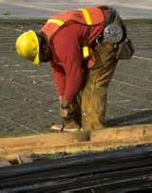
Hazards
Ergonomic Hazards
(Making the task or job fit the human)
Eliminate or Reduce:
Unnatural posture
Extreme force
Repetition
Frequency
PPT-072-01
35
Notes:
Ergonomic Hazards. Making the task or job fit the human
Eliminate or Reduce:
Unnatural posture
Extreme force
Repetition
Frequency

Slide 36
Safety Inspections
Organize
Inspection objective and procedure
Use a checklist for a guide
List potential hazards
Locate hazards in the work area
Check your list with employees
Update your list with new items
PPT-072-01
36
Notes:
Safety Inspection Steps
Organize
Inspection objective and procedure
Use a checklist for a guide
List potential hazards
Locate hazards in the work area
Check your list with employees
Update your list with new items

Slide 37
Safety Inspections
Organize
Equipment and tools
Work environment
Work practices and procedures
Employees
Behaviors (at risk or unsafe)
System/equipment
Process/procedure
Safety training
Personal/stress
PPT-072-01
37
Notes:
Organize:
Equipment and tools
Work environment
Work practices and procedures
Employees
Behaviors (at risk or unsafe)
System/equipment
Process/procedure
Safety training
Personal/stress

Slide 38
Safety Inspections
Analyze
Address systems not just symptoms
Determine if there are any system failures
Look for causes or potentials for injury
Job Hazard Analysis
PPT-072-01
38
Notes:
Analyze
Address systems not just symptoms
Determine if there are any system failures
Look for causes or potentials for injury
Job Hazard Analysis

Slide 39
Risk Assessment
1
Death or Serious Injury
Most Accident
Investigations Conducted
29
Minor Injury
Few Investigations
Conducted
300
Biggest percentage of injury causing potential!
Near Miss
3,000
Unsafe Acts, Behaviors or Conditions
PPT-
PPT-072-01
39
18
Notes:
Heinrich’s Pyramid indicates:
Out of 3,330 actual or potential situations:
3,000 were unsafe acts, behaviors or conditions. No accidents results but could have. Least likely to be investigated or causes determined through analysis
300 near miss situations. Again “almost” but no actuality of an incident. Again, least likely to be investigated.
29 conditions resulted in minor injury and were therefore investigated for cause determination.
1 fatality or serious injury resulted in cause investigation and remedial actions.
Findings showed that we are not proactive enough but reactive to resulting incidents.

Slide 40
Risk Assessment
Take time to ask yourself simple risk
assessment questions.
If the risk is too great; STOP! Control the risk! Prevent the incident!
• Why am I doing this? • What could go wrong? • How likely is it to happen? • How could it affect me or others? • What should I do about it?
PPT-072-01
40
Notes:
Risk Assessment. Take time to ask yourself simple risk assessment questions.
If the risk is too great; STOP! Control the risk! Prevent the incident!
• Why am I doing this? • What could go wrong? • How likely is it to happen? • How could it affect me or others? • What should I do about it?

Slide 41
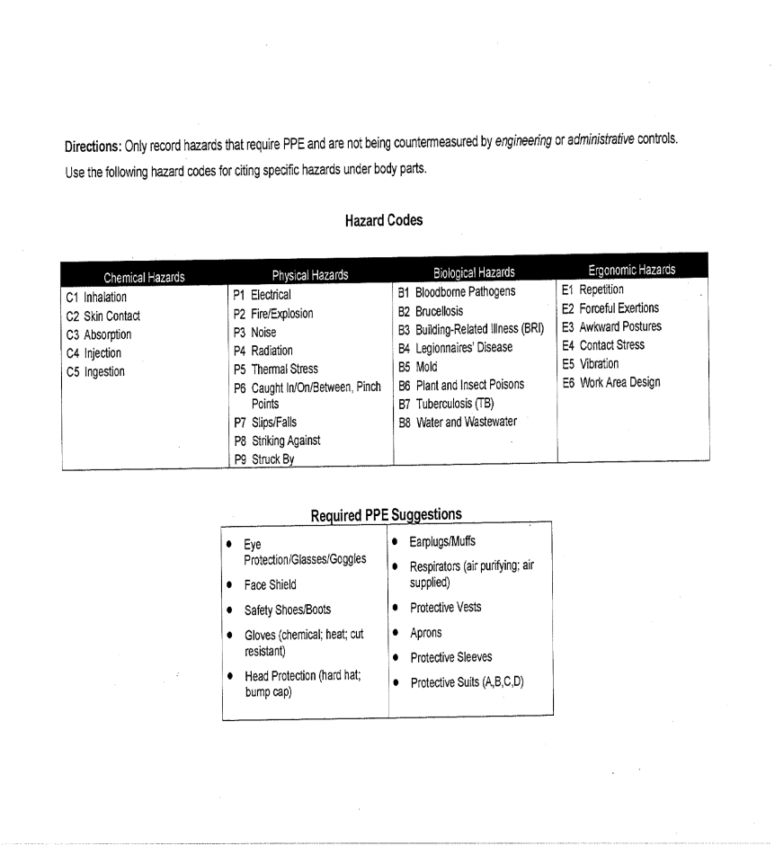
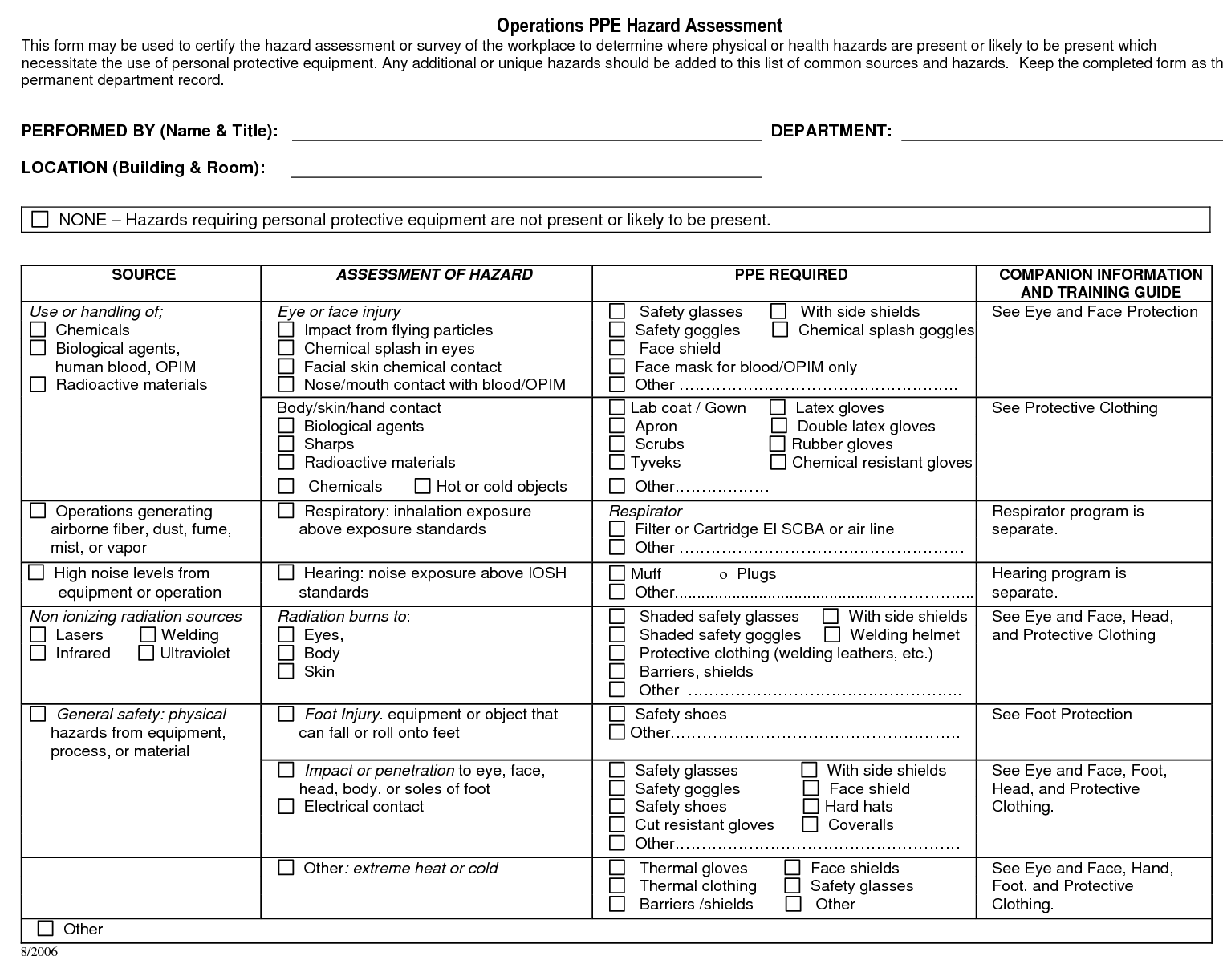
Hazard Assessment
Employers must assess the workplace to determine if hazards are present or likely to be present.
PPT-072-01
41
Notes:
Hazard assessment requires we view the workplace to determine if hazards exist or are likely to be present.
Once found or determined, remedial actions (policies) will be required.

Slide 42
Safety Inspections
Record
Observations
- Do not include names
Causes/potentials
Solutions
Distribute and post
Add to your minutes
PPT-072-01
42
Notes:
Record
Observations - Do not include names
Causes/potentials
Solutions
Distribute and post
Add to your minutes

Slide 43
Hazard Control Log
Location:
Posted in the workplace, accessible to ALL employees
Purpose:
For employees to “report” unsafe conditions
PPT-072-01
43
Notes:
The Hazard Control Log should contain:
Location: Posted in the workplace, accessible to ALL employees
Purpose: For employees to “report” unsafe conditions

Slide 44
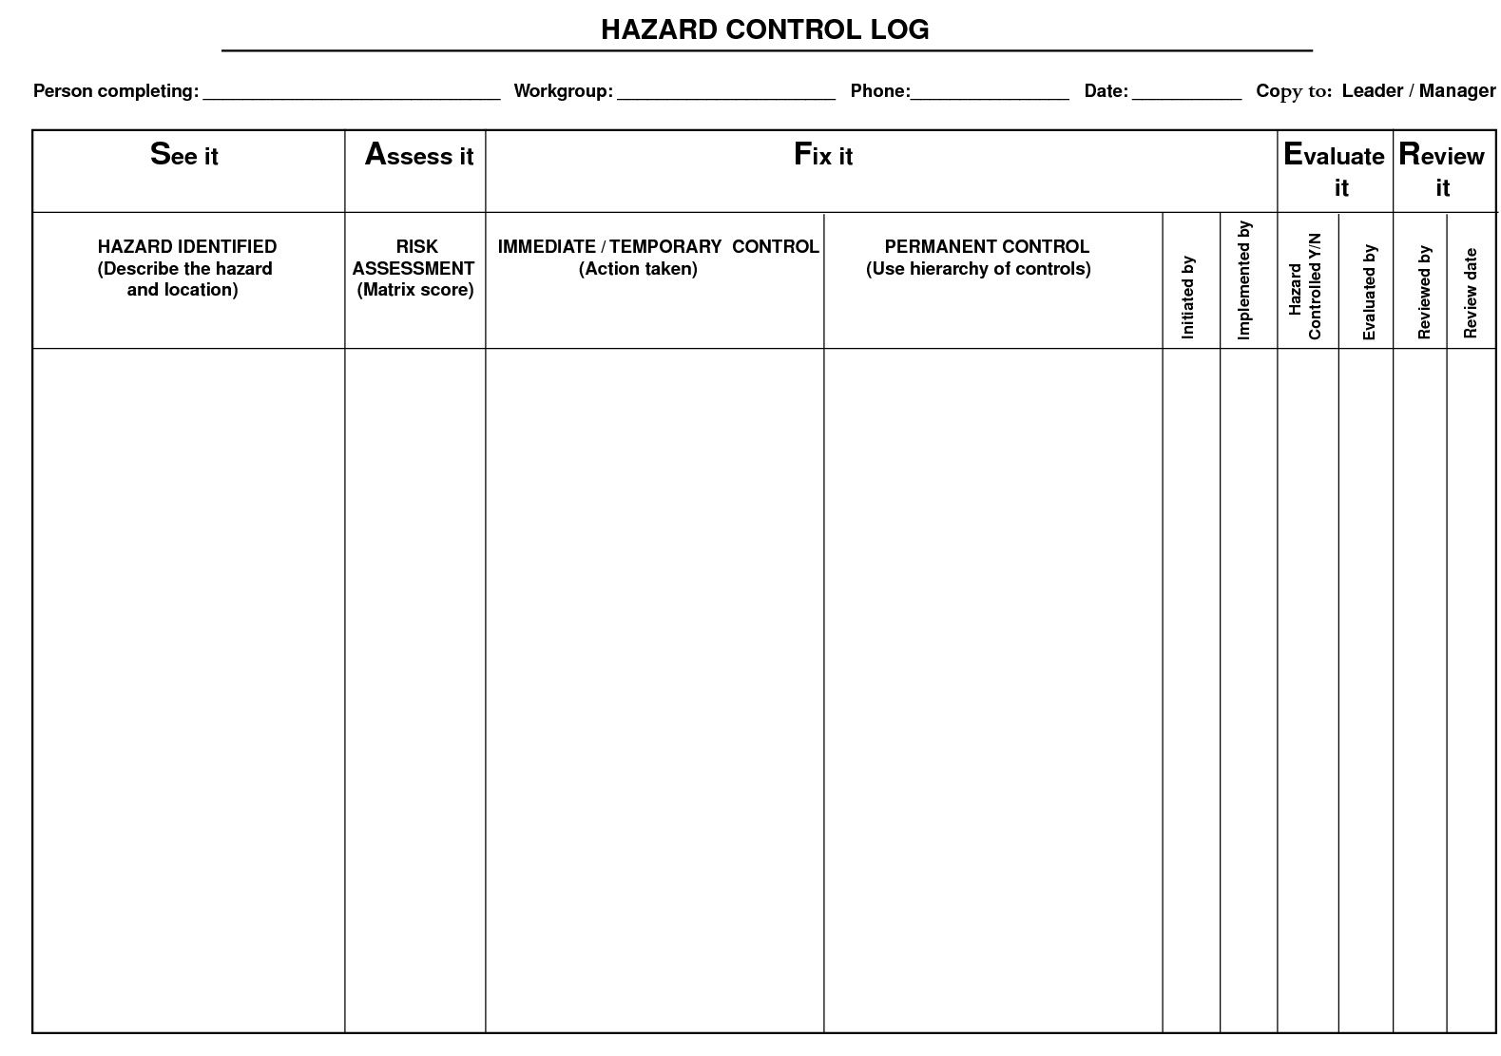
Hazard Control Log
PPT-072-01
44
Notes:
This slide shows a Hazard Control Log:
Identification
Assessment
Controls:
Immediate
Permanent
Evaluation
Review

Slide 45
Risk Priority List
Highest Risk
By ranking the hazards, we address them on a “worst-first” basis
Safety dedicated resources are always limited and should be directed at the highest risk
Lowest Risk
Warranting action
PPT-072-01
45
Notes:
You’ll need to prioritize your findings which warrant action from Highest Risk to Lowest Risk.
Rank the hazards, address them on a “worst-first” basis.
Safety dedicated resources are always limited and should be directed at the highest risk.

Slide 46
Safety Inspections
Follow Up
Develop practical effective solutions
Hierarchy of controls
Develop an action plan
Determine immediacy of solution
Implement
Act on solutions and follow up to ensure effectiveness
PPT-072-01
46
Notes:
Always Follow Up on your inspections. The information developed is vital to the safety of employees and the agency.
Develop practical effective solutions
Hierarchy of controls
Develop an action plan
Determine immediacy of solution
Implement
Act on solutions and follow up to ensure effectiveness

Slide 47
How to Document the Inspection
In Writing, In Writing, In Writing!
Email……
Checklists……….
Memorandums……….
Written inspection reports………..
Safety Inspections
PPT-
PPT-072-01
47
16
Notes:
Document the inspection. If it is not written down; it does not exist!!
You can forward the results via:
Email
Checklists
Memorandums
Written inspection reports.

Slide 48
Hazard Inspection Reports
PPT-072-01
48
Notes:
Hazard Inspect Reports can look like this slide, containing:
Item or location
Hazard Observed
Whether it is a repeat finding
What priority is it toward correcting
Recommended Action
Future Follow-up
Responsible person assigned
Action(s) taken
Date Action(s) were taken

Slide 49
Hierarchy of Control
Elimination
Substitution
Engineering Controls
Administrative Controls
Personal Protective Equipment (PPE)
PPT-072-01
49
Notes:
The Hierarchy of Control allows you to remove the hazard(s) via
Elimination
Substitution (This is often done by substituting a different chemical in a process less hazardous that the one it’s replacing.)
Engineering Controls
Administrative Controls
PPE

Slide 50
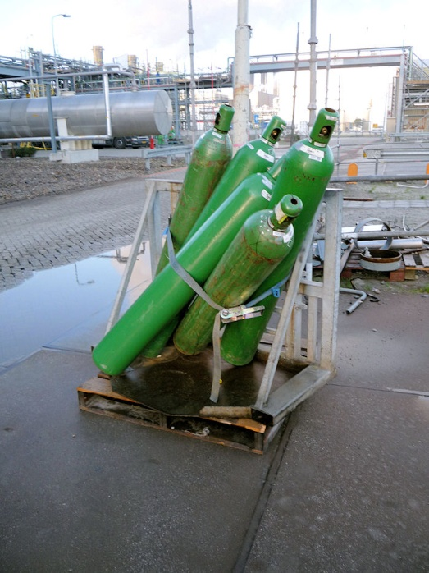
Elimination
The best method of dealing with a hazard is to eliminate it. Once the hazard has been eliminated the potential for harm has gone
Are there any problems with this situation?
Cylinders are stored in an unsafe position; not secured properly; pallet damaged/burned
Yes
PPT-072-01
50
Notes:
Elimination
The best method of dealing with a hazard is to eliminate it. Once the hazard has been eliminated the potential for harm has gone.

Slide 51
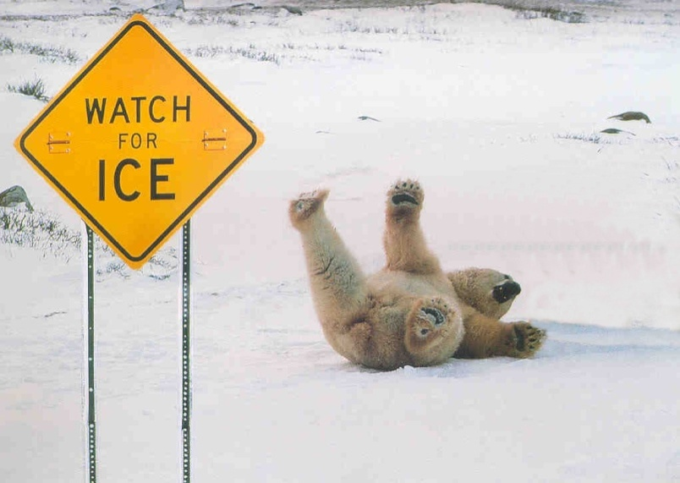
Substitution
This involves substituting a dangerous process or substance with one that is not as dangerous. This may not be as satisfactory as elimination since there may still be a risk (even if it is reduced).
PPT-072-01
51
Notes:
Substitution
This involves substituting a dangerous process or substance with one that is not as dangerous.
This may not be as satisfactory as elimination since there may still be a risk (even if it is reduced).

Slide 52
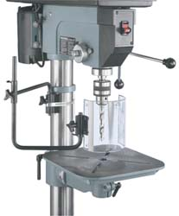
Engineering Controls
Guarding
Enclosures
Substitution
Process Modification
Equipment Modification
Ventilation
Lighting
Engineering controls eliminate the “human factor” in preventing injuries.
PPT-072-01
52
Notes:
Engineering Controls
Guarding
Enclosures
Substitution
Process Modification
Equipment Modification
Ventilation
Lighting
Engineering controls eliminate the “human factor” in preventing injuries.

Slide 53
Administrative
Administrative solutions usually involve modification.
This can be done by:
Reducing the number of people exposed to the danger and
Reducing the amount of time exposed and
Providing training to those people who are exposed to the hazard
PPT-072-01
53
Notes:
Administrative Controls
Administrative solutions usually involve modification. This can be done by:
Reducing the number of people exposed to the danger and
Reducing the amount of time exposed and
Providing training to those people who are exposed to the hazard

Slide 54
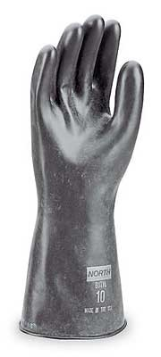
PPE
Provision of PPE should only be considered when all other control methods are impractical.
Eye (example: safety glasses)
Face (example: face shield)
Head (example: hard hat)
Ear (example: ear plugs)
Hand (example: rubber gloves)
Foot (example: safety shoes)
Body (example: rubber apron)
Respiratory (example: respirator)
PPT-072-01
54
Notes:
PPE
Provision of PPE should only be considered when all other control methods are impractical.
Eye (example: safety glasses)
Face (example: face shield)
Head (example: hard hat)
Ear (example: ear plugs)
Hand (example: rubber gloves)
Foot (example: safety shoes)
Body (example: rubber apron)
Respiratory (example: respirator)

Slide 55
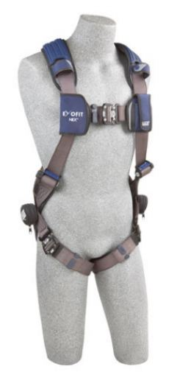
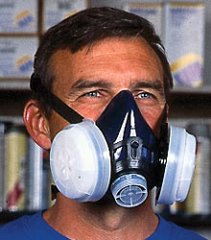
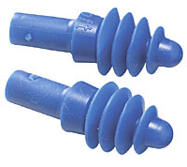
Hazard Control
What might be some drawbacks of reliance solely on PPE to protect workers?
Hazard not eliminated; may not be proper type for hazard; may not fit or be maintained properly; subject to failure
PPT-072-01
55
Notes:
Hazard Control
What might be some drawbacks of reliance solely on PPE to protection Workers?
The hazard is not eliminated; may not be proper type of PPE for hazard; may not fit or be maintained properly; subject to failure.

Slide 56
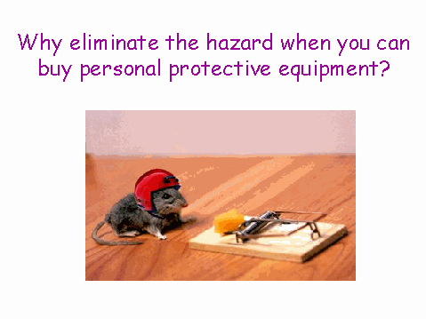
PPE
PPT-072-01
56
Notes:
Why eliminate the hazard when you can buy personal protective equipment?
Because the hazard is still there and safety is subject to all intervening PPE and other variables to hopefully ensure safety.

Slide 57
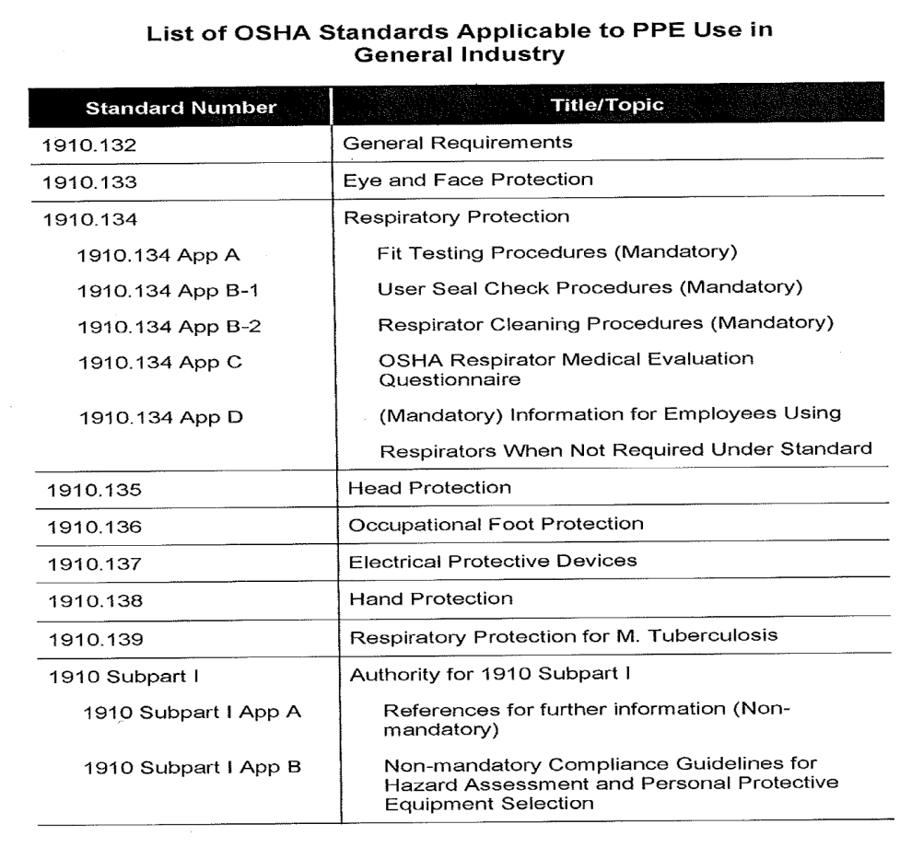
OSHA & PPE
PPT-072-01
57
Notes:
When determining the proper PPE, a list such as thing, “OSHA Standards Applicable to PPE Use in General Industry,” should be viewed.

Slide 58
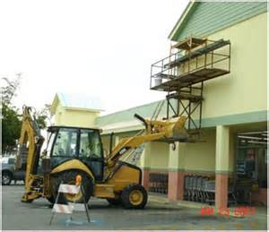
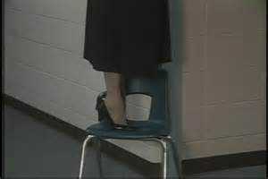
Hazards
To Fix Them, First You Have to Find Them:
PPT-072-01
58
Notes:
To fix hazards, you first have to find the hazards.
Picture on the left: It’s obvious that anyone who decides to work on this makeshift scaffolding held up by the backhoe runs the risk of becoming injured due to a fall. This is a very unsafe situation and should be corrected immediately!
Picture on the right: A chair should not be used as a ladder or step stool – especially given the fact that the person involved is wearing shoes with high heels!

Slide 59
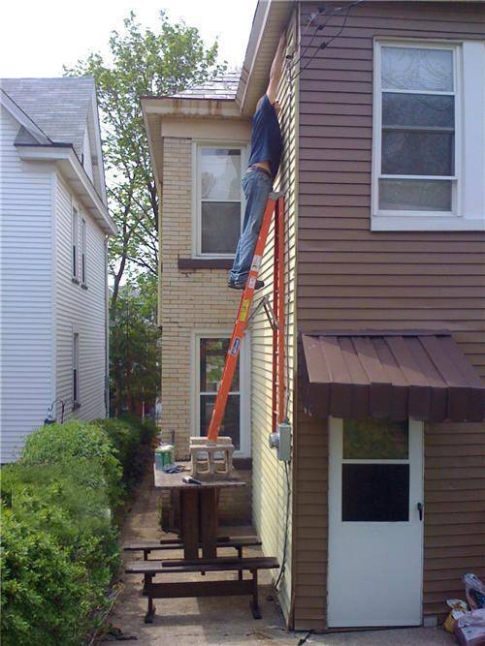
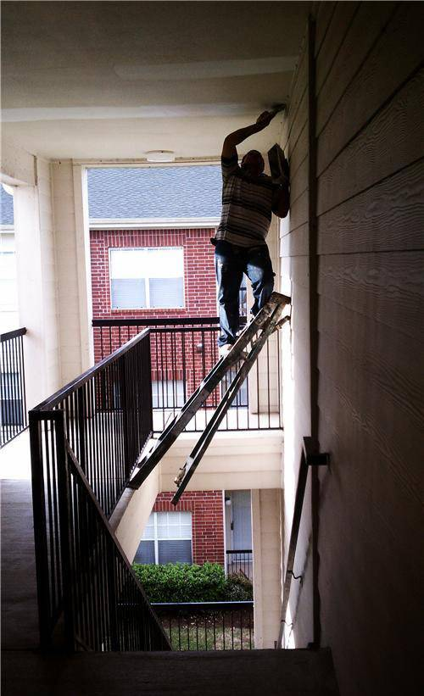
Hazards?
PPT-072-01
59
Notes:
Both pictures show unsafe ladder usage! Both pictures show situations where the individuals involved can be seriously hurt.

Slide 60
Hazards?
PPT-072-01
60
Notes:
This picture shows several issues:
An exit (some would call this a “fire exit”) is blocked obstructed by materials thereby making exit during an emergency extremely difficult
Access to the fire extinguisher is blocked/obstructed
Storage on the top shelf of the storage rack is in a precarious position and could fall on someone if it is moved slightly or bumped.

Slide 61
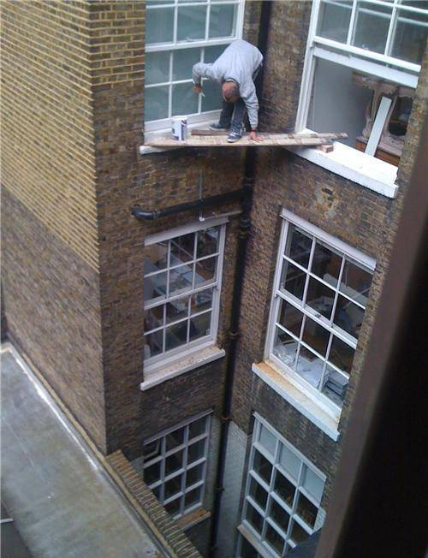
Hazards?
PPT-072-01
61
Notes:
The hazards here are very obvious – this individual is putting his life on the line working in the manner he’s chosen. Unfortunately, on the job injuries and death are many times the result of poor choices on someone’s part.

Slide 62
Hazards?
PPT-072-01
62
Notes:
In this picture there are two unsecured compressed gas cylinders. Both of these cylinders are within the “three foot boundary” around the electrical cabinet that OSHA requires.

Slide 63
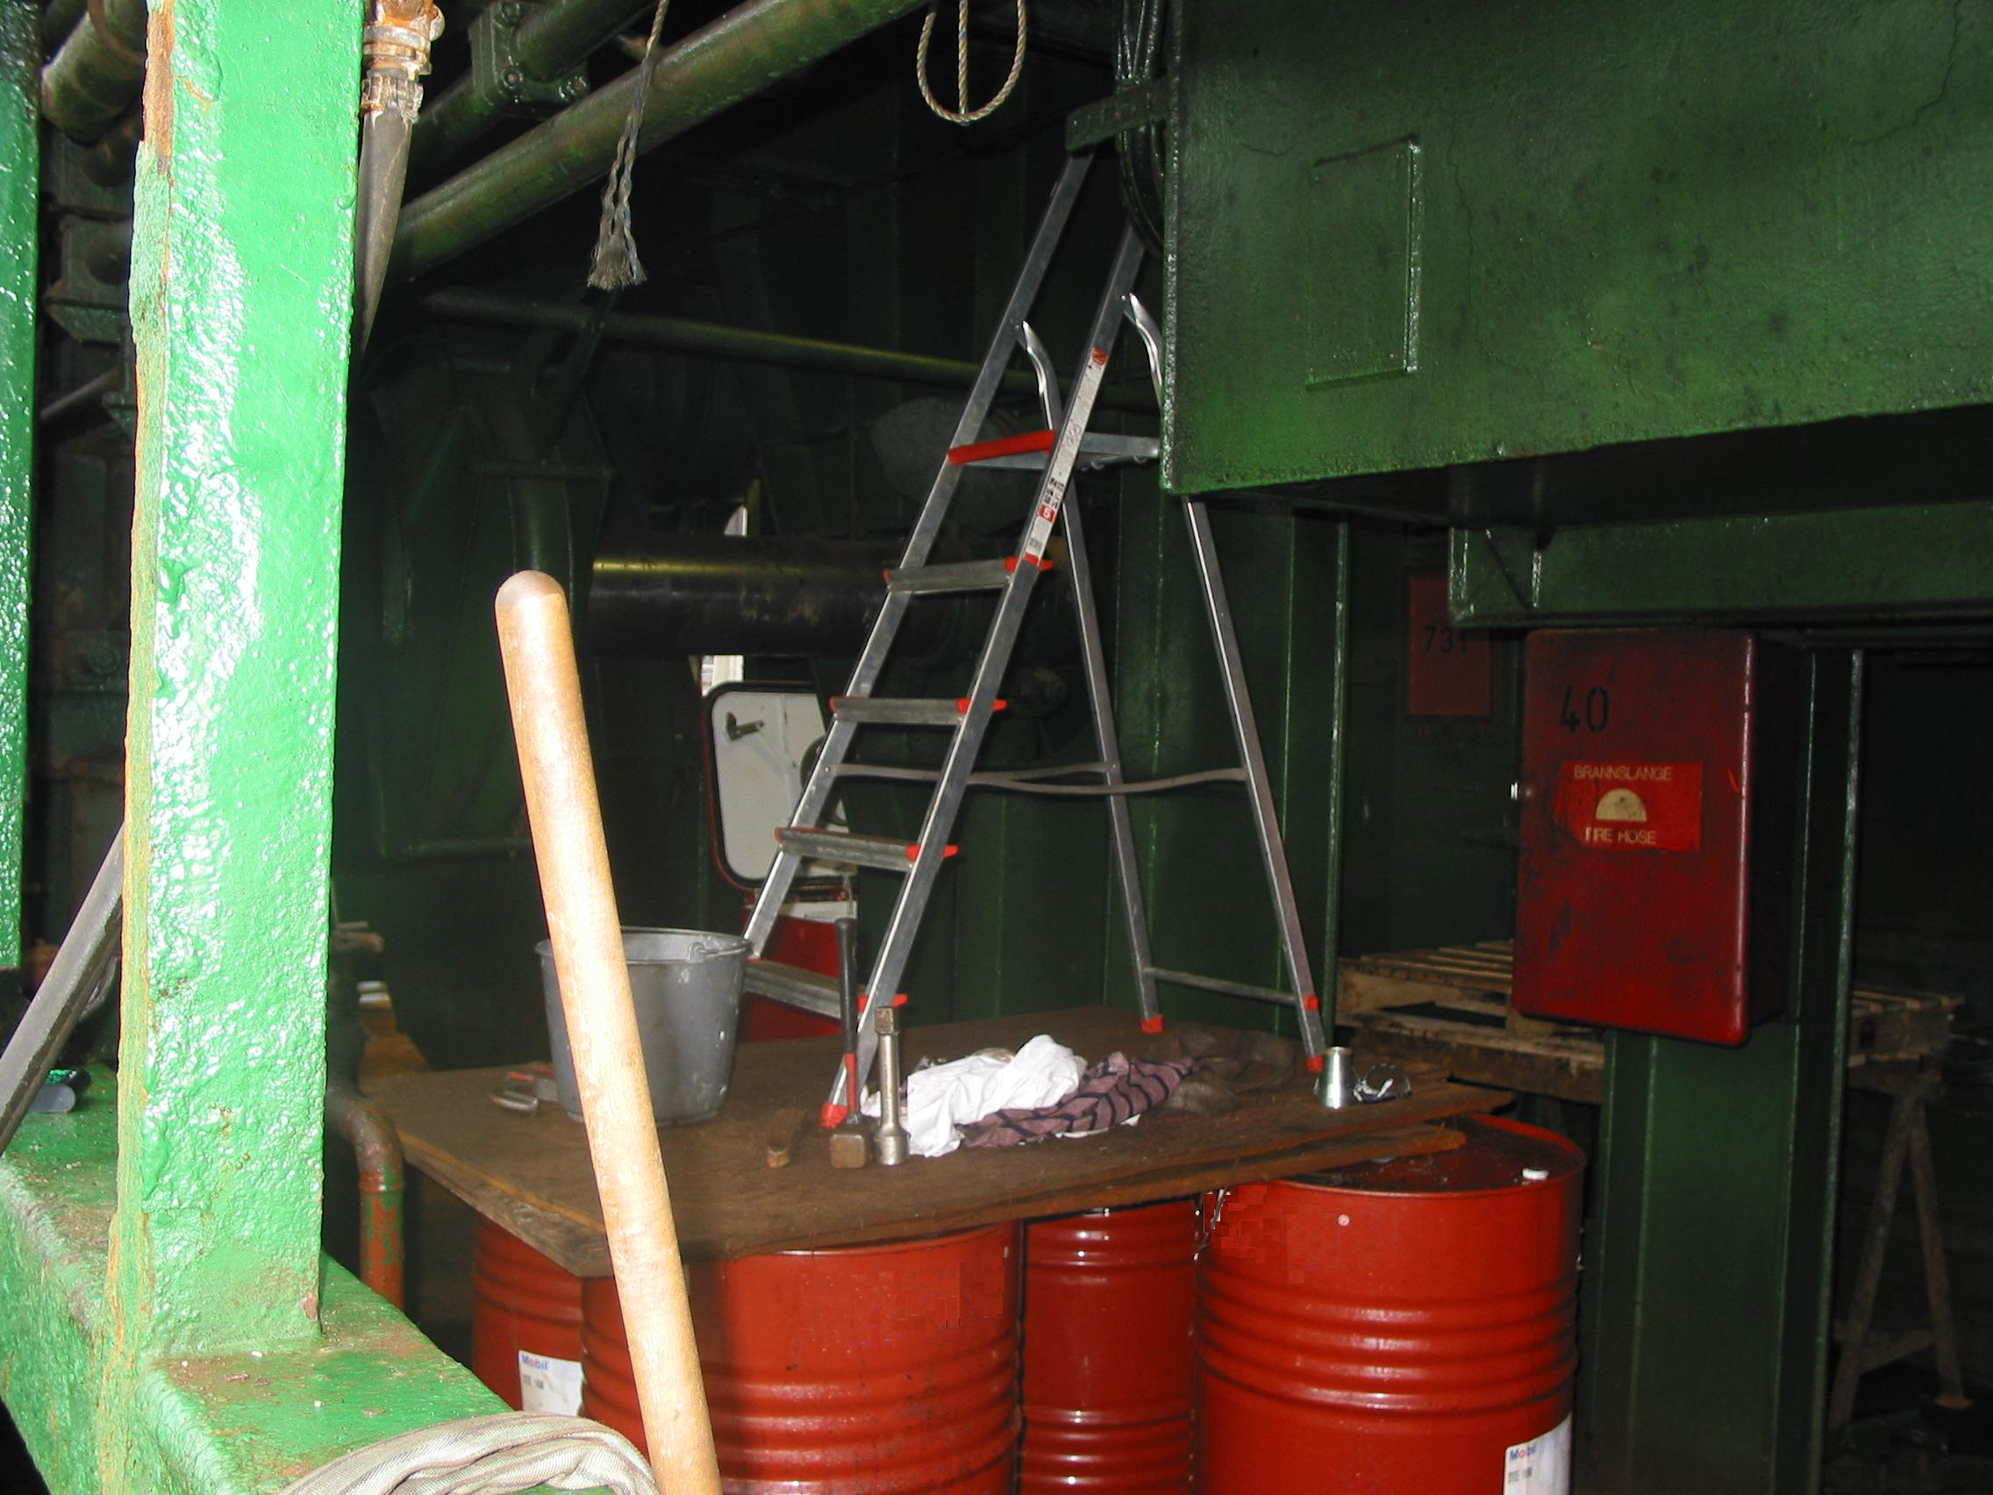
Hazards?
PPT-072-01
63
Notes:
Here’s another example of unsafe ladder usage. This could contribute to another fall injury! In addition, if the caps on the drums/barrels are not on tightly and they fall over due to a person falling there could now be a lead of a possible hazardous substance.

Slide 64
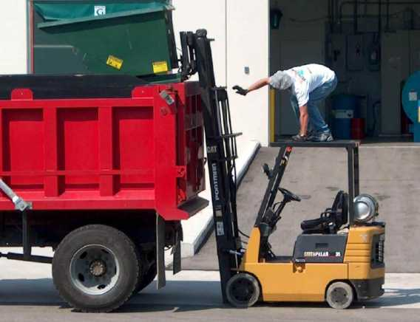
Hazards?
PPT-072-01
64
Notes:
This picture shows yet another example of how a worker’s choice can lead to their being injured. This individual was most likely given training in the safe use and operation of a forklift and may just understand why this is not a good idea, however he may be taking a shortcut to get his job completed. Shortcuts can and do lead to injuries.

Slide 65
Hazards
A hazard left uncorrected is an accident postponed
A hazard corrected is an accident prevented
PPT-072-01
65

Slide 66
Standards to Reference
OSHA
- Federal Regulations (29 CFR 1910)
Available at www.osha.gov
PA Department of Labor & Industry
– www.dli.state.pa.us
PA Department of Environmental Protection
– www.depweb.state.pa.us/portal/server.pt
Other technical standards
(NFPA, ANSI, ASTM, ASME, etc.) – get help if necessary!
PPT-
PPT-072-01
21
66
Notes:
Explore the applicability of the standards shown on this slide toward your own agency.
Even if you don’t fall under OSHA requirements, you can still adopt their standards as “Best Practices.”

Slide 67
Contact Information
Health & Safety Training Specialists
1171 South Cameron Street, Room 324
Harrisburg, PA 17104-2501
(717) 772-1635
RA-LI-BWC-PATHS@pa.gov
Like us on Facebook! - https://www.facebook.com/BWCPATHS
PPT-
PPT-072-01
21
67

Slide 68
Questions
?????
Questions
&
Answers
PPT-072-01
68

