Slide 1
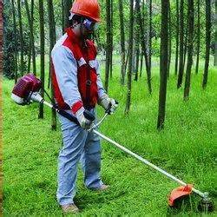
Hand & Power Tools
Bureau of Workers’ Compensation
PA Training for Health & Safety (PATHS)
Notes:
Every year, people are injured or die due to the misuse of both hand- or power-tools. The type of injury is based on the tools being used which are season-dependent. For example, we wouldn’t expect a snow blower injury in June on the East Coast.

Slide 2
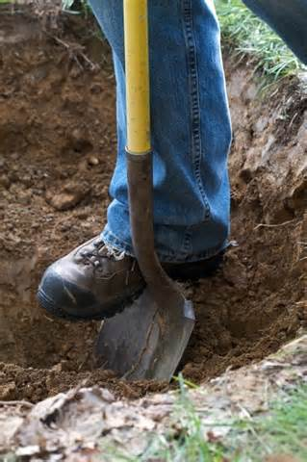
Landscaping Related Activities
Hand digging, shoveling, raking and grading
Maintaining equipment
Building and constructing landscape related structures
Tree felling, trimming and pruning
Grass trimming and leaf blowing
Notes:
Also a seasonal condition would be injuries obtained during landscaping related activities.
Hand digging, shoveling, raking and grading
Maintaining equipment
Building and constructing landscape related structures
Tree felling, trimming and pruning
Grass trimming and leaf blowing

Slide 3
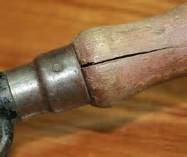
Hazardous Conditions and Unsafe Acts
Broken and defective tools
Missing guards, exposed belts and blades
Bad electrical cords
Misuse of tools
Mushroomed heads
Cracked and split handles
Not using required PPE
Notes:
Most injuries result from either hazardous conditions or unsafe acts with tool use.
Broken and defective tools
Missing guards, exposed belts and blades
Bad electrical cords
Misuse of tools
Mushroomed heads
Cracked and split handles
Not using required PPE

Slide 4
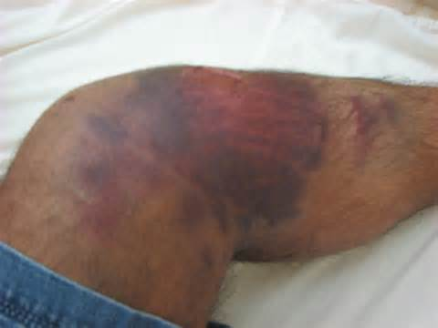
Potential Outcomes
Bruises, sprains and strains
Struck by projectiles
Lacerations and amputations
Entanglement
Eye and face injuries due to flying objects
Shocks and electrocutions
Leading to injury or death
Notes:
The potential outcomes of such unsafe acts or hazardous conditions are:
Bruises, sprains and strains
Struck by projectiles
Lacerations and amputations
Entanglement
Eye and face injuries due to flying objects
Shocks and electrocutions
Leading to injury or death

Slide 5
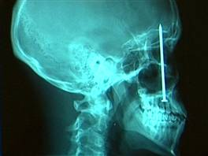
Unsafe Tool Use can be Deadly
Notes:
Misuse of nail guns can and have led to injuries (in some cases deaths), due to a lack of understanding of a specific brand as well as not understanding the safety requirements for use.

Slide 6
General Tool Safety Rules
Maintain regularly
Use the right tool for the job
Inspect before use
Operate according to the manufacturer’s instructions
Use the proper personal protective equipment
Use the guards
Notes:
Select the right tool for the job. Substitutes increase the chance of having an accident. Inspect tools for defects before use. Replace or repair defective tools. Replace cracked, splintered, or broken handles on files, hammers, screwdrivers, or sledges. Maintain tools carefully. Keep them clean and dry, and store them properly after each use. Inspect cords for defects: check the power cord for cracking, fraying, and other signs of wear or faults in the cord insulation. Check for damaged switches and ones with faulty trigger locks. Inspect the plug for cracks and for missing, loose or faulty prongs. Wear safety glasses or goggles and well-fitting gloves appropriate for the hazards to which you may be exposed when doing various tasks.
http://www.ccohs.ca/oshanswers/safety_haz/hand_tools/
http://www.ccohs.ca/oshanswers/safety_haz/power_tools/

Slide 7
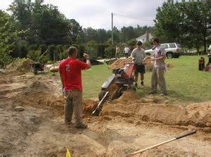
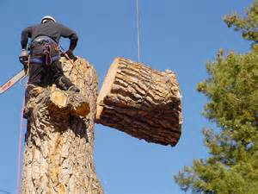
Landscape Construction Tools
Notes:
By viewing the above slides, the potential harm may be evident on-view.
Other potential hazards may require in-depth study of the tool and its use.

Slide 8
Building and Constructing Tools
Often landscapers must build or construct as part of their job.
When doing such work, construction related hand and power tools must be used.
Construction related hand and power tools require special precautions.
Notes:
Building and constructing tools.
Often landscapers must build or construct as part of their job.
When doing such work, construction related hand and power tools must be used.
Construction related hand and power tools require special precautions

Slide 9
Construction Tool Precautions
The right tools should be utilized for the right job.
Keep tools in good working order.
Any tools with frayed cords or without a grounding plug shall be taken out of service.
Do not use tools that you do not know how to operate.
Notes:
Wrenches, hammers, pliers. Pruning saws and tools. Crowbars, screwdrivers. Hand hooks, files, and scrapers. Each of these tools might be in your toolbox, and each one needs to be used safely, for the right job. Read the operator's manual before using the tool and operate the tool according to the manufacturer's instructions. Use only tested and approved tools. If a tool is defective, remove it from service, and tag it clearly "Out of service for repair". Ensure that you have been properly trained to use the tool safely.
http://www.cete.org/Trainer/SfHndTolES.pdf
http://www.ccohs.ca/oshanswers/safety_haz/power_tools/

Slide 10
Construction Tool Precautions
Never remove equipment guards without proper authorization.
Be sure the power tool is off and has stopped rotating before putting it down.
Disconnect tool from power source to change drill bits, blades, etc.
Do not use compressed air for cleaning unless the pressure is reduced to less than 30 psi.
Notes:
Ensure that the power tool has the correct guard, shield or other attachment that the manufacturer recommends. Do not leave a running tool unattended. Do not leave it until it has been turned off, has stopped running completely, and has been unplugged. Disconnect the power supply before making adjustments or changing accessories.
http://www.ccohs.ca/oshanswers/safety_haz/power_tools/saf_elec.html

Slide 11
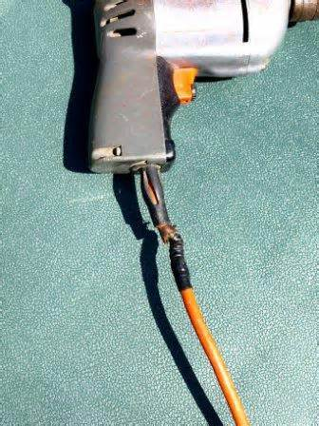
Defective Power Tools
Do Not Use! Take This Out of Service.
Notes:
Inspect cords for defects: check the power cord for cracking, fraying, and other signs of wear or faults in the cord insulation.

Slide 12
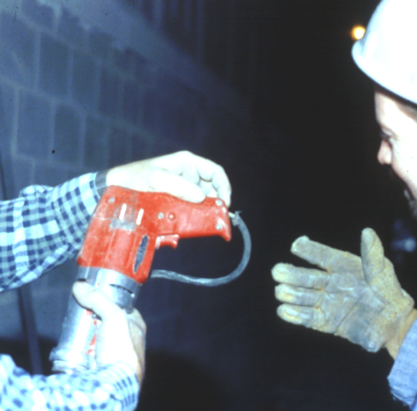
Defective Power Tools
This worker is doing his part by notifying his supervisor of a defective tool.
Notes:
Establish a written program concerning inspection of tools and manner to “red line” their use.
Let workers know that defective tools will not be used.
Promote the safety of the worker over false economic savings by using damaged equipment.

Slide 13
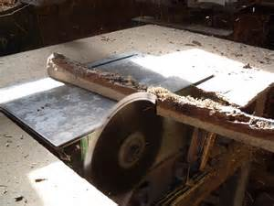
Defective Power Tools
This saw has no blade guard and the belt is exposed.
Unsafe Condition
Notes:
Ensure that the power tool has the correct guard, shield or other attachment that the manufacturer recommends.

Slide 14
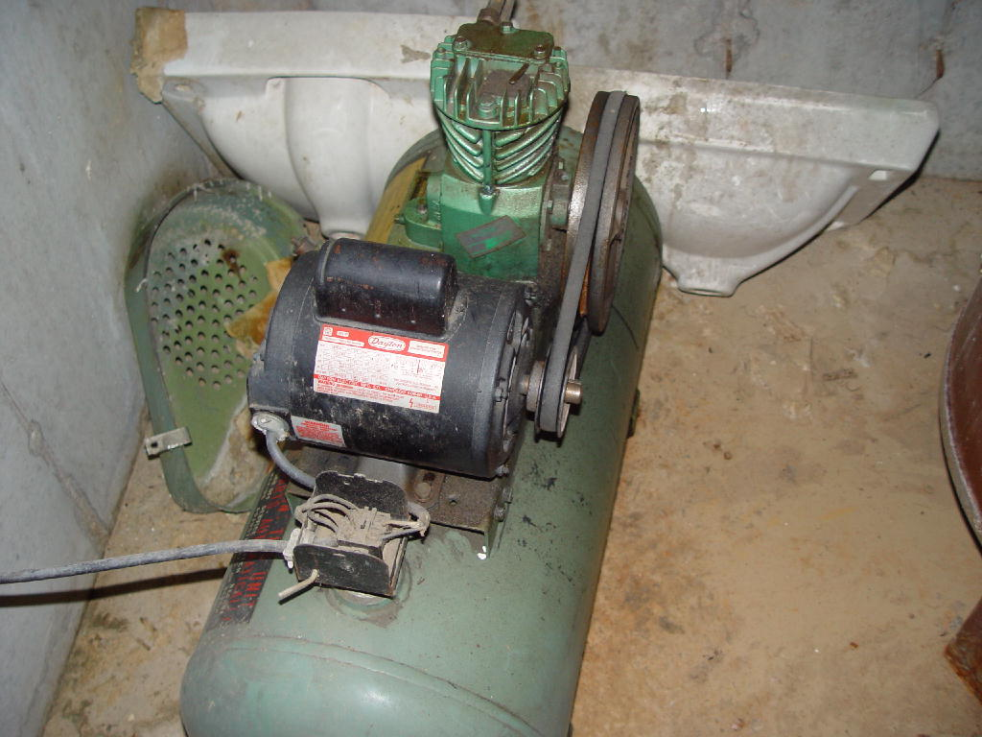
Defective Power Tools
Exposed Belt and Electrical Parts
Unsafe Condition
Notes:
If it turns or is energized, it is a potential hazard. Manufacturers understand this and make their equipment to include safety guards.
Do not permit these guards to be removed when equipment is being used.

Slide 15
Construction Tool Precautions
Pneumatic power tools shall be secured to the hose in a positive manner to prevent accidental disconnection.
Safety clips or retainers shall be securely installed on pneumatic impact tools and on hose connectors.
The manufacturer’s safe operating pressure recommendations for all fittings shall not be exceeded.
Notes:
Use the proper hose and fittings of the correct diameter. Use hoses specifically designed to resist abrasion, cutting, crushing and failure from continuous flexing. Choose air-supply hoses that have a minimum working pressure rating of 1035 kPa (150 psig) or 150% of the maximum pressure produced in the system, whichever is higher. Check hoses regularly for cuts, bulges and abrasions. Tag and replace, if defective. Blow out the air line before connecting a tool. Hold hose firmly and blow away from yourself and others. Make sure that hose connections fit properly and are equipped with a mechanical means of securing the connection (e.g., chain, wire, or positive locking device). Install quick disconnects of a pressure-release type rather than a disengagement type. Attach the male end of the connector to the tool, NOT the hose. Do not operate the tool at a pressure above the manufacturer's rating.
Turn off the air pressure to hose when not in use or when changing power tools. Do not carry a pneumatic tool by its hose. Avoid creating trip hazards caused by hoses laid across walkways or curled underfoot. Do not use compressed air to blow debris or to clean dirt from clothes.
http://www.ccohs.ca/oshanswers/safety_haz/power_tools/pneumat.html

Slide 16
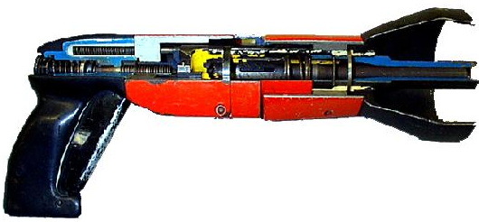
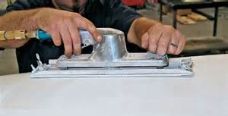
Pneumatic Tools
Powered by compressed air
Includes nailers, staplers, chippers, drills & sanders
Main hazard - getting hit by a tool attachment or by a fastener the worker is using with the tool
Take the same precautions with an air hose that you take with electric cords
Nail Gun -
Cut-Away View
Notes:
Pneumatic tools are powered by compressed air. Common types of these air-powered hand tools that are used in industry include buffers, nailing and stapling guns, grinders, drills, jack hammers, chipping hammers, riveting guns, sanders and wrenches. Review the manufacturer's instruction before using a tool. Wear safety glasses or a face shield and, where necessary, safety shoes or boots and hearing protection. Post warning signs where pneumatic tools are used. Set up screens or shields in areas where nearby workers may be exposed to flying fragments, chips, dust, and excessive noise.
http://www.ccohs.ca/oshanswers/safety_haz/power_tools/pneumat.html

Slide 17
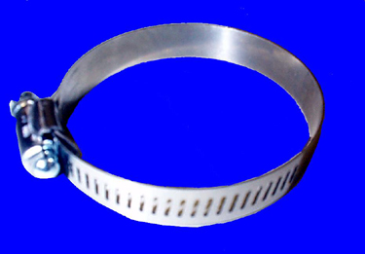
Pneumatic Tool Connections
←Unacceptable
← Acceptable
Hose clamp
Notes:
1926.302(b)(1) and (2)
Secure pneumatic power tools to the hose by some positive means to prevent the tool from becoming accidentally disconnected.
Safety clips or retainers shall be securely installed and maintained on pneumatic impact tools to prevent attachments from being accidentally expelled.
www.osha.gov

Slide 18
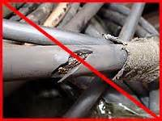
Construction Tool Precautions
Ground Fault Circuit Interrupters will be used on all tools that are not connected to a Ground Faulted Outlet.
Do not use tools with mushroomed heads, broken handles, or damaged electrical connections.
Explosion-activated tools will be used ONLY by trained employees.
Notes:
Test all tools for effective grounding with a continuity tester or a ground fault circuit interrupter (GFCI) before use. Check electric tools to ensure that a tool with a 3-prong plug has an approved 3-wire cord and is grounded. The three-prong plug should be plugged in a properly grounded 3-pole outlet. If an adapter must be used to accommodate a two-hole receptacle, the adapter wire must be attached to a known, functioning ground. NEVER remove the third, grounding prong from a plug.
www.osha.gov
http://www.ccohs.ca/oshanswers/safety_haz/power_tools/

Slide 19
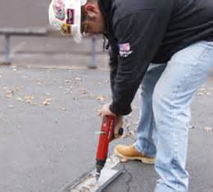
Powder-Actuated Tools
User must be trained and licensed to operate
Test tool each day before loading
Wear suitable ear, eye, and face protection
Select a powder level that will do the work without excessive force
Notes:
1926.302(e)
Allow only trained, competent and authorized persons who are familiar with the regulations governing the use of the tool to operate powder-actuated tools (also known as explosive actuated fastening tools ). The tool shall be tested each day before loading to see that safety devices are in proper working condition. The method of testing shall be in accordance with the manufacturer's recommended procedure. Any tool found not in proper working order, or that develops a defect during use, shall be immediately removed from service and not used until properly repaired. All tools shall be used with the correct shield, guard, or attachment recommended by the manufacturer.
www.osha.gov

Slide 20
Construction Tool Precautions
Before mounting abrasive wheels, inspect for cracks, chips, or other defects.
Gasoline driven tools SHALL NOT be refueled while the engine is hot or running.
Fuel shall be stored in approved containers with self closing lids and screen arrestors only.
Notes:
1926.303(c)(7) Abrasive wheels
Never fill the gasoline tank if the engine is hot. Allow it to cool down for several minutes before refueling. Clean up any spilled gasoline before starting the engine. Do not smoke while filling the gas tank or operating the machine.
www.osha.gov
http://www.cete.org/Trainer/SmallEngES.pdf

Slide 21
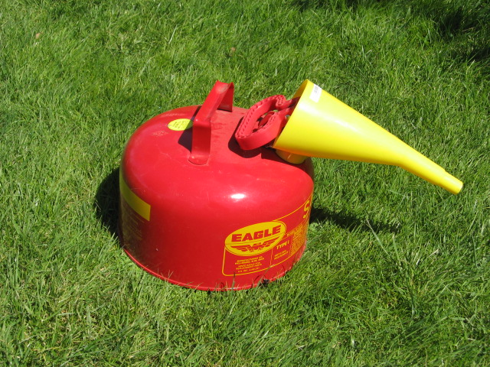
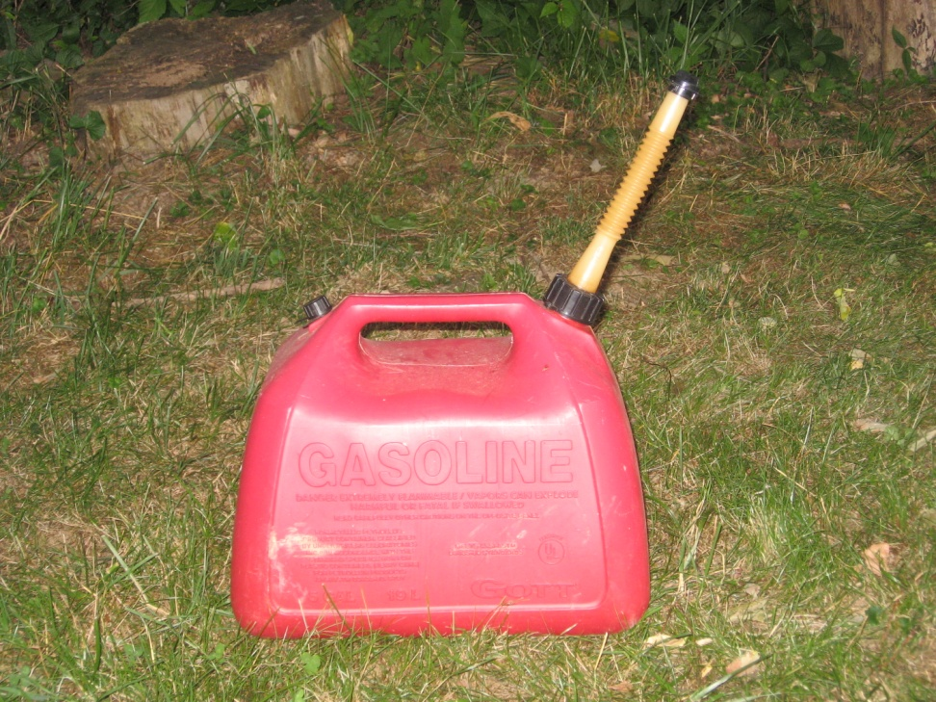
Store Fuel Properly!
Danger
Notes:
Approved safety cans are made from metal or very low conductivity plastic. Safety cans have spring-mounted spout caps. These automatically open when the vapor pressure builds up inside, to allow vapors to escape and prevent rupture (or explosion, in the event of fire). The cap-operating mechanisms also cause the spout cap to close automatically when you finish filling or pouring from the safety can, or if the can is dropped. Safety cans may also have wire mesh flame arrester screens inside the cap spouts. These prevent flashbacks from reaching the liquid in the cans.
http://www.ccohs.ca/oshanswers/prevention/flammable_general.html#_1_10

Slide 22
Construction Tool Precautions
Do not alter or remove the guard or other protective equipment from a tool. It is not permitted to operate a tool with a disabled safety device under any condition.
Unplug tools before adjusting or servicing.
Never repair tools without proper authorization.
Notes:
Make sure the guard is in position, is in good working condition, and guards the machine adequately before operating any equipment or machine. Check and adjust all other safety devices.
http://www.ccohs.ca/oshanswers/safety_haz/

Slide 23
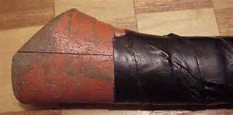
Construction Tool Precautions
Make sure power tools are properly grounded or “double insulated.”
Inspect power cords prior to each use.
“Bleed down” pneumatic tools prior to disconnecting.
Cracked handles and loose heads are not permitted.
Notes:
Prevent shocks. Ensure that the tools are properly grounded using a three-prong plug, are double-insulated (and are labelled as such), or are powered by a low-voltage isolation transformer: this will protect users from an electrical shock. Inspect wires and plugs on power tools before each use. Repair or replace damaged wires or plugs before using the equipment. Do not tape over gashes. Instead, replace the wire. Do not splice wires.
http://www.cete.org/Trainer/GrndElecES.pdf
http://www.ccohs.ca/oshanswers/safety_haz/power_tools/saf_elec.html

Slide 24
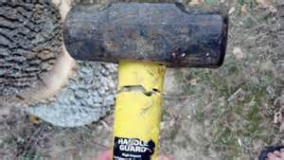
Damaged Tools
Danger! Take This Tool Out of Service, Do Not Use! Notify Your Supervisor.
Notes:
Do not use a tool with a loose or damaged handle. Do not use handles that are rough, cracked, broken, splintered, sharp-edged or loosely attached to head. Do not use any hammer head with dents, cracks, chips, mushrooming, or excessive wear.
http://www.ccohs.ca/oshanswers/safety_haz/hand_tools/hammers.html

Slide 25
Tool Inspection
Inspect the Tools You Use. Don’t Use Defective Tools!
Notes:
Using defective tools is dangerous! Inform your supervisor of the defective tool and remove it from service and label as “out of service for repair.”

Slide 26
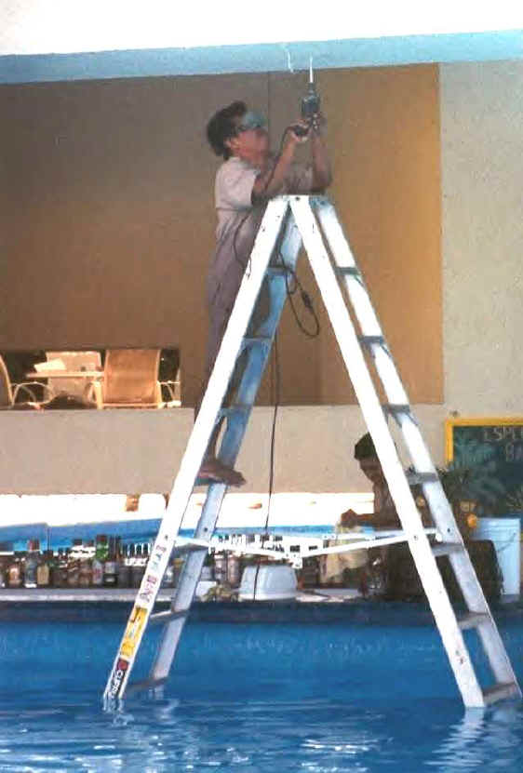
Danger!
Electricity and Water is a Dangerous Combination!
Notes:
Water and electricity don’t mix. Avoid standing in wet areas when using portable electrical tools. Do not let extension cords drag through water when using them. Have tools inspected by a qualified electrician if the tools have gotten wet before reenergizing them.

Slide 27
Additional Information
OSH Answers: Hand Tools
OSH Answers: Powered Hand Tools
http://www.cete.org/Trainer/SfHndTolES.pdf
NASD: Topic: Machinery Safety: Hand/Power Tools
eLCOSH : Hand Tools Training Guide

Slide 28
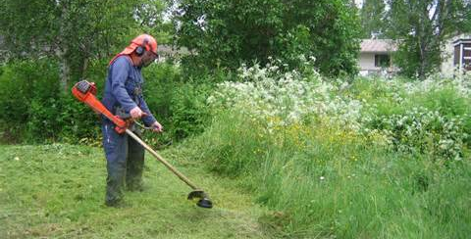
Landscape Small Engine Tools
Notes:
You may use small engine machines such as push mowers, weed trimmers, and leaf blowers.

Slide 29
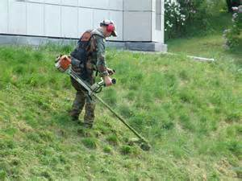
Small Engine Tools
Often landscapers must cut, trim and clean-up.
When doing such work, small engine power tools must be used.
Small engine power tools require special precautions.
Notes:
You should know how to operate and maintain them in a safe manner. If possible, read the operator’s manual. It will contain detailed information on the safe operation and maintenance of the machine. If your employer does not have a manual, ask if one can be ordered from the manufacturer.

Slide 30
Small Engine Tool Precautions
Always wear personal protection clothing such as safety goggles with shields, earmuffs or earplugs, leather or cotton gloves, long pants, and rubber-soled work boots.
Do not wear tennis shoes, sandals or open toed shoes.
Remove any loose debris (trash, tree limbs, rocks, etc.) before you start.
Notes:
Always check the oil level before starting the engine. Add oil if necessary. Always use the type of oil that is recommended in the operator’s manual. If the engine requires a mixture of oil and gasoline, be sure to use the proper ratio. Refer to the operator’s manual for the correct mixture. Never start the engine in an enclosed space. Always start it in a well-ventilated area. Carbon monoxide or fumes can be dangerous in an enclosed space. Never touch the engine muffler while it is hot. Never perform any kind of adjustment while the engine is running.
http://www.cete.org/Trainer/SmallEngES.pdf

Slide 31
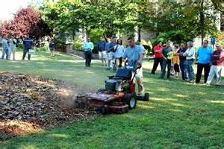
Small Engine Tool Precautions
Make sure the area where you will be working in is clear of all other workers or bystanders.
Never operate a machine while under the influence of alcohol, drugs, or medication.
Never remove any safety guards or shields.
Notes:
Never fill the gasoline tank if the engine is hot. Allow it to cool down for several minutes before refueling. Clean up any spilled gasoline before starting the engine. Do not smoke while filling the gas tank or operating the machine. Store gasoline in an approved, properly labeled container. Use only gasoline approved for the engine.
http://www.cete.org/Trainer/SmallEngES.pdf

Slide 32
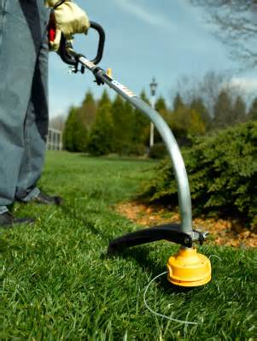
Weed Trimmer Safety
Keep your hands, face, and feet away from any moving parts.
If the trimmer should become entangled, stop the engine immediately.
Do not overreach. Always be properly balanced.
Wear a full face shield, hearing protection, long pants, and heavy work boots.
Notes:
Ensure the shield covering the string/blade is in place and secured. Walk the area to be mowed. Pick up debris such as rocks, sticks, bottles, cans, wires, etc. Debris picked up by a mower or trimmer can be thrown from the machine at speeds as high as 200 m.p.h. or cause the equipment to jam or malfunction.

Slide 33
Leaf Blower Safety
If your working area is dusty, wear a dust mask.
Make sure the area is clear of other people where you will be working.
Always wear proper clothing and eye/face and ear protection while operating blowers.
Notes:
Keep your hands, face, and feet away from any moving parts. If your working area is dusty, wear a dust mask. Do not overreach. Always be properly balanced. Be alert if the area you are trimming is wet or on a slope. Use caution while working on steps. Never operate an electric blower if the area is wet. Make sure the air intake is always free of debris. Perform a safety check before and after each time you use the blower. Check and tighten all loose nuts, bolts and screws. Clean the blower after each use.
http://www.cete.org/Trainer/SmallEngES.pdf

Slide 34
Additional Information
http://www.cete.org/Trainer/SmallEngES.pdf
Notes:
Not sure of particulars pertaining to specific tools? Obtain the owner’s/operator’s manual.

Slide 35
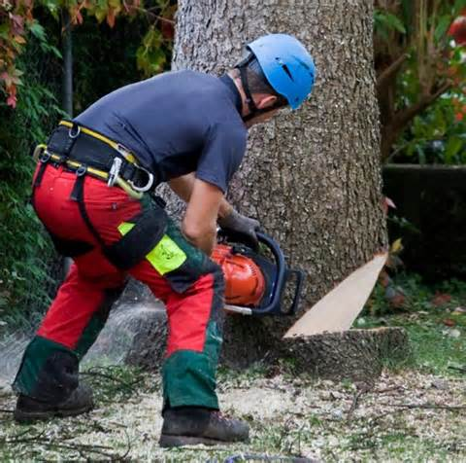
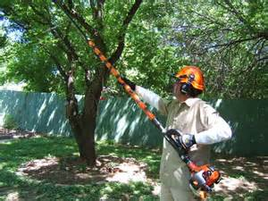
Tree Trimming and Felling

Slide 36
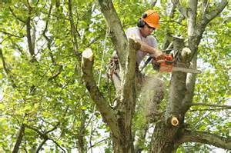
Tree Trimming and Felling
Trimming and Felling can be Dangerous
Workers can fall
Workers can come into contact with overhead power lines
Workers are using loud and dangerous tools like chain saws
Falling limbs or trees can strike workers or by-standers on the ground
Notes:
Trimming and Felling can be Dangerous
Workers can fall
Workers can come into contact with overhead power lines
Workers are using loud and dangerous tools like chain saws
Falling limbs or trees can strike workers or by-standers on the ground

Slide 37
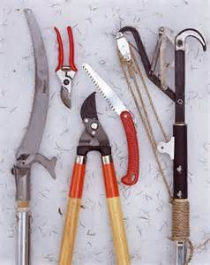
Tree Trimming and Felling Tools
Often landscaping includes the trimming, and felling of trees as part of the job.
Special tools are needed to accomplish these tasks.
Due to the dangerous nature of this work special precautions are necessary.
Chain saws are a vital part of tree trimming and tree felling.
Notes:
To prevent tree trimming accidents, read and follow directions that come with all climbing and trimming equipment. While reading, pay attention to safety instructions and look for warning labels on the equipment. If you have questions, stop and ask your supervisor before you continue.
http://www.cete.org/Trainer/ChainSawES.pdf

Slide 38
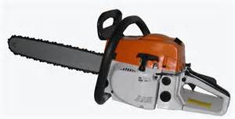
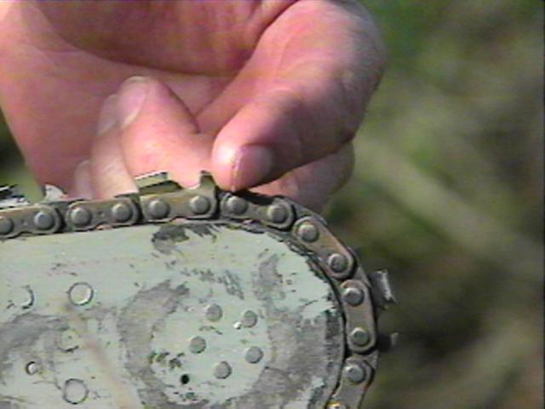
Chain Saws
Chain saws are a great tool for landscapers and arborists.
Their powerful motors cut through heavy trunks, branches, and brush quickly and easily.
However, that power also brings danger.
Safe practices are critical in using chain saws.
Notes:
The chain saw is one of the most efficient, productive, and dangerous portable power tools used in any industry. If you learn to operate it properly and maintain the saw in good working condition, you will avoid injury as well as be more productive.
http://www.cete.org/Trainer/ChainSawES.pdf
www.osha.gov

Slide 39
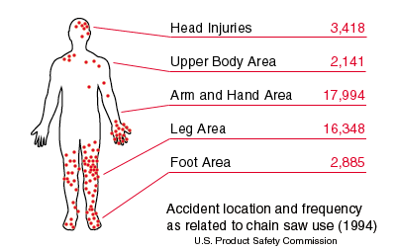
Chain Saw Injury Locations
Notes:
Notice how most injuries occur on the lower left leg and the left arm.
www.osha.gov

Slide 40
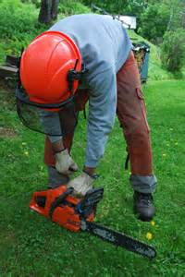
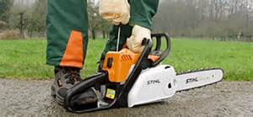
Before Starting Work
Check controls, chain tension, bolts, and handles.
Adjust according to manufacturer’s instructions.
Fuel at least 10 ft. from ignition sources.
Start at least 10 ft. away from fuel.
Start with chain brake on and on the ground or firmly supported.
Notes:
Check controls, chain tension, and all bolts and handles to ensure they are functioning properly and adjusted according to the manufacturer's instructions. With correct chain tension, you get good cutting action and a long chain life. If too loose, a chain will derail; if too tight, a chain will bind. Proper lubrication prolongs the life of the saw and increases safety. Never smoke when you are fueling or using a chain saw. Never drop-start the saw. To start the saw, always brace the saw by placing it on the ground and putting one foot on the bracket to the rear of the saw. Grip the top handle of the saw firmly with one hand and use the other to pull the starting rope.
http://www.cete.org/Trainer/ChainSawES.pdf

Slide 41
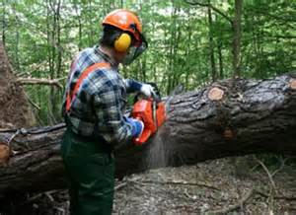
While Working
Keep hands on handles.
Maintain secure footing.
Clear area of things that get in the way.
Do not cut overhead.
Shut off or throttle released prior to moving.
Shut off or chain brake engaged if terrain is hazardous or going more than 50 ft.
Wear required PPE.
Notes:
Never operate the saw above your chest. Reaching above your chest makes the saw hard to control. Operate the chain saw in a firm two-handed grip with fingers and thumb surrounding the handles. Keep both feet firmly positioned when operating a chain saw. Engage the chain brake before starting the chain saw.
http://www.cete.org/Trainer/ChainSawES.pdf
http://www.ccohs.ca/oshanswers/safety_haz/chainsaws/safeuse.html

Slide 42
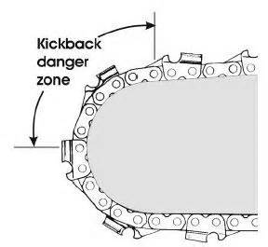
Area of Kick-Back
The top front of the bar is the area prone to kick-back.
Always keep this in mind.
No other part of the saw will work so hard to get you!
Notes:
Kickback is a common cause of injury associated with chainsaws. Kickback occurs when the chain around the end of the bar contacts a hard object (such as a knothole) or when the teeth of the saw are pinched in the wood. This kicks the saw backward and upward, rapidly, where it can strike you.
To reduce kickback: Do not cut with the upper section of the bar. Insert the saw fully. When cutting, always stand at an angle, with a firm balance on the ground or branch, so that if the saw kicks back, it will avoid your neck and head. Make sure your saw has an anti-kickback device.
http://www.oznet.ksu.edu/library/ageng2/MF2712.pdf

Slide 43
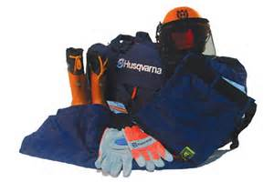
Personal Protective Equipment
A hard hat protects the head from falling limbs or branches.
A mesh full-face shield prevents injury from flying wood chips and twigs.
Protect ears from the high level of noise by using earplugs.
Chainsaw safety boots and chaps, protect the feet and legs in the event of accidental contact .
Notes:
Personal protective equipment (PPE), for the head, ears, eyes, face, hands, and legs are designed to prevent or lessen the severity of injuries to loggers and other workers using chain saws. Clothing should fit well and be free of dangling or ragged edges that can become tangled in the saw.
www.osha.gov
http://www.cete.org/Trainer/ChainSawES.pdf

Slide 44
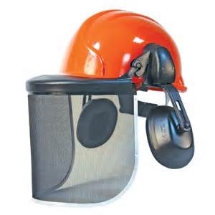
Head Protection
Most workers are killed by being struck in the head.
Without a Hardhat, even the smallest piece of wood can be deadly.
Designed to absorb energy.
Must be ANSI approved.
Must be worn!
Notes:
A hard hat protects the head from falling limbs or branches. A properly fitted hat is cool, comfortable and provides protection from head injury.
www.osha.gov
http://www.cete.org/Trainer/ChainSawES.pdf

Slide 45
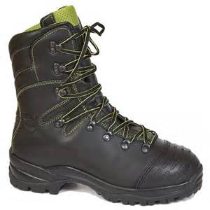
Foot Protection
If the worker uses a chain saw, boots must be cut resistant that will protect against chain saw contact.
Cut resistant boots are UL approved.
Notes:
Safety boots or shoes with high tops protect ankles in the event of accidental contact with a moving saw blade. Steel-toed boots will help protect the feet from falling limbs or logs.
www.osha.gov
http://www.cete.org/Trainer/ChainSawES.pdf

Slide 46
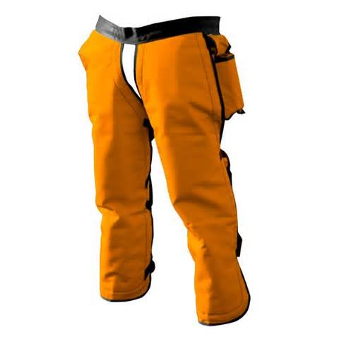
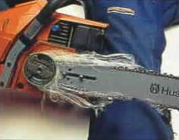
Leg Protection
Each worker who operates a chain saw must wear protection.
Made of cut resistant material.
Extend from upper thigh down to boot top.
Must be UL approved.
Notes:
Nylon mesh protective leg chaps and/or kneepads can provide increased protection for the legs.
1910.266(d)(1)(iv) The employer shall provide, at no cost to the employee, and assure that each employee who operates a chain saw wears leg protection constructed with cut-resistant material, such as ballistic nylon. The leg protection shall cover the full length of the thigh to the top of the boot on each leg to protect against contact with a moving chain saw.
www.osha.gov

Slide 47
Operator’s Manual
Keep the operator’s manual with the chain saw.
If the manual is missing, contact the manufacturer for a replacement.
Periodically review the manual for safe operating procedures.
Notes:
Keep the operator’s manual with the chain saw.
If the manual is missing, contact the manufacturer for a replacement.
Periodically review the manual for safe operating procedures.
http://www.cete.org/Trainer/ChainSawES.pdf

Slide 48
Preventive Maintenance
Keep saw in good repair.
Consult the operator’s manual and check for needed maintenance before each use.
The operator’s manual can be the best source of information for this procedure.
Notes:
Store the operator’s manual in the chain saw case.
http://www.cete.org/Trainer/ChainSawES.pdf

Slide 49
Additional Information
http://www.cete.org/Trainer/ChainSawES.pdf
http://www.osha.gov/OshDoc/data_Hurricane_Facts/chain_saw_safety.pdf
http://www.osha.gov/OshDoc/data_Hurricane_Facts/chainsaws.pdf
OSH Answers: Chainsaws

Slide 50
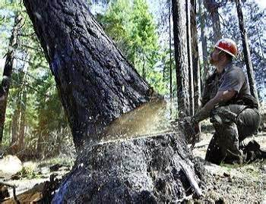
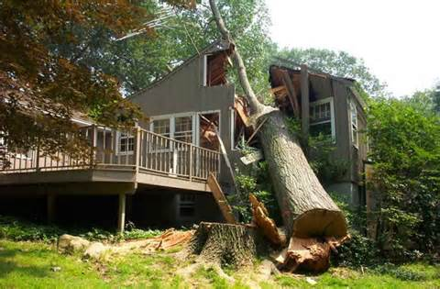
Tree Felling
To safely fell a tree, you must be trained how to:
Figure out the best felling direction.
Plan, clear and use an escape path.
Figure out the proper hinge size.
Use proper controlled felling techniques.
Maintain safe separation distances from other workers and machines.
Wear required PPE.
Tree felling requires special training !
Notes:
When a tree must be removed, there are several things to consider before cutting. 1. Ensure coworkers and all others maintain a two-tree length distance. If the tree is going to fall downhill, increase the distance depending on the slope. 2. Look for any fences, buildings or power lines and avoid felling toward them. 3. Work only in good weather. Never work in strong winds, lightning, rain or any time when visibility is low.
Inspect the tree: Is the tree leaning in one direction? This will play a major role in the direction the tree will fall. Check the trunk (where the cuts are going to be made) for knot holes, cracks or signs of rot that could hinder the felling operation. Ensure the tree has no interlocking branches or vines from another tree. If it does, they must be separated prior to felling.
Also, survey the crown of the tree for any material that may break loose as the tree falls. Trim any low branches that are in your way.
http://www.oznet.ksu.edu/library/ageng2/MF2712.pdf

Slide 51
Trimming and Felling Precautions
Check for overhead power lines!
Inform co-workers and neighbors in the vicinity.
If a ladder is used, tie it to the tree and use a ladder to have access above the branch.
Use a fall arrest harness attached to a secure part of the tree.
Use warning signs around the work site to prevent public access.
Notes:
Before trimming a tree, inspect the area to identify possible hazards (e.g., presence of power lines, broken or cracked limbs after a severe storm) and take appropriate actions to prevent injuries or accidents. Assume any power lines are energized or "live". Avoid any direct or indirect contact with the power line until the utility or hydro company has verified that the line has been de-energized. Mark off area around tree and prevent bystander access. Always work with another person who stays on the ground. Inspect the fall protection equipment and lines before each time they are used. Tag and remove any damaged or defective equipment from service until it can be repaired or replaced and disposed of properly, according the manufacturer's recommendations. If a ladder is used, tie it off on a secure branch. Use approved and appropriate fall protection gear when working above ground including when working from a ladder or platform.
http://www.ccohs.ca/oshanswers/safety_haz/landscaping/tree_trimming.html

Slide 52
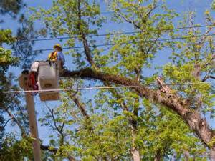
Trimming and Felling Precautions
Use control lines on trees, to direct their fall in the intended direction.
When felling, keep a distance of at least twice the length of the tree between the tree and people.
Have a co-worker assist in controlling movement of falling branches.
Stay at least 10 feet away from power lines.
Notes:
Before you begin to cut, you must determine your escape area. This is the area you will go to immediately after the back cut has been made and the tree is beginning to fall. To locate the escape areas, you must first determine the danger zones. Two danger zones can be identified and must be avoided to prevent serious injury or death. The first danger zone is located in a semi-circle, from half the diameter of the tree toward the direction of the fall. The second danger zone is one-quarter of the diameter of the tree and located in the opposite direction of the intended fall. Fellers MUST avoid these two danger zones. The escape areas are then located between the danger zones. Always retreat to one of these areas as the tree is beginning to fall.
http://www.cete.org/Trainer/TrPruTrmES.pdf
http://www.oznet.ksu.edu/library/ageng2/MF2712.pdf

Slide 53
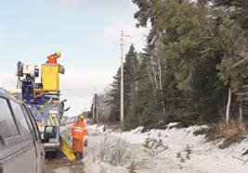
Trimming and Felling Precautions
Use an observer to watch out for power lines.
Safety observer should wear protective clothing.
All workers and observers should wear hardhat, goggles, hearing protection, fluorescent vest, cut-resistant trousers, and safety boots.
Notes:
Work as a team. One worker on the ground should be on the lookout for possible contact between equipment and power lines.
http://www.cete.org/Trainer/TrPruTrmES.pdf

Slide 54
Tree Worker Safety
Due to the highly specialized and dangerous nature of this aspect of landscaping, please review the following material
Tree Worker Safety. International Society of Arboriculture, Champaign, Illinois. Produced under OSHA grant number 46E3-HT03. The tree worker safety training program is a computer-based training program designed as a series of hazards awareness workshops targeting small landscaping businesses.
http://www.isa-arbor.com/publications/ TreeWorkerSafety.aspx
Notes:
Seek information from a reputable source as above.

Slide 55
Additional Information
http://www.cete.org/Trainer/TrPruLadES.pdf
http://www.cete.org/Trainer/TrPruTrmES.pdf
http://www.osha.gov/OshDoc/data_Hurricane_Facts/trim.pdf
http://www.osha.gov/OshDoc/data_Hurricane_Facts/tree_trimming_safety.pdf
http://landcarenetwork.org/planetFile/pdfs/PLANETSafetyTips4feb06.pdf

Slide 56
Contact Information
Health & Safety Training Specialists
1171 South Cameron Street, Room 324
Harrisburg, PA 17104-2501
(717) 772-1635
RA-LI-BWC-PATHS@pa.gov
Like us on Facebook! - https://www.facebook.com/BWCPATHS

Slide 57
Questions

