Slide 1
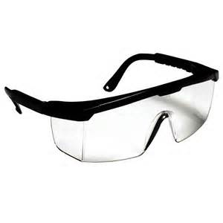
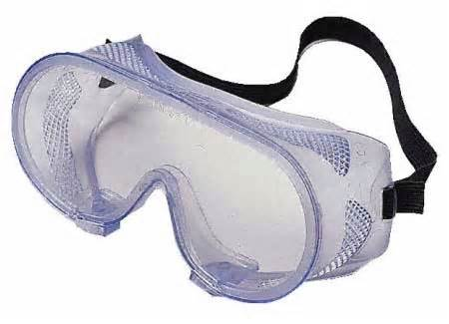
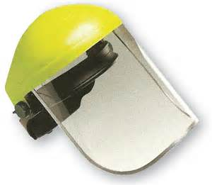
Eye Protection
Bureau of Workers’ Compensation
PA Training for Health & Safety (PATHS)
Notes:
Our eyes are vital for depth perception, hazard recognition and avoidance. We need them not only at work but in other pursuits.
OSHA recognizes the importance of sight in 29 CFR 1910.133, Eye and Face Protection.

Slide 2
Objectives
Understand the at risk jobs or job functions.
Identify the proper eye protection for the job/task.
Identify your responsibilities as well as your employer’s responsibilities.
Notes:
The objectives of this program are many. A few are:
Understand the at risk jobs or job functions.
Identify the proper eye protection for the job/task.
Identify your responsibilities as well as your employer’s responsibilities.

Slide 3
Training
Employees should be trained to be aware of:
When PPE is necessary
What kind of PPE is necessary
How to properly put on, take off, adjust, and wear PPE
The limitations of the PPE
The proper care, maintenance, useful life, and disposal of the PPE
Notes:
OSHA believes that employees, to best protect their eyes, should be trained to be aware of:
When PPE is necessary
What kind of PPE is necessary
How to properly put on, take off, adjust, and wear PPE
The limitations of the PPE
The proper care, maintenance, useful life, and disposal of the PPE

Slide 4
Training
Retraining should be conducted for the following scenarios (not an all inclusive list):
Changes in the workplace
Changes in the types of PPE to be used
Inadequacies in an employee’s knowledge or use of assigned PPE
Notes:
Retraining should be conducted, for example, if the following occur:
Changes in the workplace
Changes in the types of PPE to be used
Inadequacies in an employee’s knowledge or use of assigned PPE

Slide 5
Requirements
PPE must:
Provide protection against the particular hazards for which they are designed
Be of safe design and construction for the work to be performed
Be durable
Be distinctly marked
Be reasonably comfortable
Fit snugly and should not interfere with the movements of the wearer
Be capable of being disinfected
Be easily cleaned
Notes:
The PPE selected to promote eye protection should
Provide protection against the particular hazards for which they are designed
Be of safe design and construction for the work to be performed
Be durable
Be distinctly marked
Be reasonably comfortable
Fit snugly and should not interfere with the movements of the wearer
Be capable of being disinfected
Be easily cleaned

Slide 6
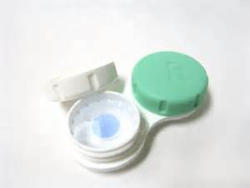
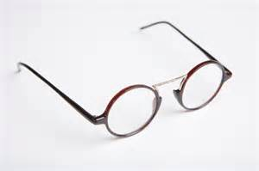
Contacts & Prescription Lenses
Employees who wear prescription (Rx) lenses or contacts must use PPE that incorporates the prescription or use eye protection that can be worn over prescription lenses.
Notes:
Employees who wear prescription (Rx) lenses or contacts must use PPE that incorporates the prescription or use eye protection that can be worn over prescription lenses.
This is especially true if respirators are worn; full facepiece or SCBA.

Slide 7
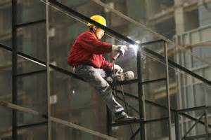
Hazards
Employees must be provided with eye and face protection equipment when machines or operations present potential eye or face injury from physical, chemical, or radiation agents.
Notes:
Hazards:
Employees must be provided with eye and face protection equipment when machines or operations present potential eye or face injury from physical, chemical, or radiation agents.

Slide 8
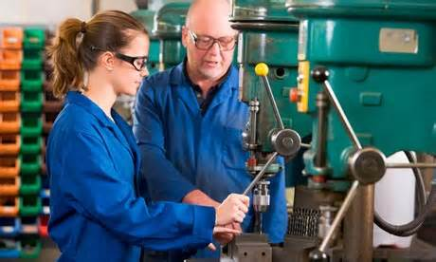
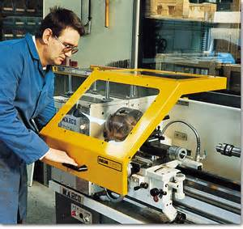
Hazards
PPE devices should not be relied on alone to provide protection against hazards, but should be used in conjunction with guards, engineering controls, and administrative controls.
Notes:
PPE devices should not be relied on alone to provide protection against hazards, but should be used in conjunction with guards, engineering controls, and administrative controls.

Slide 9
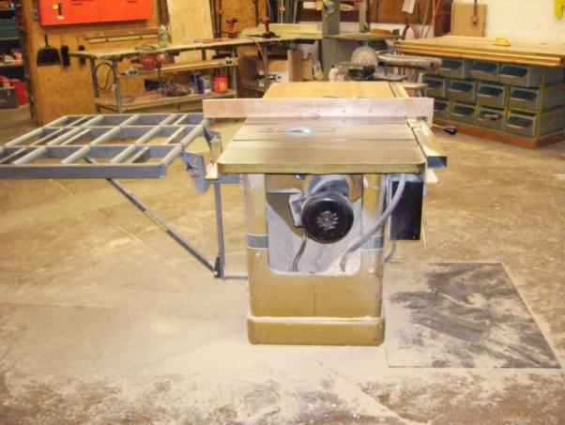
Hazard Assessment
The employer must assess the workplace and determine if hazards that require the use of eye and face protection are present, or are likely to be present, before assigning PPE to workers.
A hazard assessment determines the risk of exposure to eye and face hazards, including emergency situations.
Notes:
Hazard Assessment:
The employer must assess the workplace and determine if hazards that require the use of eye and face protection are present, or are likely to be present, before assigning PPE to workers.
A hazard assessment determines the risk of exposure to eye and face hazards, including emergency situations.

Slide 10
Hazard Assessment
Hazard | Hazard Type | Related tasks
Impact | Flying objects such as large chips, fragments, particles, sand, and dirt. | Chipping, grinding, machining, masonry work, wood working, sawing, drilling, riveting, sanding, etc.
Heat | Anything emitting extreme heat. | Furnace operations, pouring, casting, hot dipping, welding, etc.
Chemicals | Splash, fumes, vapors, and irritating mists. | Acid and chemical handling, degreasing, plating, and working with blood.
Dust | Harmful dust. | Woodworking, buffing, and general dusty conditions.
Optical Radiation | Radiant energy, glare, and intense light | Welding, torch-cutting, brazing, soldering, and laser work.
Notes:
During the Hazard Assessment, evaluate the hazard, hazard type and related tasks.

Slide 11
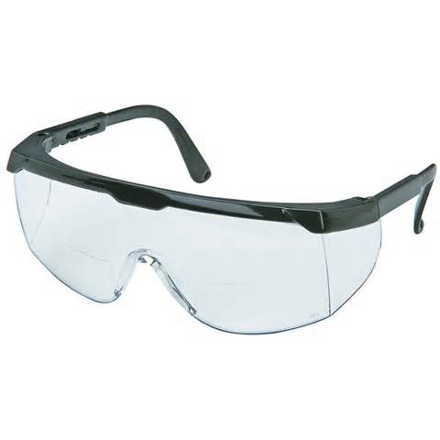
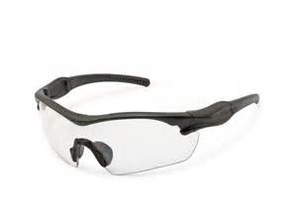
Safety Glasses
Safety glasses are intended to shield the wearer's eyes from impact hazards such as flying fragments, objects, large chips, and particles.
Workers are required to use safety glasses with side shields when there is a hazard from flying objects.
Notes:
Safety glasses are intended to shield the wearer's eyes from impact hazards such as flying fragments, objects, large chips, and particles.
Workers are required to use safety glasses with side shields when there is a hazard from flying objects.

Slide 12
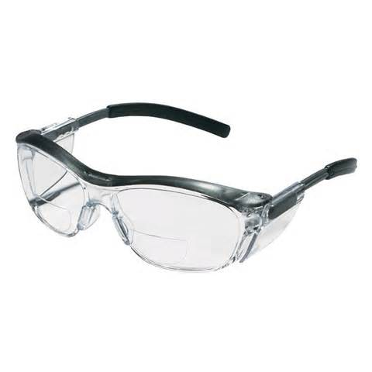
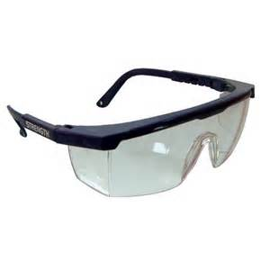
Safety Glasses & Heat Hazards
Safety glasses with side shields are used as primary protection to shield the eyes from heat hazards.
To adequately protect the eyes and face from high temperature exposure, use safety glasses in combination with a heat-reflective face shield.
Notes:
Safety Glasses & Heat Hazards
Safety glasses with side shields are used as primary protection to shield the eyes from heat hazards.
To adequately protect the eyes and face from high temperature exposure, use safety glasses in combination with a heat-reflective face shield.

Slide 13
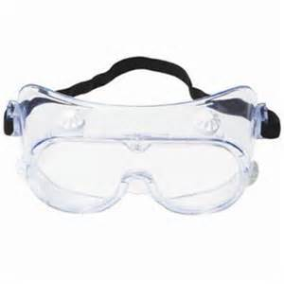
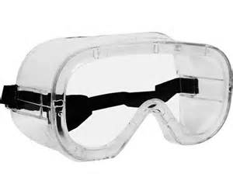
Safety Goggles
Safety goggles are intended to shield the wearer's eyes from impact hazards such as flying fragments, objects, large chips, and particles.
Goggles fit the face immediately surrounding the eyes and form a protective seal around the eyes. This prevents objects from entering under or around the goggles.
Notes:
Safety Goggles
Safety goggles are intended to shield the wearer's eyes from impact hazards such as flying fragments, objects, large chips, and particles.
Goggles fit the face immediately surrounding the eyes and form a protective seal around the eyes. This prevents objects from entering under or around the goggles.

Slide 14
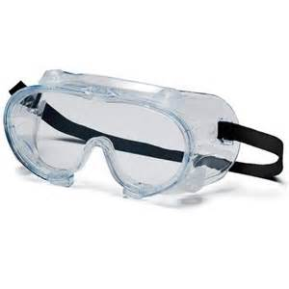
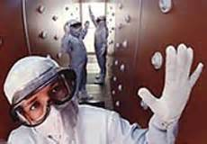
Safety Goggles & Heat Hazards
Safety goggles are used as primary protection to shield the eyes from heat hazards. Goggles form a protective seal around the eyes, preventing objects or liquids from entering under or around the goggles. This is especially important when working with or around molten metals that may splash.
Notes:
Safety goggles and Heat Hazards are used as primary protection to shield the eyes from heat hazards. Goggles form a protective seal around the eyes, preventing objects or liquids from entering under or around the goggles. This is especially important when working with or around molten metals that may splash.

Slide 15
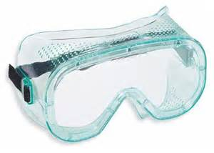
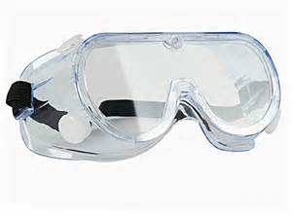
Safety Goggles & Dust Hazards
Goggles form a protective seal around the eyes, preventing nuisance dust from entering under or around the goggles. Ventilation should be adequate, but well protected from dust entry.
Notes:
Dust Hazards.
Goggles form a protective seal around the eyes, preventing nuisance dust from entering under or around the goggles. Ventilation should be adequate, but well protected from dust entry.

Slide 16
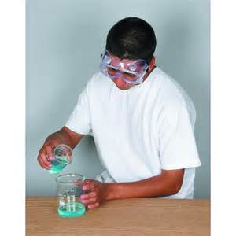
Safety Goggles & Chemical Hazards
Safety goggles protect the eyes, eye sockets, and the facial area immediately surrounding the eyes from a variety of chemical hazards. Goggles form a protective seal around the eyes, preventing objects or liquids from entering under or around the goggles.
Notes:
Chemical Hazards.
Safety goggles protect the eyes, eye sockets, and the facial area immediately surrounding the eyes from a variety of chemical hazards. Goggles form a protective seal around the eyes, preventing objects or liquids from entering under or around the goggles.

Slide 17
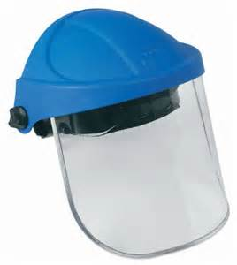
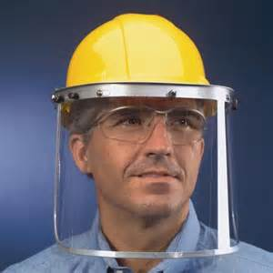
Face Shields
Face shields are intended to protect the entire face, or portions thereof, from impact hazards such as flying fragments, objects, large chips, and particles.
When worn alone, face shields do not protect employees from impact hazards. Use face shields in combination with safety spectacles or goggles for additional protection.
Notes:
Face Shields
Face shields are intended to protect the entire face, or portions thereof, from impact hazards such as flying fragments, objects, large chips, and particles.
When worn alone, face shields do not protect employees from impact hazards. Use face shields in combination with safety spectacles or goggles for additional protection.

Slide 18
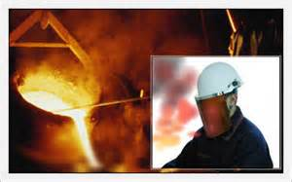
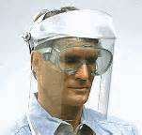
Face Shields & Heat Hazards
Heat-reflective and wire-screen face shields are intended to shield the entire face from a range of heat hazards. Face shields are considered secondary protectors to be used in addition to primary protection such as safety glasses or goggles.
Notes:
Face Shields and Heat Hazards.
Heat-reflective and wire-screen face shields are intended to shield the entire face from a range of heat hazards. Face shields are considered secondary protectors to be used in addition to primary protection such as safety glasses or goggles.

Slide 19
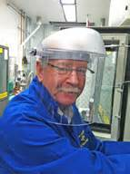
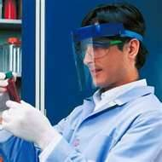
Face Shields & Chemical Hazards
Face shields are intended to protect the entire face from a variety of chemical hazards.
All face shields are considered secondary protection and must be used in addition to safety goggles to provide adequate protection.
Notes:
Face Shields and Chemical Hazards
Face shields are intended to protect the entire face from a variety of chemical hazards.
All face shields are considered secondary protection and must be used in addition to safety goggles to provide adequate protection.

Slide 20
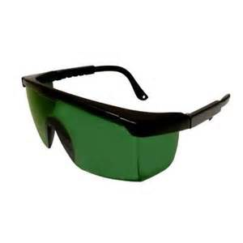
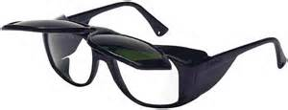
Filter Lenses
Wearing protection with the correct filter shade number is required to protect workers’ eyes from optical radiation. When selecting PPE, consider the type and degree of radiant energy in the workplace.
Notes:
Filter Lenses
Wearing protection with the correct filter shade number is required to protect workers’ eyes from optical radiation. When selecting PPE, consider the type and degree of radiant energy in the workplace.

Slide 21
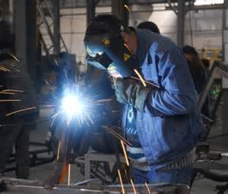
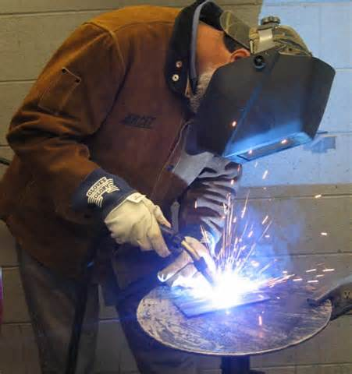
Welding
Welding helmets are secondary protectors intended to shield the eyes and face from optical radiation, heat, and impact.
Use welding helmets in addition to primary protection such as safety glasses or goggles to provide adequate protection.
Notes:
Welding
Welding helmets are secondary protectors intended to shield the eyes and face from optical radiation, heat, and impact.
Use welding helmets in addition to primary protection such as safety glasses or goggles to provide adequate protection.

Slide 22
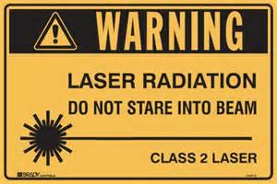
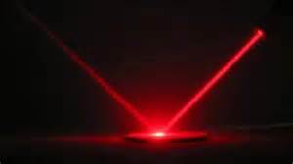
Lasers
Workers with exposure to laser beams must be furnished suitable laser safety goggles which will:
Protect for the specific wavelength of the laser
Be of optical density adequate for the energy involved
Notes:
Lasers.
Workers with exposure to laser beams must be furnished suitable laser safety goggles which will:
Protect for the specific wavelength of the laser
Be of optical density adequate for the energy involved

Slide 23
Glare
Control Glare with:
Special-Purpose Spectacles that include filter or special-purpose lenses to provide protection against eye strain.
Changes in your work area or lighting
Tinted eyeglass lenses or visor-type shade
Notes:
Control Glare with:
Special-Purpose Spectacles that include filter or special-purpose lenses to provide protection against eye strain.
Changes in your work area or lighting
Tinted eyeglass lenses or visor-type shade

Slide 24
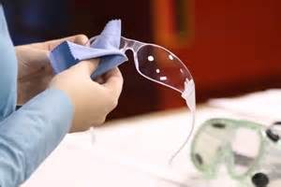
Eye Protection Care
Here are some tips for keeping eyes protection in the best shape possible:
Keep eye protection clean — continuous use of dirty lenses can cause eyestrain.
Replace pitted and/or deep scratched lenses because they reduce vision and have a greater potential to break.
Conduct daily inspection of eye protection.
Notes:
Eye Protection Care.
Here are some tips for keeping eyes protection in the best shape possible:
Keep eye protection clean — continuous use of dirty lenses can cause eyestrain.
Replace pitted and/or deep scratched lenses because they reduce vision and have a greater potential to break.
Conduct daily inspection of eye protection.

Slide 25
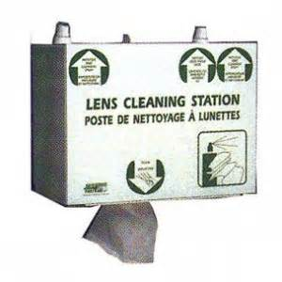
Eye Protection Care
Disinfect eye protection by thoroughly cleaning all parts with soap and warm water.
Rinse off all traces of soap and replace any defective parts.
Notes:
Eye Protection Care
Disinfect eye protection by thoroughly cleaning all parts with soap and warm water.
Rinse off all traces of soap and replace any defective parts.

Slide 26
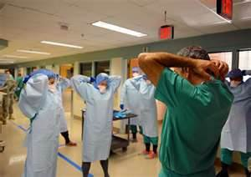
Summary
When employees are trained to work safely they should be able to anticipate and avoid injury from job-related hazards.
Notes:
Summary.
When employees are trained to work safely they should be able to anticipate and avoid injury from job-related hazards.

Slide 27
Contact Information
Health & Safety Training Specialists
1171 South Cameron Street, Room 324
Harrisburg, PA 17104-2501
(717) 772-1635
RA-LI-BWC-PATHS@pa.gov
Like us on Facebook! - https://www.facebook.com/BWCPATHS

Slide 28
Questions

