Slide 1
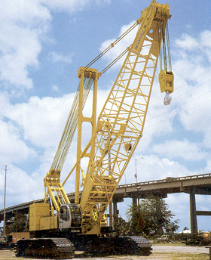
Cranes
Bureau of Workers’ Compensation
PA Training for Health & Safety (PATHS)
1926
Subpart N
Notes:
1926 Subpart N – Cranes, Derricks, Hoists, Elevators, and Conveyors
This presentation is designed to assist trainers conducting OSHA 10-hour Construction Industry outreach training for workers. Since workers are the target audience, this presentation emphasizes hazard identification, avoidance, and control – not standards. No attempt has been made to treat the topic exhaustively. It is essential that trainers tailor their presentations to the needs and understanding of their audience.
This presentation is not a substitute for any of the provisions of the Occupational Safety and Health Act of 1970 or for any standards issued by the U.S. Department of Labor. Mention of trade names, commercial products, or organizations does not imply endorsement by the U.S. Department of Labor.
Other standards and references used for this presentation are as follows:
Mobile Hydraulic Crane Standards
- PCSA Standard NO. 2
- Power Crane and Shovel Association
2. USA Standards
- Safety Code for Cranes, Derricks, Hoists, Jacks and Slings
- Crawler, locomotive and truck cranes
- USAS B30.5-1968

Slide 2
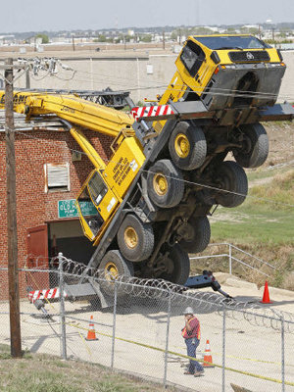
Major Causes of Crane Accidents
Contact with power lines
Overturns
Falls
Mechanical failures
Notes:
OSHA identified the major causes of crane accidents to include:
boom or crane contact with energized power lines (nearly 45% of the cases),
under the hook lifting device,
overturned cranes,
dropped loads,
boom collapse,
crushing by the counter weight,
outrigger use,
falls, and
rigging failures.
Also, some cranes are not maintained properly nor inspected regularly
to ensure safe operation.

Slide 3
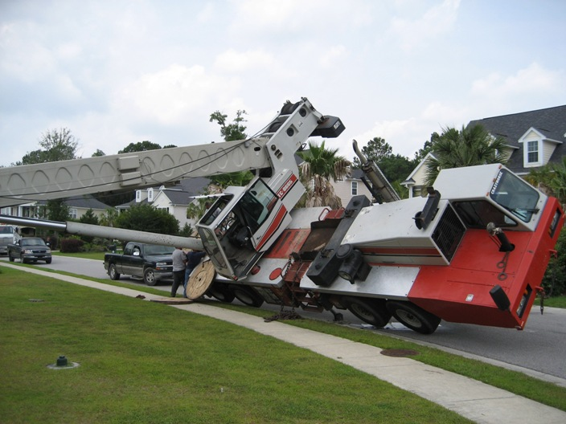
How Do Accidents Occur?
Instability – unsecured load, load capacity exceeded, or ground not level or too soft
Lack of communication - the point of operation is a distance from the crane operator or not in full view of the operator
Lack of training
Inadequate maintenance or inspection
Notes:
In addition to instability factors, communication, and training, some cranes are not maintained properly nor inspected regularly to ensure safe operation.

Slide 4
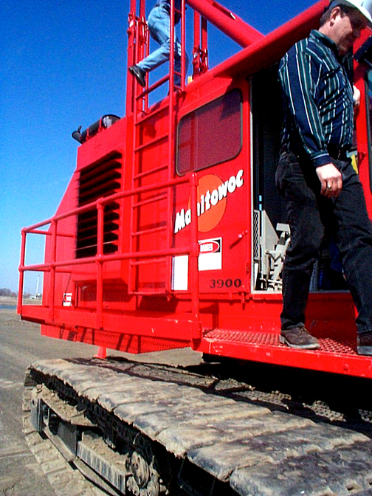
Who is at Risk
Operators
Persons at Crane Site
Notes:
A recent study by Don Dickie, a recognized crane authority with Construction Safety Association
of Ontario, indicates that although mechanical failures represent only 11% of causes of crane
accidents, they usually result in the major accidents involving injuries, fatalities, substantial
material costs, and usually spectacular media coverage. Studies and analyses of crane
accidents involving mechanical failure show they are frequently due to a lack of preventive
maintenance or adequate training and/or experience on the part of the personnel involved. It is
important that not only crane operators but also personnel working with cranes receive training in
crane operations. Cranes and associated rigging equipment must be inspected regularly to
identify any existing or potentially unsafe conditions. In addition, preventive maintenance must
be performed as required by the crane manufacturer and/or supplier to ensure safe crane
operation.

Slide 5
Definitions
Crane – Consists of a rotating structure for lifting and lowering horizontally on rubber tires or crawler treads
Hoist - Used to lift and lower load.
Boom – An inclined spar, strut, or other long member supporting the hoisting tackle
Boom stops – A device used to limit the angle of the boom at its highest position
Brake – To slow or stop motion by friction or power
Block – Sheaves or grooved pulleys in a frame with hook, eye and strap
Jib – Extension attached to the boom point to provide added boom length for lifting specified loads.
Notes:
OTHER DEFINITIONS
Boom angle indicator – An accessory device that measures the angle of boom base section centerline to horizontal
Load – The weight of the object being lifted including:
Load block and hook
Wire rope
Rigging
Boom attachments
Ancillary attachment
Outrigger – Support members attached to the crane’s carrier frame which are used to level the crane
Pendants – Stationary wire ropes used to support the boom
Radius – The horizontal distance from the axis of the rotation of the crane’s superstructure to the center of the suspended load
Superstructure – The rotating frame, gantry and boom or other operating equipment
Counter weight – Weights used for balancing loads and the weight of the crane in providing stability
Deck – The revolving superstructure or turntable bed.
Drum – The spool or cylindrical member around which cables are wound for raising and lowering loads

Slide 6
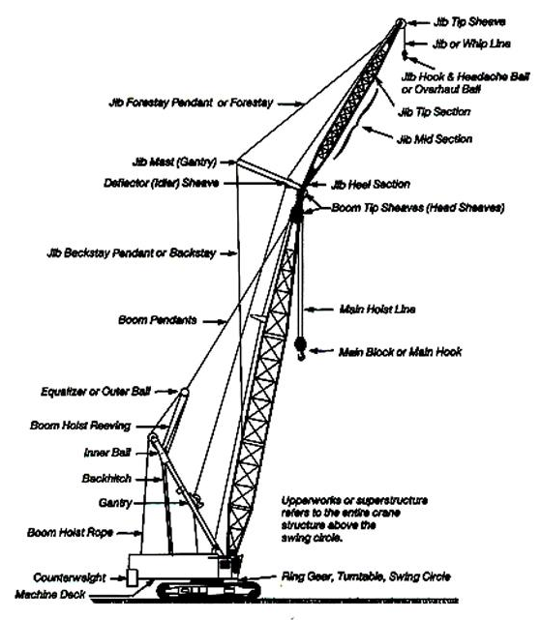
Parts of a Crane

Slide 7
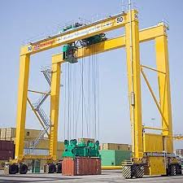
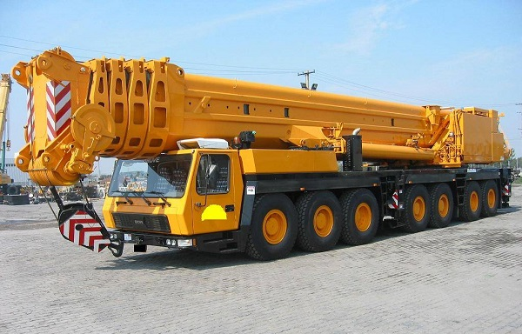
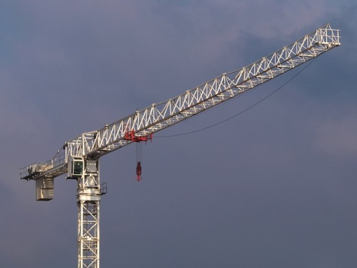
Types of Cranes
Mobile
Hydraulic
Overhead
Gantry
Tower
Notes:
COMMONLY USED CRANES - primary examples used in this presentation
Hydraulic rough terrain crane
Crawler lattice boom friction crane
Several significant differences between these cranes, primarily in boom hoist and load line controls. The somewhat smooth operation of the boom control adjustments on the hydraulic cranes may falsely suggest that it is simple to operate. The lattice boom friction cranes’ movement in its boom or its adjustment in load position tend to be a little jerky requiring more skill and experience to operate smoothly.
Another difference is their load charts. Due to the fixed boom lengths, the lattice boom friction crane has a more simplified load chart. This requires extensive motion control and anticipation of boom movement to accurately lift or place loads.
The hydraulic crane’s load charts are more extensive making them complicated due to variations in boom length, so more training in multiple charts is required
The differences between these cranes are significant enough to require specific training on each type of crane. Crane operators cannot expect to be totally knowledgeable and proficient in the operation of the many diverse types of cranes available today. They cannot be expected to move from one type of crane to another without adequate education and training on specifics of each piece of equipment.

Slide 8
Crane Hazards
Improper load rating
Excessive speeds
No hand signals
Inadequate inspection and maintenance
Unguarded parts
Unguarded swing radius
Working too close to power lines
Improper exhaust system
Shattered windows
No steps/guardrails walkways
No boom angle indicator
Not using outriggers
Notes:
Hazards Associated with Crane Operations
OSHA's analysis of crane accidents in general industry and construction identified an average of 71 fatalities each year.
A study conducted by OSHA showed that nearly 30% of work-related electrocutions involved cranes.
Although mechanical failures represent only 11% of the causes of crane accidents, they usually result in the major accidents involving injuries, fatalities, substantial material costs, and usually spectacular media coverage. Studies and analyses often show they are frequently due to a lack of preventive maintenance or adequate training and/or experience on the part of the personnel involved. Crane operators and other personnel working with cranes need to receive training in crane operations. Cranes and associated rigging equipment must be inspected regularly to identify any existing or potentially unsafe conditions. Regular inspections are before use and during use. If there are problems, get them fixed before continuing work. Preventive maintenance must also be done per crane manufacturer and/or the supplier specifications.

Slide 9
Planning Before Start-Up
Level the crane and ensure support surface is firm and able to support the load
Contact power line owners and determine precautions. Know the location and voltage of overhead power lines.
Know the basic crane capacities, limitations, and job site restrictions, such as the location of power lines, unstable soil, or high winds.
Make other personnel aware of hoisting activities.
Barricade areas within swing radius.
Ensure proper maintenance and inspections.
Determine safe areas to store materials and place machinery.
Notes:
Planning appropriately before using a crane includes:
Level the crane and ensure support surface is firm and able to support the load
Contact power line owners and determine precautions. Know the location and voltage of overhead power lines.
Know the basic crane capacities, limitations, and job site restrictions, such as the location of power lines, unstable soil, or high winds.
Make other personnel aware of hoisting activities.
Barricade areas within swing radius.
Ensure proper maintenance and inspections.
Determine safe areas to store materials and place machinery.

Slide 10
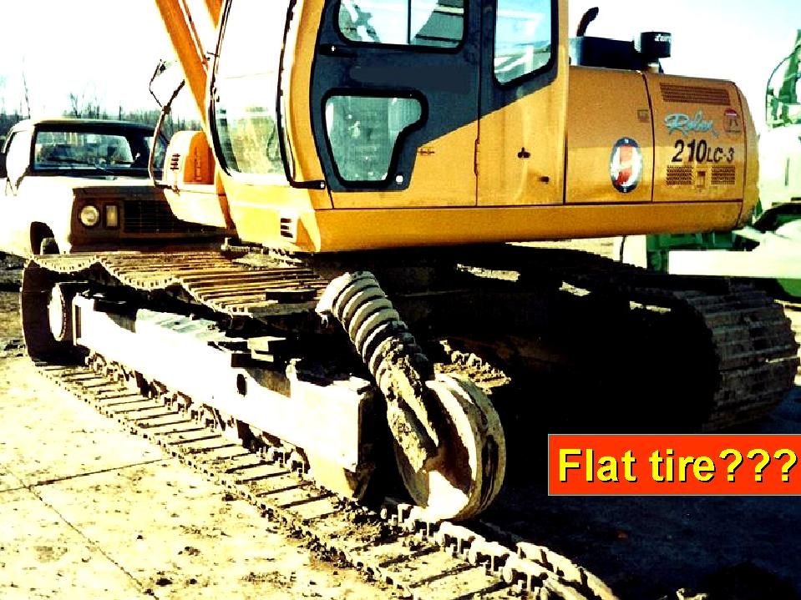
Competent Person
The competent person must inspect all machinery and equipment prior to each use, and during use, to make sure it is in safe operating condition.
If it needs to be fixed, take it out of service and don’t use it until it is repaired.
Broken
Track
Notes:
APPLICABLE OSHA STANDARD
1926.550(a)(5) The employer shall designate a competent person who shall inspect all machinery and equipment prior to each use, and during use, to make sure it is in safe operating condition. Any deficiencies shall be repaired, or defective parts replaced, before continued use.
1926.550(a)(6) A thorough, annual inspection of the hoisting machinery shall be made by a competent person, or by a government or private agency recognized by the U.S. Department of Labor. The employer shall maintain a record of the dates and results of inspections for each hoisting machine and piece of equipment
Competent Person:
1926.32(f) defines competent person as one who is capable of identifying existing and predictable hazards in the surroundings or working conditions which are unsanitary, hazardous, or dangerous to employees, and who has authorization to take prompt corrective measures to eliminate them. The OSHA construction standards do not require employees performing crane inspections to have a Level II rating, which is a term used in an ANSI standard not referenced in the OSHA standards.

Slide 11
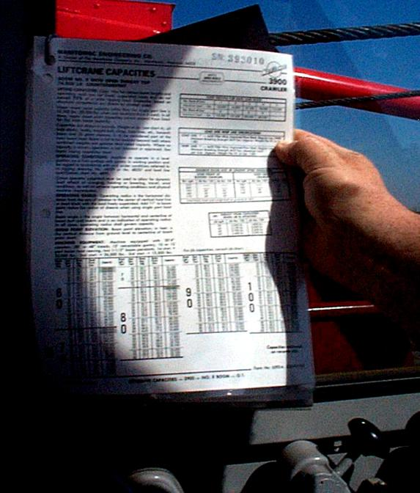
Load Capacity-Speed-Warnings
Make sure the crane operator can see the:
Rated Load Capacities
Operating Speeds
Special Hazard Warning or Instruction
Load Rating Chart
Notes:
APPLICABLE OSHA STANDARD
1926.550 (a)(2) Rated load capacities, and recommended operating speeds, special hazard warnings, or instruction, shall be conspicuously posted on all equipment. Instructions or warnings shall be visible to the operator while he is at his control station.

Slide 12
Know the Weight of the Load
Refer to shipping ticket or other documentation
Ensure lift calculations are correct
Ensure load is within load chart rating for boom length and load radius of crane
Crane is rated by the maximum weight it will lift at a minimum radius and minimum boom length – the further from its centerpoint, the less it will lift
Notes:
OVERTURNING ACCIDENTS
Basically, overloading is responsible for a relatively small portion of mobile crane
accident simply because a very small portion of lifted loads are at or near rated loads.
In concept, load and load-moment indicators are ideal means to assure cranes will not
be overloaded. In practice, they fall short of the ideal. The reasons are many and can
only be briefly mentioned here.
Some reasons that load or load-moment indicators are not reliable:
the device has been turned off or is down due to malfunction,
the device is out of calibration, or
operating conditions (wind or operating speeds or out of level) are so far from ideal
that the published rating can lead to failure. The mounting of a device is itself no
assurance operations will be safe. Just like oil pressure or temperature gauges, those
devices are not safety devices; they are indicators that advise a knowledgeable
operator of load parameters as an aid in making operating judgments.
Some authorities overstress the value of, or need for, load or load-moment indicators.
There is no doubt that there are operating situations that require a device of that type,
but on the other hand, in certain situations they offer mixed blessings. It has been
demonstrated that there is a tendency for some operators to become overly reliant on
the devices and to use them in place of judgment. This can lead to accidents when
conditions are not ideal. An untrained or inexperienced operator may use the device
as a prop and as a substitute for knowing the machine, the load, and the rating chart.
Operators who do not fully understand the meaning of the values on the rating chart,
and who do not understand the limitations of the crane and its ratings, will operate carelessly or will allow untrained, inexperienced supervisors to tell them to pick an unsafe load. The number of operators who do not understand rating charts is surprising. The number of supervisors who know little or nothing about cranes is shocking.

Slide 13
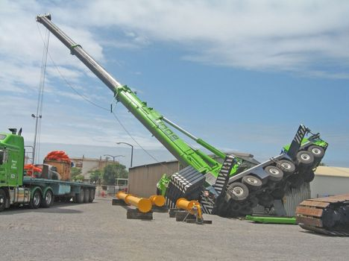
Loading Limiting Factors
Not level
Wind
Side loads
On its wheels
Lifting over the side
Use of extensions, jibs and other attachments
Limits of wire rope, slings and lifting devices

Slide 14
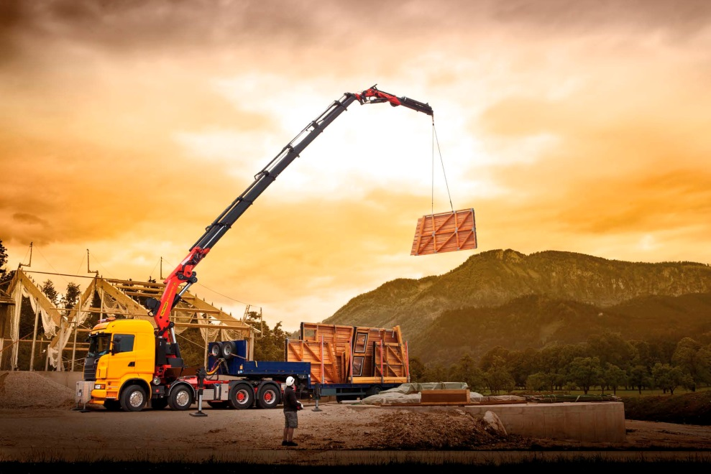
Mobile Cranes-Lifting Principles
Center of Gravity
Leverage
Stability
Structural Integrity
Notes:
Four basic lifting principles that govern a crane's mobility and safety during lifting operations:
1. Center of Gravity Point in the object where its weight can be assumed to be concentrated or, stated in another way, it is the point in the object around which its weight is evenly distributed. The location of the center of gravity of a mobile crane depends primarily on the weight and location of its heaviest components (boom, carrier, upperworks and counterweight).
2. Leverage Cranes use leverage to lift loads. Rotation of the upperworks (cab, boom, counterweight, load) changes the location of the center of gravity, its leverage point or fulcrum.
3. Stability Relationship of the load weight, angle of the boom and its radius (distance from the cranes center of rotation to the center of load) to the center of gravity of the load. Stability could also be effected by the support on which the crane is resting. A crane's load rating is generally developed for operations under ideal conditions, i.e., a level firm surface. Unlevel surfaces or soft ground therefore must be avoided. In areas where soft ground poses a support problem, mats and or blocking should be used to distribute a crane's load and maintain a level stable condition.
4. Structural Integrity The crane's main frame, crawler track and/or outrigger supports, boom sections, and attachments are all considered part of the structural integrity of lifting. In addition, all wire ropes, including stationary supports or attachment points, help determine lifting capacity and are part of the overall structural integrity of a crane's lifting capacity.
These elements may also affect structural integrity:
- The load chart capacity in relationship to stability;
- The boom angle limitations which affect stability and capacity; and
- The knowledge of the length of boom and radius in determining capacity.

Slide 15
Load Example: 30 ton Crane
Will lift 60,000 pounds at 10 feet from the center pin of the crane
Based on level surface, no wind, and outriggers fully extended
At 25 feet from the center pin with an 80 foot boom, the capacity is only 14,950 pounds
At 74 feet from the center pin, the capacity is only 4,800 pounds
Notes:
Note: the center of rotation is the center pin of the crane which is used for load chart calculations and measurements; however, be aware on some cranes there may be another location used to measure the radius. Consult the manufacturer or supplier when in doubt.

Slide 16
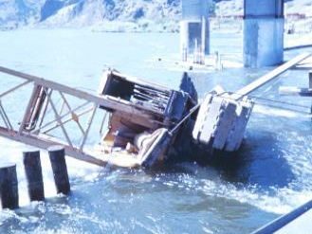
Improper Load
Improper loads or speeds can result
in the tipping of the crane
Notes:
CRANE ACCIDENT – OVERTURNED CRANE
This crane overturned while performing loading operations on a pier. The crane was attempting to remove a metal container from a barge when it tipped and slid into the water. The wind caused the load to swing violently causing the load to go outside the swing radius, at that point the load dropped into the water and took the crane with it.
See Fatal facts for descriptions of fatal crane accidents at www.osha-slc.gov/OshDoc/toc_FatalFacts.html

Slide 17
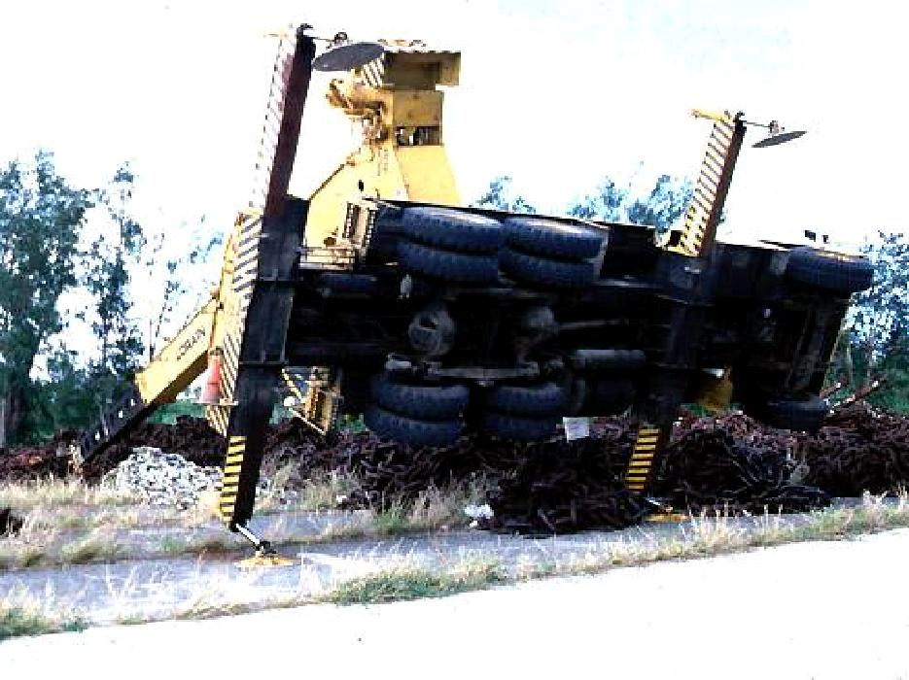
Improper Load
Notes:
CRANE ACCIDENT – OVERTURNED CRANE
The crane overturned when it attempted to lift heavy pieces of metal chain in excess of its load rating. In addition it was side loading which was not part of the load calculation. Even though the outriggers were out, the weight of the load caused the crane to overturn.

Slide 18
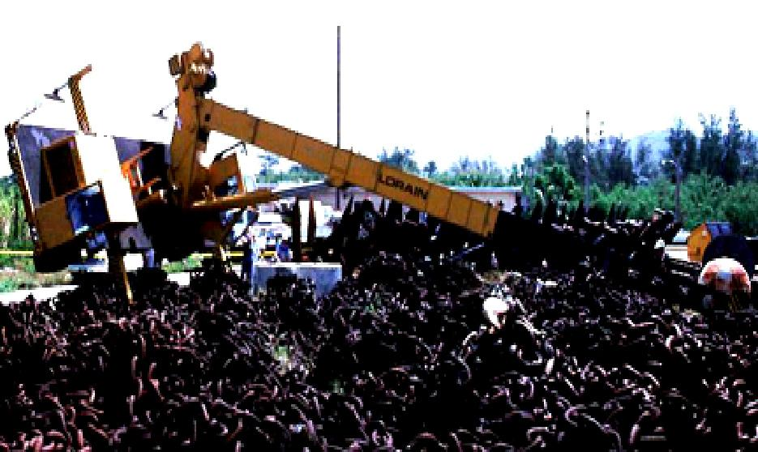
Improper Load
Notes:
Another crane accident due to improper loading.

Slide 19
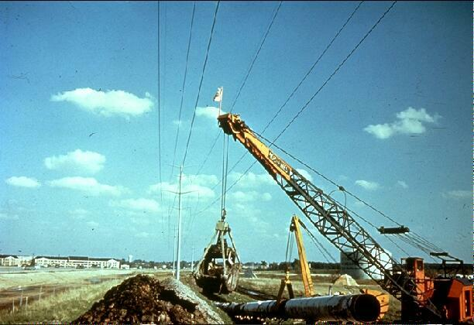
Power Lines
Stay clear from power lines at least 10 feet
Notes:
APPLICABLE OSHA STANDARD
1926.550(a)(15)
Except where electrical distribution and transmission lines have been de energized and visibly grounded at point of work or where insulating barriers, not a part of or an attachment to the equipment or machinery, have been erected to prevent physical contact with the lines, equipment or machines shall be operated proximate to power lines only in accordance with the following:
(i) For lines rated 50 kV. or below, minimum clearance between the lines and any part of the crane or load shall be 10 feet;
(ii) For lines rated over 50 kV., minimum clearance between the lines and any part of the crane or load shall be 10 feet plus 0.4 inch for each 1 kV. over 50 kV., or twice the length of the line insulator, but never less than 10 feet;
(iii) In transit with no load and boom lowered, the equipment clearance shall be a minimum of 4 feet for voltages less than 50 kV., and 10 feet for voltages over 50 kV., up to and including 345 kV., and 16 feet for voltages up to and including 750 kV.
(iv) A person shall be designated to observe clearance of the equipment and give timely warning for all operations where it is difficult for the operator to maintain the desired clearance by visual means.
It is often very difficult for operators to judge clearance to power lines because of the distance and the slack of the power line. One good practice is to measure out the clearance distance and install visual barriers for the operator and other persons to use

Slide 20
Hand Signals
An illustration of the signals must be posted at the job site.
Notes:
APPLICABLE OSHA STANDARD
1926.550 (a)(4) Hand signals to crane and derrick operators shall be those prescribed by the applicable ANSI standard for the type of crane in use. An illustration of the signals shall be posted at the job site.
These charts are available in other languages.

Slide 21
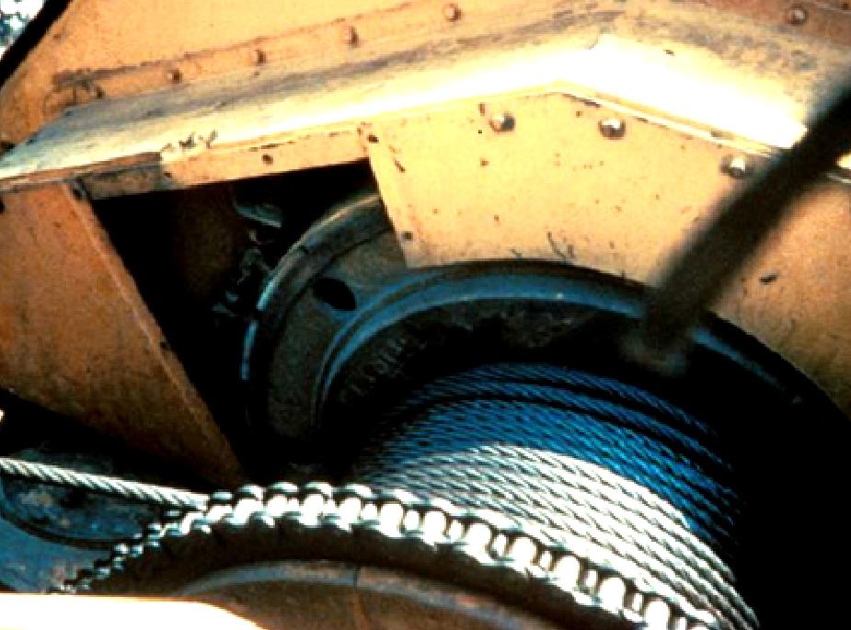
Guard Moving Parts
Unguarded
Chain Drive
Guard moving parts such as gears or belts
Notes:
APPLICABLE OSHA STANDARD
1926.550(a)(8)Belts, gears, shafts, pulleys, sprockets, spindles, drums, fly wheels, chains, or other reciprocating, rotating, or other moving parts or equipment shall be guarded if such parts are exposed to contact by employees, or otherwise create a hazard. Guarding shall meet the requirements of the American National Standards Institute B 15.1‑1958 Rev., Safety Code for Mechanical Power Transmission Apparatus.

Slide 22
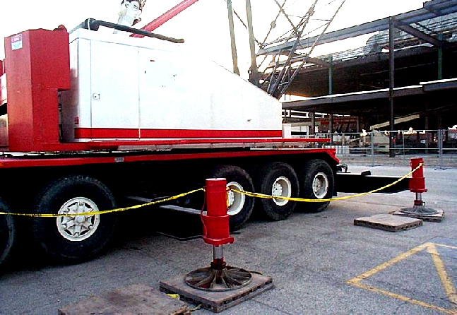
Swing Radius
Swing Radius
Stay out of the crane’s swing radius-Make sure there are barrier guards showing swing radius.
Notes:
OSHA determined that the preferred way to protect employees in these situations is to completely barricade the entire swing radius of the equipment and prevent employee access to the area.
1926.550(a)(9)
Accessible areas within the swing radius of the rear of the rotating superstructure of the crane, either permanently or temporarily mounted, shall be barricaded in such a manner as to prevent an employee from being struck or crushed by the crane.

Slide 23
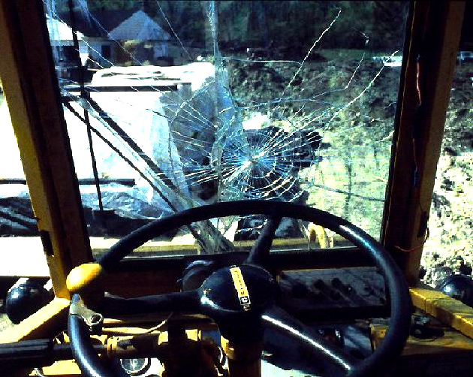
Operator Visibility
Broken Window
Make sure broken windows or other obstructions do not prevent the operator from seeing.
Notes:
APPLICABLE OSHA STANDARD
1926.550(a)(12) All windows in cabs shall be of safety glass, or equivalent, that introduces no visible distortion that will interfere with the safe operation of the machine.

Slide 24
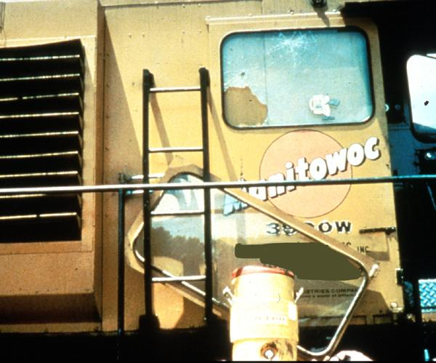
Ladders
Ladder
Use ladders to get to the upper portion of the cab
Notes:
APPLICABLE OSHA STANDARD
1926.550(a)(13)
Where necessary for rigging or service requirements, a ladder, or steps, shall be provided to give access to a cab roof.
(ii) Guardrails, handholds, and steps shall be provided on cranes for easy access to the car and cab, conforming to American National Standards Institute B30.5.
(iii) Platforms and walkways shall have anti-skid surfaces.

Slide 25
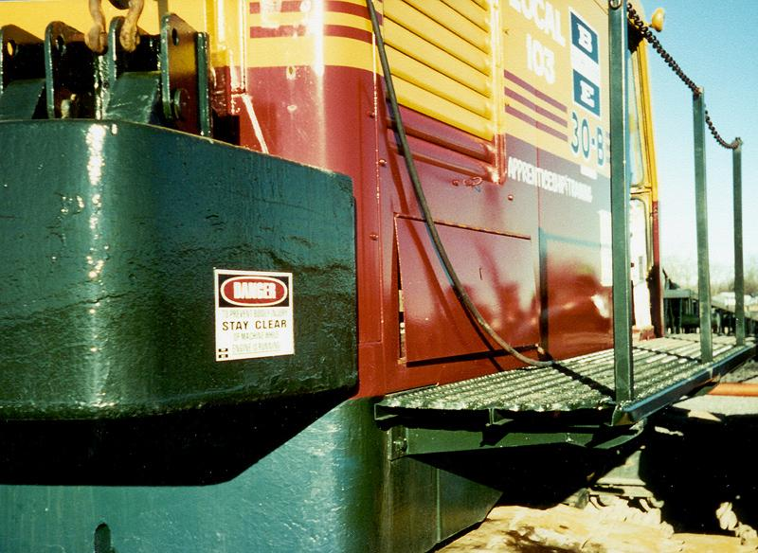
Guardrails
Runways and steps need to have guardrails, handholds and slip resistant surfaces.
Notes:
APPLICABLE OSHA STANDARDS
1926.550(a)(13)(ii)
Guardrails, handholds, and steps shall be provided on cranes for easy access to
the car and cab, conforming to American National Standards Institute B30.5.
1926.550(a)(13)(iii)
Platforms and walkways shall have anti-skid surfaces.

Slide 26
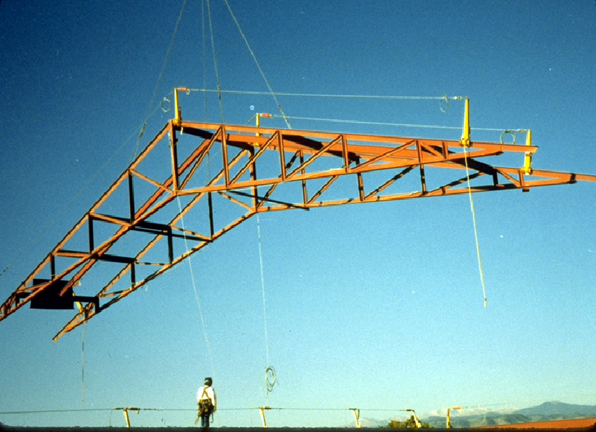
Suspended Loads
Don’t stand under suspended loads.
Notes:
Keep the load as close as possible to the ground when picking and carrying a load.
1926.550(a)(19) All employees shall be kept clear of loads about to be lifted and of suspended loads.

Slide 27
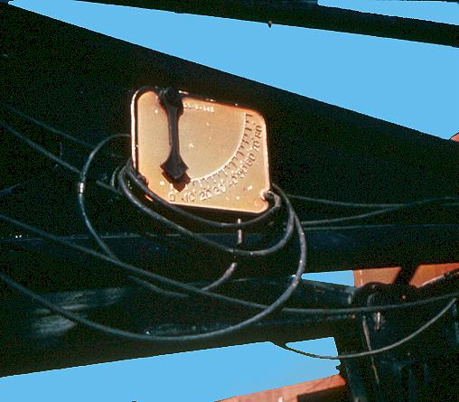
Boom Angle Indicator
A boom angle indicator must be on the crane.
Notes:
APPLICABLE OSHA STANDARD
1926.550(g)(3)(ii)(A) Cranes and derricks with variable angle booms shall be equipped with a boom angle indicator, readily visible to the operator.
The boom angle indicator is an accessory device that measures the angle of the boom base section centerline to horizontal.

Slide 28
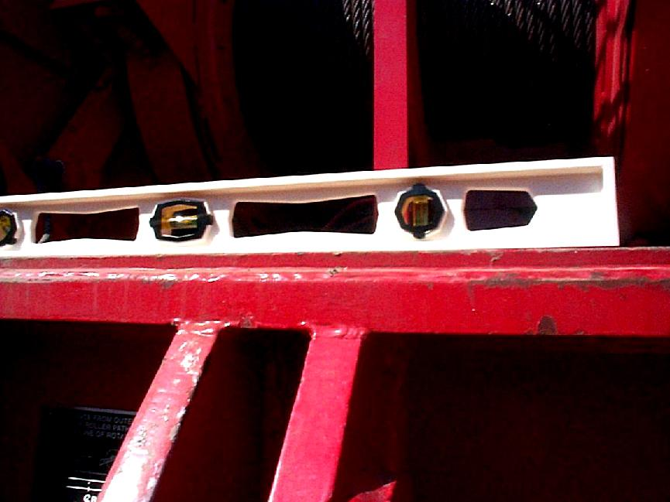
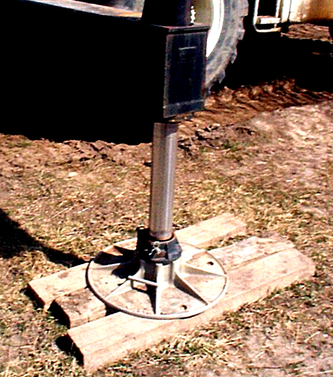
Supporting Surface
Cranes must be on a firm supporting surface and level within 1 percent.
Notes:
Level the crane according to the manufacturer’s specifications.
Extend outrigger beams.
1926.550(g)(3)(i)(D)
The crane shall be uniformly level within one percent of level grade and located on firm footing. Cranes equipped with outriggers shall have them all fully deployed following manufacturer's specifications, insofar as applicable, when hoisting employees.
Be mindful of asphalt which easily becomes a shifting, soft surface under a concentrated load.

Slide 29
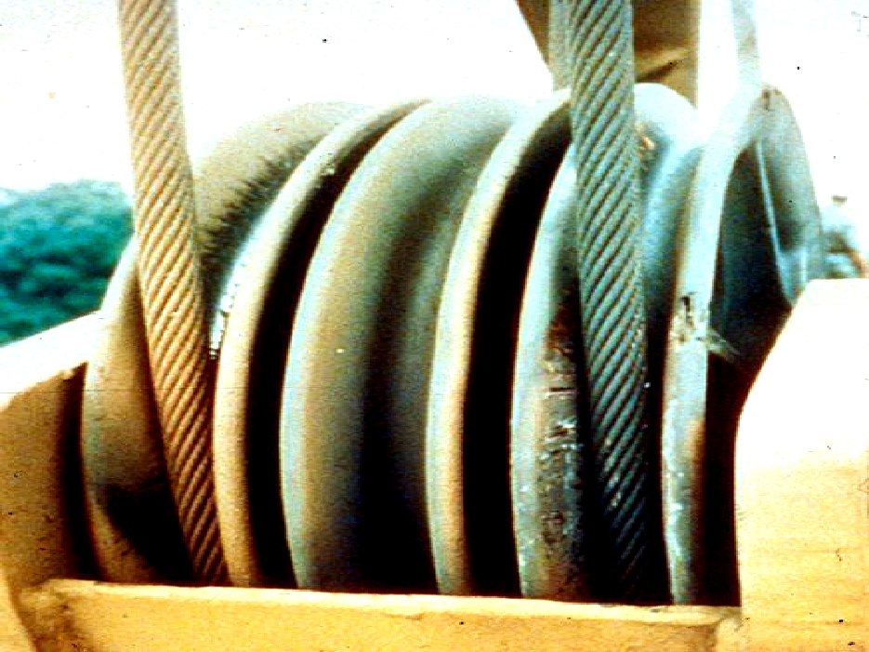
Sheaves
The grooves must be smooth and free from surface defects which could cause rope damage.
Notes:
Reference 1926.550(a)(1) Attachments used with cranes shall not exceed the capacity, rating, or scope recommended by the manufacturer.
Reference:ANSI B30.5-1968
5-1.7.4 Sheaves
Sheave grooves shall be smooth and free from surface defects which could cause rope damage. the cross sectional radius at the bottom of the groove should be such as to form a close fitting saddle for the size rope used and the sides of the groove should be tapered outwardly to facilitate entrance of the rope into the groove. Flange corners should be rounded and the rims should run true about the axis of the rotation.
Sheaves carrying ropes which can be momentarily unloaded shall be provided with close fitting guards or other suitable devices to guide the rope back into the groove when the load is applied again
The sheaves in the lower loads block shall be equipped with close-fitting guards that will prevent load from becoming fouled when the block is lying on the ground with ropes loose.
Means should be provided, if necessary, to proven the chafing of the ropes.
All sheave bearings shall be provided with means for lubrication. Permanently lubricated bearings are acceptable.
5-1.7.5 Sheave Sizes
Boom hoisting sheave shall have pitch diameters of not less than 15 times the nominal diameter of the rope used

Slide 30
Rigging Equipment Slings
Types of slings include alloy steel chain, wire rope, metal mesh, natural or synthetic fiber rope and synthetic web.
Chain
Wire rope
Metal mesh
Synthetic
Notes:
1926.251(a)(5)
This section applies to slings used in conjunction with other material handling equipment for the movement of material by hoisting.
The types of slings covered are those made from alloy steel chain, wire rope, metal mesh, natural or synthetic fiber rope (conventional three strand construction), and synthetic web (nylon, polyester, and polypropylene).
Slings and rigging are also included in the OSHA 10-hour Construction presentation Material Handling, Storage, Use and Disposal – located on OSHA’s web site.

Slide 31
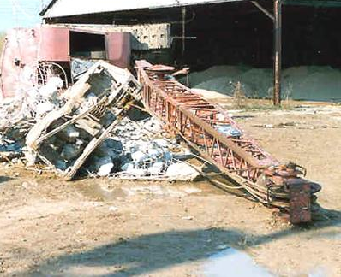
Annual Inspections
Inspection of the hoisting machinery must be made by a competent person
The employer must maintain a record of these inspections
Crane wasn’t inspected
and tipped over
Notes:
APPLICABLE OSHA STANDARD
1926.550(a)(6) A thorough, annual inspection of the hoisting machinery shall be made by a competent person, or by a government or private agency recognized by the U.S. Department of Labor. The employer shall maintain a record of the dates and results of inspections for each hoisting machine and piece of equipment.

Slide 32
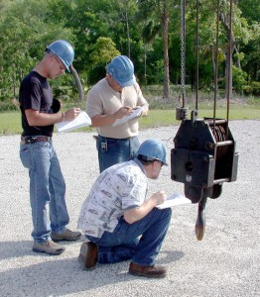
What to Inspect
Correct air pressure and no leaks
Tires properly inflated
Clearance for tail swing
Wire rope wear
Physical damage to crane
Loose or missing hardware, nuts, or bolts
Fluid leaks
Notes:
For inspection criteria refer to Mobile Crane Inspection Guidelines for OSHA Compliance Officers.
These are only some of the items to be inspected on a regular basis and for a complete inspection criteria contact the crane manufacturer and/or supplier.

Slide 33
Remove From Service
Immediately remove damaged or defective slings from service!

Slide 34
Damaged Wire Rope
Crushed Rope
Broken Strands
Damaged wire rope must be taken out of service!
Notes:
APPLICABLE OSHA STANDARD
1926.550(a)(7) Wire rope shall be taken out of service when any of the following conditions exist:
In running ropes, six randomly distributed broken wires in one lay or three broken wires in one strand in one lay;
(ii) Wear of one-third the original diameter of outside individual wires. Kinking, crushing, bird caging, or any other damage resulting in distortion of the rope structure;
(iii) Evidence of any heat damage from any cause;
(iv) Reductions from nominal diameter of more than one-sixty-fourth inch for diameters up to and including five-sixteenths inch, one-thirty-second inch for diameters three-eighths inch to and including one-half inch, three-sixty-fourths inch for diameters nine-sixteenths inch to and including three-fourths inch, one-sixteenth inch for diameters seven-eighths inch to 1 1/8 inches inclusive, three-thirty-seconds inch for diameters 1 1/4 to 1 1/2 inches inclusive;
(v) In standing ropes, more than two broken wires in one lay in sections beyond end connections or more than one broken wire at an end connection.
(vi) Wire rope safety factors shall be in accordance with American National Standards Institute B 30.5-1968 or SAE J959-1966.

Slide 35
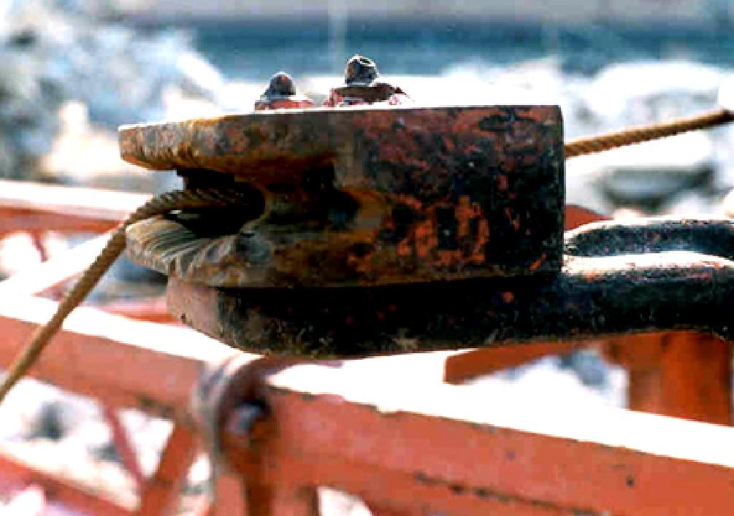
Worn Part
Notes:
This part is badly worn and should be replaced.

Slide 36
Tire Inspections
Conduct regular inspections of tires for excessive wear or damage
Notes:
Reference 1926.550(a)(1) The employer shall comply with the manufacturer's specifications and limitations applicable to the operation of any and all cranes and derricks. Where manufacturer's specifications are not available, the limitations assigned to the equipment shall be based on the determinations of a qualified engineer competent in this field and such determinations will be appropriately documented and recorded. Attachments used with cranes shall not exceed the capacity, rating, or scope recommended by the manufacturer.

Slide 37
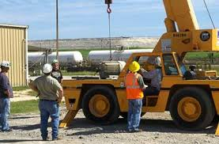
Training
Operators:
Must qualify on specific crane type
Must include on-the-job training
Supervisor / competent person
Notes:
Reference ANSI B30.5-1968
5-3.1.1 Operators
Cranes shall be operated only by the following personnel:
Designated operators
Learners under the direct supervision of a designated operator
Maintenance and test personnel, when it is necessary in the performance of their duties
Inspectors
No one other than personnel specified in Paragraph 5-3.1a shall enter a crane cab, with the exception of persons such as oilers and supervisors, whose duties require them to do so, and then only in the performance of their duties and with the knowledge of the operator of other appointed person.
5-3.1.2 Qualifications for Operators
Operators shall be required to pass practical operating examination. Examination shall be limited to the specific type equipment he/she will operate
Operators shall meet the following physical qualifications
Have vision of at least 20/30 Snellen in one eye, and 20/50 in the other, with or without glasses
Be able to distinguish red, green, and yellow, regardless of position of colors, if color differentiation is required for operation
Hearing with or without hearing aid, must be adequate for the specific operation
A history of epilepsy or of a disabling heart condition shall be sufficient reason for disqualification
SEE ALSO 5-3.1.3 Operating Practices

Slide 38
Summary
An unstable load, lack of communication, lack of training, and inadequate maintenance or inspection are major contributors to crane accidents.
Operators or others working in the area can be victims to “struck by" and "caught in" injuries.
Contact with power lines causes many accidents.
A competent person must inspect a crane regularly to insure it is in proper order.
Planning and training reduces accidents.

Slide 39
Bibliography
Main document
29 CFR 1926.550 Subpart N – Cranes, Derricks, Hoists, Elevators, and Conveyors
See Fatal facts for descriptions of fatal crane accidents at www.osha-slc.gov/OshDoc/toc_FatalFacts.html
Wire Rope
American National Standards Institute B 30.5-1968 or SAE J959-1966.

Slide 40
Contact Information
Health & Safety Training Specialists
1171 South Cameron Street, Room 324
Harrisburg, PA 17104-2501
(717) 772-1635
RA-LI-BWC-PATHS@pa.gov
Like us on Facebook! - https://www.facebook.com/BWCPATHS
Notes:
Please contact us for other available free training for your organization.

Slide 41
Questions

