Slide 1
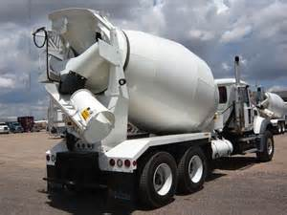
Concrete & Masonry Construction
Bureau of Workers’ Compensation
PA Training for Health & Safety (PATHS)
29 CFR 1926 Subpart Q
Notes:
This subpart sets forth requirements to protect all construction employees from the hazards associated with concrete and masonry construction operations performed in workplaces covered under 29 CFR Part 1926. In addition to the requirements in Subpart Q, other relevant provisions in Parts 1910 and 1926 apply to concrete and masonry construction operations.

Slide 2
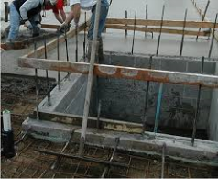
Subpart Q-Concrete & Masonry
Concrete & Masonry Construction
1926.700-706
Reinforcing steel - Guarding
Masonry walls - Bracing
Masonry construction - Limited access zone
Notes:
Incidents of violations found.

Slide 3
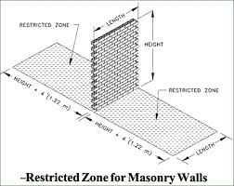
Masonry & Concrete
Revisions to standard during the 1990’s
Standard expands/toughens protection against wall collapse
Revised bracing requirements
Requires limited access zones
Notes:
Employers may now use several methods of testing concrete
Pre-cast and cast in place requirements are clarified

Slide 4
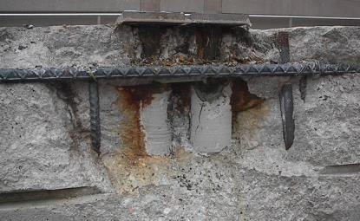
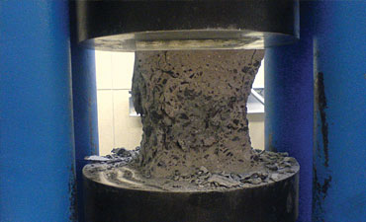
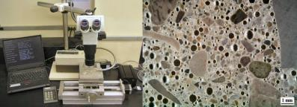
Concrete Test Methods
Notes:
Clockwise from upper left:
Swiss Hammer for testing Kips of pressure which can be withstood
Testing distressed concrete for rebar/concrete separation
Analytical view of core samples
Compression testing to determine Kips (1,000’s of pounds) at which point the sample fails under compression.

Slide 5
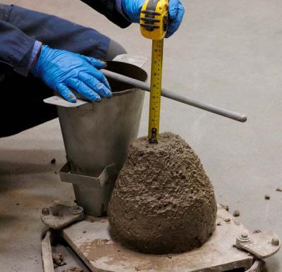
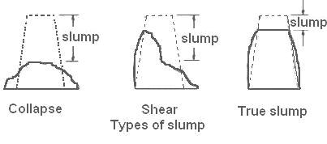
Slump Tests

Slide 6
Tragedy – Case Study
Cooling Tower, St. Mary’s West Virginia, 1978
51 killed
170 feet above ground
Entire form peeled away from newly-placed concrete

Slide 7
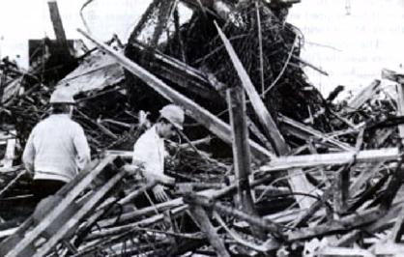
Tragedy – Case Study
Wreckage 168 feet below the top of the St. Mary’s tower being picked apart by investigators looking for clues.
The state of West Virginia objected to the site being cleaned before it could make its own full investigation.

Slide 8
Tragedy – Case Study
A number of safety lapses caused the collapse:
Scaffold was attached to concrete that had not had time to sufficiently cure.
Bolts were missing and the existing bolts were of insufficient grade.
Only one access ladder, restricting ability to escape.
An elaborate concrete hoisting system was modified without proper engineering review.
Contractors were rushing the construction.

Slide 9
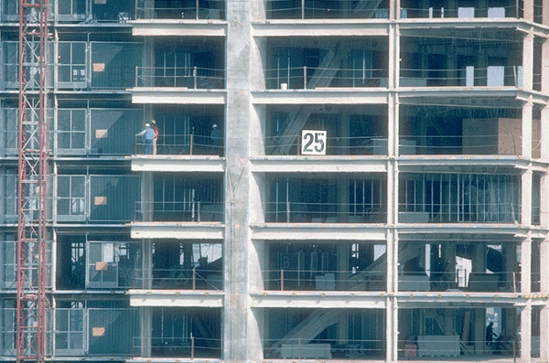
General Requirements 1926.701
No construction loads placed on concrete structure unless:
Employer determines safe to do so
Person qualified in industrial design
Structure capable of supporting loads
Notes:
Construction loads. No construction loads shall be placed on a concrete structure or portion of a concrete structure unless the employer determines, based on information received from a person who is qualified in structural design, that the structure or portion of the structure is capable of supporting the loads.

Slide 10
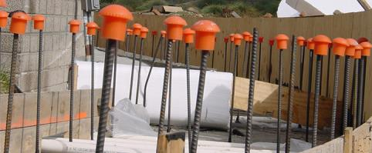
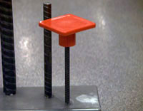
Concrete and Masonry
All rebar must be capped.
Notes:
Reinforcing steel. All protruding reinforcing steel, onto and into which employees could fall, shall be guarded to eliminate the hazard of impalement.

Slide 11
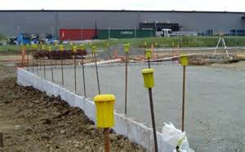
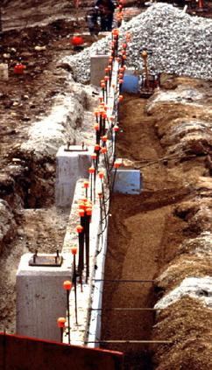
Capped Rebar

Slide 12
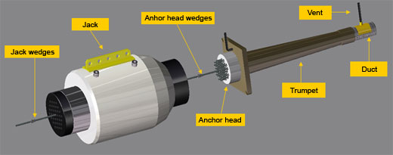
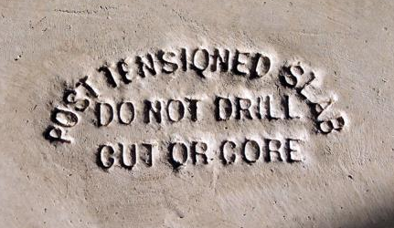
Post-Tensioning

Slide 13
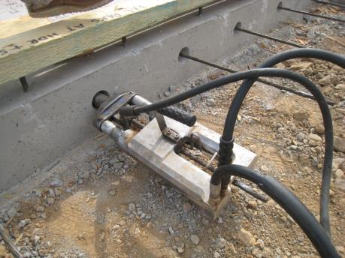
Post-Tensioning Operations
No employee except those essential to operations permitted behind the jack during tensioning operations
Signs and barriers erected to limit employee access to area during operations

Slide 14
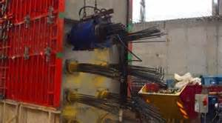
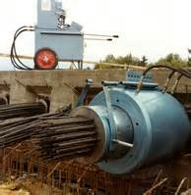
Post-Tensioning Operations
Notes:
Post-tensioning

Slide 15
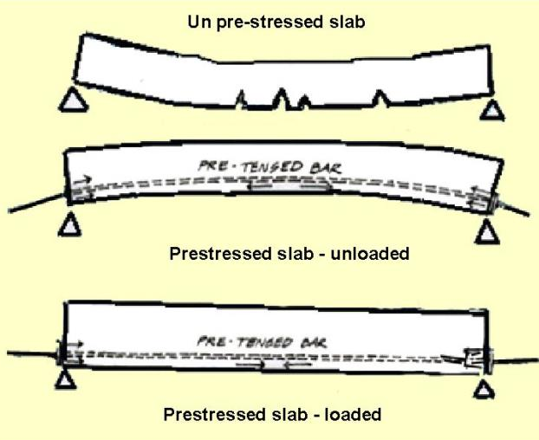
Slabs

Slide 16
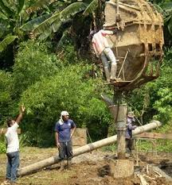
Concrete Bucket
No employee is ever permitted to ride concrete buckets

Slide 17
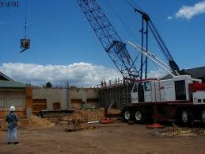
Working Under Loads
No employee shall work under concrete bucket while:
Bucket is being raised
Bucket is being lowered
To the extent practical… route buckets so no employees or the fewest number are exposed

Slide 18
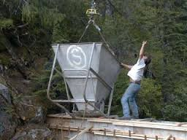
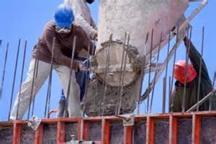
Where’s the Hazard?

Slide 19
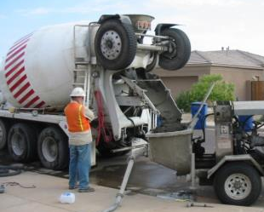
Personal Protective Equipment
If pneumatic hose is used to pump cement sand and water mixture
employees must wear protective head and face equipment

Slide 20
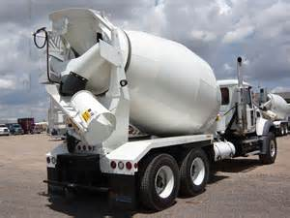
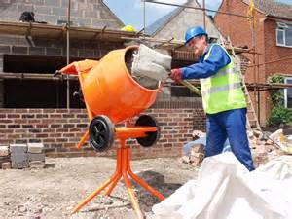
Bulk Cement Storage
Storage bins and silos:
Conical or tapered bottoms
Locked and tagged before entering
Concrete Mixers: Loading skip 1yd3 or larger:
- Mechanical device to clear material
- Guardrails on each side of the skip
Notes:
No employee shall be permitted to enter storage facilities unless the ejection system has been shut down, locked out, and tagged to indicate that the ejection system is not to be operated.

Slide 21
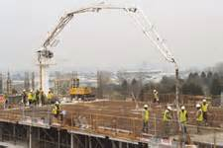
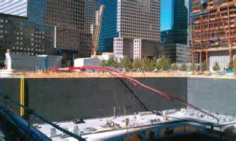
Concrete Pumping Systems
Provided with pipe supports designed for 100% overload
Compressed air hoses on pumping systems:
Positive fail-safe joint connectors
Prevent separation of sections while pressurized

Slide 22
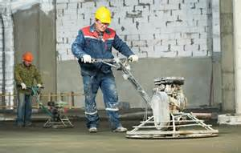
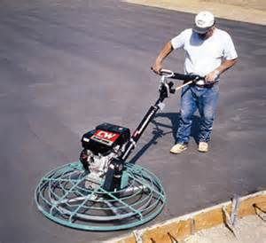
Power Concrete Trowels
Stop automatically when hand(s) are released from control
Notes:
Power concrete trowels. Powered and rotating type concrete troweling machines that are manually guided shall be equipped with a control switch that will automatically shut off the power whenever the hands of the operator are removed from the equipment handles.

Slide 23
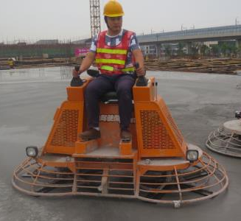
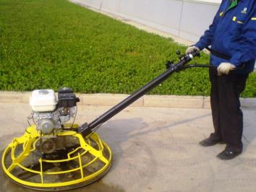
Power Trowels

Slide 24
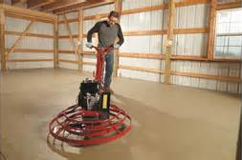
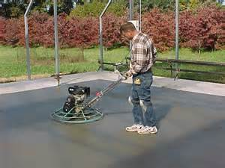
Power Trowel

Slide 25
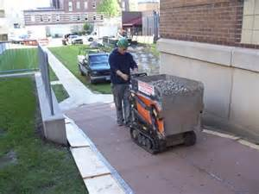
Buggy
Concrete buggy handles may not extend beyond the wheels on either side of the buggy

Slide 26
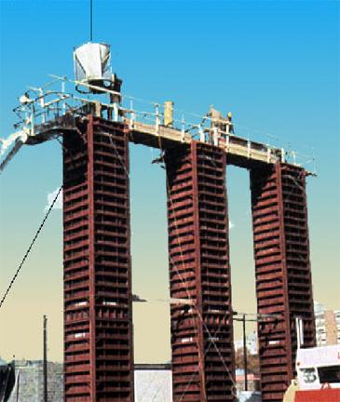
Dumping
Safety device required to prevent premature or
accidental dumping
Notes:
Concrete buckets equipped with hydraulic or pneumatic gates shall have positive safety latches or similar safety devices installed to prevent premature or accidental dumping.
(2) Concrete buckets shall be designed to prevent concrete from hanging up on top and the sides.

Slide 27
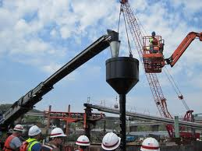
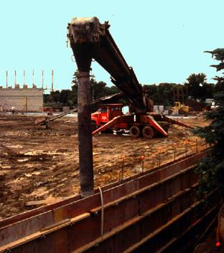
Tremies
Tremies: secured with wire rope (or similar) in addition to regular couplings or connections
Notes:
1926.702(g) Tremies. Sections of tremies and similar concrete conveyances shall be secured with wire rope (or equivalent materials) in addition to the regular couplings or connections.

Slide 28
Bull Floats
If handles could contact electrical conductors they must be of the non- conductive type
Notes:
Bull floats. Bull float handles used where they might contact energized electrical conductors, shall be constructed of nonconductive material or insulated with a nonconductive sheath whose electrical and mechanical characteristics provide the equivalent protection of a handle constructed of nonconductive material.

Slide 29
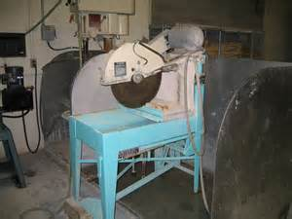
Saws
Guarded with semi-circular enclosure over blade
Enclosure must provide for retaining flying blade fragments
Notes:
Masonry saw shall be guarded with a semicircular enclosure over the blade.
A method for retaining blade fragments shall be incorporated in the design of the semicircular enclosure.

Slide 30
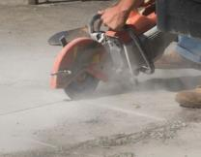
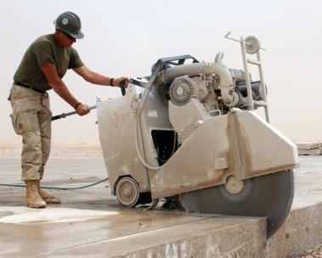
Cutting Concrete

Slide 31
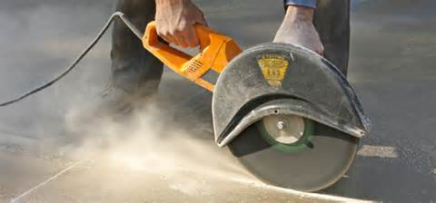
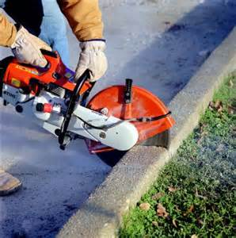
Cutting Concrete

Slide 32
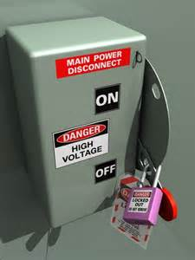
Lockout/Tagout Procedures
No repair or maintenance on equipment where inadvertent operation of the equipment could occur and cause injury unless hazardous energy sources have been locked out and tagged
Notes:
No employee shall be permitted to perform maintenance or repair activity on equipment (such as compressors mixers, screens or pumps used for concrete and masonry construction activities) where the inadvertent operation of the equipment could occur and cause injury, unless all potentially hazardous energy sources have been locked out and tagged.

Slide 33
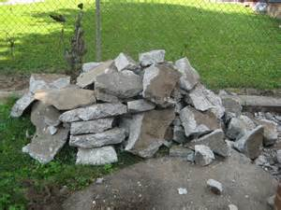
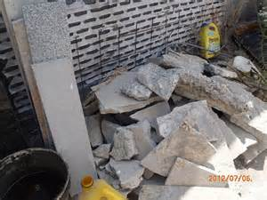
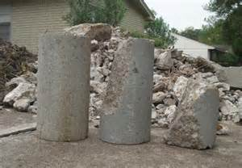
Housekeeping

Slide 34
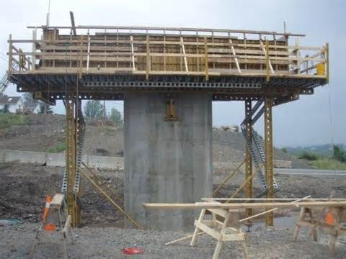
Cast-in-Place Concrete
Must be capable of supporting, without failure:
Vertical loads
Lateral loads
Use ANSI A10.9-1983
Drawings and plans
Must be on job site
Must include all revisions

Slide 35
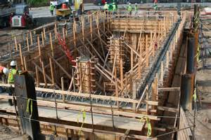
Cast-in-Place

Slide 36
Shoring and Reshoring
Shoring inspected prior to erection for:
Conformance with formwork drawings
Damaged shoring equipment not used
Shoring damaged after erection immediately reinforced
Notes:
Shoring shall be inspected prior to erection for conformance with formwork drawings
Damaged shoring equipment not meeting the requirements of 1926.703(a)(1) shall not be used
Shoring damaged after erection shall be immediately reinforced

Slide 37
Shoring and Reshoring
Sills sound, rigid, and capable of carrying the maximum intended load
Base plates, shore heads, adjustment screws in firm contact w/ form and foundation
Notes:
Sills shall be sound, rigid and capable of carrying the maximum intended load
Base plates, shore heads, extension devices, adjustment screws in firm contact w/ form and foundation
Unless designed for such eccentric loads on shore heads are prohibited

Slide 38
Tiered Single Post Shores
Designed & inspected by qualified engineer
Vertically aligned
Spliced to prevent misalignment
Braced in 2 mutually perpendicular directions at splice
Each tier diagonally braced in same 2 dir.
No raising of shores after concrete poured
Notes:
The design of the shoring shall be prepared by a qualified designer and the erected shoring shall be inspected by an engineer qualified in structural design.
The single post shores shall be a adequately braced in two mutually perpendicular directions at the splice level. Each tier shall also be diagonally braced in the same two directions.
Adjustment of single post shores to raise formwork shall not be made after the placement of concrete.

Slide 39
Vertical Slip Forms
Rods or pipes on which jacks climb:
Designed for that purpose
No excessive distortion during jacking
Provided with scaffolds where employees are required to pass
Notes:
Steel rods or pipes on which jacks climb shall be:
Specifically designed for that purpose
No excessive distortion during jacking
All VSF’s provided with scaffolds or work platforms where employees are required to work or pass

Slide 40
Vertical Slip Forms
Jack rod
1926.703(c)
Jack
Thin pipe around
jack rod
Yoke assembly
Working deck
Splash board
Wales
Bracing for Wales
Slight batter of sheathing
Sheathing
Notes:
The jacks or other lifting devices shall be provided with mechanical dogs or other automatic holding devices to support the slip forms whenever failure of the power supply or lifting mechanism occurs.
The predetermined safe rate of lift shall not be exceeded.

Slide 41
Vertical Slip-Form Operation

Slide 42
Reinforcing Steel
For walls, piers, columns, & other vertical structure shall be supported to prevent overturning or collapse
Employers take measures to prevent wire mesh from recoiling

Slide 43
Removal of Formwork
Forms and shores (Except those used for slabs on grade & slip forms):
Not removed until employer determines concrete has gained sufficient strength to support its weight and superimposed loads
Notes:
Forms and shores (except those used for slabs on grade and slip forms) shall not be removed until the employer determines that the concrete has gained sufficient strength to support its weight and superimposed loads. Such determination shall be based on compliance with one of the following:
The plans and specifications stipulate conditions for removal of forms and shores, and such conditions have been followed, or
The concrete has been properly tested with an appropriate ASTM standard test method designed to indicate the concrete compressive strength, and the test results indicate that the concrete has gained sufficient strength to support its weight and superimposed loads.

Slide 44
Flying Forms

Slide 45
Precast Concrete
Tilt-up walls supported to prevent overturning & collapse
Lifting inserts capable of supporting 2X the intended load
Lifting inserts in other than tilt-up members 4X the intended load
Lifting Hardware… 5X intended load
Only erectors under members being lifted
Notes:
Precast concrete wall units, structural framing, and tilt-up wall panels shall be adequately supported to prevent overturning and to prevent collapse until permanent connections are completed.
Lifting inserts which are embedded or otherwise attached to tilt-up precast concrete members shall be capable of supporting at least two times the maximum intended load applied or transmitted to them.
Lifting inserts which are embedded or otherwise attached to precast concrete members, other than the tilt-up members, shall be capable of supporting at least four times the maximum intended load applied or transmitted to them.
Lifting hardware shall be capable of supporting at least five times the maximum intended load applied transmitted to the lifting hardware.
No employee shall be permitted under precast concrete members being lifted or tilted into position except those employees required for the erection of those members.

Slide 46
Lift-Slab Operations
Designed and planned by registered P.E. with experience in lift-slab construction
Employer must implement P.E.’s design
Plans include instructions, sketches & method of erection
Design ensures lateral stability of the building/structure during construction
Notes:
Lift-slab operations shall be designed and planned by a registered professional engineer who has experience in lift-slab construction. Such plans and designs shall be implemented by the employer and shall include detailed instructions and sketches indicating the prescribed method of erection. These plans and designs shall also include provisions for ensuring lateral stability of the building/structure during construction.
Jacks/lifting units shall be marked to indicate their rated capacity as established by the manufacturer, this capacity cannot be exceeded.
Jacking equipment shall be capable of supporting at least two and one-half times the load being lifted during jacking operations and the equipment shall not be overloaded. For the purpose of this provision, jacking equipment includes any load bearing component which is used to carry out the lifting operation(s). Such equipment includes, but is not limited, to the following: threaded rods, lifting attachments, lifting nuts, hook-up collars, T-caps, shearheads, columns, and footings.

Slide 47
Lift-Slab Operations
Jacks designed so they will not lift, or continue to lift if loaded beyond their rated capacity
Jacks synchronized so that all points are within 1/2 inch of being level
Notes:
Jacks/lifting units shall be designed and installed so that they will neither lift nor continue to lift when they are loaded in excess of their rated capacity.
Jacks/lifting units shall have a safety device installed which will cause the jacks/lifting units to support the load in any position in the event any jacklifting unit malfunctions or loses its lifting ability.
Jacking operations shall be synchronized in such a manner to ensure even and uniform lifting of the slab. During lifting, all points at which the slab is supported shall be kept within 1/2 inch of that needed to maintain the slab in a level position.
If leveling is automatically controlled, a device shall be installed that will stop the operation when the 1/2 inch tolerance set forth in paragraph (g) of this section is exceeded or where there is a malfunction in the jacking (lifting) system.

Slide 48
Lift-Slab Operations
Notes:
If leveling is maintained by manual controls, such controls shall be located in a central location and attended by a competent person whole lifting is in progress. In addition to meeting the definition in 1926.32(f), the competent person must be experienced in the lifting operation and with the lifting equipment being used.

Slide 49
Jack Lifting Unit

Slide 50
Jacking Operation
Notes:
No employee, except those essential to the jacking operation, shall be permitted in the building/structure while any jacking operation is taking place unless the building/structure has been reinforced sufficiently to ensure its integrity during erection. The phrase "reinforced sufficiently to ensure its integrity" used in this paragraph means that a registered professional engineer, independent of the engineer who designed and planned the lifting operation, has determined from the plans that if there is a loss of support at any jack location, that loss will be confined to that location and the structure as a whole will remain stable.
Under no circumstances, shall any employee who is not essential to the jacking operation be permitted immediately beneath a slab while it is being lifted.
For the purpose of paragraph (k) of this section, a jacking operation begins when a slab or group of slabs is lifted and ends when such slabs are secured (with either temporary connections or permanent connections).

Slide 51
Manual Lifting Controls
Notes:
Such controls shall be centrally located.
If leveling is maintained by manual controls, such controls shall be located in a central location and attended by a competent person whole lifting is in progress. In addition to meeting the definition in 1926.32(f), the competent person must be experienced in the lifting operation and with the lifting equipment being used.
The maximum number of annually controlled jacks/lifting units on one slab shall be limited to a number that will permit the operator to maintain the slab level within specified tolerances of paragraph (g) of this section, but in no case shall that number exceed 14.

Slide 52
Masonry Construction
CFR 1926.706

Slide 53
Limited Access Zone
Shall be established whenever a masonry wall is being constructed
Prior to start of construction
Equal to height of wall plus four feet
Entire length of wall
Opposite scaffold side
Only masons allowed

Slide 54
Limited Access Zone
L.A.Z. shall remain in place until wall is supported
If wall is over eight feet tall it must be braced unless adequately supported
Bracing must remain until permanent support structures are in place

Slide 55
Bibliography
OSHA Office of Education and Training

Slide 56
Contact Information
To contact a Health & Safety Training Specialist:
Bureau of Workers’ Compensation
1171 South Cameron Street Room 324
Harrisburg, PA 17104-2501
717-772-1635
RA-LI-BWC-PATHS@pa.gov
Like us on Facebook! - https://www.facebook.com/BWCPATHS

Slide 57
Questions

