Slide 1

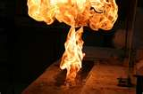
Compressed Gas Safety
Bureau of Workers’ Compensation
PA Training for Health & Safety (PATHS)
OSHA 29 CFR 1910.101
Compressed Gases
(General Requirements)
&
OSHA 29 CFR 1910.253
Oxygen-fuel gas
Welding & cutting
Safe Use, Handling and Storage
PPT-043-01
1
Notes:
The hazards of compressed gases are recognized by several professional organizations besides the Compressed Gas Association.
OSHA regulations address the hazards and proper storage, handling and use of specific gases. These regulations serve as planning tools to better ensure safety in the workplace.

Slide 2
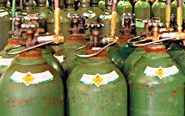
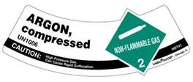
Topics
Regulations
Uses
Properties & Examples
Compressed Gas
Liquefied Gas
Cryogenics
Terms & Behavior
Containers & Markings
Pressure Relief Valves
Violent Reactions
Handling & Storage
Inspections
Emergency Response
Assist Standards
Bibliography
PPT-043-01
2
Notes:
Above are the various topics this program will address, selectively working with specific gases as examples. Using the same methods for planning, use and response, you can apply similar job planning for unique gases at your location.

Slide 3

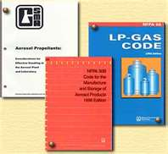
Regulations
Regulations for use, storage and handling will be according to the AHJ (Authority Having Jurisdiction
In the absence of codes, the following may provide guidance:
Compressed Gas Association
NFPA (National Fire Protection Association)
Safety Data Sheet (formerly Material Safety Data Sheet)
PPT-043-01
3
Notes:
Various regulations may be adopted by the AHJ (Authority Having Jurisdiction) indicating the manner of operation with gases.
In the absence of such codes, guidance may be found in professional publications such as available from:
The Compressed Gas Association (CGA),
National Fire Protection Association (NFPA) and
Safety Data Sheets

Slide 4
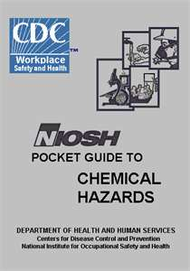

Other Sources
For determining hazards
and for planning
purposes:
NIOSH Pocket Guide to
Chemical Hazards
2012 Emergency
Response Guidebook
PPT-043-01
4
Notes:
Other sources, used for emergency planning and response, include:
The NIOSH Pocket Guide to Chemical Hazards and
The most recent edition of the Emergency Response Guidebook

Slide 5
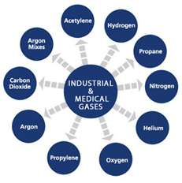
Uses
Industrial uses include: processes, heating, forklifts. Industrial gases may also have other gases added for process purity
Medical gases are blends of several gases
Vehicles converted from gasoline or diesel
Citizen use for heating
PPT-043-01
5
Notes:
Gases in our society can be found in
Industrial processes
Medical uses
Vehicle fuels
Citizen use for heating

Slide 6

Gas Properties
Gases can be:
Flammable
Non-Flammable
Oxidizers
Corrosive
Asphyxiants
Poison
Inert
Or a mixture
PPT-043-01
6
Notes:
Gas may possess various physical properties as shown.
They may be found in a single state or as blended mixtures.

Slide 7
Physical States
Gas In Cylinder Temperature
Compressed Gas +70 to +32F in gaseous state
Liquefied Gas +32 to -130 in liquefied state
Cryogenic Liquid -130 to -432 refrigerated liquefied gas
Storage temperatures are gas-dependent
PPT-043-01
7
Notes:
Physical states for gases will depend on a pressure and temperature relationship. Also whether they can sustain this physical state solely dependent upon container design.
Cryogenic liquids, to retain their physical state must be partnered with refrigeration methods.

Slide 8
Compressed Gas Examples
Vapor
Types Hazard Class Density LEL/UEL Flashpoint (F)
Methane 2.1 Fl 0.55 5-15% -306
Ethane 2.1 Fl 1.04 3-12.4% -211
Propane 2.1 Fl 1.52 2.2-9.5% -56
Butane 2.1 Fl 2.0 1.8-8.4% -101
Nitrogen 2.2 Non-Fl 0.96 Inert ------
Oxygen 5.1 Ox 1.1 NF/Oxidizer ------
Arsine 2.1 FL/2.3 PG 2.69 4.5-64% ------
Chlorine 2.2 NFl/2.3 PG 2.48 Oxidizer ------
Fl=Flammable
NFl=Non-Flammable
PG=Poison Gas
Ox=Oxidizer
PPT-043-01
8
Notes:
The above examples of compressed gases indicate their:
Hazard class assignment for labeling and shipping
Their vapor density; whether heavier or lighter than air
The Lower and Upper Explosive (or flammable) Limits in air and
Flashpoint (Ignition temperature)

Slide 9
Definitions
Gas:
State of matter in which material has a very low density and viscosity
Can expand and contract in response to temperature and pressure changes
Easily diffuses into other gases; distributes itself inside a container
If the temperature is dropped and pressure increased, the gas can be changed to a liquid or semi-solid state
PPT-043-01
9
Notes:
Of the three (3) main physical states; solids, liquids and gas, it is gas with a very low density and viscosity.
Gases expand and contract depending upon temperature and pressure changes.
Gases can easily diffuse into other gases and distributes itself inside a container.
By dropping the temperature and increasing the pressure, a gas can be changed to a liquid or semi-solid state.

Slide 10
Compressed Gas
“Material or mixture having in the container an absolute pressure exceeding 40 psi at 70ºF or, regardless of pressure at 70ºF, having an absolute pressure exceeding 104 psi at 130ºF or any liquid material having a vapor pressure exceeding 40 psi absolute at 100ºF as determined by ASTM Test D-323”
page 597, CGA Handbook, 3rd Edition
PPT-043-01
10
Notes:
The definition of a compressed gas is provided by the Compressed Gas Association in their 3rd edition Handbook.
“Material or mixture having in the container an absolute pressure exceeding 40 psi at 70ºF or, regardless of pressure at 70ºF, having an absolute pressure exceeding 104 psi at 130ºF or any liquid material having a vapor pressure exceeding 40 psi absolute at 100ºF as determined by ASTM Test D-323”
Absolute pressure (psia: pounds per square inch, absolute) includes 14.7 psi for atmospheric pressure at sea level.
For a reading of psig (pounds per square inch gauge) subtract the 14.7 psi at sea level.

Slide 11
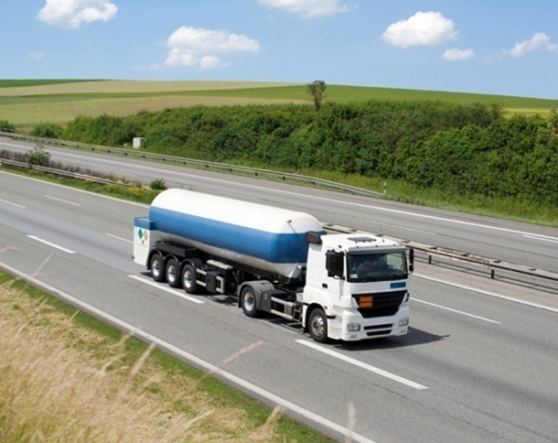
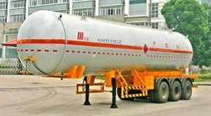
Liquefied Petroleum Gas
LP Gas or LPG –
• Any material with a vapor pressure not exceeding that allowed for commercial propane
• Composed predominantly of the following hydrocarbons, either by themselves or as mixtures: propane, propylene, butane (normal butane or isobutene), and butylenes
PPT-043-01
11
Notes:
LP Gas or LPG –
• Any material with a vapor pressure not exceeding that allowed for commercial propane
• Composed predominantly of the following hydrocarbons, either by themselves or as mixtures: propane, propylene, butane (normal butane or isobutene), and butylenes

Slide 12
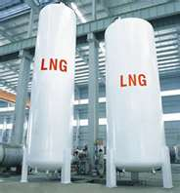
Liquefied Natural Gas
Also called LNG
A fluid in the cryogenic liquid state that is composed predominantly of methane.
PPT-043-01
12
Notes:
Liquefied natural gas is also called LNG.
A fluid in the cryogenic liquid state that is composed predominantly of methane.

Slide 13
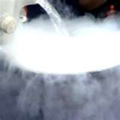
Cryogenic Liquid
Cryogenic liquid: Refrigerated liquefied gas with normal boiling point below -130ºF
Hazards include those of the gas, frostbite and asphyxiation if breathable oxygen in air is displaced
PPT-043-01
13
Notes:
Cryogenic liquid: Refrigerated liquefied gas with normal boiling point below -130ºF
Hazards include those of the gas, frostbite and asphyxiation if breathable oxygen in air is displaced
“cryogen” is from the Greek meaning born icy cold.

Slide 14
Terms
Boiling Point:
Temperature when a gas converts from its liquefied state to vaporous state
Critical Pressure:
Temperature above which a gas cannot be liquefied by pressure alone
PPT-043-01
14
Notes:
Some terms used to describe gases and their behavior include:
Boiling Point:
Temperature when a gas converts from its liquefied state to vaporous state
Critical Pressure:
Temperature above which a gas cannot be liquefied by pressure alone

Slide 15
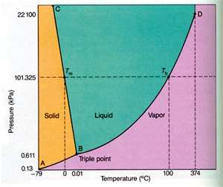
Triple Point
The only temperature and pressure at which three phases (gas, liquid, and solid) in a one-component system can exist in equilibrium
PPT-043-01
15
Notes:
The Triple Point of a gas is described as,
The only temperature and pressure at which three phases (gas, liquid, and solid) in a one-component system can exist in equilibrium

Slide 16

Compressed Gas Terms
Vapor Density (Gas Specific Gravity): A comparison of the weight of the gas to air (1.0). Heavier-than-air gases will have a vapor density greater than 1.0; lighter gases will have a vapor density less than 1.0
PPT-043-01
16
Notes:
Vapor Density (Gas Specific Gravity): A comparison of the weight of the gas to air (1.0). Heavier-than-air gases will have a vapor density greater than 1.0; lighter gases will have a vapor density less than 1.0

Slide 17
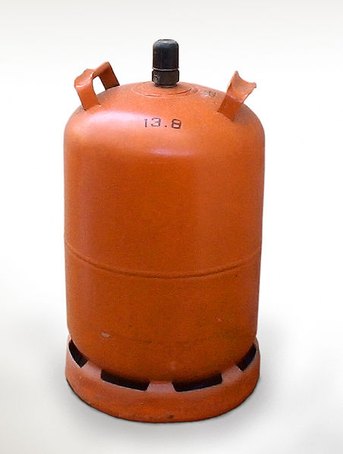
TLV-TWA
TLV-TWA (threshold limit value-time weighted average): Given in ppm (parts per million). Exposure amount which most people can work in for an 8 hour day without suffering harmful effects
PPT-043-01
17
Notes:
TLV-TWA (threshold limit value-time weighted average): Given in ppm (parts per million). Exposure amount which most people can work in for an 8 hour day without suffering harmful effects

Slide 18
IDLH
IDLH: Immediately Dangerous to Life and Health. Amounts to which persons should not be exposed due to their harmful effects.
Sources for determining these limits will be found on the SDS, as well in various guides, i.e. “NIOSH Pocket Guide to Chemical Hazards”
PPT-043-01
18
Notes:
IDLH: Immediately Dangerous to Life and Health. Amounts to which persons should not be exposed due to their harmful effects.
Sources for determining these limits will be found on the SDS, as well in various guides, i.e. “NIOSH Pocket Guide to Chemical Hazards”

Slide 19
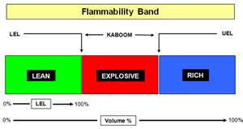
LEL
Lower Explosive Limits (LEL) also known as lower flammable limits (LFL): least percentage of a gas, mixed with the proper proportions of air, whereby having the necessary heat applied, combustion may result
PPT-043-01
19
Notes:
Lower Explosive Limits (LEL) also known as lower flammable limits (LFL): least percentage of a gas, mixed with the proper proportions of air, whereby having the necessary heat applied, combustion may result

Slide 20
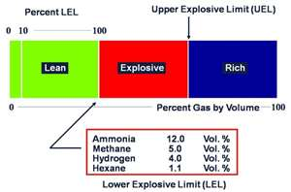
UEL
Upper Explosive Limits (UEL) also known as upper flammable limits (UFL): greatest percentage of a gas, that when proportioned with air, may permit sustained combustion
PPT-043-01
20
Notes:
Upper Explosive Limits (UEL) also known as upper flammable limits (UFL): greatest percentage of a gas, that when proportioned with air, may permit sustained combustion

Slide 21
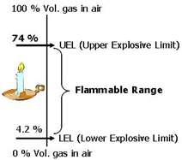
Flammable Limits
Flammable Limits also known as the Flammable Range: percentage of gas within the LEL and UEL where combustion may occur and be sustained
Shown: Hydrogen approximated (4%-75%)
PPT-043-01
21
Notes:
Flammable Limits also known as the Flammable Range: percentage of gas within the LEL and UEL where combustion may occur and be sustained.
Shown: Hydrogen approximated (4%-75%)

Slide 22
Ignition Temperature
Ignition Temperature: Unique to various solids, vapors and gases, the requisite heat from an open flame source required to ignite materials.
Autoignition temperature is the temperature required to ignite materials absent an open flame source
PPT-043-01
22
Notes:
Ignition Temperature: Unique to various solids, vapors and gases, the requisite heat from an open flame source required to ignite materials.
Autoignition temperature is the temperature required to ignite materials absent an open flame source

Slide 23
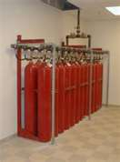
Inert Gas
Gas which does not react with other materials (e.g. argon, helium, neon)
Can be an asphyxiant which reduces the amount of breathable air in a location
Used in fire suppression systems, purging and cleaning
PPT-043-01
23
Notes:
Gas which does not react with other materials (e.g. argon, helium, neon)
Can be an asphyxiant which reduces the amount of breathable air in a location
Used in fire suppression systems, purging and cleaning

Slide 24
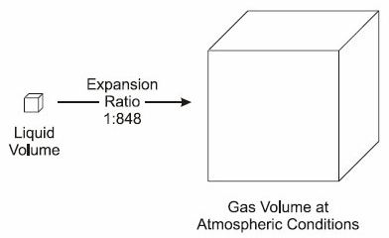
Expansion Rate (or Ratio)
Conversion of cubic feet of liquid to cubic feet of gas
Can result in achieving the LEL or Flammable Limits in an inside environment
Can also result in the toxic levels or IDLH for a gas expressed as percentage by volume or ppm (parts per million)
PPT-043-01
24
Notes:
Conversion of cubic feet of liquid to cubic feet of gas
Can result in achieving the LEL or Flammable Limits in an inside environment
Can also result in the toxic levels or IDLH for a gas expressed as percentage by volume or ppm (parts per million)

Slide 25
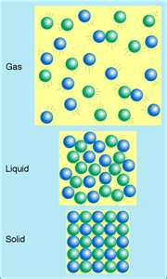
Expansion Rate
Gas Expansion Rate
Methane 625:1
Propane 270:1
Butane 284:1
Nitrogen 696:1
Oxygen 860:1
Chlorine 444:1
PPT-043-01
25
Notes:
The Expansion Rate (or Ratio) of a gas describes the cubic feet of vapor from each liquefied cubic foot of gas. The larger the number, the greater the area inside or outside to be overwhelmed by the gas.

Slide 26
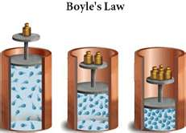
Gas Laws of Gas Behavior
Boyle’s Law:
Decrease container’s
volume by ½
Temperature and amount
of gas remain constant
Pressure will double
PPT-043-01
26
Notes:
Various Laws of behavior are utilized when discussing how a gas will act.
Boyle’s Law indicates
Decrease container’s volume by ½
Temperature and amount of gas remain constant inside a closed system
Pressure will double

Slide 27
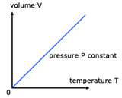
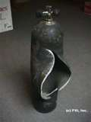
Gas Laws
Charles Law
When the temperature increases, the volume increases
Perhaps the container won’t be able to handle the volume increase
PPT-043-01
27
Notes:
Charles Law states:
When the temperature increases, the volume increases
Perhaps the container won’t be able to handle the volume increase

Slide 28

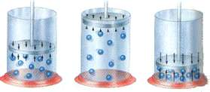
PVT Relationship
If temperature of a gas increases in cylinder, volume of cylinder can not be increased
Pressure increases and may activate relief valve
Too rapidly increasing
pressures may rupture cylinder
PPT-043-01
28
Notes:
The PVT (or pressure, volume, temperature) relationship indicates,
If temperature of a gas increases in cylinder, volume of cylinder can not be increased
Pressure increases and may activate relief valve
Too rapidly increasing
pressures may rupture cylinder

Slide 29
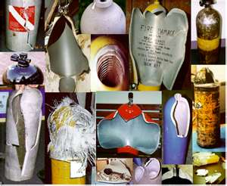
Rule of Thumb
Increase gas temperature 500 degrees = double pressure
Increase gas temperature 1,000 degrees = triple pressure
Increase gas temperature 1,500 degrees = quadruple pressure
(Some gas cylinders do NOT have a pressure relief valve, could be a catastrophic rupture!)
PPT-043-01
29
Notes:
Pressure increases inside a cylinder may adapt the above Rule of Thumb:
Increase gas temperature 500 degrees = double pressure
Increase gas temperature 1,000 degrees = triple pressure
Increase gas temperature 1,500 degrees = quadruple pressure
(Some gas cylinders do NOT have a pressure relief valve, could be a catastrophic rupture!)

Slide 30
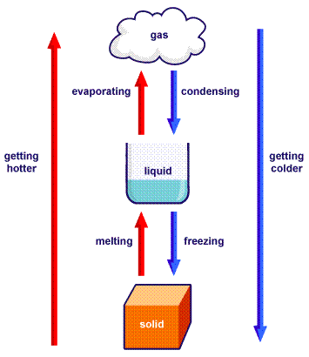
Cryogenic
Heat expands a gas
If we pressurize a gas while cooling it, we can turn a gas into a liquefied gas
Further cooling and pressure may convert it to a cryogenic gas
This increases the amount of product that can be put in a cylinder
PPT-043-01
30
Notes:
With a Cryogenic,
Heat expands a gas
If we pressurize a gas while cooling it, we can turn a gas into a liquefied gas
Further cooling and pressure may convert it to a cryogenic gas
This increases the amount of product that can be put in a cylinder

Slide 31
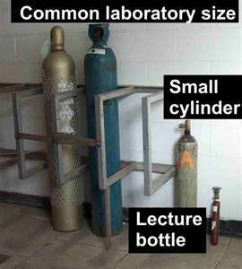
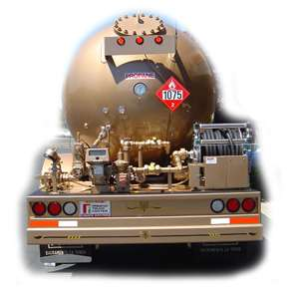
Gas Containers
Lecture Bottles
Cylinders
Tank Trucks
PPT-043-01
31
Notes:
Gas containers come in a variety of sizes and styles.
Lecture bottles containing small amounts of gas,
Cylinders of differing sizes and
Tank trucks

Slide 32

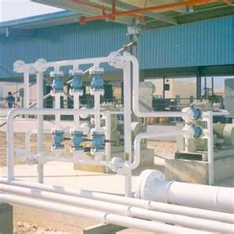
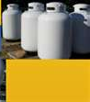
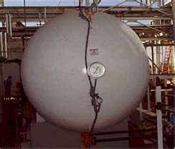
Gas Containers
Railroad Tank Cars
Portable Tanks
Fixed Storage
Pipelines
PPT-043-01
32
Notes:
More containers include:
Tank cars for railroad shipments to move bulk product.
Portable Tanks
Fixed Storage
Pipelines
Transport vehicles may also be found at locations connected to building systems.

Slide 33
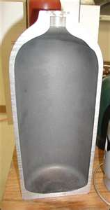
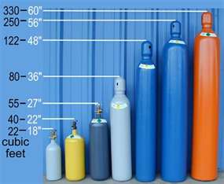
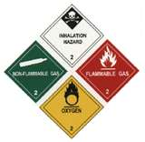
Cylinders
Construction
Must be compatible
with the material
contained
Markings
Labeling required to
identify the gas in storage
and during shipment
PPT-043-01
33
Notes:
Cylinders are usually the most readily found containers at a variety of locations.
Construction
Must be compatible with the material contained
Markings Labeling required to identify the gas in storage and during shipment

Slide 34
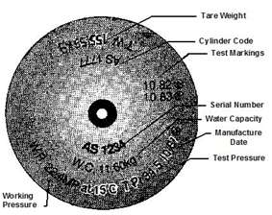
Markings
Nomenclature related to the cylinder and its contents will assist in the safety process
Low Pressure: Below 900 psi
High Pressure: 900 psi or greater
PPT-043-01
34
Notes:
Nomenclature related to the cylinder and its contents will assist in the safety process
Low Pressure: Below 900 psi
High Pressure: 900 psi or greater

Slide 35
Storage Pressure
Storage Ignition
Types Pressure (PSI) Temperature
Methane up to 6000psi 999F
Ethane 544 959
Propane 109.7 871
Butane 31 761
Nitrogen 2,000/below 200 as cryogen Inert
Oxygen 2,000/below 200 as cryogen Inert
Arsine 219.7 (*see note)
*Note: Arsine has no given Ignition Temperature but decomposes into arsenic and hydrogen between 446 F to 464 degrees F
PPT-043-01
35
Notes:
Storage pressures at which gases may be found are shown on the slide above. Precautions need to be taken not only for the characteristics of a gas but the possibility of a pressure vessel rupture.

Slide 36
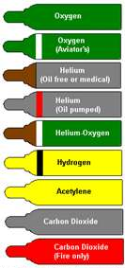
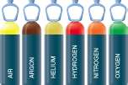
Color Codes
Cylinder shells can also be color coded to better identify the contents permitted into the specific type of cylinder
This eliminates cross-contamination by introducing non-compatible gases into non-specification cylinders
PPT-043-01
36
Notes:
Cylinder shells can also be color coded to better identify the contents permitted into the specific type of cylinder
This eliminates cross-contamination by introducing non-compatible gases into non-specification cylinders

Slide 37
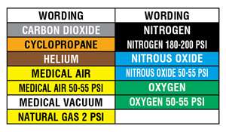
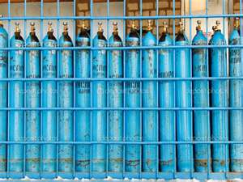
Medical Gas Color Codes
Medical gases will often be a blend of a parent gas with fractions of other gases introduced for purity and stability
PPT-043-01
37
Notes:
Medical gases will often be a blend of a parent gas with fractions of other gases introduced for purity and stability

Slide 38
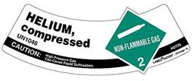
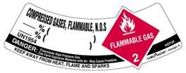
Labels
FTSC Code
Standard numerical code
for a gas indicating:
Flammability
Toxicity
State of the gas
Corrosiveness
CGA V-7 pamphlet provides more
in-depth information.
PPT-043-01
38
Notes:
The Compressed Gas Association has a code system for gases known as the FTSC Code.
A standard numerical code for a gas indicates:
Flammability
Toxicity
State of the gas
Corrosiveness
More information can be found in pamphlet CGA V-7 from the Compressed Gas Association

Slide 39
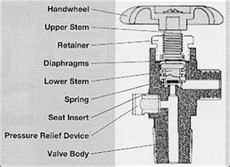
Diaphragm Valve
Diaphragm Valve better retains the cylinder contents
Not as prone to leakage as the packed valve
Note the diaphragm’s location
Note also the relief valve’s location in the product line
PPT-043-01
39
Notes:
Depending upon the valve on a cylinder, leaks of product may occur. Response to such situations should be known and trained on.
Diaphragm Valve better retains the cylinder contents
Not as prone to leakage as the packed valve
Note the diaphragm’s location
Note also the relief valve’s location in the product line

Slide 40
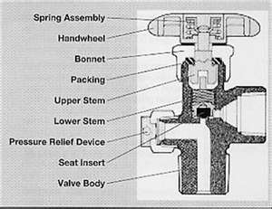
Packed Valve
The Packed Valve has packing between the upper stem and bonnet
This type is known for leaking through the packing
Often the leak may be secured by tightening the bonnet nut
PPT-043-01
40
Notes:
The Packed Valve has packing between the upper stem and bonnet
This type is known for leaking through the packing
Often the leak may be secured by tightening the bonnet nut

Slide 41
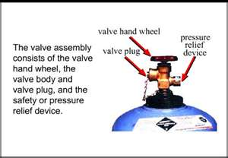
Pressure Relief Valve (PRV):
May be pressure, temperature or spring activated to permit container contents to escape thereby averting a container rupture
The PRV is in the product line
PPT-043-01
41
Notes:
Some gas valves will have Pressure Relief Valves should the internal cylinder pressure rise. It is a means to vent-off over pressurization so the cylinder does not fail violently.
A reading of CGA charts will indicate the type of relief valve which must be used or whether, based on the gas hazard, if no PRV is to be used.
May be pressure, temperature or spring activated to permit container contents to escape thereby averting a container rupture
The PRV is in the product line

Slide 42
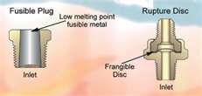
Fusible Plug/Combination
Fusible plug melts at a designated temperature and permits the product of a cylinder to be released to avert a catastrophic rupture
Combination relief: One with a rupture disk and fusible plug
Both are Non-resealing
PPT-043-01
42
Notes:
Fusible plug melts at a designated temperature and permits the product of a cylinder to be released to avert a catastrophic rupture
Combination relief: One with a rupture disk and fusible plug
Both are Non-resealing

Slide 43
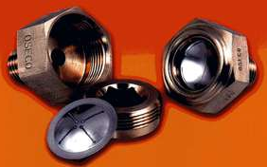
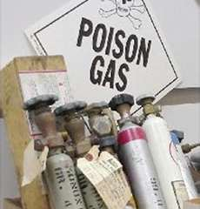
Rupture Disk
Rupture disk (frangible disk) - Operating part of a PRV: ruptures at a predetermined pressure allowing cylinder contents to escape
Non-resealing
Poison gas cylinders do not have a PRV Depending on their classification PRVs are “prohibited”
PPT-043-01
43
Notes:
Rupture disk (frangible disk) - Operating part of a PRV: ruptures at a predetermined pressure allowing cylinder contents to escape
Non-resealing
Poison gas cylinders do not have a PRV Depending on their classification PRVs are “prohibited”

Slide 44
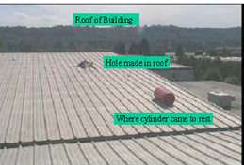
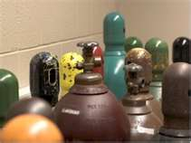
Cylinder Hazards
Material Hazards
Flammability
Spontaneously Flammable
(arsine, silane and
phosphine)
Corrosivity
Reactivity
Poison
Carcinogenic
Container Behavior
Frostbite
Rupture
Rocketing
BLEVE (Boiling Liquid
Expanding Vapor
Explosion)
PPT-043-01
44
Notes:
Cylinder hazards can be the result of the gas characteristic as well as container behavior under varying impacting conditions.

Slide 45
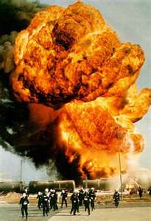
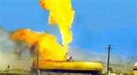
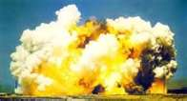
BLEVE: Boiling Liquid Expanding Vapor Explosion
A cylinder or tank is heated.
Contents absorb heat and convert to pressurized
vapor.
Relief valve activates.
Pressure increases beyond the PRV capacity.
Container, thermally stressed, violently ruptures.
If the gas is flammable, the fireball
is devastating.
PPT-043-01
45
Notes:
One of the most catastrophic failures of a container is known as a B.L.E.V.E. (blev-E).
This condition occurs when:
A cylinder or tank is heated.
Contents absorb heat and convert to pressurized
vapor.
Relief valve activates.
Pressure increases beyond the PRV capacity.
Container, thermally stressed, violently ruptures.
If the gas is flammable, the fireball
is devastating. Also, shrapnel from the container is dangerous.

Slide 46

BLEVE
BLEVEs can occur with liquefied nitrogen and helium or refrigerants and cryogens as well as LP Gas or LNG
The Pressure, Volume, Temperature relationship drives the BLEVE
PPT-043-01
46
Notes:
BLEVEs can occur with liquefied nitrogen and helium or refrigerants and cryogens as well as LP Gas or LNG
The Pressure, Volume, Temperature relationship drives the BLEVE

Slide 47


BLEVE
Cylinder exploded inside a building
Cylinder exploded outside
  May occur with Liquefied Petroleum Gas (LPG) Propane and Butane being main components or
  with Liquefied Natural Gas (LNG) of which Methane is the largest component
PPT-043-01
47
Notes:
The slide shows a Cylinder exploded inside a building
Cylinder exploded outside
May occur with Liquefied Petroleum Gas (LPG) Propane and Butane being main components or
with Liquefied Natural Gas (LNG) of which Methane is the largest component

Slide 48

Railroad Tank Car BLEVE
Crescent City, Illinois, June 21, 1970, 7:30am.
Train No. 20 derailed involving 3 tank cars
BLEVE was 34,000 gallons of Propane
Emergency planning paid off
PPT-043-01
48
Notes:
A railroad tank car incident in the 1970’s was typical of disasters which caused several changes in tank car construction;
A reinforced end on tanks (deflector baffle),
A bottom and top shelf on couplers to reduce the possibility of cars becoming uncoupled during an incident
Also, sprayed-on insulation or double-walling tank cars to keep heat from the contents.
Shown above:
Crescent City, Illinois, June 21, 1970, 7:30am.
Train No. 20 derailed involving 3 tank cars
BLEVE was 34,000 gallons of Propane
Emergency planning paid off

Slide 49

Fixed Location BLEVE
65,000 gallons of propane at bulk storage location in Canada, 2008
PPT-043-01
49
Notes:
Incidents can devastate fixed locations.
Here is 65,000 gallons of propane at a bulk storage location in Canada, 2008.

Slide 50

Hydrocarbon Gases
Contain flammable hydrogen and combustible carbon in their make-up.
  Flammable
  Non-Corrosive
  Non-Toxic
  Colorless
Examples include:
  Propane and
  Butane
PPT-043-01
50
Notes:
Hydrocarbon gases contain flammable hydrogen and combustible carbon in their make-up.
Flammable
Non-Corrosive
Non-Toxic
Colorless
Examples include:
Propane and
Butane

Slide 51
Hydrocarbon Gases
Ignition
Gas Formula Temperature (F)
Methane CH₄ 999
Ethane C₂H₆ 959
Propane C₃H₈ 871
Butane C₄H₁₀ 761
PPT-043-01
51
Notes:
Shown in order of the number of carbon atoms are basic hydrocarbon gases along with their representative ignition temperatures.
Another rule of thumb is that depending on the number of carbon atoms, the physical state may be determined.
1-4 carbon atoms=a gas,
5-12 carbon atoms=a liquid (around 11 carbon atoms, a waxy-solid may form)
Over 12 carbon atoms=a solid

Slide 52


Oxygen
Not flammable
Sensitizes flammable and combustible materials requiring less input heat for ignition.
In some cases, materials impregnated with oxygen can be ignited with static electricity.
PPT-043-01
52
Notes:
Oxygen:
Is not flammable
It sensitizes flammable and combustible materials requiring less input heat for ignition.
In some cases, materials impregnated with oxygen can be ignited with static electricity.

Slide 53
PELs/IDLH
TWA:
Gas CAS # OSHA PEL IDLH
Methane 74-82-8
Ethane 74-84-0
Propane 74-98-6 1,000 ppm 2,100 ppm (10% LEL)
Butane 106-97-8 None Not Determined
Nitrogen 7727-37-9
Oxygen 7782-44-7
Arsine 7784-42-1 0.05ppm Ca (3 ppm)
Chlorine 7782-50-5 1 ppm 10 ppm
(*Note: to convert ppm into percent by volume, divide the number given in ppm by 10,000. This will give you the percentage by volume.)
PPT-043-01
53
Notes:
For gases, Permissible Exposure Limits and levels determined to be Immediately Dangerous to Life and Health (IDLH) have been established by OSHA.
This is an important area to determine when working with, storing or using a gas.
Does your staff require Engineered Safeguards to be applied?
Or administrative controls required?
What PPE is required?

Slide 54


Effects of Exposure
Explosive rupture of contents which can destroy vehicles
Cylinders may go through barriers or walls
PPT-043-01
54
Notes:
Some effects of exposure also include,
Explosive rupture of contents which can destroy vehicles
Cylinders may go through barriers or walls

Slide 55


Other Gas Accidents
Flammability
Chemical burns
Handling safety requires
an understanding of the
gas properties
Personal Protective
Equipment (PPE):
-Gloves
-Eye protection
-Respirator
-Foot/body protection
PPT-043-01
55
Notes:
Other gas accidents may occur due to:
Flammability
Chemical burns may result
Handling safety requires an understanding of the gas properties
Personal Protective Equipment (PPE) may be required to work safely, i.e.
-Gloves
-Eye protection
-Respirator
-Foot/body protection

Slide 56

Safe Handling and Storage
Determine safe handling and storage needs based on your industry and the gases with which you work
Create or follow check lists to best ensure a continuous safety program
PPT-043-01
56
Notes:
Determine safe handling and storage needs based on your industry and the gases with which you work
Create or follow check lists to best ensure a continuous safety program

Slide 57


Proper Handling
Use proper hand trucks-do not roll the cylinder on its side
Provide a forklift cylinder change-out area which maximizes safety for the operator and other staff
Provide:
Ventilation
Fire Extinguisher
PPE
PPT-043-01
57
Notes:
Use proper hand trucks-do not roll the cylinder on its side
Provide a forklift cylinder change-out area which maximizes safety for the operator and other staff
Provide:
Ventilation
Fire Extinguisher
PPE

Slide 58

Handling
Take time to plan what you’re going to do with a cylinder and how you’re going to do it
Always decide on the side of personal safety
PPT-043-01
58
Notes:
Take time to plan what you’re going to do with a cylinder and how you’re going to do it
Always decide on the side of personal safety

Slide 59



Storage
Proper ventilation
Out of the weather
Not subject to temperature extremes
Segregate gas types to eliminate fire or chemical reaction hazards
Use good house keeping practices
Post signage
PPT-043-01
59
Notes:
Storage requires:
Proper ventilation
Out of the weather
Not subject to temperature extremes
Segregate gas types to eliminate fire or chemical reaction hazards
Use good house keeping practices
Post signage

Slide 60
Lab Ventilation
Critical for safe and healthy operation
Occupied lab air exchange rates should be 6 to 10
times an hour per applicable standards
Unoccupied lab air exchange rates including
storerooms should be 4x in 1 hour (NFPA 45)
Air supplies to labs, storerooms, prep rooms
should never be recycled to any other part of the
building or offices
Only conduct experiments the ventilation system
can handle without a fume hood
HVAC filters should be changed quarterly
PPT-043-01
60
Notes:
Lab Ventilation
Critical for safe and healthy operation
Occupied lab air exchange rates should be 6 to 10 times an hour per applicable standards
Unoccupied lab air exchange rates including storerooms should be 4x in 1 hour (NFPA 45)
Air supplies to labs, storerooms, prep rooms should never be recycled to any other part of the building or offices
Only conduct experiments the ventilation system can handle without a fume hood
HVAC filters should be changed quarterly

Slide 61
Fume Hood
Provides local exhaust ventilation
Essential in exhausting hazardous gases,
particulates, vapors, etc.
Use hood to remove airborne chemicals (e.g.
aerosols, dusts, fumes, vapors)
Do not store items within fume hoods
Place apparatus far back to rear of hood for
efficient air flow
Ensure only necessary materials are under hood
during an operation
PPT-043-01
61
Notes:
Fume hoods provide local exhaust ventilation
Essential in exhausting hazardous gases, particulates, vapors, etc.
Use hood to remove airborne chemicals (e.g. aerosols, dusts, fumes, vapors)
Do not store items within fume hoods
Place apparatus far back to rear of hood for efficient air flow
Ensure only necessary materials are under hood during an operation

Slide 62

Fume Hoods
Always keep the sash between the face and experiment – sash should be lowered
Check air flow before and during operation (face velocity of 80-120 fpm)
PPT-043-01
62
Notes:
Always keep the sash between the face and experiment – sash should be lowered
Check air flow before and during operation (face velocity of 80-120 fpm)

Slide 63



Compressed Gas Cylinders
Storage, Maintenance, Handling
Isolate threats:
Hourly fire rated walls
Distances
Methods of securing:
Adjustable bay rack
Individually supported
Eye bolts, chain and latch
PPT-043-01
63
Notes:
Storage, Maintenance, Handling
Isolate threats:
Hourly fire rated walls
Distances
Methods of securing:
Adjustable bay rack
Individually supported
Eye bolts, chain and latch

Slide 64

Compressed Gas Cylinders
Compressed gases can be hazardous because each cylinder contains large amounts of energy and may also have high flammability and toxicity potential. Think safety:
Ensure the contents of all compressed gas
cylinders are clearly stenciled or stamped
on the cylinder or durable label
Do not identify a gas cylinder only by the
manufacturer’s color code
Never use cylinders with missing or
unreadable labels
PPT-043-01
64
Notes:
Compressed gases can be hazardous because each cylinder contains large amounts of energy and may also have high flammability and toxicity potential. Think safety:
Ensure the contents of all compressed gas cylinders are clearly stenciled or stamped on the cylinder or durable label
Do not identify a gas cylinder only by the manufacturer’s color code
Never use cylinders with missing or unreadable labels

Slide 65
Compressed Gas Cylinders
Check all cylinders for damage before using
Be familiar with the properties and hazards of
the gas inside the cylinder before using
Wear appropriate PPE before handling/using
Check for leaks after attaching a cylinder by
using a soap solution, “snoop” liquid, or gas
detector
Label empty cylinders as “EMPTY” or “MT”
Always attach safety caps when storing or
moving cylinders
PPT-043-01
65
Notes:
Check all cylinders for damage before using
Be familiar with the properties and hazards of the gas inside the cylinder before using
Wear appropriate PPE before handling/using
Check for leaks after attaching a cylinder by using a soap solution, “snoop” liquid, or gas detector
Label empty cylinders as “EMPTY” or “MT”
Always attach safety caps when storing or moving cylinders

Slide 66
Compressed Gas Cylinders
Larger cylinders should be secured to a wall or lab
bench by a clamp or chain
Store cylinders by gas type; separate oxidizing
gases from flammable gases by either 20 feet or
30 minute 5 foot high firewall
Store cylinders in a cool, dry, well-ventilated area
away from incompatible materials and ignition
sources
Store empty cylinders separately from full ones
Do not subject any part of a cylinder to
temperatures higher than 125 deg F or lower than
50 deg F
PPT-043-01
66
Notes:
Larger cylinders should be secured to a wall or lab bench by a clamp or chain
Store cylinders by gas type; separate oxidizing gases from flammable gases by either 20 feet or 30 minute 5 foot high firewall
Store cylinders in a cool, dry, well-ventilated area away from incompatible materials and ignition sources
Store empty cylinders separately from full ones
Do not subject any part of a cylinder to temperatures higher than 125 degrees F or lower than 50 degrees F

Slide 67


Heating
Use only approved methods to heat cylinders to guard against rapid temperature and likewise pressure rises in cylinder
Do NOT heat with salamander heaters or direct impingement heaters
PPT-043-01
67
Notes:
Heating of cylinders.
Use only approved methods to heat cylinders to guard against rapid temperature and likewise pressure rises in cylinder
Do NOT heat with salamander heaters or direct impingement heaters

Slide 68


Inspection
Physical Inspection for:
Rust, chemical reactions, fire
or heat impact
Leaking
Bulging, distortions
Paint changes due to
chemical reaction or heat
PPT-043-01
68
Notes:
Physical Inspection for:
Rust, chemical reactions, fire
or heat impact
Leaking
Bulging, distortions
Paint changes due to
chemical reaction or heat

Slide 69



Inspection
Fatigue or stress
Dents, gouges,
impact points
Internal problems
Repair methods and
correctness
Protective valve
caps
PPT-043-01
69
Notes:
Fatigue or stress
Dents, gouges,
impact points
Internal problems
Repair methods and
correctness
Protective valve
caps

Slide 70


Inspect
For leaking fittings and correct connections
Know what to do when finding such situations:
  Handle alone?
  Call a co-worker?
  Call the Supervisor?
  Call 911 and Evacuate?
PPT-043-01
70
Notes:
For leaking fittings and correct connections
Know what to do when finding such situations:
Handle alone?
Call a co-worker?
Call the Supervisor?
Call 911 and Evacuate?

Slide 71


Checking Connections
Ensure proper valves have been used
“Snoop” connections to eliminate leakage of gas to surrounding areas*
* “Snooping” uses a soap solution on
a compatible gas/connection to
determine leakage; no bubbles-no
leakage
PPT-043-01
71
Notes:
Ensure proper valves have been used
“Snoop” connections to eliminate leakage of gas to surrounding areas*
* “Snooping” uses a soap solution on a compatible gas/connection to
determine leakage; no bubbles-no leakage

Slide 72


Welding Gases
Exercise the needed care when dealing with dual gases such as oxygen and acetylene.
Practice storage and use safety
Secured and capped
Not taken into confined spaces
or work areas
Segregated from combustibles
PPT-043-01
72
Notes:
Exercise the needed care when dealing with dual gases such as oxygen and acetylene.
Practice storage and use safety
Secured and capped
Not taken into confined spaces
or work areas
Segregated from combustibles

Slide 73

Inspect Set-Ups
Check:
  Valves
  Hoses
  Flashback arrestor
  Confirm operating
  pressures
  Connections are secure
  Personal Protective
  Equipment is in use
  Area secured from
  other hazards
PPT-043-01
73
Notes:
Check:
Valves
Hoses
Flashback arrestor
Confirm operating
pressures
Connections are secure
Personal Protective
Equipment is in use
Area secured from
other hazards

Slide 74


Hydrostatic Testing (Hydro)
Pressurizing a cylinder for a period of time then determining if the shell returns to a percentage of its normal shape within a set time period
Determines serviceability of the cylinder
Determine hydro schedule for your cylinders and keep a record on file
PPT-043-01
74
Notes:
Periodically, cylinders must be pressure-tested to determine if they can continue to be used. This is the hydrostatic (or Hydro) test.
This test involves,
Pressurizing a cylinder for a period of time then determining if the shell returns to a percentage of its normal shape within a set time period
Determines serviceability of the cylinder
Determine hydro schedule for your cylinders and keep a record on file

Slide 75


Hydro Test Intervals
Hydro test intervals are based on the composition of the cylinder
Retesting of cylinders can be found in
  49 CFR 173.34 and
  CGA C-1 Methods for Hydrostatic Testing of Compressed Gas Cylinders
PPT-043-01
75
Notes:
Hydro test intervals are determined by cylinder shell construction, i.e. whether of aluminum or steel material.
Hydro test intervals are based on the composition of the cylinder
Retesting of cylinders can be found in
49 CFR 173.34 and
CGA C-1 Methods for Hydrostatic Testing of Compressed Gas Cylinders

Slide 76


Emergency Response
Gas emergency response would fall under Hazardous Materials response per 29 CFR 1910.120(q)
Likely events may result from the gases you use and methods of transport, storage or handling
PPT-043-01
76
Notes:
If your facility uses compressed gas, planning for emergencies is required whether you have an in-house response plan and team or if you’ll rely on off-site specialty teams.
Gas emergency response would fall under Hazardous Materials response per 29 CFR 1910.120(q)
Likely events may result from the gases you use and methods of transport, storage or handling

Slide 77


Possible Gas Accidents
LP Gas tank fire
Gas pipeline explosion
PPT-043-01
77
Notes:
The above slide shows some possible gas accidents.
An LP Gas tank fire,
A Gas pipeline explosion.

Slide 78




Release Events
PPT-043-01
78
Notes:
Other release events can be service connection leaks, forklift accidents, ammonia tank releases on farms or situations dealing with converted transportation.

Slide 79


Detection & Monitoring
Determine leaks with various detectors:
Combustible Gas Indicators (CGI) or
Gas Detector (gas specific)
You will need to know:
Gas LEL/UEL and
IDLH limits before
monitoring for gas
PPT-043-01
79
Notes:
Detection and monitoring of containers and containment can establish if leaks have occurred for which actions must be taken.
Determine leaks with various detectors:
Combustible Gas Indicators (CGI) or
Gas Detector (gas specific)
You will need to know:
Gas LEL/UEL and
IDLH limits before
monitoring for gas

Slide 80


Detection
Portable leak detector
Broom used to detect burning hydrogen due to it burning light blue to almost invisible.
PPT-043-01
80
Notes:
Portable leak detectors exist which are calibrated to a particular gas.
A broom can be used to detect burning hydrogen due to it burning light blue to almost invisible. The broom is waved in the suspect area. Ignition will show you the hazard zone.

Slide 81
Detection
Similar “broom” method may also be used:
◦ If attempting to detect presence of Chlorine, wrap
clean cloth around broom
◦ Put ammonia on cloth and wave in suspected
Chlorine cloud
◦ If cloth fumes, you’ve detected presence of
Chlorine
◦ If looking for ammonia leaks, cloth treated with
Chlorine bleach may be wrapped around broom
◦ Waved in suspect area, if fuming occurs,
ammonia present
Both methods rely on chemical reactions – you’ll need training and PPE: USE CAUTION
PPT-043-01
81
Notes:
Similar “broom” method may also be used:
◦ If attempting to detect presence of Chlorine, wrap clean cloth around broom
◦ Put ammonia on cloth and wave in suspected Chlorine cloud
◦ If cloth fumes, you’ve detected presence of Chlorine
◦ If looking for ammonia leaks, cloth treated with Chlorine bleach may be wrapped around broom
◦ Waved in suspect area, if fuming occurs, ammonia present
Both methods rely on chemical reactions – you’ll need training and PPE: USE CAUTION
The best and safest way is to use the appropriate detector.

Slide 82


Emergency Response Methods
An extraction hood used for daily operations may be used to vent escaping gas from a cylinder up through a filter
Hoods and vents may also be equipped with a “scrubber” to neutralize various gases
Some poison gases may be “scrubbed” this way
PPT-043-01
82
Notes:
An extraction hood used for daily operations may be used to vent escaping gas from a cylinder up through a filter
Hoods and vents may also be equipped with a “scrubber” to neutralize various gases
Some poison gases may be “scrubbed” this way

Slide 83


Response
Do you have a trained team?
Or will you call specialty
responders?
Will special response equipment be
needed?
Special precautions are required for
spontaneously combustible gases
such as silane.
PPT-043-01
83
Notes:
When considering your method of response, ask yourself,
Do you have a trained team?
Or will you call specialty
responders?
Will special response equipment be
needed?
Special precautions are required for
spontaneously combustible gases
such as silane.

Slide 84


Recovery Vessel
Recovery vessel is a DOT Exempt containment vessel
It can handle large cylinders as well as smaller
Service pressures vary
It may be the most expedient means to control a leaking cylinder
PPT-043-01
84
Notes:
The recovery vessel is a DOT Exempt containment vessel
It can handle large cylinders as well as smaller
Service pressures vary
It may be the most expedient means to control a leaking cylinder

Slide 85


Containment
Containment is a team effort
Remote openers also exist for containers which may be suspect so responders are not subjected to pressure injuries
PPT-043-01
85
Notes:
Containment is a team effort
Remote openers also exist for containers which may be suspect so responders are not subjected to pressure injuries

Slide 86



Chlorine “A” Kit
Chlorine “A” kit to be used for leaking Chlorine cylinders
The pressures of some gases may limit the kit’s use to Chlorine
Teams should be trained in proper use
PPT-043-01
86
Notes:
Chlorine “A” kit to be used for leaking Chlorine cylinders.
The pressures of some gases may limit the kit’s use to Chlorine.
Teams should be trained in proper use

Slide 87


Chlorine “B” Kit
“B” kit is used to control leaks on 1 ton containers of Chlorine
Where contents can not be pumped out of a container, the container might be able to be drilled
Drilling requires pressure reduction (cooling) and highly trained responders
PPT-043-01
87
Notes:
A chlorine “B” kit is used to control leaks on 1 ton containers of Chlorine.
Where contents can not be pumped out of a container, the container might be able to be drilled
Drilling requires pressure reduction (cooling) and highly trained responders

Slide 88

Response
Determine if you will handle an event alone or with off-site help
Pre-plan potential zones of harm should your facility have a release
Practice safety and be safe in handling, use, storage and response to gas incidents
PPT-043-01
88
Notes:
Again, determine if you will handle an event alone or with off-site help
Pre-plan potential zones of harm should your facility have a release
Practice safety and be safe in handling, use, storage and response to gas incidents

Slide 89
Some Standards to Aid You
The following 29 CFR 1910 Standards may guide you in developing your own program:
  1910.101 Compressed Gases (General Requirements)
  1910.102 Acetylene
  1910.103 Hydrogen
  1910.104 Oxygen
  1910.111 Storage and Handling of LP Gas
  Compressed Gas Assn., Inc., 14501 George Carter Way, Chantilly, VA 20151
PPT-043-01
89
Notes:
The above standards are provided to aid you in your Compressed Gas Safety Program.

Slide 90


Contact Information
Health & Safety Training Specialists
1171 South Cameron Street, Room 324
Harrisburg, PA 17104-2501
(717) 772-1635
RA-LI-BWC-PATHS@pa.gov
Like us on Facebook! - https://www.facebook.com/BWCPATHS
PPT-043-01
90

Slide 91
Questions?
PPT-043-01
91

