Slide 1
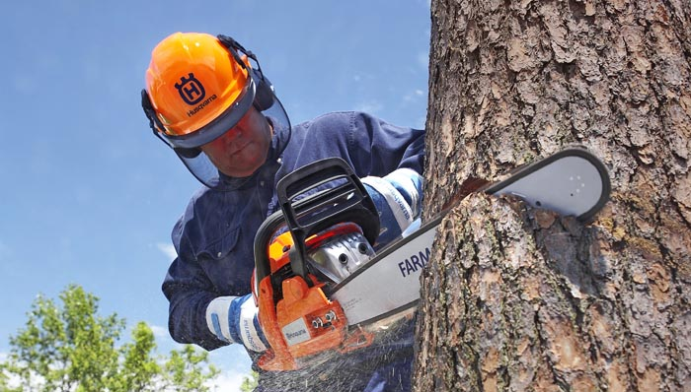
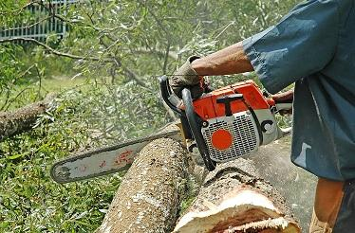
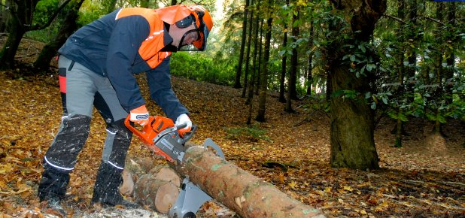
Basic Chain Saw Safety
Bureau of Workers’ Compensation
PA Training for Health & Safety (PATHS)
Notes:
In the United States as well as other countries, chainsaws are used regularly all throughout the year in a work or home environment whether it’s to fell trees, cut logs, build homes or furniture or make items. Using a chainsaw improperly can lead to serious injuries and even death. This presentation is a basic program which should assist those who work with chainsaws to operate them safely thereby avoiding injuries. This program does not provide information on how to safely fell trees or conduct limbing or bucking operations.

Slide 2
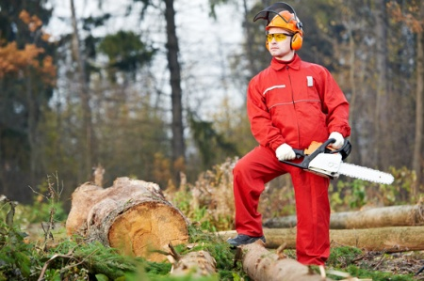
Topics
How Chainsaws Can Harm an Operator
Parts of a Chainsaw
Steps to Take Before Starting a Chainsaw
Personal Protective Equipment (PPE)
Conditions Affecting Use
Chainsaw Safety Procedures
Notes:
This presentation will address the topics listed as well as provide other pertinent, safety information.

Slide 3
Chainsaw Injury Statistics
Approximately 40 percent of all chainsaw accidents occur to the legs and well over 35 percent occur to the left hand and wrist.
The average chainsaw injury requires 110 stitches.
Based on the assumption that four weeks of recovery are required, workers’ compensation costs can be estimated to be at least $125 million annually.
Chaps or chainsaw pants as well as keeping both hands on the saw would reduce chainsaw injuries by 75 percent or more.
Incident Prevention Magazine October 16, 2014
Notes:
Statistics prove that chainsaws can be dangerous and even experienced users can become injured if they do not follow procedures for safe operation.

Slide 4
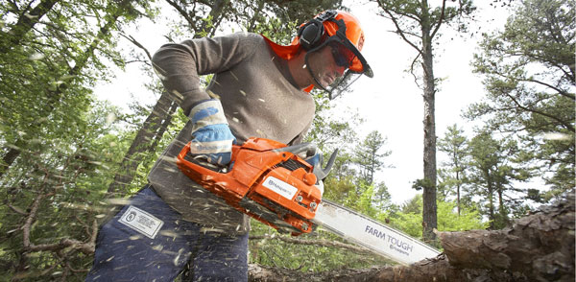
How Chainsaws Can Harm
The blades can cut a person.
Can be heavy and postures used can cause back injuries.
Noise can cause hearing loss.
Can kick back and cause injuries.
Vibration can cause numbness and injuries to muscles, nerves, or tendons
Flying debris can cause eye injuries.
Notes:
Chainsaws can harmful in many ways:
The blades can cut a person.
Can be heavy and postures used can cause back injuries.
Noise can cause hearing loss.
Can kick back and cause injuries.
Vibration can cause numbness and injuries to muscles, nerves, or tendons
Flying debris can cause eye injuries.

Slide 5
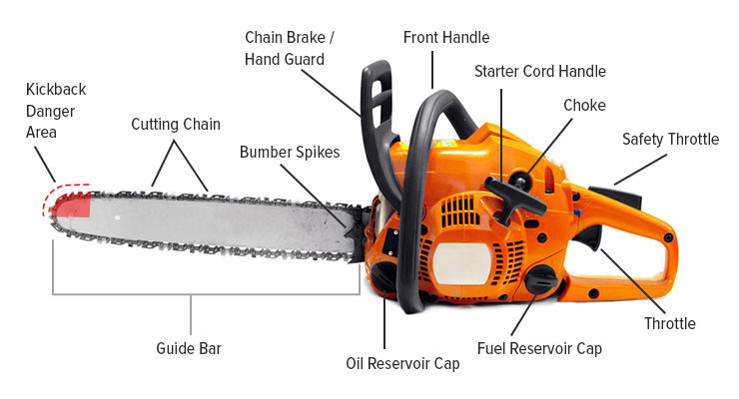
Parts of a Chainsaw
Notes:
While chainsaws may differ from manufacturer to manufacturer, they are basically set up the same as detailed in the slide.

Slide 6
Before Starting a Chainsaw
Read the Operator’s Manual and related safety information.
Check the controls, chain brake, chain tension, and all bolts and handles to make sure they’re functioning properly.
Make sure the clutch cover is not broken or exposing the chain or sprocket.
Ensure the chain “teeth” are sharpened.
When adding fuel to the saw make sure you’re at least 10 feet away from ignition sources.
Start the saw on the ground with the chain brake engaged and at least 10 feet from the fueling area.
Notes:
One thing that should be done no matter what device being used is to read the Operator’s Manual that is normally provided with the equipment. That Manual usually contains information on the correct and safe operation of the device as well as any safety precautions that need to be observed.

Slide 7
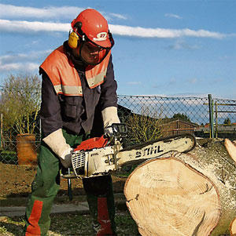
Personal Protective Equipment
Before starting and using a chainsaw, operators should ensure they have the necessary PPE:
Ear plugs/ear muffs for noise protection
Gloves for hand protection/vibration reduction
Goggles for eye protection
Chaps for leg protection
Safety shoes/heavy boots for foot protection
Hard hat for head protection
Notes:
Wearing the appropriate Personal Protective Equipment (PPE) is a very important way to protect yourself from injuries that may occur while using a chainsaw. Head to toe protection should be used at all times when operating a chainsaw even if it’s only going to be used for a short period of time.

Slide 8
Personal Protective Equipment
Head Protection – Hardhat (full brim or cap style)
Inspect hardhats daily for signs of dents, cracks, penetration or any other damage-includes suspension systems, headbands and sweatbands.
Notes:
Hardhats that comply with the American National Standards Institute (ANSI) Z-89.1 Standard should be worn. A hardhat with a full brim or more in the style of a cap can be used. Hardhats should be inspected at least weekly to ensure they do not have any cracks, dents or other damage – this includes the suspension system and head/sweatband.

Slide 9
Personal Protective Equipment
Eye/Face Protection – ANSI approved wrap-around (safety glasses, goggles, face shield)
Inspect before each use to ensure no cracks, scratches, etc.
Notes:
Eye and face protection should always be worn when operating a chainsaw. The eye protection used should comply with ANSI Z-87.1 and should be inspected before each use to ensure the lenses are not scratched, cracked or there is other damage.

Slide 10
Personal Protective Equipment
Hearing Protection – Ear plugs, or muffs (approved for 85dB and higher)
Inspect before using to ensure in good condition; clean as appropriate
Notes:
Some chainsaws produce noise as high as 110-120dB while running so it is imperative to wear appropriate hearing protection while using a chainsaw. Always reference the “noise reduction rating” (NRR) provided by the manufacturer and listed on the packaging to ensure that the hearing protection chosen is appropriate to mitigate the noise level to lower than 85dB. Remember that OSHA recommends as a “quick field reference” to subtract seven (7) from the listed NRR to provide a more accurate “protection level” for the hearing protection chosen. For example, if the NRR is 30 the actual rating would be 23 (30-7=23).

Slide 11
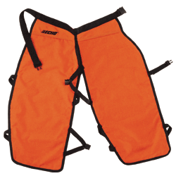
Personal Protective Equipment
Arms, Body, Leg Protection – Protective Clothing:
Long-sleeved shirt appropriate for weather
Loose fitting pants, long enough to cover boots
No loose clothing (e.g. belt ends, untucked shirts, etc.)
Chainsaw chaps should overlap boot tops by at least 2 inches
Clothing should be in good condition and appropriate for weather
Notes:
To ensure a person is as safe as possible when operating a chainsaw appropriate protection should be provided for the arms, legs and body to include a long-sleeved shirt, long pants that are loose fitting, and chaps that overlap boot tops by at least two (2) inches.

Slide 12
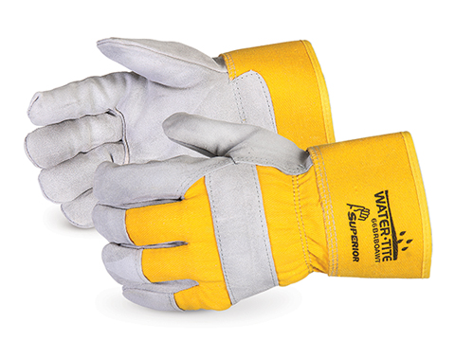
Personal Protective Equipment
Hand Protection – Gloves (slip and cut-resistant and appropriate for weather)
Inspect before each use to ensure no cuts, rips, tears etc.
Notes:
Since hands and fingers are at a high risk of being injured, gloves that are slip and cut-resistant and appropriate for the weather expected should be worn. Gloves should be inspected regularly to ensure they are in good shape with no cuts, rips, tears, etc.

Slide 13
Personal Protective Equipment
Foot Protection – Boots that are:
Heavy-duty
Eight Inches (8”) high
Laced
Water-resistant
Leather
Cut-resistant
Ankle Support
Non-slip Soles
Boots should be in good repair and appropriate for weather conditions
Notes:
Foot protection should be given important consideration when determining what type of PPE to wear. Leather boots that are heavy duty, at least eight (8) inches high, laced, water-resistant, cut-resistant with non-slip soles should be used. Boots should be in good repair and adequate for the weather expected.

Slide 14
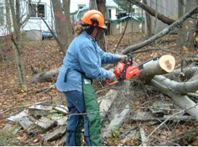
Conditions Affecting Use
Physical Conditions of Operator:
General health
Physical conditioning
On medication (may affect judgement/coordination)
Fatigue
Work-rest cycles
Dehydration
Other factors:
Training/experience
Notes:
Before using a chainsaw the conditions of the operator need to be taken into consideration. These include but are not limited to:
General health
Physical conditioning
On medication (may affect judgement/coordination)
Fatigue
Work-rest cycles
Dehydration
Training/experience of operator

Slide 15
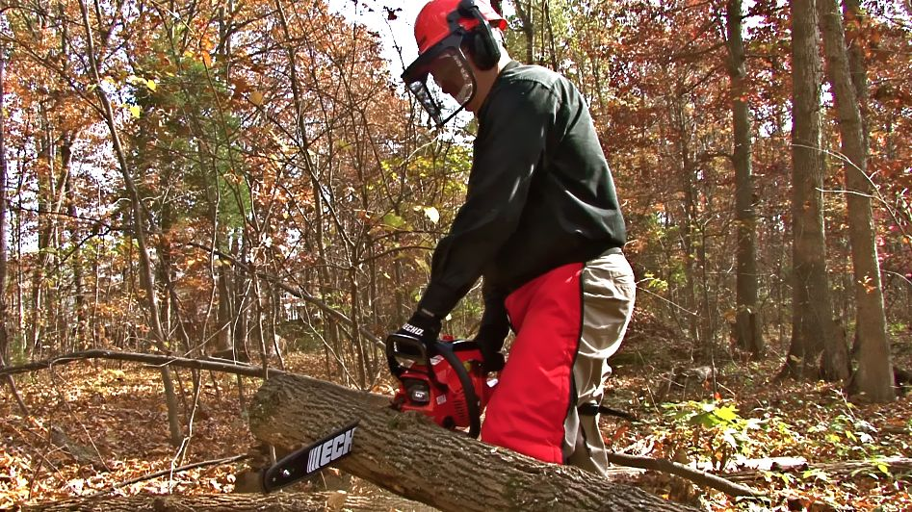
Conditions Affecting Use
Environmental Conditions:
Light
Rain, fog, snow
Wind speed and direction
Dust
Location of structures
Terrain
Objects in tree/log:
◦ Pieces of wire fence
◦ Nails
◦ Bullets
Notes:
In addition to physical conditions, environmental conditions should also be taken into consideration. These include:
Light
Rain, fog, snow
Wind speed and direction
Dust
Location of structures
Terrain
Objects in the tree/log being worked on such as pieces of a wire fence, nails, bullets or something similar

Slide 16
Starting a Chainsaw Safely
First and foremost: NEVER “DROP-START” A CHAINSAW! (one of most dangerous methods of starting because there is no control of the saw).
Maintain a secure grip on the saw at all times.
Start the saw on the ground or where it is firmly supported.
Ensure that appropriate PPE is being worn.
Engage the chain brake (very important!).
Place the saw on firm ground in an open area.
Grip the front handle firmly with your left hand.
Place toe of the right foot into rear handle and press down.
Notes:
Before even starting a chainsaw the following safety procedures should be used:
First and foremost: NEVER “DROP-START” A CHAINSAW! (one of most dangerous methods of starting because there is no control of the saw). **
Maintain a secure grip on the saw at all times.
Start the saw on the ground or where it is firmly supported.
Ensure that appropriate PPE is being worn.
Engage the chain brake (very important!).
Place the saw on firm ground in an open area.
Grip the front handle firmly with your left hand.
Place toe of the right foot into rear handle and press down.
** The term “drop-start” is used to describe the method used whereby an operator holds onto the saw handle and basically “drops” the saw while pulling on the starter rope.

Slide 17
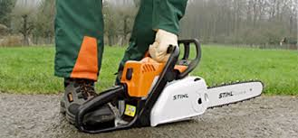
Starting a Chainsaw Safely
Avoid allowing slack in the starter rope – this can lead to handle, rope or recoil spring damage.
Gradually return starter rope to housing – do NOT allow starter rope to snap back.
Once saw starts running tap throttle trigger which causes saw to idle on its own.
Only disengage chain brake after saw is idling.
Notes:
Some other safety precautions to take when starting a chainsaw include:
Avoid allowing slack in the starter rope – this can lead to handle, rope or recoil spring damage.
Gradually return starter rope to housing – do NOT allow starter rope to snap back.
Once saw starts running tap throttle trigger which causes saw to idle on its own.
Only disengage chain brake after saw is idling.

Slide 18
Before Cutting
Ensure there is adequate spacing between anyone working around/cutting (more than two tree lengths apart).
Ensure all workers are aware of one another’s locations – communicate!
Eliminate potential hazards:
◦ Avoid overhead ropes, cables or electric lines
◦ Knock snow/ice off all branches
Determine an appropriate felling direction.
Plan and clear a retreat path.
Notes:
To ensure the safety of all concerned, before beginning cutting operations the following safety precautions should be taken:
Ensure there is adequate spacing between anyone working around/cutting (more than two tree lengths apart).
Ensure all workers are aware of one another’s locations – communicate!
Eliminate potential hazards:
◦ Avoid overhead ropes, cables or electric lines
◦ Knock snow/ice off all branches
Determine an appropriate felling direction.
Plan and clear a retreat path.

Slide 19
Reactive Forces
Kickback is the most powerful reactive force that can be encountered while operating a chainsaw.
Can occur while felling, limbing, bucking or brushing or slashing.
Occurs when the upper quadrant of the bar nose contacts a solid object or is pinched.
Factors that determine severity:
- Chain speed
- Angle of contact
- Condition of the chain
- Speed at which bar contacts the object
Notes:
The laws of physics explain for every action there is an equal and opposite reaction. These reactions happen very quickly during chainsaw operation and can be dangerous.
One force that can happen and can happen regularly if the proper operating methods aren’t used is “kickback.” Kickback is a very powerful reactive force that occurs when a saw is “kicked back” toward an operator.

Slide 20
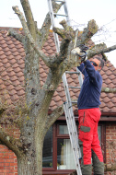
Ways to Avoid Kickback
Hold the saw with both hands securely gripping the rear handle and the front handle between your thumb and forefinger.
Be aware of the location of the bar nose at all times (accidently cutting with the top half of the guide bar nose is the most common mistake).
Never let the bar nose contact another object.
Never cut with power head above shoulder height.
Never overreach.
Notes:
Some ways to avoid kickback include:
Hold the saw with both hands securely gripping the rear handle and the front handle between your thumb and forefinger.
Be aware of the location of the bar nose at all times (accidently cutting with the top half of the guide bar nose is the most common mistake).
Never let the bar nose contact another object.
Never cut with power head above shoulder height.
Never overreach.

Slide 21
Ways to Avoid Kickback
Have a stance that allows you to pull the saw smoothly out of the “kerf” (slit or notch) when cutting (reduces fatigue also).
Cut one log at a time.
Stand to the side of the kickback “arc.” Never rely on the chain brake for protection from kickback.
Use caution when entering the bar into a partially completed cut.
Use a properly sharpened and tensioned chain.
Watch the kerf and the log for any movement that could pinch the chain.
Use the “attack” corner of the bar when boring.
Notes:
The following additional methods should be used to avoid kickback:
Have a stance that allows you to pull the saw smoothly out of the “kerf” (slit or notch) when cutting (reduces fatigue also).
Cut one log at a time.
Stand to the side of the kickback “arc.” Never rely on the chain brake for protection from kickback.
Use caution when entering the bar into a partially completed cut.
Use a properly sharpened and tensioned chain.
Watch the kerf and the log for any movement that could pinch the chain.
Use the “attack” corner of the bar when boring.

Slide 22
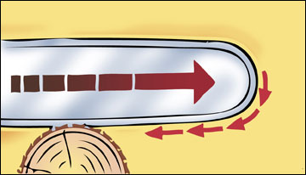
More Reactive Forces
Pull-in occurs when the chain on the bottom of the bar is caught or pinched and suddenly stops.
The chain pulls the saw forward.
Notes:
Another reactive force is “pull-in” which occurs when the chain on the bottom of the bar is caught or pinched and suddenly stops; this action pulls the saw forward which could cause an injury to the operator.

Slide 23
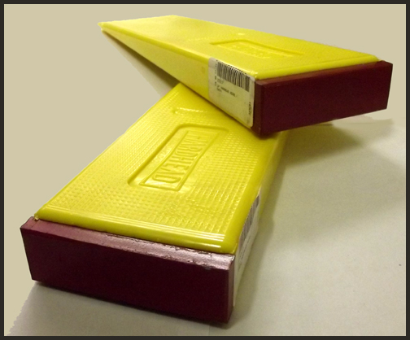
Ways to Avoid Pull-in
Always start a cut with the chain moving at half or near full speed.
Watch the cut and log for any movement that may pinch the bar.
Uses wedges to keep the cut open.
Notes:
To avoid pull-in:
Always start a cut with the chain moving at half or near full speed.
Watch the cut and log for any movement that may pinch the bar.
Uses wedges to keep the cut open.

Slide 24
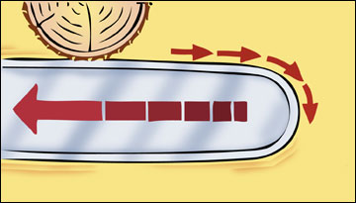
Another Reactive Force
Pushback occurs when the chain on top of the bar is suddenly stopped by contacting another object or by being pinched.
The chain drives the saw straight back toward the user.
Notes:
“Pushback” is still another reactive force that could cause injuries to the user and occurs when the chain on top of the bar is suddenly stopped by contacting another object or by being pinched. This action drives the saw straight back toward the user.

Slide 25
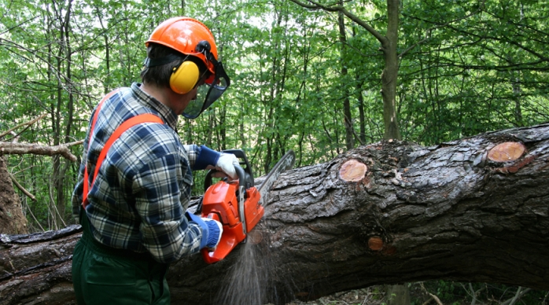
Ways to Avoid Pushback
Only cut with the top of the bar when necessary.
Watch the kerf and log for any movement that may pinch the top of the bar.
Do not twist the bar when removing it from a boring cut.
Notes:
To avoid pushback:
Only cut with the top of the bar when necessary.
Watch the kerf and log for any movement that may pinch the top of the bar.
Do not twist the bar when removing it from a boring cut.

Slide 26
Using the Saw
Clear the area of obstacles that may interfere with cutting the tree, brush, etc.
Keep hands on the handles and have secure footing while operating the saw.
Don’t cut directly overhead or between legs.
Look up before cutting to ensure there are no loose limbs that may fall.
Be prepared for kickback – don’t cut with the tip of the saw & keep track of where the tip is.
Shut off or release the throttle before retreating, carrying the saw more than 50’ or over hazardous terrain.
Notes:
When operating a chainsaw the following safety precautions should be used:
Clear the area of obstacles that may interfere with cutting the tree, brush, etc.
Keep hands on the handles and have secure footing while operating the saw.
Don’t cut directly overhead or between legs.
Look up before cutting to ensure there are no loose limbs that may fall.
Be prepared for kickback – don’t cut with the tip of the saw & keep track of where the tip is.
Shut off or release the throttle before retreating, carrying the saw more than 50’ or over hazardous terrain.

Slide 27
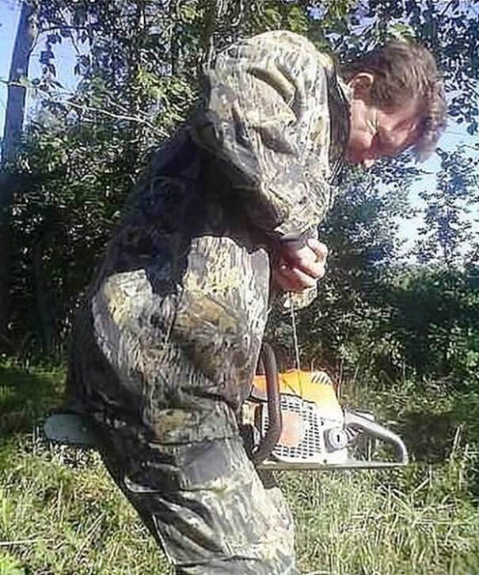
Using the Saw
Don’t carry the saw on your shoulder (if you fall the blade will be near your neck).
Work at a safe distance from other workers (twice the height of the trees being cut/felled).
Communicate with and watch out for co-workers.
Take breaks – tired workers make mistakes!
Inexperienced workers must be supervised by a trained worker when cutting or felling trees.
Obviously this is NOT the safe way to start a chainsaw!
Really?
Notes:
Additional safety precautions to take while using a chainsaw also include:
Don’t carry the saw on your shoulder (if you fall the blade will be near your neck).
Work at a safe distance from other workers (twice the height of the trees being cut/felled).
Communicate with and watch out for co-workers.
Take breaks – tired workers make mistakes!
Inexperienced workers must be supervised by a trained worker when cutting or felling trees.

Slide 28
General Safety Tips
Make a plan – decide what you are trying to achieve.
Have a first aid kit available.
If possible when cutting/felling have a “spotter” available to watch for safety issues.
Have a plan in place in case there is a medical emergency.
Operators should take regular breaks and keep themselves hydrated (no caffeine/alcohol).
Operators and supervisors should watch for fatigue-tired people can make mistakes!
Notes:
To ensure the safety off all concerned it’s important to follow the general safety tips listed in the slide. The use of a chainsaw can save time and physical effort, however as with anything else safety should be given top priority – it can only take a second to cause and injury and change a life. Think safety, act safely!

Slide 29
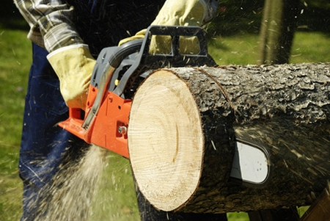
Resources
Chainsaw Safety – Health & Safety Education for Forest Workers; Alliance of Forest Workers & Harvesters, Labor Occ. Health Program, U.C. Berkeley
Wildland Fire Chainsaw S-212 Student Workbook – National Wildfire Coordinating Group
Chain Saw Safety – OSHA QuickCard: https://www.osha.gov/Publications/3269-10N-05-english-06-27-2007.html
Notes:
Here are some resources to use to get more information on the safe use of chainsaws.

Slide 30
Contact Information
Health & Safety Training Specialists
1171 South Cameron Street, Room 324
Harrisburg, PA 17104-2501
(717) 772-1635
RA-LI-BWC-PATHS@pa.gov
Like us on Facebook! - https://www.facebook.com/BWCPATHS

Slide 31
Questions

