Slide 1
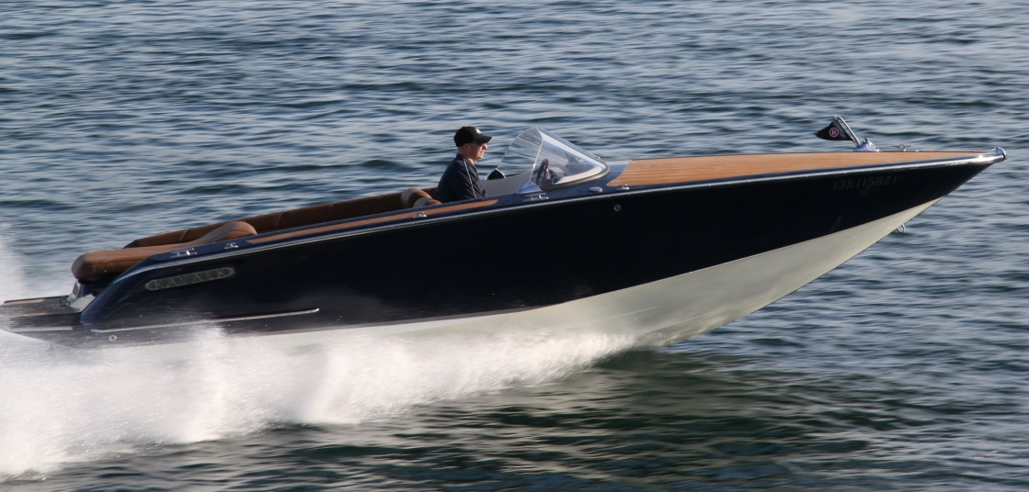
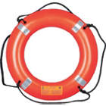
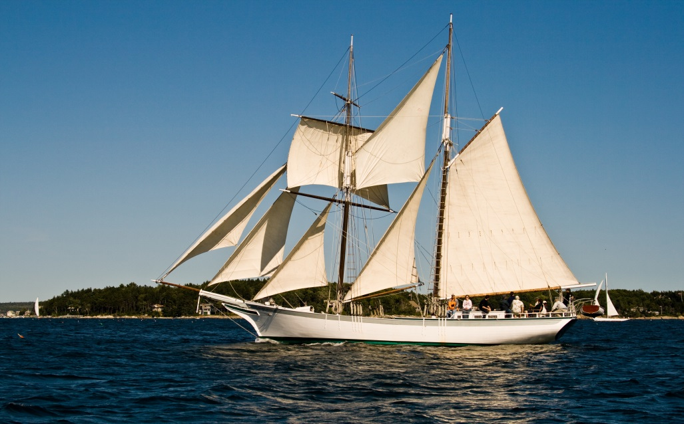
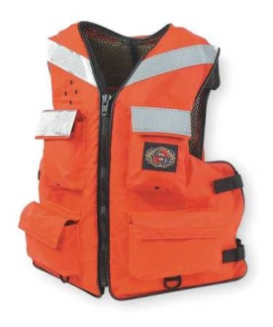
Boating Safety - Basics
Bureau of Workers’ Compensation
PA Training for Health & Safety (PATHS)
Notes:
Recreational boating is a popular leisure activity in the U.S. On average, more than 88 million U.S. adults participate in recreational boating each year, using a boat for (sports) activities such as fishing and water skiing and/or to travel.
Recently published statistics indicated that:
Drowning was reported as the cause of death in three-fourths of all fatalities.
Approximately 84 percent of those who drowned were not wearing life jackets.
During a recent year, the U.S. Coast Guard counted 4,064 accidents that involved 610 deaths, 2,678 injuries and approximately $39 million dollars of damage to property as a result of recreational boating accidents.
About 12 percent of deaths occurred on boats where the operator had received boating safety instruction.
Operator inattention, improper lookout, operator inexperience, excessive speed and alcohol rank as the top 5 primary contributing factors in accidents.
The most common types of vessels involved in reported accidents were open motorboats (47%), personal watercraft (17%) and cabin motorboats (15%).

Slide 2
Boating Safety - Basics
Bureau of Workers’ Compensation
PA Training for Health & Safety (PATHS)
Boats and watercraft consist of a variety of craft each posing unique safety considerations.
This program focuses on general boating safety with non-powered boats.
It is based on safety topics detailed by the PA Fish and Boat Commission.
Training + Education + Experience = Knowledge of Safe Boating
Notes:
This presentation will cover the basics of boating safety, for more extensive information concerning all areas of boating safety in Pennsylvania go to www.fishandboat.com

Slide 3
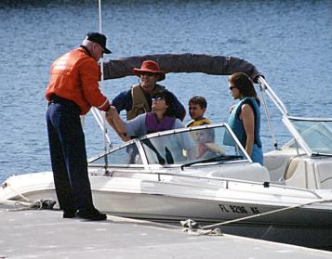
Topics
Boating Hazards
Water Hazards to include:
Personal Safety Issues
Hypothermia and Heat Injuries
Emergency Actions
PFDs (Personal Flotation Devices)
General Boating Safety Issues
Notes:
This presentation will cover the topics listed.
Picture: newenglandboating.com

Slide 4
Types of Boats
Powered and non-powered have their own hazards.
Powered boats will move into and through the travel path at greater speeds. Reacting to hazards may be difficult.
Non-powered boat movements are dependent upon the current and talent of the boater.
Notes:
Non-powered boats can also be referred to as “human-powered boats,” meaning oars are used as the prime mover.
This information can be used for powered boats, non-powered boats, boats with trawling motors as well as those under sail.
It will concentrate on non-powered boats.
Pictures: iboats.com

Slide 5
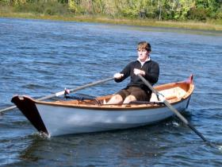
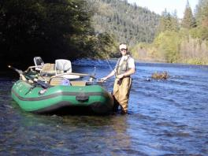
Boat Hull Types
The shape of the hull will determine how the craft may operate in the water.
Flat bottom
V-hull
Pontoon boats
Jon boats
Notes:
There are several different hull types available to boaters with each type having advantages and disadvantages depending on what the operator intends to use the craft for on a regular basis.
Pictures: nextwaveboat.com
flyfishingtraditions.blogspot.com

Slide 6
Advantages/Disadvantages
Advantages
Disadvantages
Flat bottom
V-hull
Pontoon boats
Jon boats
This planing hull has a shallow draft, which is good for fishing in small lakes and rivers.
Rides roughly in choppy waters.
This planing hull gives a smoother ride than a flat bottom hull in rough water.
Takes more power to move at the same speed as flat bottom hulls. May roll or bank in sharp turns.
This typical displacement hull moves easily through the water even at slow speeds.
Has a tendency to roll unless it has a deep keel or stabilizers.
See flat bottom boats
See flat bottom boats
Notes:
This slide lists the basic advantages and disadvantages of the different hull types.
Pictures: nextwaveboat.com
flyfishingtraditions.blogspot.com

Slide 7
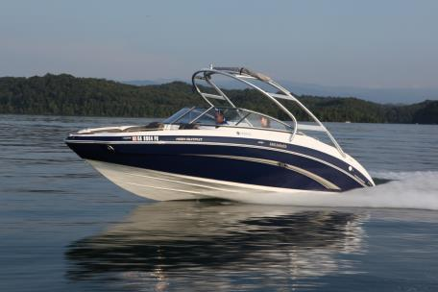
Boating Hazards
Hazards with the water craft
Personal Safety Issues
Water Hazards to include:
Dams
Current
Waves
Weather-storms
Sunburn
Submerged objects
Alcohol and boating
Other boats and swimmers
Notes:
Many other hazards may exist due to flooding conditions upstream as well as storms which may wash transitory materials into a waterway. Be alert to not only what might be downstream of your journey but what may be upstream waiting to overtake you and your craft.

Slide 8
Dams
Currents above the dam can draw boats into water going over or through a dam.
Deploy an anchor upstream of the dam.
Below a dam, recirculating currents and turbulent water will be may be found.
Many small dams are not marked-know your route of travel.
Use a map to plot your trip.
Some dams may be seen by looking for a horizontal line going across the water.
Plan your trip!
Notes:
Although some dams may be seen by the horizon view stated, some will not be seen this way.

Slide 9
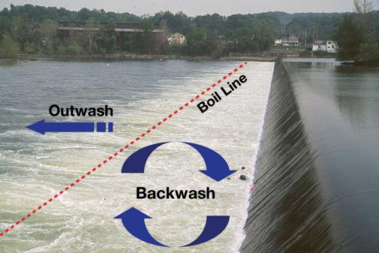
Low Head Dams
More than 2,000 in Pennsylvania. These are called “Drowning Machines.” Water going over a dam creates a back current or undertow. They can pull a boat into the turbulence and capsize it, trapping a boater.
Notes:
There are numerous low head dams in Pennsylvania as well as other states. These dams have been referred to as “drowning machines” since so many people are killed each year while boating near or around them.
Picture: boat-ed.com

Slide 10
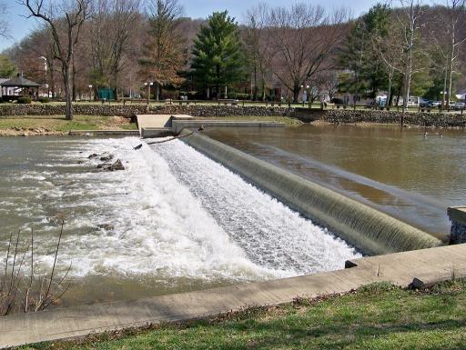
Shallow Drop Dams
Shallow Drop Dams can create a backwash. During storms and heavy rains these become stronger and can extend further downstream.
Notes:
Shallow drop dams are also dangerous.
Picture: panoramio.com

Slide 11
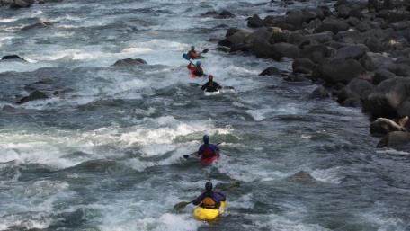
Current
Currents can change due to underwater topography and submerged objects.
Many tons of force can be exerted on a boat.
This may not only draw the boat into dangerous conditions but also pin the boat against obstructions.
Never exceed your capabilities when dealing with current!
Notes:
The strongest current may be found half the distance across a stream and then half the depth.
Picture: tofinoseakayaking.com

Slide 12
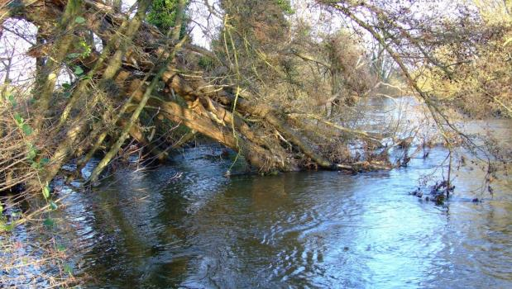
Strainers
Obstructions such as a tree or fence in the water.
It allows the passage of water but can hold boaters and boats.
Maintain a safe distance from strainers.
Notes:
Obstructions in the water that can hold water craft in a location are called “strainers” and should be avoided.
Picture: riverkennet.blogspot.com

Slide 13
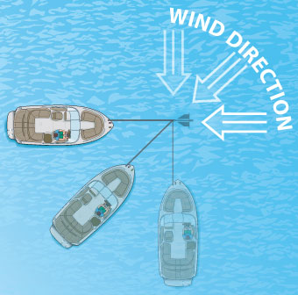
Anchoring in Current
Always anchor from the bow of the boat!
The boat will ride over oncoming waves.
Anchoring from the stern may permit water to rise over the transom and flood, sink or capsize the boat.
Notes:
When anchoring in a current keep the information listed in mind.
Picture: boat-ed.com

Slide 14
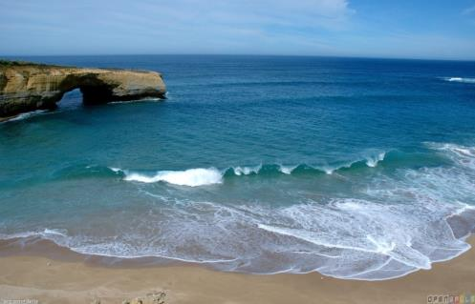
Tidal Currents
Boaters venturing into tidal waters, i.e. Lower Delaware River, should understand water movement and behavior.
Vertical rises and falls of tides are governed by gravitational pull of the moon and sun.
Understand the hazards before venturing out.
Notes:
Tidal currents can pose a danger to boaters and swimmers alike.
Picture: openwalls.com

Slide 15
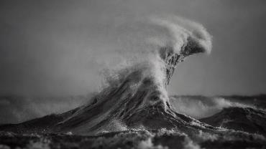
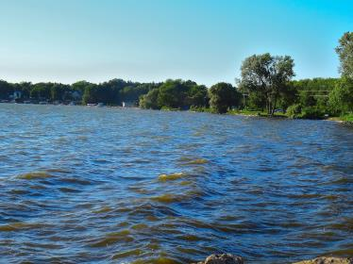
Waves
Caused by the wind acting on the water’s surface. Greater wind=greater the waves.
Boaters should not go into larger bodies of water (Lake Erie) in small boats.
Small lakes with greater exposed surfaces may be susceptible to the same conditions.
Also caused by powered boats traveling too close to non-powered craft.
Notes:
Lake Erie storms, as shown in the top picture, can be deadly. Remember the Edmund Fitzgerald!
Pictures: strangesounds.org
panoramio.com

Slide 16
Weather
Can affect the conditions on which you travel.
Wind, temperature and barometric pressures all combine
National Weather Service. Issues new marine forecasts at least every 6 hours. Signs of worsening conditions
Clouds gathering, darkening and increasing in size
Rapid wind shift or change in speed
Static on the AM radio may indicate approaching storm
Barometric pressure drops
Notes:
Check the weather during the times you will be out on the water as well as an extended forecast.
www.weather.gov

Slide 17
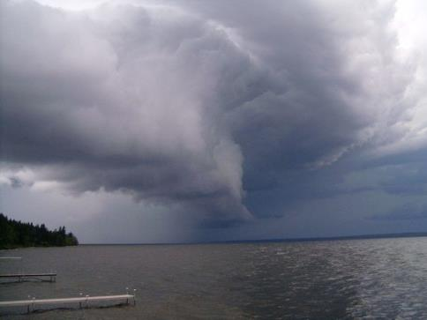
Storm Near
Drop sails
Stow gear
Head for land
Head bow into waves and current
Slow boat’s movement with anchor or improvise with a bucket and rope
Notes:
While on the water a storm can be a very dangerous situation to face. Follow the listed information if you see a storm approaching and are unable to get back to dry land.
Picture: pinterest.com

Slide 18
Lightning
Place fishing rods and antennas flat on deck
Maintain a low profile on board
Get to a safe harbor
Notes:
Lightning can kill whether a person is on dry land or on the water. When in a water craft it’s necessary to follow the instructions given in this slide.
Picture: pinterest.com

Slide 19
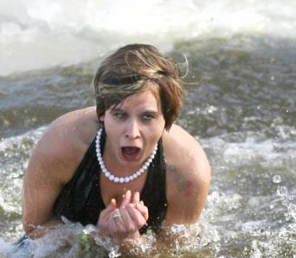
Cold Water Shock
Water need not be freezing
Sudden immersion in water even above 50⁰F can cause cold water shock
Body’s response:
Torso reflex of involuntary gasp
Hyperventilation
Breathlessness
Ability to hold breath, control breathing and swim diminished
Notes:
Cold water can cause issues no matter what a person’s physical condition is.
Picture: kayakdave.com

Slide 20
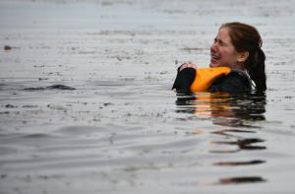
Hypothermia
Loss of body’s core temperature
Shivering loss of feeling in extremities
Skin is cold and turns blue
Decreased mental skills and slurred speech
Notes:
Generally, a person can survive in 41-degree F (5-degree C) water for 10, 15 or 20 minutes before the muscles get weak, you lose coordination and strength, which happens because the blood moves away from the extremities and toward the center, or core, of the body.
Picture: watersafetyguy.org

Slide 21
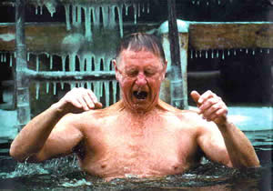
Cold Water Immersion
4 stages
Initial cold shock (first 3-5 minutes)
Gasp
Hyperventilation heart rate and rhythm and blood pressure drop
Panic
Can lead to death especially with pre-existing conditions
Notes:
There are basically four (4) stages involved with cold water immersion.
Picture: emnrd.state.nm.us

Slide 22
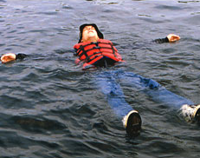
Cold Water Immersion
Short term swim failure (3-30 minutes)
Cold water saps energy, legs weak
Movement slow or difficult
Death possible by drowning
Notes:
Picture: boatsmartexam.com

Slide 23
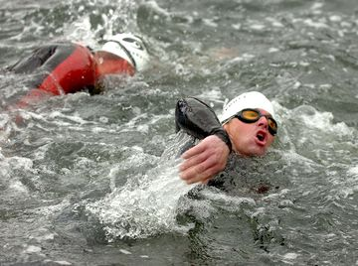
Cold Water Immersion
Long term hypothermia (30+ minutes)
Body heat lost to cold water 25 x faster than cold air
Hypothermia
Unconsciousness and death without drowning
Notes:
Picture: unchainedfitness.com

Slide 24
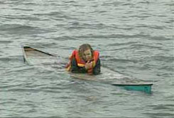
Post-Immersion Collapse
Occurs during or after rescue
Death due to complications of inhaling water or lowered body temperature
Notes:
A person can collapse or even die after being rescued.

Slide 25
Cold Water Survival
Wear a life jacket
Wear insulating clothing; wool, fleece or synthetics
If about to fall, cover mouth and nose to avoid inhaling water
Do not remove clothing
Get back into or on top of boat
Unable to get out of water
HELP posture (Heat Escape Lessening Posture) or
HUDDLE (Position if with a group)
Notes:
To survive a cold water immersion remember the information provided in this slide.

Slide 26
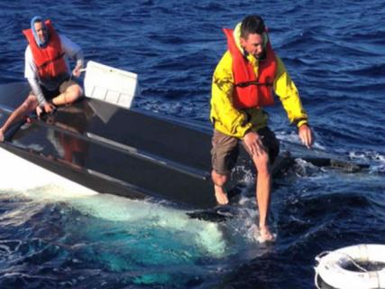
Hypothermia (water)
Get out of the water quickly or climb on anything floating.
DO NOT attempt to swim unless a floating object or another person can be reached.
Swimming or other activity uses the body’s heat and reduces survival time by about 50%.
Notes:
Get out of the water quickly or climb on anything floating.
DO NOT attempt to swim unless a floating object or another person can be reached.
Swimming or other activity uses the body’s heat and reduces survival time by about 50%.

Slide 27
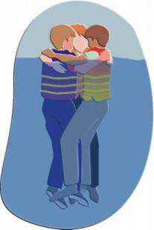
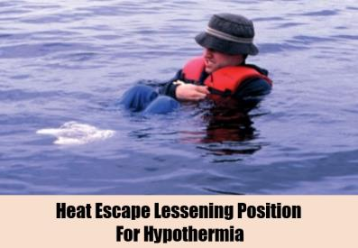
Hypothermia (water)
Can’t get out of the water:
Wait quietly, conserve body heat.
Fold arms across the chest, keep thighs together, bend knees, and cross ankles.
If another person is in the water, huddle together with chests held closely.
Notes:
Hypothermia regarding water incidents:
Wear a life jacket (also called a personal flotation device).
Exit the water, if possible.
Don’t swim unless land is close by - conserve your energy.
Minimize heat loss by drawing extremities into your core.
Huddle with others and do not remove your clothing.
The sequence indicated better maintains body-to-body contact for heating purposes.

Slide 28
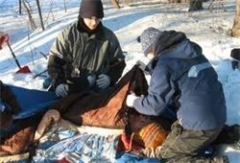
First Aid: Hypothermia
Remove person from water/weather ASAP
Replace wet clothing with dry; wrap in blankets
Give nothing by mouth if unconscious
Never give alcohol
Seek medical help ASAP
Notes:
One of the first things to do to assist a person who may be suffering from hypothermia is to get them out of the water and weather as soon as possible.
Picture: firstaidforeveryone.ie

Slide 29
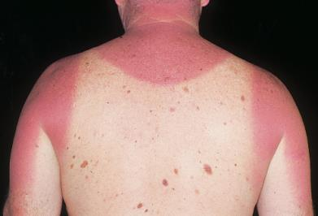
Overheating & Sunburn
Hot days tend to dehydrate
High humidity sweating is less efficient
Symptoms
Faint or nauseous
Rapid heart rate
Headache
Young and elderly are more susceptible
Notes:
While hypothermia may not be as prevalent in warmer weather, boaters should still realize that there can be affects of being exposed to direct sunlight which many times can have more of an impact while on the water.
Picture: emedicinehealth.com

Slide 30
Treatment
Stop activities and seek shade
Get out of sun and heat
Drink fluids-not carbonated or alcoholic
If left untreated
It can progress to severe heat stroke
Mental function and coordination affected
Begin cooling
Seek medical aid ASAP
Notes:
Heat related injuries needed to be dealt with in a very timely manner.
Picture: ask.com

Slide 31
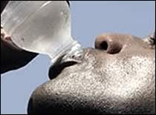
Overheat Prevention
Wear lightweight, light colored & loose fitting clothes
Limit outdoor activity to morning and evening hours
Seek shade
Wear a wide-brimmed hat, sunglasses and use sunscreen of SPF 30 or higher
Drink more fluids (nonalcoholic)
PPT-145-01
31
Notes:
Some tips for the prevention of heat related illnesses include:
Stay indoors and utilize AC
Use fans
Take a cool, not COLD, shower
Wear lightweight, light colored & loose fitting clothes.
Limit your outdoor activity to morning and evening hours.
Protect yourself from the sun by wearing a wide-brimmed hat, sunglasses and by putting on sunscreen of SPF 30 or higher.
Drink more fluids (nonalcoholic or liquids not containing caffeine)

Slide 32
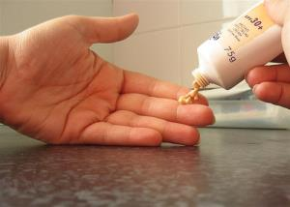
Sunburn Prevention
Direct sunlight is not required;
UV rays are reflected from water’s surface
Sunburn prevention
Hat and protective clothing
Rehydrate with fluids
Use sunscreen with SPF (sun protection factor) of 30 or more; reapply as needed
Sunglasses protect from UV rays and lessen eye fatigue
Notes:
Effects of a day on the water can be cumulative. Judgment and ability to “keep a proper lookout” can be impaired.
Picture: beatifulwithbrains.com

Slide 33
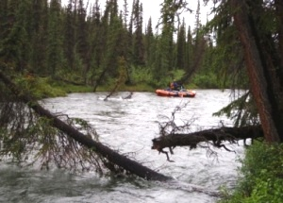
Submerged Objects
Can take the form of
Rocks
Stumps
Logs
Any other object which can interfere with the boat’s progress
Notes:
Some of these obstructions can be stationery or moving up and down with the current or flowing downstream.
Pictures: hendrix2.uoregon.edu
pc.gc.ca

Slide 34
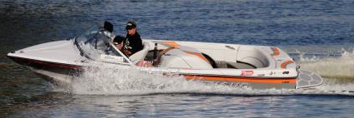
Submerged Objects
Can damage the hull reducing water worthiness
Can foul the motor
Can result in injury and even death
Depth meters or fathometers can assist in reading the bottom
If not sure-slow down
Notes:
Submerged objects can cause many issues such as damage to the boat or motor. Use caution if there is a possibility there may be submerged objects in the area where boating is taking place.
Picture: en.wikipedia.org

Slide 35
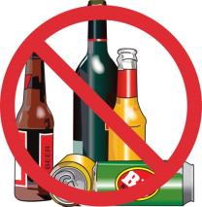
Alcohol and Boating
Ability to think and react are affected
Alcohol and controlled substances and operating under the influence is prohibited in all state parks and at most U.S. Army Corps of Engineer projects
Pre-arrest breath tests can be used to determine if boater is under influence.
A BAC (blood alcohol content) of 0.08% or more is over the legal limit
Penalties: loss of boating privileges, fines and imprisonment
Notes:
It is illegal to operate a watercraft on all the waters of the Commonwealth while under the influence of alcohol or a controlled substance.
Note: 0.02% for minors
Picture: portal.lackawanna.edu

Slide 36
Carbon Monoxide Hazards
Carbon Monoxide is the byproduct of internal combustion engines from powered craft
Understand the effects and conditions creating and maintain safe distances from the source
Causes:
Blocking exhaust outlets
Exhaust from another vessel
Slow speeds/idling
Accumulation at various locations on the craft; cabin, aft deck and bridge
Notes:
Check the Carbon Monoxide Prevention brochure at www.fish.state.pa.us for additional information and a checklist to prevent this exposure.

Slide 37
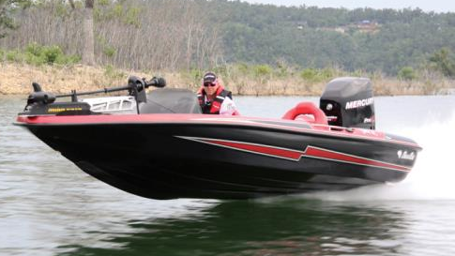
Other Boats
Stay clear of the irresponsible actions of others
Report violations to a waterways conservation officer
Stay alert; read boating traffic in all directions periodically
Notes:
You should always be on the “lookout” for other traffic on the waterway. Others may not be a careful or cautious as you are.
Maintain vigilance and determine what protective actions you will take to stay safe.
Picture: iboats.com

Slide 38
Emergencies
Swamping and Capsizing
Stay calm
Right the boat if you can and bail it out
If you’re overboard get into the self-rescue position
Your feet pointed upstream, near the surface
This guards against head injury and foot entrapment
Notes:
If an emergency occurs while operating or inside a water craft it is important that all involved remain calm which many times can be easier said than done.
Pictures: westislandweather.com
linksservice.com

Slide 39
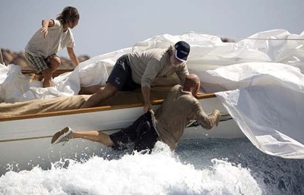
Emergencies
Falls Overboard
Remember the thermal shock we discussed
Your life jacket may be your only source of survival
Notes:
It is important that operators and passengers wear a Personal Flotation Device (PFD) while boating. A PFD can and has saved the lives of many who have fallen overboard.
Picture: indiayactpage.com

Slide 40
General Safety
Getting into and moving around a boat requires
maintaining 3 points of contact for stability
Keep your body profile and weight low and in the centerline
Prohibit
Standing in small boats
Sitting on foredecks, gunwales, engine boxes, seat backs or transoms
Frequently check that all are on board
Wear deck-gripping shoes-no bare feet
Avoid rough water and weather when possible
Notes:
Always promote a low center of gravity when moving in a boat.

Slide 41
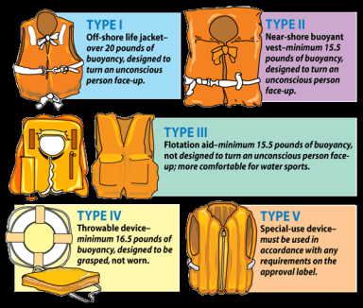
PFDs
Personal Flotation Devices
Best defense against drowning.
80% of all boating deaths could have been prevented if victims had been wearing a life jacket.
Each person in the boat must have a wearable, USCG-approved life jacket. There are NO EXCEPTIONS!
Also, a PFD is no substitute for good swimming ability.
Notes:
Note: In a move that’s expected to benefit recreational boaters, on October 22 (2016) the U.S. Coast Guard will drop the current life jacket type code scheme – Type I, II, III, IV and V – that has been used for years to label and differentiate the types of life jackets and their specific use. Chris Edmonston, BoatUS Foundation for Boating Safety president and chairman of the National Safe Boating Council, said, “The boating safety community believes this move by the Coast Guard will help lead the way toward more comfortable and innovative life jacket designs, help boaters stay on the right side of the law, lower costs and save lives.”
UPDATE –
Type coding is being removed as a USCG requirement as of October 22nd. However, manufacturers will continue to use Type I-V coding until newer labels are designed and approved, and new standards are adopted.
Removing type coding is simply the first step in a multi-year process, which includes designing new labels and developing new, ‘harmonized’ standards. Once that is accomplished, manufacturers will then be able to get jackets approved under the new standards. It’s at that point that we’ll see life jackets without the current type coding on their labels.
Our friends in the life jacket manufacturing community further advise that 2017 is likely the earliest they could potentially see any new life jacket standards on production lines.
Current life jackets that have Type I-V coding on their labels will be legal to sell and wear for the useful life of the jacket.
Picture: fishandboat.com

Slide 42
PFD Types
All boats must have a U.S. Coast Guard approved, wearable PDF on board for each person
Type I, II, III or V designations
All wearable types readily accessible and sized for person wearing
Type IV is a throwable device required for boats 16 feet or greater
Seat cushions and other flotation devices-not life jackets
Notes:
Note: Explains Edmonston, “This is positive news is that we will no longer see a Type I, II, III, IV or V label on a new life jacket label after October 22, (2016). This type coding was unique to the United States, tended to confuse boaters, limited choice and increased the cost of life jackets.” He says removing the type coding is a first step towards the adoption of new standards that will eventually simplify life jacket requirements for recreational boaters.

Slide 43
Type I PFD
Off-Shore Life Jacket
Will turn an unconscious person vertical or reclining position
Over 20 pounds of buoyancy
Best in large and rough water where rescue is slow to arrive
Found on commercial boats
Notes:
As stated in the previous slides there are different types of PFD. The Type I PFD will turn an unconscious person vertical or into a reclining position.
Picture: marinesafetytrinidad.com

Slide 44
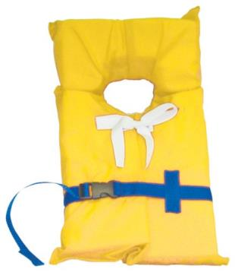
Type II PFD
Near-Shore Buoyant Vest
Will turn an unconscious person vertical or reclining position
Less bulky than Type I
Minimum buoyancy of 15.5 pounds
For calm, inland water where there’s a chance of fast rescue
Notes:
Type II PFD’s will also turn an unconscious persons vertical or into a reclining position.
Picture: dealnay.com

Slide 45
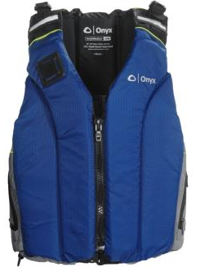
Type III PFD
Flotation Aid
Thought to be most comfortable
Not designed to upright an unconscious person unless it is a Type III Inflatable
Minimum buoyancy of 15.5 pounds
Notes:
Type III PFD’s are thought to be the most comfortable, but are not designed to upright an unconscious person unless it is a Type III inflatable.
picture: sierratradingpost.com

Slide 46
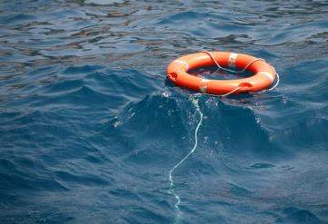
Type IV PFD
Throwable Device
Boat cushions, rings and horseshoe buoys
Not worn on back but grasped to chest
Kept immediately available for emergencies
Notes:
A Type IV PFD is basically a “throwable device” such as a cushion, ring and/or horseshoe buoy. It is not meant to be worn but instead grasped to the chest.
Pictures: gcaptain.com
go2marine.com

Slide 47
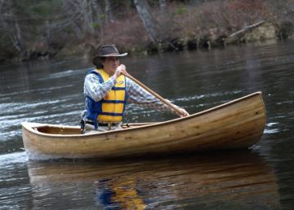
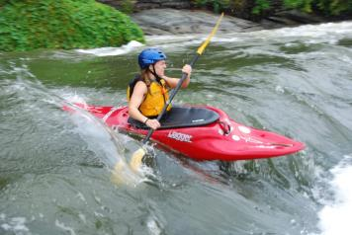
Exceptions for PFDs
Canoes and kayaks are not required to have a throwable device
Not a substitute for a life jacket
Not designed to be worn
Must be “immediately available” (within arm’s reach) to operator and all passengers
Notes:
In Pennsylvania canoes and kayaks do not need to have throwable devices on board.
Pictures: canoeshelburne.blogspot.com
web.jhu.edu

Slide 48
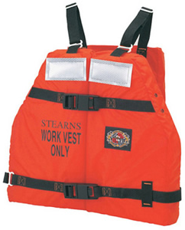
Type V PFD
Special-Use Device
Wearable and approved only for specific activities
Approved uses/limitations appear on label
Variants:
Work vests
Boat sailing vests
White water vests
Notes:
Type V PFD’s must be used per their labels
All PFD’s:
In good and serviceable condition
No rips, tears, missing belts or buckles
U.S. Coast Guard approval label/number must be legible
NOTE: ANNAPOLIS, Md. –
“Until the final change, life jackets must bear the USCG label and adhere to labeling specifications.”
Picture: go2marine.com

Slide 49
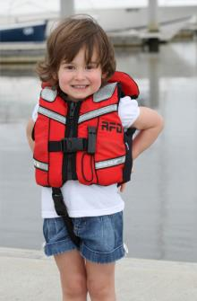
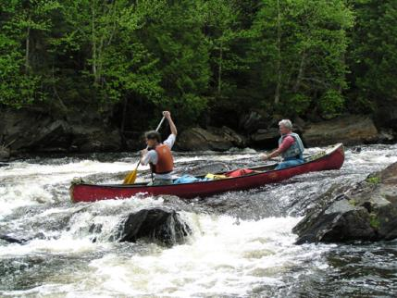
Life Jacket/PFD Required
All children 12 years or younger
While underway on any boat 20 feet in length or less
All canoes and kayaks
Notes:
Note: “underway” includes drifting boats
Pictures: rfd.com.au
trekearth.com

Slide 50
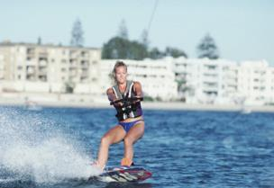
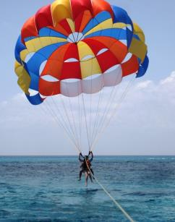
Life Jacket/PFD Required
Anyone towed behind a boat regardless of activity
All personal watercraft operators and passengers
All sailboarders (windsurfers)
Everyone boating on U.S. Army Corps of Engineers Pittsburgh District lakes regardless of age
Notes:
Note: A type III life jacket with an impact rating of 50 m.p.h. or more is recommended as the safest and most comfortable type to wear in high-speed boating activities. Lesser types may be harmful.
Pictures: paddleinspain.com
thelinknews.net

Slide 51
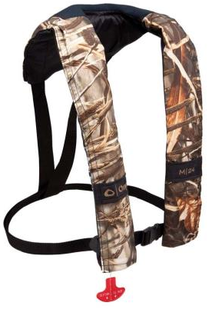
Inflatable Life Jackets/PFD’s
Two (2) types, both use a CO2 cartridge to inflate the jacket
Manually activated uses a rip cord to puncture the cartridge permitting inflation
These must be worn at all times or another standard type wearable device kept on board to comply with law
Notes:
Both have backup oral inflation tubes
Note: Better buoyancy than regular PFDs and have the ability to turn an unconscious person face-up in the water. Available as suspender types, fishing bests, belt pack vests and float coats and deck suits. They can be classed as Type III or V PFDs. Higher buoyance = higher lift
Picture: lfsmarineoutdoor.com

Slide 52
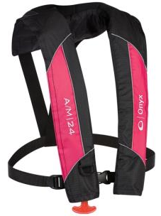
Inflatable Life Jackets/PFD’s
Automatically activated
A water-soluble material dissolves releasing a spring trigger plunger puncturing the cartridge allowing inflation
These also must be worn at all times or another standard type wearable device kept on board to comply with law
Notes:
Inflatable PFD’s/Life Jackets are automatically activated and therefore do not require a user to do anything to make it useful.
Picture: sportsmansguide.com

Slide 53
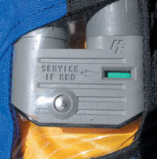
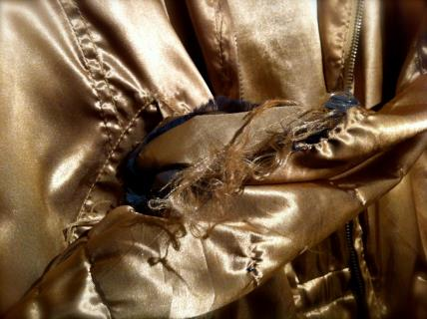
Inflatable PFD Checks
Faulty or inaccessible inflation mechanism
Operable CO2 cartridge
Tears
Broken bucks and missing straps
Notes:
Inflatable PFD’s should be checked before use to ensure they are in an operable condition.
Pictures: westmarine.com
poststreet.wordpress.com

Slide 54
Buying a PFD
Go for Comfort
Can you swim and float comfortably in it?
Is it adjustable?
Where will you be boating?
If on big lakes, at sea, or white water, select higher buoyancy PFD
Notes:
Each PFD sold for use on a recreational boat is required to be provided with a guide to selection entitled “Think Safe – Choose the Right PFD”. These pamphlets are tailored to the kind of PFD to which they are attached. The following information is a combination of information taken from the various pamphlets and additional guidance.
Picture: youtube.com

Slide 55
PFD Maintenance
Air dry before storing
Do not store in plastic which can retain moisture
Check for mildew, leaks and other damage. Destroy and replace damaged units
PFDs are lifesaving equipment NOT to be used as boat fenders. Do not crush or compress with heavy objects
Do not allow PFDs to become contaminated with oil or grease which deteriorate the material
Notes:
Defective PFDs should be taken “out of service” and replaced with new.

Slide 56
Summary
Know the water on which you will travel
Understand the possible harm or hazards to you and your family
Ensure proper protection equipment is at-hand
Use PFDs
Inspect worthiness of the craft
Have survival equipment available:
Whistles
Flares
Spare fuel (if a motorized boat)
Review weather before venturing out!
Notes:
Many people use boats on a daily basis and have safe and fun trips without incident. Keeping the information listed in mind before boating can make a trip much more enjoyable and ensure all involved arrive home safely.

Slide 57
Contact Information
Health & Safety Training Specialists
1171 South Cameron Street, Room 324
Harrisburg, PA 17104-2501
(717) 772-1635
RA-LI-BWC-PATHS@pa.gov
Like us on Facebook! - https://www.facebook.com/BWCPATHS
Notes:
Please contact us for a full list of other programs available to you free of charge.

Slide 58
Questions

Slide 59
Bibliography
Pennsylvania Fish and Boat Commission, Bureau of Boating and Access. www.fishandboat.com
Boating Course Hotline:
1-888-723-4741 (1-888-PAFISH-1)
Boat-ed.com/pennsylvania
americanboating.org/safety.asp
www.boatus.org/boating-safety.asp

Slide 60
Bibliography
https://www.boat-ed.com/pennsylvania/studyGuide/10103901
US Coast Guard, pages 20-39 of their pdf
http://public.d11nuscgaux.info/pe/bss/08%20boating%20safety%20Augmented.pdf
http://boatingindustry.com/news/2014/09/30/u-s-coast-guard-drops-life-jacket-type-code-labels/

Slide 61
Other Suggested Programs
The following presentations are also available to supplement your in-house program:
Cold Weather Injuries
Heat Related Injuries & Illnesses
Near Miss
Poison Ivy
Summer Safety
Ticks & Lyme Disease
Please contact us for a full list of other programs available to you free of charge.

