Slide 1
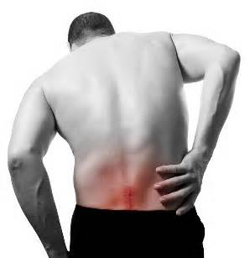
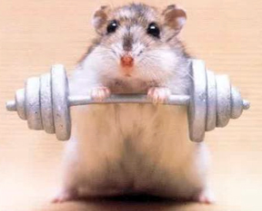
BACK SAFETY & SAFE LIFTING
Bureau of Workers’ Compensation
PA Training for Health & Safety (PATHS)
Notes:
Preventing back injuries is a major workplace safety challenge. According to the Bureau of Labor Statistics, more than one million workers suffer back injuries each year, and back injuries account for one of every five workplace injuries or illnesses. Further, one-fourth of all worker's compensation claims involve back injuries, costing industry billions of dollars on top of the pain and suffering borne by employees.
Cases involving injuries to the back were 182,270 in 2011. In 2012 such cases were down to 177,580 or 2.5%.
blog.nationalsafetycompliance.com/.../back-injuries-and...lifting.html

Slide 2
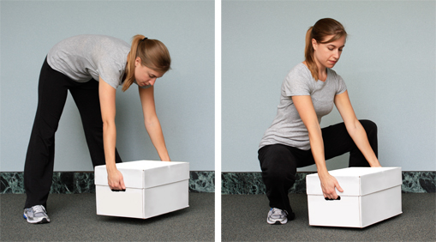
Anatomy of the Back
Why do injuries occur?
  Knowing what causes back injuries can help you prevent them.
Notes:
“… Though lifting, placing, carrying, holding and lowering are involved in manual materials handling (the principal cause of recordable work injuries) the BLS survey shows that four out of five of these injuries were to the lower back, and that three out of four occurred while the employee was lifting.”
blog.nationalsafetycompliance.com/.../back-injuries-and...lifting.html

Slide 3
The Forces Involved
The amount of force you place on your back in lifting may surprise you!
Think of your back as a lever.
With the fulcrum in the center,
it only takes ten pounds of
pressure to lift a ten pound
object.
Notes:
The amount of force you place on your back in lifting may surprise you!
Think of your back as a lever.
With the fulcrum in the center,
it only takes ten pounds of
pressure to lift a ten pound
object.

Slide 4
The Forces Involved
If you shift the fulcrum to one side, it takes much more force to lift the same object.
Your waist acts like the fulcrum in a lever system, on a 10:1 ratio.
Lifting a ten pound
object puts 100
pounds of pressure
on your lower back.
Notes:
It is easy to strain your back by lifting improperly. Bending at the waist puts a great strain on the back muscles. Using your weaker back muscles instead of your strong leg muscles requires you to use more energy to lift. This can hurt your back. A painful back injury can last a lifetime!
Don’t lift from your waist. It takes 10 times the effort to lift that way! For example, lifting a 10-pound object puts 100 pounds of pressure on your lower back.

Slide 5
The Forces Involved
Adding in 105 pounds of the average human upper torso = 1,150 pounds of pressure on the lower back when lifting a ten pound object.
Notes:
Adding in 105 pounds of the average human upper torso = 1,150 pounds of pressure on the lower back when lifting a ten pound object.

Slide 6
The Forces Involved
If you are 25 pounds overweight, it adds an additional 250 pounds of pressure on your back every time you bend over!
Notes:
If you are 25 pounds overweight, it adds an additional 250 pounds of pressure on your back every time you bend over!

Slide 7
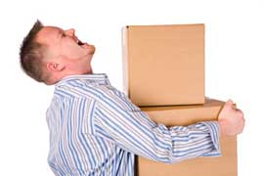
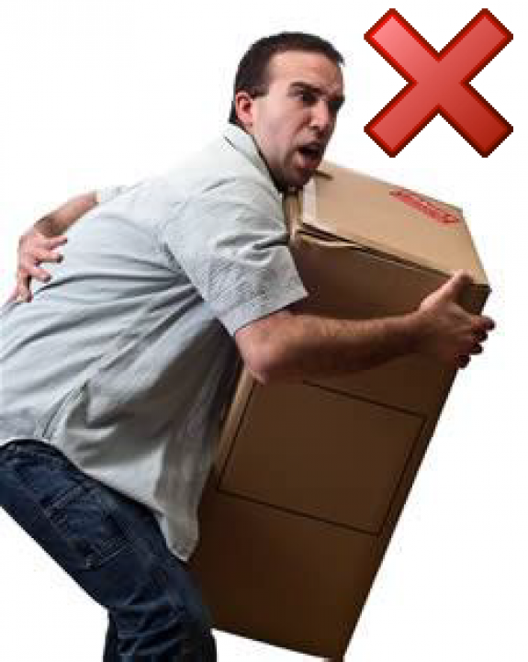
Common Causes of Back Injuries
Anytime you find yourself
lifting think: DANGER! My back is at risk!
Try to avoid heavy lifting,
especially repetitive lifting
over a long period of time
Notes:
Anytime you find yourself lifting think:
DANGER! My back is at risk!
Try to avoid heavy lifting,
especially repetitive lifting
over a long period of time

Slide 8
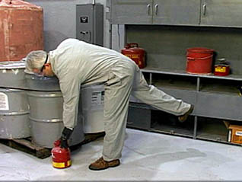
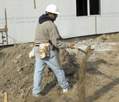
Common Causes of Back Injuries
▪ Twisting at the
waist while lifting.
▪ Holding a heavy load.
▪ Both can happen
when using a shovel.
Notes:
Some common causes of back injuries include:
Posture
Body Mechanics/Work Habits
Stressful Living
Loss of Flexibility
Poor Conditioning

Slide 9
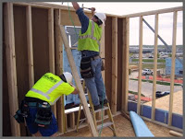
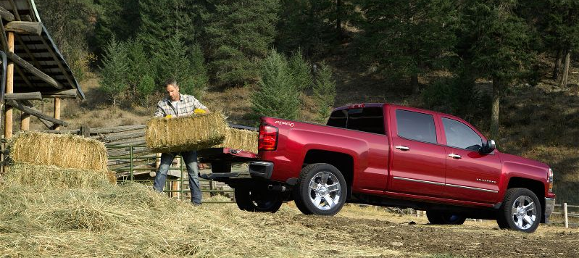
Common Causes of Back Injuries
Reaching and lifting:
Over your head,
Across a table,
From the back of a truck.
Notes:
Some other back injury causes also include:
Reaching and lifting:
Over your head,
Across a table,
From the back of a truck.

Slide 10
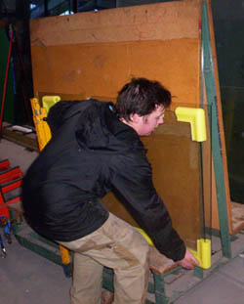
Common Causes of Back Injuries
Lifting or carrying objects with awkward or odd shapes.
Notes:
Also consider that not all back injuries are a result of sudden trauma - most are of a cumulative type, where a repeated minor injury has flared up, or continued use of a heavy tool in the same position has caused pain, or a great deal of time is spent in the same position.
www.safety.com/articles/back-safety-lifting-techniques

Slide 11

Common Causes of Back Injuries
Working in awkward, uncomfortable positions.
Notes:
Working in awkward, uncomfortable positions can cause back injuries.
In one study it was determined that at least one-third of recordable back injuries could be prevented through better job design (ergonomics).
blog.nationalsafetycompliance.com/.../back-injuries-and...lifting.html

Slide 12
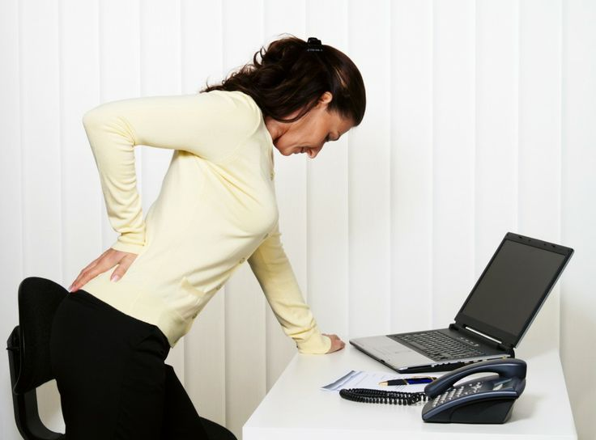
Common Causes of Back Injuries
Sitting or standing in one position too long.
Sitting can be very hard on the lower back
Notes:
Sitting or standing in one position too long.
Sitting can be very hard on the lower back.

Slide 13
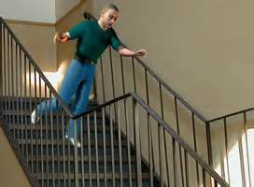
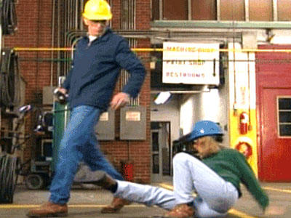
Common Causes of Back Injuries
Slipping on a wet floor or ice covered area.
Notes:
Traumatic back injuries can occur from slipping on a wet floor or ice covered area.

Slide 14
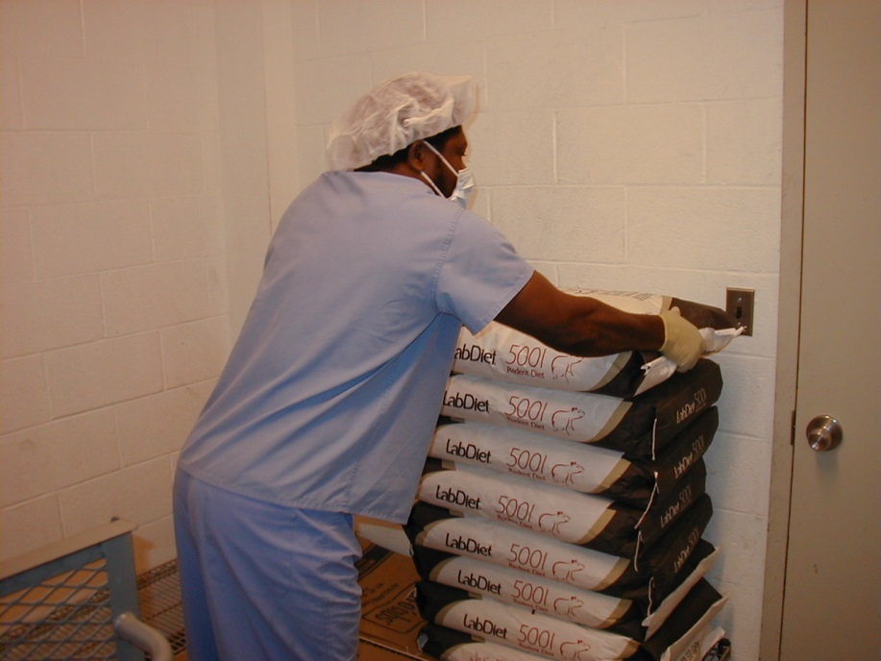
How to Prevent Back Injuries
Avoid lifting and bending whenever you can.
Place objects up off the floor.
Raise/lower shelves.
Use carts and dollies.
Notes:
Avoid lifting and bending whenever you can.
Place objects up off the floor so you can get a good grip.
Raise/lower shelves to decrease the distance you must lift them.
Use carts and dollies and let mechanical devices do the exertive work.

Slide 15
How to Prevent Back Injuries
Plan Your Lift
Before you lift that box, or tool, or piece of equipment, take a moment to consider your action:
Do you need to lift the item manually?
How heavy is it?
Where are you moving the item from?
Where does it have to go?
What route do you have to follow?
Notes:
Plan your lift:
Before you lift that box, or tool, or piece of equipment, take a moment to consider your action:
Do you need to lift the item manually?
How heavy is it?
Where are you moving the item from?
Where does it have to go?
What route do you have to follow?

Slide 16
Plan Ahead – The Route
Check the route you will take and place where you will put the load down.
Injuries and property damage can occur when unexpected problems happen during the move.
Considerations for the route:
- Are there steps, tripping hazards, closed
doors, tight doorways or passageways?
- Are there blind corners or wet/slippery floors?
- What is the traffic situation (people, vehicles,
etc.)?
Notes:
Plan your lift:
Take into consideration the overall route you’ll be using when carrying/moving something.
Where will the load/object be placed? Is the area big enough to accommodate the size of the object and strong enough to support the weight?
Are there steps, tripping hazards, closed doors, tight doorways or passageways?
Are there blind corners or wet/slippery floors?
What is the traffic situation (people, vehicles, etc.)?

Slide 17
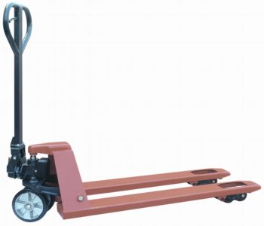
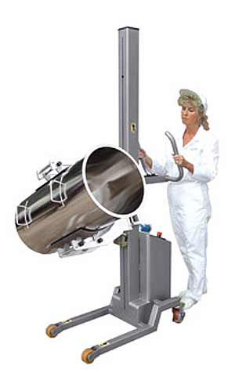
How to Prevent Back Injuries
Use cranes, hoists, lift tables, and other lift-assist devices whenever you can.
Test the weight of an object before lifting by slightly pushing with hand or foot.
Get help if it’s too heavy for you to lift by yourself
Notes:
Use cranes, hoists, lift tables, and other lift-assist devices whenever you can.
Test the weight of an object before lifting by slightly pushing with hand or foot.
Get help if it’s too heavy for you to lift by yourself

Slide 18
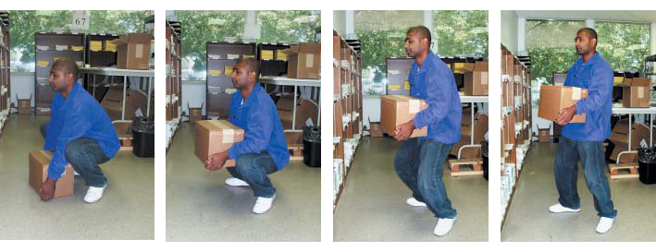
How to Prevent Back Injuries
Use proper lifting procedures; follow these steps when lifting:
Take a balanced stance, feet shoulder width apart.
Squat down to lift, get as close as you can.
Bend your knees
Notes:
Use proper lifting procedures; follow these steps when lifting:
Take a balanced stance, feet shoulder width apart.
Squat down to lift, get as close as you can.
Bend your knees

Slide 19
How to Prevent Back Injuries
Get a secure grip, hug the load.
Lift gradually using your legs.
Keep load close to you.
Keep back and neck straight
Notes:
Get a secure grip, hug the load.
Lift gradually using your legs.
Keep load close to you.
Keep back and neck straight

Slide 20
How to Prevent Back Injuries
Once standing, change directions by pointing your feet and turn your whole body.
Avoid twisting at your waist.
To put load down use these guidelines in reverse.
Notes:
Once standing, change directions by pointing your feet and turn your whole body.
Avoid twisting at your waist.
To put load down use these guidelines in reverse.
Remember, it is also possible to injure your back…
􀂃 Slipping on a wet floor or ice
􀂃 Falling down a flight of steps
􀂃 Attempting to catch an object that falls from your grasp
􀂃 Failing to get assistance when needed

Slide 21
Helping Your Back
You can minimize back problems with exercises that tone the muscles in your back, hips and thighs.
Before beginning any exercise program, check with your doctor and follow advice given. With approval:
Exercise regularly, at least every other day.
  Warm up slowly . . . walking is a good way to
  warm up.
  Inhale deeply before each repetition of an
  exercise and exhale when performing each repetition.
Notes:
No approach has been found for totally eliminating back injuries caused by lifting, though it is felt that a substantial portion can be prevented by an effective back safety training and control program and ergonomic design of work tasks.
blog.nationalsafetycompliance.com/.../back-injuries-and...lifting.html

Slide 22
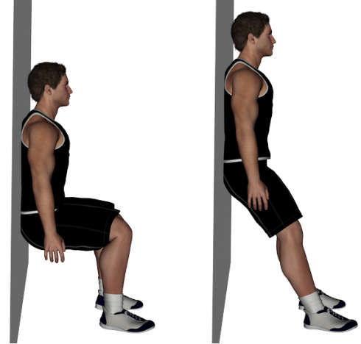
Back Exercises
Wall slides to strengthen
your muscles:
Stand with your back against a wall, feet shoulder-width apart.
Slide down into a crouch with knees bent to 90 degrees.
Count to 5 and slide back up the wall.
Repeat 5 times.
Notes:
Wall slides can strengthen your muscles:
Stand with your back against a wall, feet shoulder-width apart.
Slide down into a crouch with knees bent to 90 degrees.
Count to 5 and slide back up the wall.
Repeat 5 times.

Slide 23
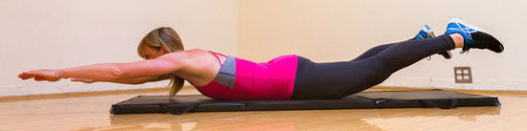
Back Exercises
Leg raises to strengthen back and hip muscles:
Lie on your stomach.
Tighten muscles in one leg and raise leg from floor.
Hold for count of 10, and return leg to floor.
Do the same with your other leg.
Repeat five times with each leg.
Notes:
Leg raises can be done to strengthen back and hip muscles:
Lie on your stomach.
Tighten muscles in one leg and raise leg from floor.
Hold for count of 10, and return leg to floor.
Do the same with your other leg.
Repeat five times with each leg.

Slide 24
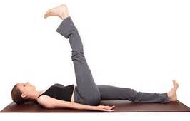
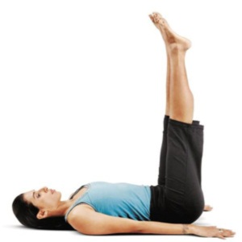
Back Exercises
Leg raises (variation):
Lie on back, arms at your sides.
Lift both legs off floor and hold for count of 10.
If this is too difficult… keep one knee bent and the foot flat on the floor while raising the other leg.
Notes:
Another variation of leg raises:
Lie on back, arms at your sides.
Lift both legs off floor and hold for count of 10.
If this is too difficult… keep one knee bent and the foot flat on the floor while raising the other leg.

Slide 25
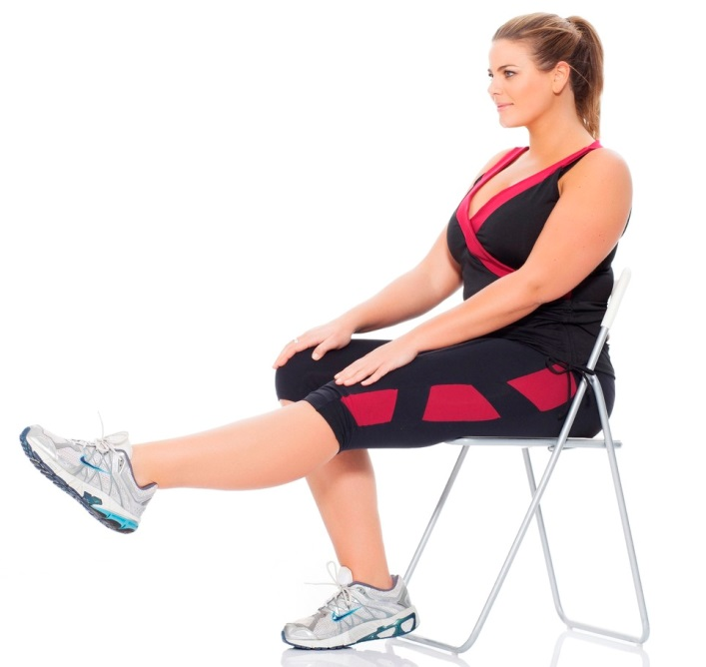
Back Exercises
Leg raises while seated:
Sit upright, legs straight and extended at an angle to floor.
Lift one leg waist high.
Slowly return to floor.
Do the same with the other leg.
Repeat 5 times with each leg.
Notes:
Leg raises can also be done while you’re seated.
Sit upright, legs straight and extended at an angle to floor.
Lift one leg waist high.
Slowly return to floor.
Do the same with the other leg.
Repeat 5 times with each leg.

Slide 26

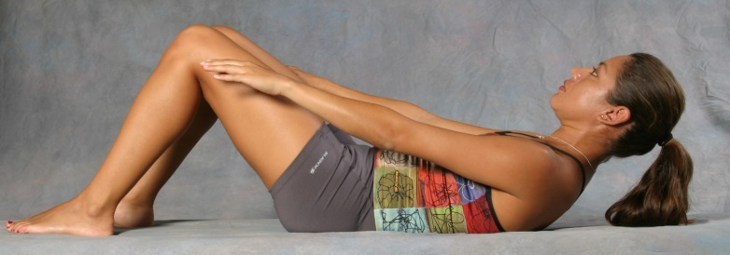
Back Exercises
Partial sit-up to strengthen stomach muscles:
Lie on back, knees bent and feet flat on floor.
Slowly raise head and shoulders off floor.
Count to 10.
Repeat 5 times.
Notes:
Partial sit-ups can strengthen stomach muscles:
Lie on back, knees bent and feet flat on floor.
Slowly raise head and shoulders off floor.
Count to 10.
Repeat 5 times.

Slide 27
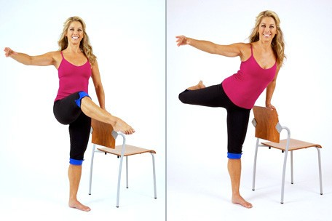
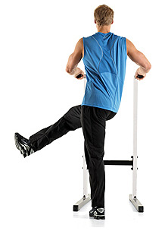
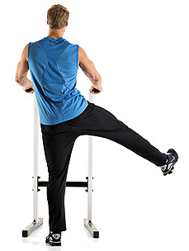
Back Exercises
Back leg swing: strengthen hip and back muscles:
Stand behind chair, hands on chair.
Lift one leg back and up, keeping the knee straight.
Return slowly.
Raise other leg and return.
Repeat 5 times with each leg.
Notes:
Back leg swings are done to strengthen hip and back muscles:
Stand behind chair, hands on chair.
Lift one leg back and up, keeping the knee straight.
Return slowly.
Raise other leg and return.
Repeat 5 times with each leg.

Slide 28
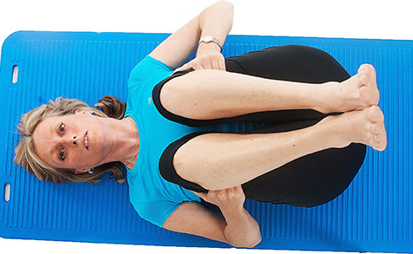
Decrease Back Strain
Lie on back, knees bent, feet flat on floor.
Raise knees toward chest.
Place hands under knees & pull knees to chest.
Do not raise head.
Do not straighten legs as you lower them.
Start with 5 repetitions, several times a day.
Notes:
To reduce back strain:
Lie on your back, knees bent, feet flat on floor.
Raise knees toward chest.
Place hands under knees & pull your knees to chest.
Do not raise your head.
Do not straighten your legs as you lower them.
Start with 5 repetitions, several times a day.

Slide 29
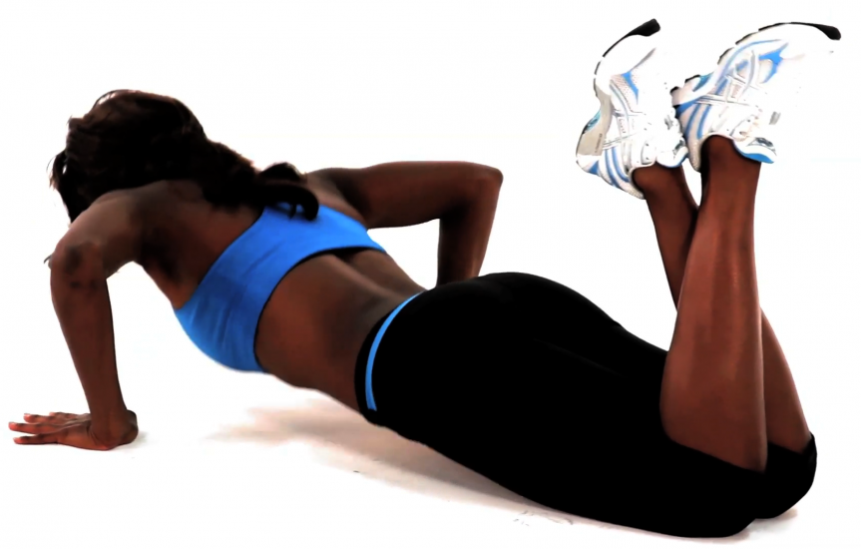
Decrease Back Strain
Lie on stomach, hands under shoulders, elbows bent and push up.
Raise top half of body as high as possible.
Keep hips and legs on floor.
Hold for one or two seconds.
Repeat 10 times, several times a day.
Notes:
One method to decrease back strain is to
Lie on your stomach, hands under shoulders, elbows bent and push up.
Raise the top half of body as high as possible.
Keep hips and legs on floor.
Hold for one or two seconds.
Repeat 10 times, several times a day.

Slide 30
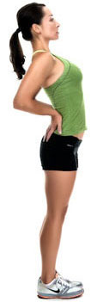
Decrease Back Strain
Stand with feet apart.
Place hands in small of back.
Keep knees straight.
Bend backwards at waist as far as possible and hold for one or two seconds.
Repeat as needed.
Notes:
Also to decrease back strain:
Stand with your feet apart.
Place hands in the small of back.
Keep your knees straight.
Bend backwards at waist as far as possible and hold for one or two seconds.
Repeat as needed.

Slide 31
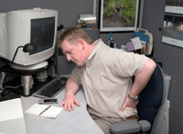
Take Care of Your Back
And it will take care of you!
  Exercise daily
  Avoid heavy lifting
  Get help with heavy or bulky objects
  If you must bend over, do it properly
  Avoid twisting at the waist when carrying objects
  Always watch where you’re going
Notes:
Take care of your back and it will take care of you!
Exercise daily
Avoid heavy lifting
Get help with heavy or bulky objects
If you must bend over, do it properly
Avoid twisting at the waist when carrying objects
Always watch where you’re going

Slide 32


Contact Information
Health & Safety Training Specialists
1171 South Cameron Street, Room 324
Harrisburg, PA 17104-2501
(717) 772-1635
RA-LI-BWC-PATHS@pa.gov
Like us on Facebook! - https://www.facebook.com/BWCPATHS

Slide 33

Questions

