Slide 1
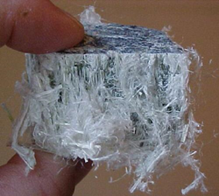
Asbestos Safety Standard
Bureau of Workers’ Compensation
PA Training for Health & Safety (PATHS)
29 CFR 1910.1001
Subpart Z
Toxic & Hazardous Substances
ASBESTOS
Notes:
We suggest you view our “Asbestos Awareness” powerpoint program before viewing this.
The Awareness provides more specific information on asbestos. This program, above, “Asbestos Safety Standard,” is for those involved
in manufacturing ACM as well as working with asbestos in other venues.

Slide 2
Standard Applicability
This standard applies to all occupational exposures to asbestos in all industries covered by the OSH Act.
It does NOT apply to:
Construction work per 29 CFR 1910.12(b)
(Construction work is covered in 29 CFR
1926.1101)
Ship repairing, shipbuilding and shipbreaking per 29 CFR 1915.4
(Such exposures are covered by 29 CFR
1915.1101)
Notes:
This standard applies to all occupational exposures to asbestos in all industries covered by the OSH Act.
It does NOT apply to:
Construction work per 29 CFR 1910.12(b)
(Construction work is covered in 29 CFR
1926.1101)
Ship repairing, shipbuilding and shipbreaking per 29 CFR 1915.4
(Such exposures are covered by 29 CFR
1915.1101)

Slide 3
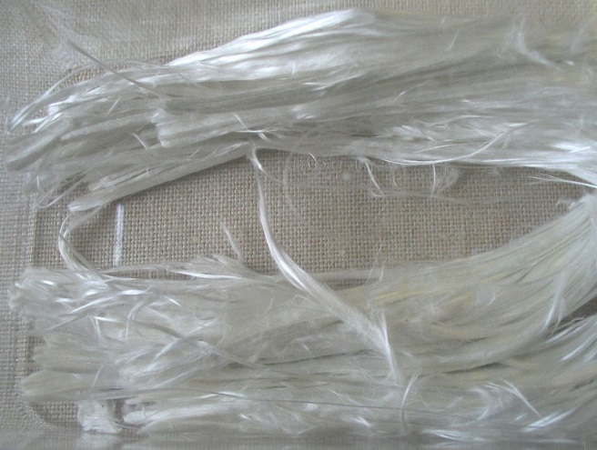
Topics
Terms
Exposure Limits and Monitoring
Compliance Controls and Practices
Respiratory Protection and PPE
Duties of Owners
Notes:
This program will discuss the following topics:
Terms
Exposure Limits and Monitoring
Compliance Controls and Practices
Respiratory Protection and PPE
Duties of Owners of Properties with Asbestos-Containing materials

Slide 4
Topics
Rebutting PACM
Medical Surveillance
Recordkeeping
Mandatory Appendices (A, D, E and F)
Notes:
Also,
The rebutting of Presumed Asbestos-Containing Materials
Medical Surveillance for those working with or around asbestos
Recordkeeping
Mandatory Appendices A, D, E and F (Non-mandatory Appendices are always a good source of information related to the situation.)

Slide 5
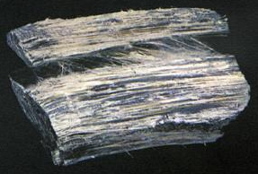
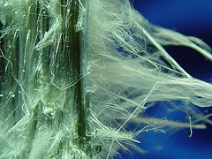
Terms
Asbestos Defined: Any of several minerals that readily separate into long flexible fibers implicated in certain cancers and used formerly as fireproof insulating materials
Asbestos: Includes chrysotile, amosite, crocidolite, tremolite asbestos, anthophyllite asbestos, actinolite asbestos, and any of these minerals that have been chemically treated and/or altered
Notes:
Asbestos Defined: Any of several minerals that readily separate into long flexible fibers implicated in certain cancers and used formerly as fireproof insulating materials
Asbestos: Includes chrysotile, amosite, crocidolite, tremolite asbestos, anthophyllite asbestos, actinolite asbestos, and any of these minerals that have been chemically treated and/or altered

Slide 6
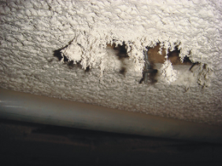
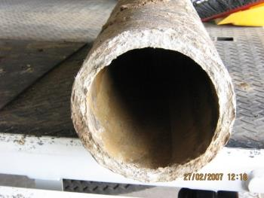
Terms
ACM: Asbestos-containing material with more than 1% asbestos
PACM: Presumed asbestos containing material; thermal system insulation and surfacing material found in buildings constructed no later than 1980
Notes:
ACM: Asbestos-containing material with more than 1% asbestos
PACM: Presumed asbestos containing material; thermal system insulation and surfacing material found in buildings constructed no later than 1980

Slide 7
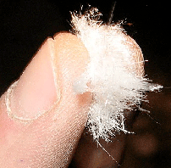
Terms
Fiber: Particulate form of asbestos 5 microns or longer with a length-to-diameter ratio of at least 3 to 1 (3:1)
Thermal System Insulation (TSI): ACM applied to pipes, fittings, boilers, breeching, tanks, ducts or other structural components to prevent heat loss or gain
Notes:
Fiber: Particulate form of asbestos 5 microns or longer with a length-to-diameter ratio of at least 3 to 1 (3:1)
Thermal System Insulation (TSI): ACM applied to pipes, fittings, boilers, breeching, tanks, ducts or other structural components to prevent heat loss or gain
*Note: 1 micron is equal to 1/25,000 of an inch.

Slide 8
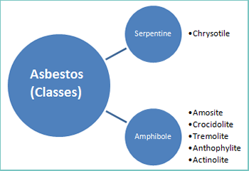
Types
Notes:
The Asbestos classes can be categorized according to their fibrous structure:
1.Serpentine= Chrysotile
2.Amphibole=
Amosite
Crocidolite
Tremolite
Anthophylite
Actinolite

Slide 9
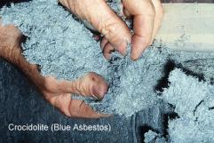
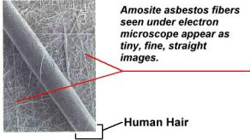
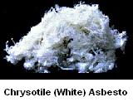
Types of Asbestos
Types most commonly found on
which this program focusses:
Crocidolite (blue)
Amosite (brown)
Chrysotile (white)
Notes:
As will be noted, the fibers of some asbestos may be thinner than a human hair.

Slide 10
Dangers of Asbestos
Health Hazards
Notes:
Health hazards which may be acquired include:
Asbestosis which is a scarring of the lungs impeding the lung’s capability to absorb oxygen,
Mesothelioma and
Lung Cancer.

Slide 11
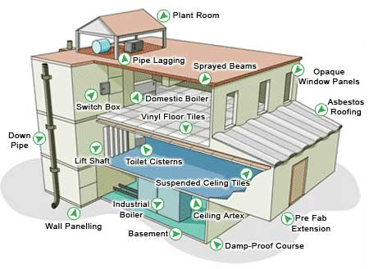
Locations of Asbestos
Home Locations
Notes:
Locations in the home, where asbestos may be found are numerous as shown by the diagram. If not disturbed, the chance is lessened for exposure although not completely eliminated.
Renovations and home remodeling can permit the release of asbestos and ACM into the breathable atmosphere. Air handling and moving units can project the fibers to locations remote from the release.

Slide 12
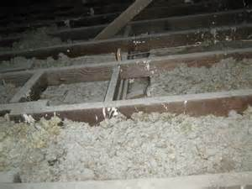
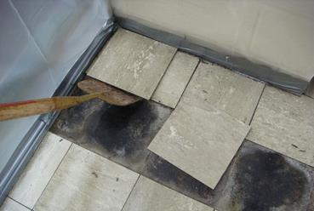
Locations of Asbestos
Attic insulation:
Vermiculite contaminated
by asbestos
Floor tiles, backing
and adhesives
Notes:
Attic insulation: Vermiculite contaminated by asbestos from the Libby mine in Montana. Seventy (70) % of the vermiculite taken from this mine between 1919 and 1990 was contaminated with asbestos.
Floor tiles, backing and adhesives may also contain asbestos.

Slide 13
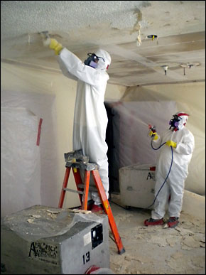
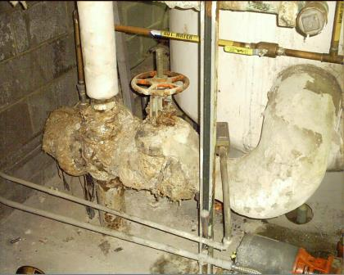
Locations of Asbestos
Ceiling tiles
Pipe Insulation
Notes:
Ceiling tiles which contributed not only sound-proofing but also fire resistivity and pipe insulation are locations of asbestos.

Slide 14
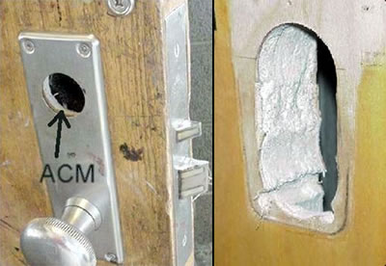
Locations of Asbestos
Fire Doors
Notes:
As you can well imagine, to gain the fire resistance for “fire doors,” asbestos may have been used in the core to achieve this hourly rating.

Slide 15
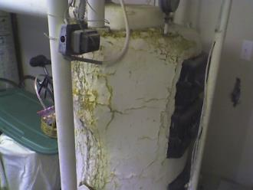
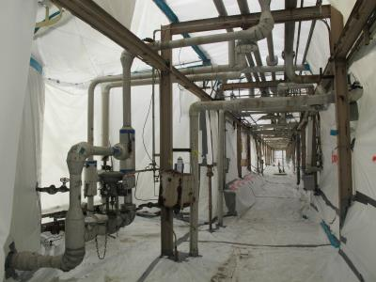
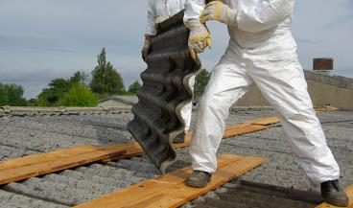
Locations of Asbestos
Commercial Buildings:
Notes:
Commercial buildings may have asbestos in their heat plant and other locations. Even if modernized, roofing, heating plant and transmission lines for steam may have an asbestos covering.

Slide 16
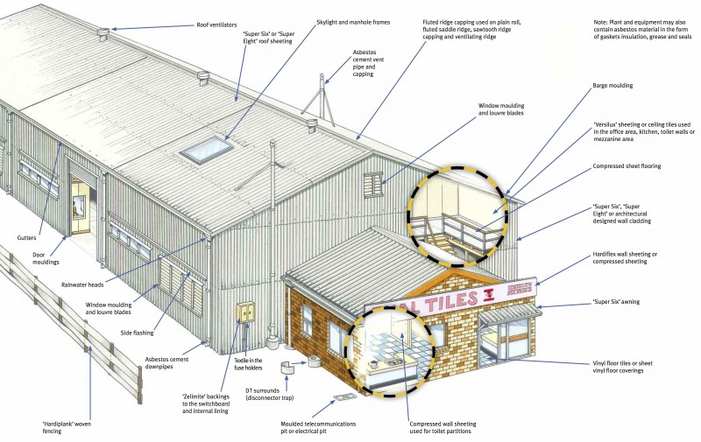
Locations of Asbestos
Commercial Buildings:
Notes:
If you work in or own a commercial building, perform an inspection to determine the location of ACM and PACM. Determine the exposure to workers and prioritize replacement programs.

Slide 17
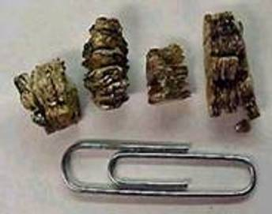
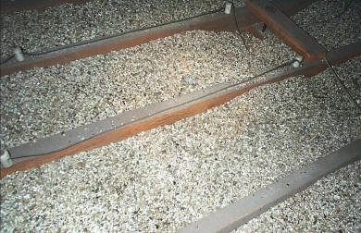
Vermiculite
Origin: Libby Mine in Montana
70% of vermiculite used in insulation from 1919 to 1990 was from this mine
Vermiculite was contaminated by asbestos also in the mine!
Notes:
Vermiculite as stated originated from the Libby Mine in Montana.
70% of vermiculite used in insulation from 1919 to 1990 was from this mine.
Vermiculite was contaminated by asbestos in the mine which translates into cross-contamination at the end use point-possibly your home.

Slide 18
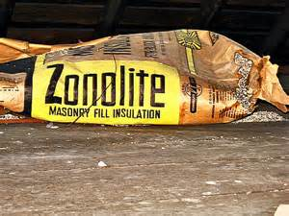
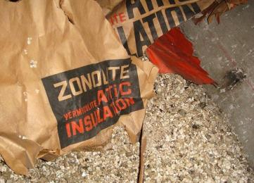
Vermiculite
Brand name for insulation and
masonry fill
Notes:
Zonolite is a brand name for insulation and masonry fill.

Slide 19
Permissible Exposure Limits
EPA indicates no amount of asbestos exposure is safe. Industrial limits are established that, if achieved or exceeded, require Protective Actions be established for workers.
Permissible Exposure Limit (PEL): No employee shall be exposed to an airborne concentration of asbestos in excess of 0.1 fibers per cubic centimeter of air as an eight (8) hour time-weighted average (TWA)
Notes:
EPA indicates no amount of asbestos exposure is safe. Industrial limits are established that, if achieved or exceeded, require Protective Actions be established for workers.
Permissible Exposure Limit (PEL): No employee shall be exposed to an airborne concentration of asbestos in excess of 0.1 fibers per cubic centimeter of air as an eight (8) hour time-weighted average (TWA)
Still, Good Practices would indicate that the exposure should be kept A.L.A.R.A. (as low as reasonably achieveable)

Slide 20
Excursion Limit for Asbestos
Excursion Limit: The airborne concentration in excess of 1.0 fiber per cubic centimeter of air (1f/cc) as averaged over a sampling period of 30 minutes
Again, the EPA indicates that no level of asbestos exposure is acceptable
However, from a planning standpoint, levels have been assigned at and beyond which PAGs (protective action guidelines) are required
Notes:
Excursion Limit: The airborne concentration in excess of 1.0 fiber per cubic centimeter of air (1f/cc) as averaged over a sampling period of 30 minutes
Again, the EPA indicates that no level of asbestos exposure is acceptable
However, from a planning standpoint, levels have been assigned at and beyond which PAGs (protective action guidelines) are required.
Excursion limit as determined in Appendix A of the Standard or by an equivalent method.

Slide 21
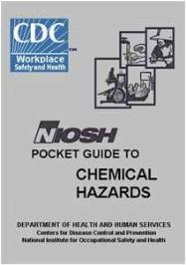
NIOSH Pocket Guide Information
Asbestos: white or greenish (Chrysotile), blue (Crocidolite), or gray-green fibrous (Amosite), odorless solids
Formula: hydrated mineral silicates
CAS# 1332-21-4
IDLH: Ca (N.D.)
DOT: 2212 (blue, brown), 2590 (white)
ERG Guide page 171 (Noncombustible solids))
OSHA PEL: 0.1 fibers per cubic centimeter of air
as an eight (8) hour time-weighted average (TWA), 1.0 fiber per cubic centimeter of air (1f/cc) as averaged over a sampling period of 30 minutes.
Synonyms/Trade names: various i.e. Crocidolite, Amosite, Chrysotile.
Notes:
NIOSH Pocket Guide to Chemical Hazards, Department of Health and Human Services, Centers for Disease Control, National Institute for Occupational Safety and Health, September 2010, DHHS (NIOSH) Publication No. 2010-149 provides an indication of hazards of Asbestos.

Slide 22
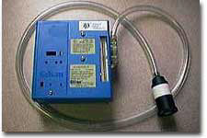
Exposure Monitoring
Exposure determination to be made from breathing zone air samples representative of the 8-hour TWA and 30 minute short-term exposures of each employee
Representative 8-hour TWA
Determined by 1 or more samples representing full-shift exposures for:
Each shift for
Each employee in
Each job classification in
Each work area
Notes:
If asbestos is in evidence or work is being done with asbestos, an exposure determination is to be made from breathing zone air samples representative of the 8-hour TWA and 30 minute short-term exposures of each employee.
Representative 8-hour TWA
Determined by 1 or more samples representing full-shift exposures for:
Each shift for
Each employee in
Each job classification in
Each work area

Slide 23
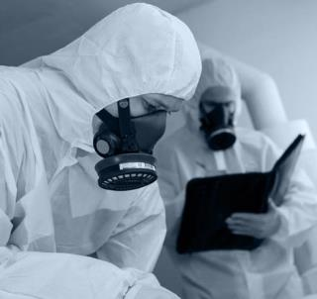
Representative Short Term Exposure
Representative 30-minute short-term exposures shall be determined on basis of 1 or more samples representing 30 minute exposures associated with operation most likely to produce exposures above excursion limit for:
Each shift for
Each job classification in
Each work area
Notes:
Representative 30-minute short-term exposures shall be determined on basis of 1 or more samples representing 30 minute exposures associated with operation most likely to produce exposures above excursion limit for:
Each shift for
Each job classification in
Each work area

Slide 24
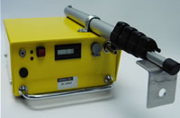
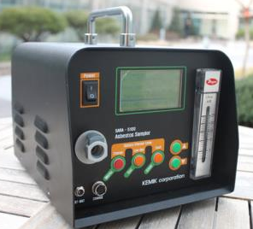
Initial Monitoring
Each employer covered by this standard shall provide initial monitoring of employees who are, or may reasonably be expected to be exposed to airborne concentrations at or above TWA PELS and/or excursion limit
Notes:
Each employer covered by this standard shall provide initial monitoring of employees who are, or may reasonably be expected to be exposed to airborne concentrations at or above TWA PELS and/or excursion limit

Slide 25
Monitoring after March 31, 1992
When monitoring after March 31, 1992 for TWA PEL and/or excursion limit and monitoring satisfies all other requirements, employer may rely on earlier monitoring to satisfy the requirements of paragraph (d)(2)(i) of this section
If objective data demonstrates asbestos is not capable of being released in TWA PEL and/or excursion limits, then no initial monitoring is required
Notes:
When monitoring after March 31, 1992 for TWA PEL and/or excursion limit and monitoring satisfies all other requirements, employer may rely on earlier monitoring to satisfy the requirements of paragraph (d)(2)(i) of this section
If objective data demonstrates asbestos is not capable of being released in TWA PEL and/or excursion limits, then no initial monitoring is required

Slide 26
Monitoring Frequency/Patterns
Periodic monitoring of such frequency and pattern to represent, with reasonable accuracy, the levels of exposure of employees
Sampling shall not be at intervals greater than 6 months for employees whose exposure may reasonably be foreseen to exceed the TWA PEL and/or excursion limit
Notes:
Periodic monitoring of such frequency and pattern to represent, with reasonable accuracy, the levels of exposure of employees
Sampling shall not be at intervals greater than 6 months for employees whose exposure may reasonably be foreseen to exceed the TWA PEL and/or excursion limit

Slide 27
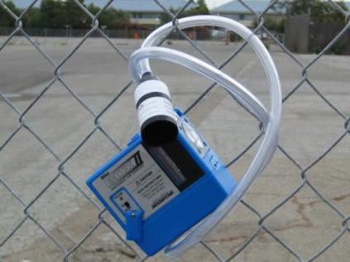
Monitoring Frequency Changes
If either initial or periodic monitoring indicates exposures are below TWA PEL and/or excursion limit, employer may discontinue monitoring employees whose exposures are represented by such monitoring
Notes:
If either initial or periodic monitoring indicates exposures are below TWA PEL and/or excursion limit, employer may discontinue monitoring employees whose exposures are represented by such monitoring.

Slide 28
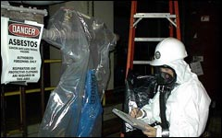
Additional Monitoring
Conducted when a change in production, process, control equipment, personnel or work practices that may result in new or additional exposures above TWA PEL and/or excursion limit
Notes:
Additional monitoring is conducted when a change in production, process, control equipment, personnel or work practices that may result in new or additional exposures above TWA PEL and/or excursion limit.

Slide 29
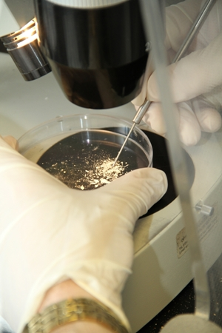
Monitoring Methods
All samples shall be personal samples collected by procedures per Appendix A of this standard evaluated using OSHA Reference Method (ORM) per Appendix A or an equivalent counting method
Notes:
All samples shall be personal samples collected by procedures per Appendix A of this standard evaluated using OSHA Reference Method (ORM) per Appendix A or an equivalent counting method.

Slide 30
Equivalent Method
If equivalent method to the OSHA Reference Method is used, ensure method meets following:
Replicate exposure data used to establish equivalency are collected in side-by-side field and lab comparisons; and
Comparison indicates 90% of samples in range of 0.5 to 2.0 times PEL have an accuracy range of plus or minus 25% of OSHA Reference Method (ORM) results at a 95% confidence level as demonstrated by a statistically valid protocol; and
Equivalency method is documented and results of testing are maintained
Notes:
If an equivalent method to the OSHA Reference Method is used, ensure the method meets the following:
Replicate exposure data used to establish equivalency are collected in side-by-side field and lab comparisons; and
Comparison indicates 90% of samples in range of 0.5 to 2.0 times PEL have an accuracy range of plus or minus 25% of OSHA Reference Method (ORM) results at a 95% confidence level as demonstrated by a statistically valid protocol; and
Equivalency method is documented and results of testing are maintained.

Slide 31
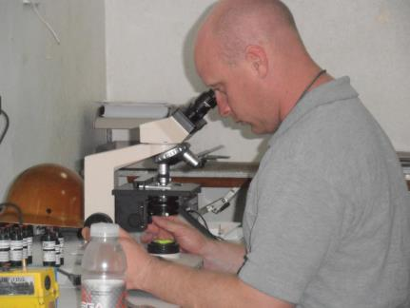
Equivalent Method
To satisfy monitoring requirements, the employer must use results of monitoring analysis performed by labs which instituted quality assurance programs per Appendix A
Notes:
Equivalent method:
To satisfy monitoring requirements, the employer must use results of monitoring analysis performed by labs which instituted quality assurance programs per Appendix A.

Slide 32
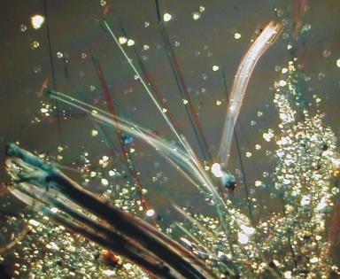
Employee Results Notification
Employees for which monitoring was conducted, are notified of results:
By employer within 15 working days after receipt of results
Each affected employee individually in writing or by posting
Shall contain corrective action being taken to reduce to or below TWA and/or excursion limit
Notes:
Employees shall be notified of monitoring results.
Employees for which the monitoring was conducted, are notified of results:
By employer within 15 working days after receipt of results
Each affected employee is notified individually in writing or by posting
The notification shall contain corrective action being taken to reduce to or below TWA and/or excursion limit.

Slide 33
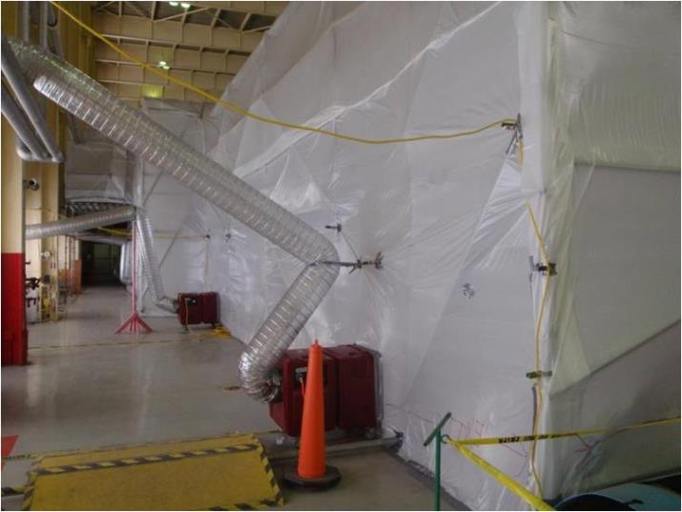
Regulated Areas
Notes:
The slide shows an area cordoned-off to keep the exposing material inside the borders established.

Slide 34
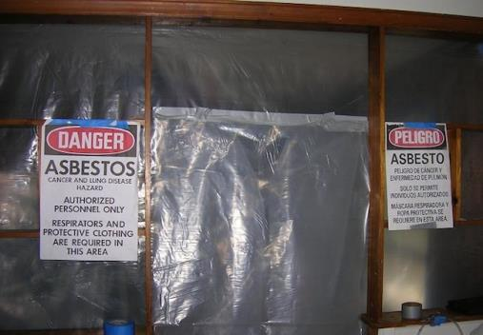
Regulated Areas
Defined: area established by employer to demarcate areas where airborne concentrations of asbestos exceed, or there is a reasonable possibility they may exceed, the PEL
Notes:
Regulated areas are established by employer to demarcate areas where airborne concentrations of asbestos exceed, or there is a reasonable possibility they may exceed, the PEL.

Slide 35
Regulated Areas
Establish: when airborne concentrations and/or PACM exceed TWA and/or excursion limit
Demarcation: to minimize exposures
Access: limit to authorized persons
Provision of Respirators: supplied with and required to use per this standard
Prohibited activities: eating, drinking, smoking, chewing tobacco or gum or applying cosmetics
Notes:
Establish regulated areas when airborne concentrations and/or PACM exceed TWA and/or excursion limit.
Demarcation boundaries are set to minimize exposures.
Access is limit to authorized persons
Respirators are supplied by the employer and employees are required to use per this standard.
Prohibited activities are set for the regulated area to include; eating, drinking, smoking, chewing tobacco or gum or applying cosmetics.

Slide 36
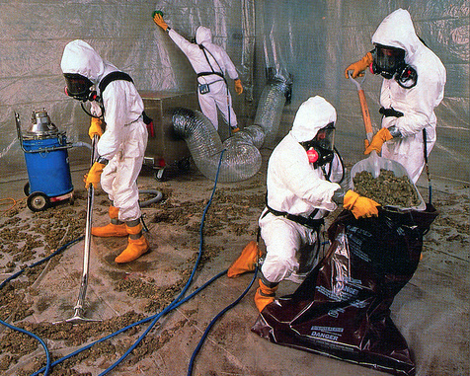
Regulated Areas
Notes:
This slide shows a clean-up operation. Note the division of labor required to minimize the amount of asbestos “chased” into the air as well as to capture the loose material.
Each person is wearing PPE to eliminate their potential exposure due to contact and inhalation.

Slide 37
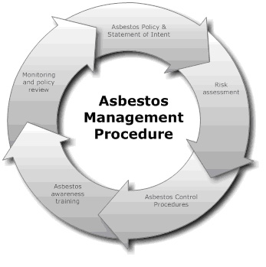
Compliance
Engineering controls/work practices
Instituted to reduce and maintain TWA and/or excursion limits
Compliance Program
Specific compliance methods for brake and clutch repair
Notes:
The Asbestos Standard addresses the following to gain compliance:
Engineering controls/work practices
Instituted to reduce and maintain TWA and/or excursion limits
Compliance Program
Specific compliance methods for brake and clutch repair

Slide 38
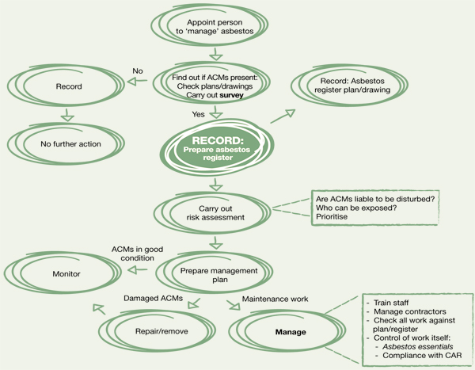
Program Management
Notes:
When committing to any program, there is a systematic concept and “flow” which can be adopted.

Slide 39
Reduction Controls/Practices
Controls used to limit levels to lowest achievable levels
Supplement with respirators
Used to reduce exposure to or below 0.5 fiber per cubic centimeter (8-hour TWA) or 2.5 fibers/cc for 30 minutes (short-term exposure) and
Supplement with combination of respirator, work practices or engineering controls
Notes:
Reduction Controls and Practices can be employed to minimize the hazard.
Controls used to limit levels to lowest achievable levels
Supplement with respirators
Used to reduce exposure to or below 0.5 fiber per cubic centimeter (8-hour TWA) or 2.5 fibers/cc for 30 minutes (short-term exposure) and
Supplement with combination of respirator, work practices or engineering controls

Slide 40
Insufficiency Examples
Coupling cutoff in primary asbestos cement pipe manufacturing;
Sanding in primary and secondary asbestos cement sheet manufacturing;
Grinding in primary and secondary friction product manufacturing;
Carding and spinning in dry textile process;
Grinding and sanding in primary plastics manufacturing
Notes:
Insufficiency in reducing the hazard include,
Coupling cutoff in primary asbestos cement pipe manufacturing;
Sanding in primary and secondary asbestos cement sheet manufacturing;
Grinding in primary and secondary friction product manufacturing;
Carding and spinning in dry textile process;
Grinding and sanding in primary plastics manufacturing

Slide 41
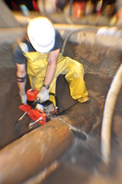
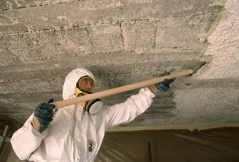
Ventilation
Dust collection and local exhaust ventilation per good practices in ANSI Z9.2-1979
Particular Tools
All hand-operated and power-operated tools which produce or release fibers shall be provided with local exhaust ventilation systems
Notes:
Dust raised by renovation, remodeling and demolition can benefit from correct ventilation.
Dust collection and local exhaust ventilation per good practices in ANSI Z9.2-1979.
Particular Tools
All hand-operated and power-operated tools which produce or release fibers shall be provided with local exhaust ventilation systems.
.

Slide 42
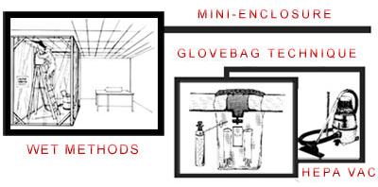
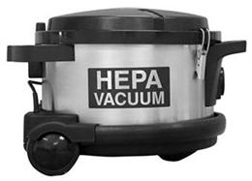
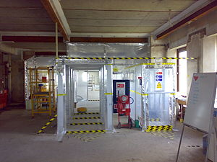
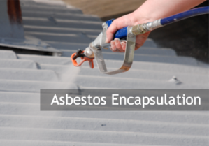
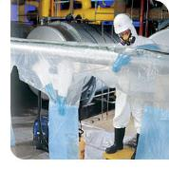
Precautions
Methods to Minimize Exposure
Notes:
Precautions and methods to minimize exposure involve,
Wet methods to reduce the amount of friable dry fiber from going airborne,
Mini enclosures, like a glove bag technique localizes the materials,
HEPA (High Efficiency Particulate Air) filtration can be used, as well as
Encapsulation which coats the asbestos under a protective coating.

Slide 43
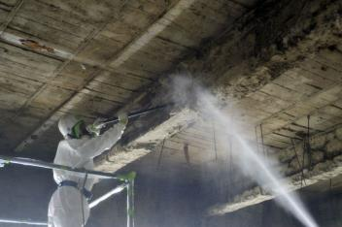
Wet Methods
Asbestos shall be handled, mixed, applied, removed, cut, scored or worked in a wet state sufficient to prevent emission of airborne fibers exceeding TWA and/or excursion levels, unless usefulness of product would be diminished
Notes:
With the Wet method, Asbestos shall be handled, mixed, applied, removed, cut, scored or worked in a wet state sufficient to prevent emission of airborne fibers exceeding TWA and/or excursion levels, unless usefulness of product would be diminished.

Slide 44
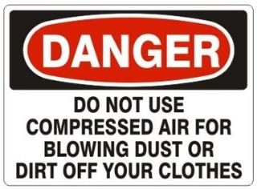
Particular Products/Operations
No asbestos material shall be removed from containers without either being:
Wetted,
Enclosed,
Ventilated to prevent release
of airborne fibers
Compressed air shall NOT be used to remove asbestos
Floor sanding of asbestos-containing material is prohibited!
Notes:
Operations involving particular products of ACM or PACM indicate,
No asbestos material shall be removed from containers without either being:
Wetted,
Enclosed,
Ventilated to prevent release of airborne fibers.
Compressed air shall NOT be used to remove asbestos.
Floor sanding of asbestos-containing material is prohibited!

Slide 45
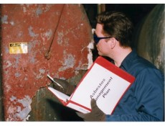
Written Compliance
Where TWA and/or excursion limits are exceeded
Reviewed and updated as needed
Submitted on request to Assistant Secretary, Director, affected employees and designated employee representatives
Employer shall not use employee rotation to comply with TWA and/or excursion limit
Notes:
Written compliance pertains
Where TWA and/or excursion limits are exceeded
Reviewed and updated as needed
Submitted on request to Assistant Secretary, Director, affected employees and designated employee representatives
Employer shall not use employee rotation to comply with TWA and/or excursion limit

Slide 46
Brake and Clutch Repair
Applies during:
Inspection,
Disassembly, repair and assembly operations
Engineering controls and work practices used to limit exposure
(Equivalent method obtaining equivalent results per Method A, Appendix F)*
Notes: “Work Practices and Engineering Controls for Automotive Brake and Clutch Inspection, Disassembly, Repair and Assembly – Mandatory”
Notes:
Safety provisions for the brake and clutch repair industry apply during:
Inspection,
Disassembly, repair and assembly operations
Engineering controls and work practices used to limit exposure
(Equivalent method obtaining equivalent results per Method A, Appendix F)*
*Notes: “Work Practices and Engineering Controls for Automotive Brake and Clutch Inspection, Disassembly, Repair and Assembly – Mandatory”

Slide 47
Brake and Clutch Repair
Where no more than 5 pair of brakes or 5 clutches are inspected, disassembled, repaired or assembled per week, method in paragraph [D], Appendix F may be used (This is the Wet Method)
Notes:
Where no more than 5 pair of brakes or 5 clutches are inspected, disassembled, repaired or assembled per week, method in paragraph [D], Appendix F may be used (This is the Wet Method)

Slide 48
Equivalent Methods
May be used which follow written procedures to perform the 2 preferred methods.
Monitoring data,
Under workplace conditions, or
Objective data documenting resulting exposure are equivalent to methods in Appendix F
Notes:
Equivalent methods may be used which follow written procedures to perform the 2 preferred methods.
Monitoring data,
Under workplace conditions, or
Objective data documenting resulting exposure are equivalent to methods in Appendix F

Slide 49
Respiratory Protection
Employer provides appropriate respirator complying with requirements.
Respirators must be used during:
Periods necessary to install or implement feasible engineering and work practice controls,
Work operations: maintenance and repair for which such controls are not feasible, and where not sufficient to reduce exposure below TWA and/or excursion limit
Emergencies
Notes:
The employer shall provide the appropriate respirator complying with requirements.
Respirators must be used during:
Periods necessary to install or implement feasible engineering and work practice controls,
Work operations: maintenance and repair for which such controls are not feasible, and where not sufficient to reduce exposure below TWA and/or excursion limit
Emergencies

Slide 50
Respirator Program
Provided with Powered Air-Purifying Respirator (PAPR) instead of negative pressure respirator
No employee is assigned to a respirator if medical exam precludes such use
Such employee must be assigned to another job or given opportunity to transfer to another position
Must be same employer
Same geographical area
Same seniority status and pay rate employee had prior to such transfer
Notes:
The Respirator Program will indicate the operating provisions of the employer.
Employees will be provided with Powered Air-Purifying Respirator (PAPR) instead of negative pressure respirator.
No employee is assigned to a respirator if medical exam precludes such use.
Such employee must be assigned to another job or given opportunity to transfer to another position.
Must be same employer
Same geographical area
Same seniority status and pay rate employee had prior to such transfer

Slide 51
Respirator Selection
Select and provide per 29 CFR 1910.134(d)(3)(i)(A)
No filtering face piece for protection against asbestos fibers!!
Provide HEPA filters for powered and non-powered air-purifying respirators
Notes:
Respirator selection will be in accordance with 29 CFR 1910.134(d)(3)(i)(A)
No filtering face piece for protection against asbestos fibers!!
Provide HEPA filters for powered and non-powered air-purifying respirators

Slide 52
Protective Clothing/Equipment
Protective Work Clothing and Equipment
Provided by employer when employee is:
Exposed to asbestos above TWA and/or excursion limit, or
Possibility of eye irritation exists
Examples, but not limited to:
Coveralls or similar full-body work clothing
Gloves, head coverings, and foot coverings; and
Face shields, vented goggles or other compliant protective clothing
Notes:
Protective Work Clothing and Equipment
Provided by employer when employee is:
Exposed to asbestos above TWA and/or excursion limit, or
Possibility of eye irritation exists
Examples, but not limited to:
Coveralls or similar full-body work clothing
Gloves, head coverings, and foot coverings; and
Face shields, vented goggles or other compliant protective clothing

Slide 53
PPE: Removal/Storage
To promote highest levels of safety:
Removed only in change rooms
No contaminated items taken from change room
Put and stored in closed containers
Contaminated items removed for cleaning, maintenance or disposal shall have labels per this standard (i)(4) this section
Notes:
PPE removal and storage shall promote the highest levels of safety. The PPE:
Is removed only in change rooms.
No contaminated items taken from change room.
Put and stored in closed containers.
Contaminated items removed for cleaning, maintenance or disposal shall have labels per this standard (i)(4) this section.

Slide 54
Cleaning/Replacing PPE
Employer must provide clean PPE and equipment at least weekly
Prohibits asbestos removal from PPE and equipment by blowing or shaking
Laundering done to prevent release of fibers
If PPE given to another for laundering, inform of this standard’s provisions
Must inform launderer of hazards of asbestos
Contaminated clothing transported in sealed, impermeable bags or other closed impermeable containers which are labeled
Notes:
Employer must provide clean PPE and equipment at least weekly
Prohibits asbestos removal from PPE and equipment by blowing or shaking
Laundering done to prevent release of fibers
If PPE given to another for laundering, inform of this standard’s provisions
Must inform launderer of hazards of asbestos
Contaminated clothing transported in sealed, impermeable bags or other closed impermeable containers which are labeled

Slide 55
Hygiene Facilities/Practices
Provided by employer where exposures are above TWA and/or excursion level:
Change rooms: per 1910.141(e)
Showers: in accord with 1910.141(d)(3)
Lunchrooms: positive pressure, filtered air
supply
No smoking in work areas
Notes:
Hygiene Facilities are provided by the employer where exposures are above TWA and/or excursion level:
Change rooms: per 1910.141(e)
Showers: in accord with 1910.141(d)(3)
Lunchrooms: positive pressure, filtered air supply
No smoking in work areas

Slide 56
Communication of Hazards
▪ Most employees who manufacture ACM, repair and replace automotive brakes and clutches are covered by OSHA’s general industry standard with exception of state or local governmental employees in non-state plan states
▪ Those performing housekeeping activities during and after construction are covered by the asbestos construction standard, 29 CFR 1916.1101
Regardless of industry designation, housekeeping should be informed of potential asbestos hazards
Notes:
Most employees who manufacture ACM, repair and replace automotive brakes and clutches are covered by OSHA’s general industry standard with exception of state or local governmental employees in non-state plan states.
Those performing housekeeping activities during and after construction are covered by the asbestos construction standard, 29 CFR 1916.1101.
Regardless of industry designation, housekeeping should be informed of potential asbestos hazards.

Slide 57
Installed ACM
Employers and building owners are required to treat installed TSI and sprayed on and troweled-on surfacing materials as ACM in buildings constructed no later than 1980; these materials are treated as PACM
Notes:
Employers and building owners are required to treat installed TSI (Thermal System Insulation) and sprayed on and troweled-on surfacing materials as ACM in buildings constructed no later than 1980; these materials are treated as PACM (Presumed Asbestos Containing Materials).

Slide 58
Installed ACM
Asphalt and vinyl flooring installed no later than 1980 must also be treated as ACM
Employers and owners may demonstrate PACM and flooring do not contain asbestos per (j)(8)(iii)
Notes:
Asphalt and vinyl flooring installed no later than 1980 must also be treated as ACM (Asbestos Containing Materials).
Employers and owners may demonstrate PACM and flooring do not contain asbestos per (j)(8)(iii).

Slide 59
Duties of Owners
Duties of owners and employers and building and facility owners:
Determine presence, location and quantity of ACM or PACM
Maintain records of all information required and retain for duration of ownership then transfer to successive owners
Employers inform employees and those performing housekeeping of areas containing PACM of presence, location
Notes:
Duties of owners and employers and building and facility owners:
Determine presence, location and quantity of ACM or PACM
Maintain records of all information required and retain for duration of ownership then transfer to successive owners
Employers inform employees and those performing housekeeping of areas containing PACM of presence, location

Slide 60
Warning Signs
Post each regulated area at all approaches to area
Sign specifications:
DANGER
ASBESTOS CANCER AND LUNG DISEASE HAZARD
AUTHORIZED PERSONNEL ONLY
Notes:
Post each regulated area at all approaches to the area.
Sign specifications:
DANGER
ASBESTOS CANCER AND LUNG DISEASE HAZARD
AUTHORIZED PERSONNEL ONLY

Slide 61
Warning Signs
Where respirators and PPE are required:
DANGER
ASBESTOS CANCER AND LUNG DISEASE HAZARD
AUTHORIZED PERSONNEL ONLY
RESPIRATORS AND PROTECTIVE CLOTHING
ARE REQUIRED IN THIS AREA
Ensure those working in such areas and in contiguous areas understand the warning signs
Notes:
Where respirators and PPE are required:
DANGER
ASBESTOS CANCER AND LUNG DISEASE HAZARD
AUTHORIZED PERSONNEL ONLY
RESPIRATORS AND PROTECTIVE CLOTHING
ARE REQUIRED IN THIS AREA
Ensure those working in such areas and in contiguous areas understand the warning signs

Slide 62
Mechanical Room Entrance
Post signs identifying materials, location and work practices to room and areas where ACM and/or PACM is reasonably expected
Notes:
As for the Mechanical Room Entrance in the slide, as an example:
Post signs identifying materials, location and work practices to room and areas where ACM and/or PACM is reasonably expected.

Slide 63
Warning Labels
Affixed to all raw material, mixtures, scrap, waste, debris and other products containing asbestos fibers or to their containers.
Affix labels or signs (signs may be used instead of labels)
Label Specifications
DANGER
CONTAINS ASBESTOS FIBERS
AVOID CREATING DUST
CANCER AND LUNG DISEASE HAZARD
Notes:
Warning labels shall be affixed to all raw material, mixtures, scrap, waste, debris and other products containing asbestos fibers or to their containers.
Affix labels or signs (signs may be used instead of labels).
Label Specifications
DANGER
CONTAINS ASBESTOS FIBERS
AVOID CREATING DUST
CANCER AND LUNG DISEASE HAZARD

Slide 64
SDS
Safety Data Sheet: Manufacturers, importers of asbestos or asbestos products shall comply with SDS development
These provisions for labels do NOT apply where:
Asbestos fibers have been modified by a bonding agent, coating, binder, or other material provided manufacturer can show that during any reasonably foreseeable use, handling, storage, disposal, processing, or transportation, no airborne concentrations of fibers in excess of TWA PEL and/or excursion limit will be released, or
Asbestos is present in concentrations less than 1.0%
Notes:
Safety Data Sheet: Manufacturers, importers of asbestos or asbestos products shall comply with SDS development
These provisions for labels do NOT apply where:
Asbestos fibers have been modified by a bonding agent, coating, binder, or other material provided manufacturer can show that during any reasonably foreseeable use, handling, storage, disposal, processing, or transportation, no airborne concentrations of fibers in excess of TWA PEL and/or excursion limit will be released, or
Asbestos is present in concentrations less than 1.0%

Slide 65
Employee Information/Training
Those who are exposed to airborne concentrations at or above PEL and/or excursion limit
Provided prior to or at time of initial assignment and annually thereafter
Training presented in understandable manner and informed of:
• Health effects
• Relationship between smoking and exposure
• Quantity, location, manner of use, release and storage and nature of operations
• Engineering controls and work practices
• Procedures to protect employees
Notes:
Employee information and training is furnished to those who are exposed to airborne concentrations at or above PEL and/or excursion limit
Provided prior to or at time of initial assignment and annually thereafter
Training presented in understandable manner and informed of:
• Health effects
• Relationship between smoking and exposure
• Quantity, location, manner of use, release and storage and nature of operations
• Engineering controls and work practices
• Procedures to protect employees

Slide 66
Employee Information/Training
Respirator and PPE: proper use and limitations
Purpose and type of medical surveillance
Content of this standard and appendices
Public health agency names, phone numbers, addresses to obtain information
Requirements for posting signs and labels
Notes:
Also included in the information and training to employees would be:
Respirator and PPE: proper use and limitations
Purpose and type of medical surveillance
Content of this standard and appendices
Public health agency names, phone numbers, addresses to obtain information
Requirements for posting signs and labels

Slide 67
Housekeeping Training Topics
Awareness training course
Health effects
Locations
Recognition of ACM and PACM
Response to fiber release episodes
Notes:
Housekeeping staff would also be informed and trained. Topics and information include:
Awareness training course
Health effects
Locations
Recognition of ACM and PACM
Response to fiber release episodes

Slide 68
Training Information/Materials
Affected employees shall have access to a copy of this standard and appendices
Upon request, all materials relating to employee information and training shall be provided to the Assistant Secretary and Director
Self-Help Programs
Employer shall inform all employees of availability to smoking cessation program materials
Distribute NIH Pub No. 89-1647 or equivalent self-help material
Notes:
Affected employees shall have access to a copy of this standard and appendices
Upon request, all materials relating to employee information and training shall be provided to the Assistant Secretary and Director
Self-Help Programs
Employer shall inform all employees of availability to smoking cessation program materials
Distribute NIH Pub No. 89-1647 or equivalent self-help material

Slide 69
Rebutting PACM
An employer or building owner who can demonstrate materials are not PACM (presumed asbestos containing materials) are not required to communicate information about a building material which does not exist
Information, data and analysis supporting the absence of asbestos shall be retained per paragraph (m)
Notes:
Often employers and owners may wish to rebut the presence of PACMs on their property.
An employer or building owner who can demonstrate materials are not PACM (presumed asbestos containing materials) are not required to communicate information about a building material which does not exist
Information, data and analysis supporting the absence of asbestos shall be retained per paragraph (m)

Slide 70
Rebutting PACM
Have an inspection completed
Test suspect materials
Demonstrate floor, backing and adhesive do not contain PACM
Notes:
The rebuttal will include
Having an inspection completed,
Testing the suspect materials and
Demonstrate floor, backing and adhesive do not contain PACM.

Slide 71
Housekeeping
All surfaces shall be maintained as free as practicable of ACM waste and debris and accompanying dust
All spills and sudden releases of ACM shall be cleaned-up as soon as possible
Contaminated surfaces can NOT be cleaned with compressed air
Notes:
Housekeeping operations shall ensure:
All surfaces shall be maintained as free as practicable of ACM waste and debris and accompanying dust
All spills and sudden releases of ACM shall be cleaned-up as soon as possible
Contaminated surfaces can NOT be cleaned with compressed air

Slide 72
Housekeeping
HEPA-filtered vacuuming equipment shall be used for ACM waste and debris
Shoveling, dry sweeping and dry clean-up only done when vacuuming and/or wet cleaning are not feasible
Notes:
Housekeeping also includes:
HEPA-filtered vacuuming equipment shall be used for ACM waste and debris.
Shoveling, dry sweeping and dry clean-up are only done when vacuuming and/or wet cleaning are not feasible.

Slide 73
Waste Disposal
All debris, waste, scrap consigned for disposal shall be collected, recycled and disposed of in sealed, impermeable bags or other closed, impermeable containers
Asbestos-containing flooring material:
Sanding: Prohibited
Stripping of finishes only conducted using low abrasion pads at speeds lower than 300 rpm and wet methods
Burnishing or dry buffing: only on flooring with sufficient finish so pad cannot contact asbestos containing material
Notes:
Any waste containing ACM or PACM must abide by requirements.
All debris, waste, scrap consigned for disposal shall be collected, recycled and disposed of in sealed, impermeable bags or other closed, impermeable containers.
Asbestos-containing flooring material:
Sanding: is Prohibited.
Stripping of finishes is only conducted using low abrasion pads at speeds lower than 300 rpm and wet methods.
Burnishing or dry buffing is done only on flooring with sufficient finish so the burnishing or buffing pad cannot contact asbestos containing material.

Slide 74
Waste and Debris
Waste and debris and accompanying dust in areas with accessible ACM and/or PACM or visibly deteriorated ACM shall not be dusted or swept dry or vacuumed without using a HEPA filter
Notes:
Waste and debris and accompanying dust in areas with accessible ACM and/or PACM or visibly deteriorated ACM shall not be dusted or swept dry or vacuumed without using a HEPA filter.

Slide 75
Medical Surveillance
▫ Institute a program for all employees who are or will be exposed to airborne concentrations of fibers at or above the TWA and/or excursion limit
▫ Physician’s exam: all exams are performed by or under the supervision of a licensed physician
Notes:
A medical surveillance program is required in some cases.
Institute a program for all employees who are or will be exposed to airborne concentrations of fibers at or above the TWA and/or excursion limit.
▫ Physician’s exam: all exams are performed by or under the supervision of a licensed physician.

Slide 76
Medical Surveillance
Those performing the pulmonary function test, other than licensed physicians, shall complete a training course in spirometry sponsored by an appropriate academic or professional institution
Pre-placement exam
Before assignment
Periodic exams shall be made available annually
Protocol according to this standard
Notes:
Those performing the pulmonary function test, other than licensed physicians, shall complete a training course in spirometry sponsored by an appropriate academic or professional institution
Pre-placement exam
Before assignment
Periodic exams shall be made available annually
Protocol according to this standard

Slide 77
Termination Exam
Exams are for those exposed
to TWA and/or excursion limit
given within 30 calendar days
before or after date of termination
No Exam Required
If one conducted within past 1 year period
Pre-employment exam can not be used to meet these requirements unless cost of said exam is borne by the employer
Notes:
Exams are for those exposed to TWA and/or excursion limit given within 30 calendar days before or after date of termination
No Exam Required
If one conducted within past 1 year period
Pre-employment exam can not be used to meet these requirements unless cost of said exam is borne by the employer

Slide 78
Information to Physician
Copy of this standard plus Appendices D and E
Description of employee’s duties
Employee’s representative exposure level or anticipated level
Description of PPE and respiratory equipment to be used
Information from previous medical exams of affected employee not otherwise available to examining physician
Notes:
The physician, in order to make a proper determination of individual need, is furnished with information.
Copy of this standard plus Appendices D and E
Description of employee’s duties
Employee’s representative exposure level or anticipated level
Description of PPE and respiratory equipment to be used
Information from previous medical exams of affected employee not otherwise available to examining physician

Slide 79
Physician’s Written Opinion
Given to employer
No other information than asbestos exposure
Employer provides copy of written opinion to employee within 30 days from its receipt
Any conditions which may increase risk from asbestos exposure
Recommendations and limitations on employee or PPE
Statement employee has been informed of exam results and the risks associated with smoking and asbestos exposure
Notes:
The physician’s written opinion,
Is given to the employer.
No other information than asbestos exposure is provided.
Employer provides copy of the written opinion to the employee within 30 days from its receipt.
Any conditions which may increase risk from asbestos exposure are indicated.
Recommendations and limitations on the employee or PPE are noted in the report.
Statement the employee has been informed of exam results and the risks associated with smoking and asbestos exposure are included.

Slide 80
Recordkeeping
Exposure records of monitored employees
Data for exempted operations are to be retained for duration employer relies
on such data
Records kept on each employee
subject to medical surveillance
Record maintained for duration of
employment plus 30 years per 29
CFR 1910.1020
Training records kept for 1 year beyond last date of employment
Notes:
Recordkeeping requirements involve maintaining,
Exposure records of monitored employees.
Data for exempted operations are to be retained for the duration for which the employer relies on such data.
Records kept on each employee who is subject to medical surveillance.
Record is maintained for duration of employment plus 30 years per 29 CFR 1910.1020.
Training records are kept for 1 year beyond the last date of employment.

Slide 81
Monitoring Observation
Provide affected employees or representative opportunity to observe any monitoring of employee exposure
If entry into area requires PPE, observer shall be provided with and required to use and comply with all other applicable safety and health procedures
Notes:
Monitoring is required to determine exposure.
Provide the affected employees or representative opportunity to observe any monitoring of employee exposure.
If entry into area requires PPE, the observer shall be provided with and required to use and comply with all other applicable safety and health procedures.

Slide 82
Mandatory Appendices
1910.1001 Appendix A
OSHA Reference Methods-Mandatory
This is the ORM discussed in the program
Notes:
Appendices, whether mandatory or non-mandatory, provide insight and guidance in various areas of the standard.
1910.1001 Appendix A
OSHA Reference Methods-Mandatory

Slide 83
Mandatory Appendices
1910.1001 Appendix D
Medical Questionnaires – Mandatory
(Full size forms available free at
www.oshacfr.com)
Notes:
1910.1001 Appendix D
Medical Questionnaires – Mandatory

Slide 84
Mandatory Appendices
1910.1001 Appendix E
Interpretation and Classification of Chest Roentgenograms – Mandatory
Notes:
1910.1001 Appendix E
Interpretation and Classification of Chest Roentgenograms – Mandatory

Slide 85
Mandatory Appendices
1910.1001 Appendix F
Work Practices and Engineering Controls for Automotive Brake and Clutch Inspection, Disassembly, Repair and Assembly-Mandatory
Negative Pressure Enclosure/HEPA
Vacuum System Method
(B)Low Pressure/Wet Cleaning Method
(C)Equivalent Methods
(D)Wet Method
Notes:
1910.1001 Appendix F
Work Practices and Engineering Controls for Automotive Brake and Clutch Inspection, Disassembly, Repair and Assembly-Mandatory
(A) Negative Pressure Enclosure/HEPA Vacuum System Method
(B) Low Pressure/Wet Cleaning Method
(C) Equivalent Methods
(D) Wet Method

Slide 86
Contact Information
Health & Safety Training Specialists
1171 South Cameron Street, Room 324
Harrisburg, PA 17104-2501
(717) 772-1635
RA-LI-BWC-PATHS@pa.gov
Like us on Facebook! - https://www.facebook.com/BWCPATHS
PPT-073-01
87
Notes:
You are invited to contact us for information related to other free training programs and power point presentations. Please visit our website above to view toolbox talks, short videos and other power point programs to assist your training needs.

Slide 87
Questions

