Slide 1
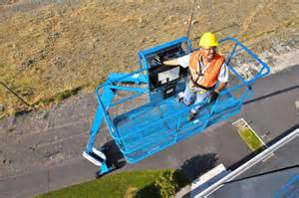
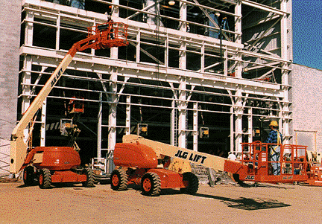
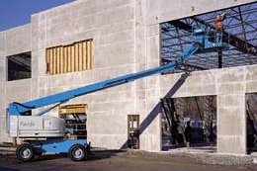
Aerial Work Platform Safety
Bureau of Workers’ Compensation
PA Training for Health & Safety (PATHS)
29 CFR 1910.67
And
29 CFR 1910.68
Notes:
When work requires a person to ascend to heights, safety factors must be incorporated into the effort.
The following OSHA regulations apply to this program:
29 CFR 1910.67, Vehicle-mounted elevating and rotating work platforms;
29 CFR 1910.68, Man lifts

Slide 2
Objectives
Operator Training Requirements
Before Operation Inspection
Safety Operations of a Lift
Aerial Lift Requirements
Scissors Lift Requirements
Maintenance Requirements
Notes:
This program will address the following topics toward achieving safety during operations:
Operator Training Requirements
Before Operation Inspection
Safety Operations of a Lift
Aerial Lift Requirements
Scissors Lift Requirements
Maintenance Requirements

Slide 3
Aerial Lift Deaths
Notes:
This slide shows the fatality statistics for 1992 through 1999 compiled by the US Bureau of Labor Statistics.

Slide 4
Aerial Lifts
Falls
1/5 of deaths involved ejections, after being struck by object
Cause of fall unknown in 3/5 of deaths
Other causes included removal of chains, standing on or leaning over railings
Notes:
Falls
1/5 (20%) of deaths involved ejections after being struck by object
Cause of fall unknown in 3/5 (60%) of deaths
Other causes included removal of chains, standing on or leaning over railings

Slide 5
Aerial Lifts
Tip-overs
Caused almost 1/3 of scissor lift deaths
Mostly while elevated over 15 feet
1/4 of tip-overs occurred where lift hit a hole or curb while moving
Electrocutions
1/2 involved overhead power lines
Notes:
Tip-overs
Caused almost 1/3 of scissor lift deaths
Mostly while elevated over 15 feet
1/4 (25%) of tip-overs occurred where the lift hit a hole or curb while moving
Electrocutions
1/2 (50%) involved overhead power lines

Slide 6
Operator Training
Training must be done by a qualified person experienced with the particular lift model. Training must include:
Nature of electrical, fall, tip-over, and other hazards involved in operating lift
Precautions for dealing with hazards
Notes:
Training must be done by a qualified person experienced with the particular lift model. Training must include:
Nature of electrical, fall, tip-over, and other hazards involved in operating a lift
Precautions for dealing with hazards

Slide 7
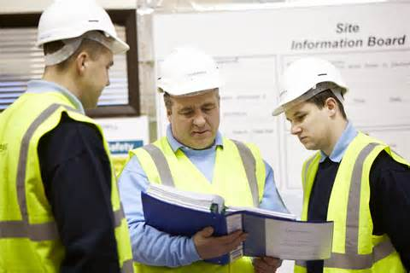
Operator Training
Rated load capacity for the lift (including workers, tools, materials, bucket liner, etc.)
Manufacturer requirements, as outlined in operator manual
Demonstration of skill and knowledge in actual operation of the aerial lift
Notes:
Operator training will also include:
Rated load capacity for the lift (including workers, tools, materials, bucket liner, etc.)
Manufacturer requirements, as outlined in the operator manual
Demonstration of skill and knowledge in actual operation of the aerial lift

Slide 8
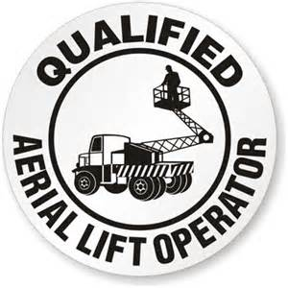
Qualified Person
OSHA 1926.450(b)
A qualified person .…by extensive knowledge, training, and experience can….solve….problems related to the subject matter….
Notes:
OSHA discusses a “Qualified Person” and the requisite abilities.
According to OSHA 1926.450(b)
Qualified, “means one who, by possession of a recognized degree, certificate, or professional standing, or who by extensive knowledge, training, and experience, has successfully demonstrated his/her ability to solve or resolve problems related to the subject matter, the work, or the project.”

Slide 9
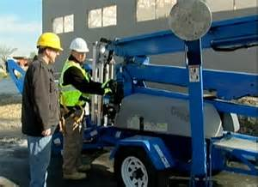
Before Operating a Lift
Do not modify aerial lift without written permission
Check safety devices, operating controls before each use
Notes:
Before operating a lift:
Do not modify the aerial lift without written permission
Check safety devices and operating controls before each use

Slide 10
Before Operating a Lift
Check area in which aerial lift will be used for:
Level surface (Do not exceed manufacturer slope recommendations)
Holes, drop-offs, bumps, debris, etc.
Overhead obstructions and overhead power lines
Stable surface
Other hazards
Set outriggers, brakes, wheel chocks
Notes:
Before operation,
Check area in which aerial lift will be used for:
Level surface (Do not exceed manufacturer slope recommendations)
Holes, drop-offs, bumps, debris, etc.
Overhead obstructions and overhead power lines
Stable surface
Other hazards
Set outriggers, brakes, wheel chocks

Slide 11
Aerial Lifts
Do not raise platform on uneven or soft surfaces
Do not raise platform in windy or gusty conditions
Do not travel to job location with lift in elevated position
Do not use lift with railing removed
Notes:
Precautions for aerial lift operation also consider,
Do not raise platform on uneven or soft surfaces
Do not raise platform in windy or gusty conditions
Do not travel to job location with lift in elevated position
Do not use lift with railing removed

Slide 12
Aerial Lifts
Do not stand on railing to reach work area rather than repositioning the lift
Do not use near power lines, junction boxes, etc.
Do not overload
Do not use near moving vehicles
Do not override safety devices
Notes:
Aerial lift safety considerations:
Do not stand on railing to reach work area rather than repositioning the lift
Do not use near power lines, junction boxes, etc.
Do not overload
Do not use near moving vehicles
Do not override safety devices

Slide 13
Aerial Lifts
Do not use ladder or other device to increase size or working height
Do not use with damaged wheels or tires
Notes:
Additional precautions.
Do not use ladder or other device to increase size or working height
Do not use with damaged wheels or tires

Slide 14
Aerial Lifts
Do List
Read and understand ALL caution and danger warnings and operating manuals
Perform daily maintenance inspection
Replace all worn or damaged parts
Fasten entry gate/chin/bar
Use work platform only on hard level surfaces
Notes:
Those things which should be accomplished regarding aerial lifts,
Do List
Read and understand ALL caution and danger warnings and operating manuals
Perform daily maintenance inspection
Replace all worn or damaged parts
Fasten entry gate/chin/bar
Use work platform only on hard level surfaces

Slide 15
Aerial Lifts
Inspect the following daily:
Operating and emergency controls
Safety devices
Personal protective devices
Tires and wheels
Air, hydraulic and fuel system for leaks
Look for loose or missing parts
Notes:
Aerial lifts require daily inspection for safety and serviceability. Inspect the following daily:
Operating and emergency controls
Safety devices
Personal protective devices
Tires and wheels
Air, hydraulic and fuel system for leaks
Look for loose or missing parts

Slide 16
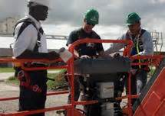
Aerial Lifts
Inspect the following daily:
Cable and wiring harness
Guardrail system
Hydraulic reservoir level
Coolant level
Taking an extra minute or two may prevent you from a serious injury
Notes:
Inspect the following daily:
Cable and wiring harness
Guardrail system
Hydraulic reservoir level
Coolant level
Taking an extra minute or two may prevent you from a serious injury

Slide 17
Fall Protection
Scissors Lifts (Fall Protection)
Fall protection is not necessary or required unless the railing has been removed.
Articulating & telescoping boom lift.
Fall protection is required due to potential for being bounced out of lift or from climbing out basket.
Notes:
Due to being at elevated heights, fall protection is required when operating lift equipment.
Scissors Lifts (Fall Protection)
Fall protection is not necessary or required unless the tailing has been removed.
Articulating & telescoping boom lift.
Fall protection is required due to potential for being bounced out of lift or from climbing out basket.

Slide 18
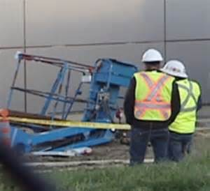
Preventing Tip-Over
Do not exceed manufacturer rated load capacity limits
Do not travel to job location with lift in elevated position.
Set up proper work zone protection when working near traffic
Avoid excessive horizontal forces when working on elevated scissor lifts
Notes:
Tip-overs lead to injuries and death. Preventive measures concerning tip-overs include:
Do not exceed manufacturer rated load capacity limits
Do not travel to job location with lift in elevated position.
Set up proper work zone protection when working near traffic
Avoid excessive horizontal forces when working on elevated scissor lifts

Slide 19
Preventing Tip-Over
Positioning of lifts
Do not drive near drop-offs or holes.
Do not raise platform on uneven or soft surfaces.
Do not drive onto uneven or soft surfaces when elevated.
Do not raise platform on slope or drive onto slope when elevated.
Do not raise platform in windy or gusty conditions.
Notes:
One method to prevent tip-over is the positioning of the lift.
Do not drive near drop-offs or holes.
Do not raise platform on uneven or soft surfaces.
Do not drive onto uneven or soft surfaces when elevated.
Do not raise platform on slope or drive onto slope when elevated.
Do not raise platform in windy or gusty conditions.

Slide 20
Aerial Baskets
Safe Setup
Solid footing for wheels and outriggers is crucial
Wheels and outriggers blocked and/or cribbed as necessary
Awareness of and clearance from overhead electrical hazards
Warm-up period followed by safe test of hydraulic system
Notes:
Aerial baskets also require a safe setup.
Solid footing for wheels and outriggers is crucial
Wheels and outriggers blocked and/or cribbed as necessary
Awareness of and clearance from overhead electrical hazards
Warm-up period followed by safe test of hydraulic system

Slide 21
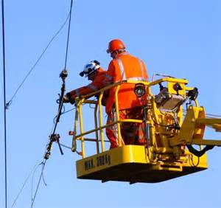
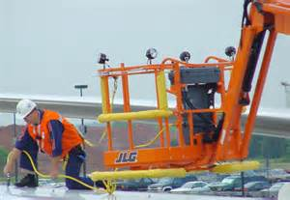
Aerial Baskets
Safe Setup
Lanyard and safety belts worn by ALL in basket
Barricades necessary to separate unit from ground traffic
Notes:
Also during an aerial basket’s safe setup,
Lanyard and safety belts worn by ALL in basket
Barricades necessary to separate unit from ground traffic

Slide 22
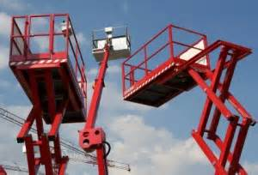
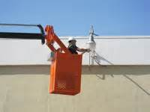
Aerial Baskets
All operators must be trained
No basket riding allowed when truck is moving
Operator’s feet always must be on basket floor
Lanyard and safety belt must restrict operator movement within basket
Notes:
Aerial basket safety also includes provisions for the following:
All operators must be trained
No basket riding allowed when truck is moving
Operator’s feet always must be on basket floor
Lanyard and safety belt must restrict operator movement within basket

Slide 23
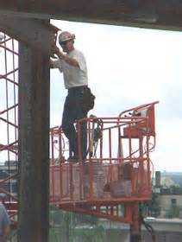
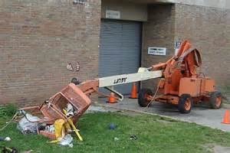
Aerial Baskets
Load limits of boom & basket posted and never exceeded
Boom lowered and basket cradled before truck movement
No overreaching from basket
Notes:
Ensure with aerial baskets,
Load limits of boom & basket posted and never exceeded
Boom lowered and basket cradled before truck movement
No overreaching from basket

Slide 24
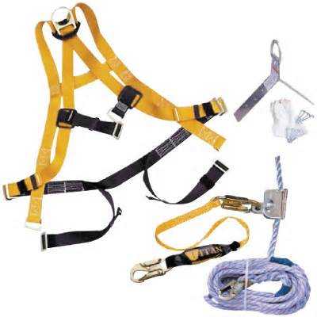
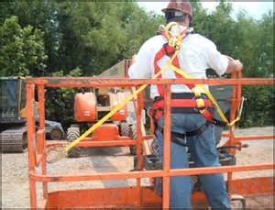
Fall Protection
Fall protection is required (full body harness with lanyard or body belt with 2-foot lanyard as restraint device)
Fall arrest systems (harness plus lanyard to stop a fall)
Can tip over some boom lifts and scissor lifts due to fall stopping force
Notes:
An indicated, when working at elevated heights, fall protection is a must.
Fall protection is required (full body harness with lanyard or body belt with 2-foot lanyard as restraint device)
Fall arrest systems (harness plus lanyard to stop a fall)
Can tip over some boom lifts and scissor lifts due to fall stopping force

Slide 25
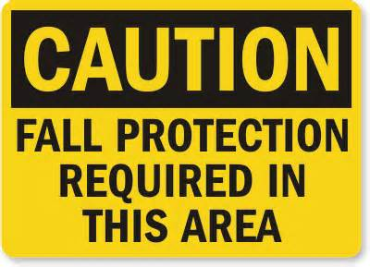
Fall Protection
Fall restraint systems intended to prevent falls are preferred
e.g. Full body harness plus lanyard designed for size of lift platform
Always close entrance chains or doors
Stand on floor of bucket or lift platform
Do not climb on or lean over guardrails
Notes:
Fall restraint systems intended to prevent falls are preferred e.g. Full body harness plus lanyard designed for size of lift platform
Always close entrance chains or doors
Stand on floor of bucket or lift platform
Do not climb on or lean over guardrails

Slide 26
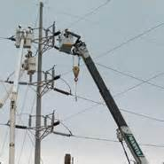
Preventing Electrocutions
Non-electrical workers must stay at least 10 feet away from overhead power lines.
Electrical workers must de-energize/insulate power lines or use proper PPE/equipment.
Use insulated buckets near overhead power lines
Regularly check insulation on buckets
Notes:
Electricity is another hazard commonly encountered by aerial and lift truck operations. Electrocution can be prevented.
Non-electrical workers must stay at least 10 feet away from overhead power lines.
Electrical workers must de-energize/insulate power lines or use proper PPE/equipment.
Use insulated buckets near overhead power lines
Regularly check insulation on buckets
More information can be found in 29 CFR 1910.333(c)(3)(iii).

Slide 27
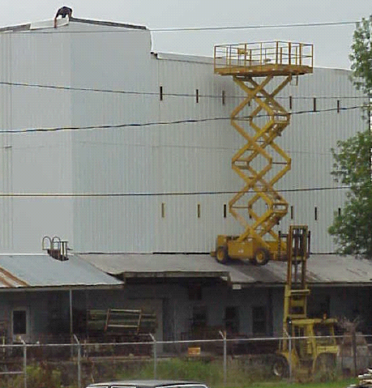
What’s Wrong Here?!
Notes:
Misuse, to the extreme, of aerial lift trucks; scissors and forklift.

Slide 28
Contact Information
Health & Safety Training Specialists
1171 South Cameron Street, Room 324
Harrisburg, PA 17104-2501
(717) 772-1635
RA-LI-BWC-PATHS@pa.gov
Like us on Facebook! - https://www.facebook.com/BWCPATHS
Notes:
Please contact us for other available free training for your organization.

Slide 29
Questions

