Slide 1
Why driving while using hands-free cell phones is risky behavior
National Safety Council
White Paper

Slide 2
Motor Vehicle Crashes
No. 1 cause of death for 3- to 34-year-olds
An estimated 39,000 to 46,000 people killed in crashes every year
More than 2.2 million injuries from crashes in 2008
^{Distractions now join}
^{alcohol and speeding as} leading factors in fatal and serious injury crashes.

Slide 3
Distracted Driving
Driver distractions leading factor in fatal and serious injury crashes
In 2008, 28% of all crashes attributable to cell phones
1.6 million crashes
645,000 injuries
Cell phone users 4x as likely to crash

Slide 4
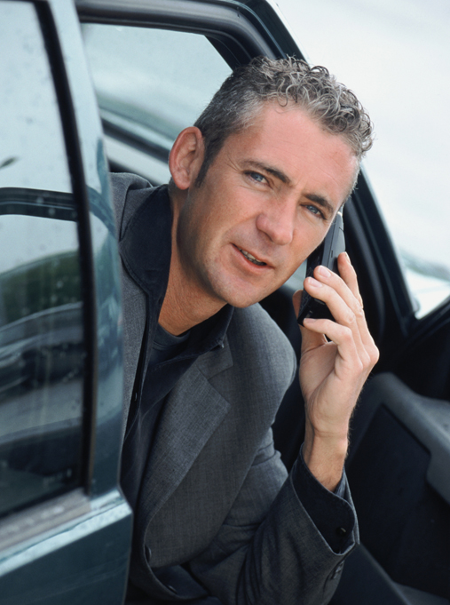
Millions of People are Talking While Driving
11% of drivers at any point during the day are on cell phones
81% of drivers admit to talking on cell phone while driving:
74% of Boomers
88% of Gen X
89% of Gen Y
62% of Teen Drivers

Slide 5
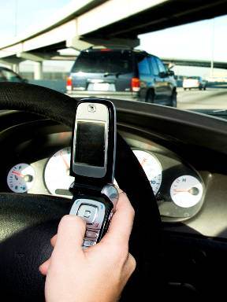
Millions of People are Texting While Driving
18% of drivers admit to texting while driving:
4% of Boomers
15% of Gen X
39% of Gen Y
36% of Teen Drivers

Slide 6
Driving Culture Change
“A century ago, Model T’s brought motoring to an emerging middle class.
A half century ago, teenagers cuddled in convertibles at drive-in movies.
A new generation of drivers see cars as an extension of their plugged-in lives, with iPods, DVD players and other gadgets.”
USA Today, 2-17-2009

Slide 7
Driving Culture Change
Webster’s Dictionary named “distracted driving” its 2009 Word of the Year
In 2009:
More than 200 state bills introduced
U.S. DOT Distracted Driving Summit held
President Obama signed Executive Order
NSC membership survey
Favorable public opinion polls

Slide 8
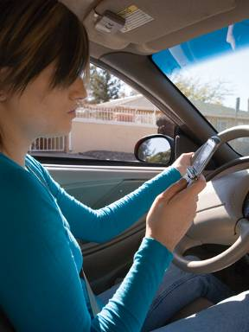
How Cell Phones Distract
Visual – Eyes off road
Mechanical – Hands off wheel
Cognitive – Mind off driving
CHALLENGE: Drivers don’t understand or realize that talking on a cell phone distracts the brain and takes focus away from the primary task of driving.

Slide 9
The Problem
Hands-free seen as solution and mistakenly believed to be safer than handheld
People recognize the risk of talking on handheld and texting more than the risk of hands-free
Most legislation focuses on only handheld devices or texting
All state laws and some employer policies allow hands-free devices
^{Hands-free devices offer} ^{no safety benefit} ^{when driving.}

Slide 10
What is a Hands-Free Device?
Headset that communicates via wire or wireless connection to cell phone
Factory-installed or aftermarket feature built into vehicle (voice recognition)

Slide 11
Cognitive Distraction
Cognitive distraction still exists with hands-free
Talking occurs on both handheld and hands-free cell phones
Mind focuses on conversation
Listen and respond to disembodied voice
Hands-free devices do not eliminate cognitive
^{distraction.}

Slide 12
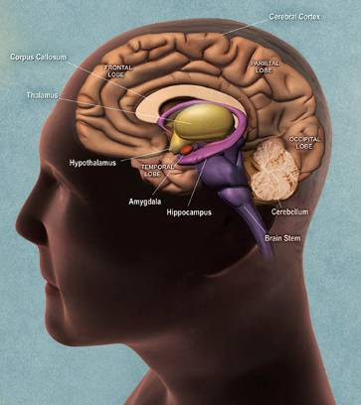
Multitasking: A Brain Drain
Multitasking for the brain is a myth
Human brains do not perform two tasks at same time
Brain handles tasks sequentially
Brain switches between one task and another
^{The four lobes of the brain.}
Source: National Institutes of Health

Slide 13
Multitasking: A Brain Drain
Brain engages in a constant process to:
1. Select information brain will attend to
2. Process information
3. Encode to create memory
4. Store information
It must also:
5. Retrieve
6. Execute or act on information
When brain is overloaded these steps are affected

Slide 14
Multitasking: A Brain Drain
Encoding Stage
Brain filters information due to overload
Drivers not aware of information filtered out
Information does not get into memory
Drivers miss critical information on potential hazards
Inattention blindness and encoding.
Source: National Safety Council

Slide 15
Multitasking: A Brain Drain
Brain juggles tasks, focus and attention
Brain switches between primary and secondary tasks
Inattention blindness
When people do 2 cognitively complex tasks (driving and using a cell phone), causing brain to shift focus
Bottleneck
Different regions of brain must pull from a shared and limited resource for unrelated tasks

Slide 16
Inattention Blindness
A type of cognitive distraction
“looking” but not “seeing”
Hands-free drivers less likely to see:
High and low relevant objects
Visual cues
Exits, red lights and stop signs
Navigational signage
Content of objects

Slide 17
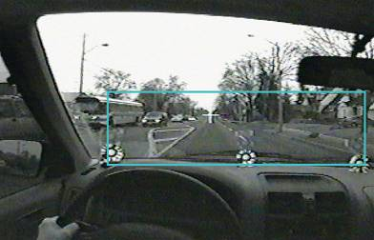
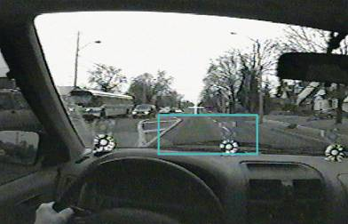
Inattention Blindness
A narrowed scope
Where drivers not using a
hands-free cell phone looked.
Where drivers using a
hands-free cell phone looked.
^{Source: Transport Canada}

Slide 18
Multitasking: Impairs Performance
Carnegie Mellon University Study (2008)
Took fMRI pictures of brain while drivers listened to sentences and drove simulator
Literally see the results…

Slide 19
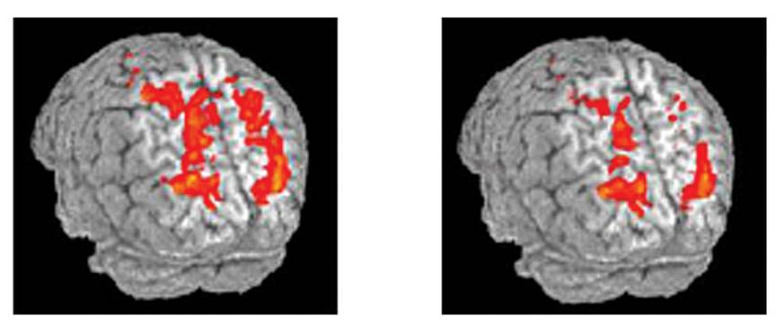
^{Driving alone}
Driving with sentence listening
L R
L R
Functional magnetic resonance imaging images.
Source: Carnegie Mellon University

Slide 20
Multitasking: Impairs Performance
Just listening to sentences on cell phones decreased activity by 37% in the brain’s parietal lobe which perceives movement, integrates sensory information and also has importance for language processing
Listening and language comprehension drew cognitive resources away from driving
Also decreased activity in brain’s occipital lobe which processes visual information

Slide 21
Multitasking: Impairs Performance
We can walk and chew gum safely because it is not a cognitively-demanding task
But even cell phone-using pedestrians act unsafely. They are less likely to:
Look for traffic before stepping into street
Look at traffic while crossing street
Notice unusual objects placed along path

Slide 22
Multitasking: Impairs Performance
Driving involves a more complex set of tasks than walking:
Visual
Manual
Cognitive
Auditory
A driver’s job is to watch for hazards, but this cannot be done when brain is overloaded

Slide 23
Cell Phone: Driver Risks
Inattention blindness
Slower reaction/response times
Problems staying in lane

Slide 24
Passenger Conversations
Adult passengers share awareness of driving situation, a safety benefit
Front seat passengers reduce risk of crashing by 38% compared to cell phone conversations
Adults with passengers have lower crash rates than adults without passengers
Not true for novice teen drivers

Slide 25
Prevention Steps
Widespread education
Corporate cell phone bans
Legislation
Law enforcement
Technology

Slide 26
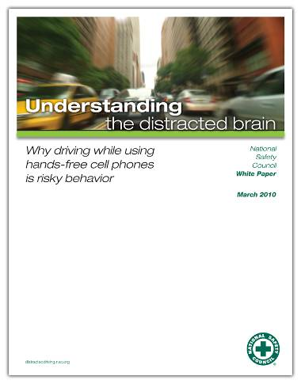
Download the NSC White Paper
nsc.org

Slide 27
More than 1.6 million crashes are caused by cell phone use and texting while driving each year.

Slide 28
Countless lives have been lost as a result.
Joe, 12
Bailey, Merideth, Hannah, Sara and Katie
Cady, 16
Erica, 9
Jean and Jay, 58
Linda, 61
Jason, 38
Lauren, 17
Matt, 25
Frances, 13
Jordan, 18

Slide 29
Help us save lives. Tell everyone you know. On the Road, Off the Phone

