Slide 1
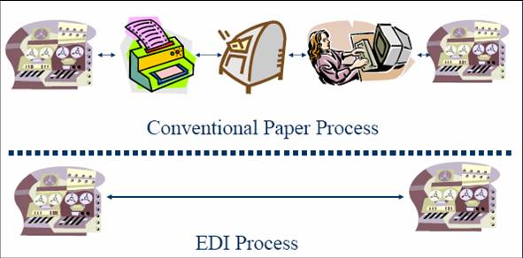
Bureau of Workers’ Compensation
Introduction to Pennsylvania Electronic Data Interchange (EDI)

Slide 2
Implementation Information
The Bureau of Workers’ Compensation (BWC) implemented the IAIABC Release 3 EDI Claims Standard for BOTH First Report of Injury (FROI) and Subsequent Report of Injury (SROI) claim filings on Sept. 9, 2013.

Slide 3
General EDI Information
EDI = Electronic Data Interchange
EDI is a structured transmission of data between organizations by electronic means.
It is computer-system to computer-system communication with no human intervention.
EDI for claims is an electronic way of sending workers’ compensation claim information, which is currently being sent by paper, to BWC.
It will be used to report all claim events.
EDI increases quality and timeliness.

Slide 4
What is a Trading Partner?
An entity that has entered into an agreement with another entity to exchange data electronically.
It can be an insurance company, TPA or self-insured employer.
Trading partners will determine the channel they choose to submit their data.

Slide 5
Trading Partners must:
Select a transaction partner that they will partner with to submit FROI and SROI EDI transactions via flat file transmission, or
File directly via flat file transmission with BWC , or
Use the Web Portal which is also available for submission of data. This method requires manual data entry, but will most likely be the preferred option for small insurers or self-insurers who have a small volume of yearly transactions.

Slide 6
Submission Options
Trading Partners will transmit data to BWC using
one of the following channels.
Submission to BWC
Flat files from direct-filing trading partner
Flat files from transaction partners
BWC's EDI claims Web portal
The same information
will be required for all
types of transmissions.

Slide 7
What is a Transaction Partner?
An organization that has met BWC’s requirements to accept EDI claim transactions from Trading Partners.
Transaction Partners provide services to submit EDI transactions to jurisdictions.
Trading Partners should choose a transaction partner that best suits their needs, if they choose to utilize one.

Slide 8
Approved EDI Transaction Partners
EBIX Inc
HealthTech Inc.
Insurance Services Office Inc.
Mitchell Workers’ Compensation Solutions (WCS)
Aerie EDI Group
Contact information for the Transaction Partners is on the Labor & Industry website at www.dli.pa.gov/EDI.

Slide 9
Trading Partner Agreements
Trading Partner agreements are available on the Labor & Industry website and must be submitted to BWC. Go to www.dli.pa.gov/EDI.
BWC requires new documents be filed for every Trading Partner so the most current information is on file.
Send your Trading Partner agreements and corresponding documents via a WCAIS Customer Service ticket (category= EDI; sub-category= Trading Partner Agreements).

Slide 10
EDI Direct-Filing Trading Partners
A Trading Partner can submit EDI Release 3 FROI/SROI transactions by placing their files directly at the Department of Labor & Industry’s SFTP location.
Direct filers must fulfill the direct filer’s criteria and complete all testing requirements successfully.

Slide 11
EDI Claims Web Portal
Trading Partners can submit FROI/SROI transactions directly to BWC by using the WCAIS EDI claims Web Portal.
It has data entry screens which allow Trading Partners to enter information that would otherwise be required to be submitted using one of the approved Transaction Partners or by filing directly.
The data elements captured through the Web Portal screens corresponds to IAIABC EDI Release 3 claims data elements.

Slide 12
EDI Claims Web Portal - continued
Trading Partners using the Web Portal to submit the EDI transactions will not receive acknowledgements. Instead, they will receive an onscreen confirmation.
Web Portal submitters must file a Web Portal Trading Partner Agreement with the Bureau.

Slide 13
EDI Reporting – FROI’s & SROI’s
Claim Event – an incident that requires you to report information to BWC.
First Report of Injury (FROI) – may contain information on claim administrator, employee, employer and accident information.
Subsequent Report of Injury (SROI) – may contain information on indemnity payments, non-indemnity payments, reason(s) why claim is not being paid, changes, reoccurrences, modifications and suspensions.

Slide 14
Maintenance Type Codes (MTC)
MTCs describe the type of FROI or SROI being submitted.
Used to report claim events.
Example of MTCs:
FROI-00 Original Report
FROI-01 Cancel Report
FROI-02 Change
FROI-04 Denial
SROI-IP Initial Payment
SROI-S1 Suspension
SROI-RB Reinstatement
*Note – For a listing of all accepted PA MTCs, see the PA EDI Claims Implementation Guide and/or the FROI/SROI event tables.

Slide 15
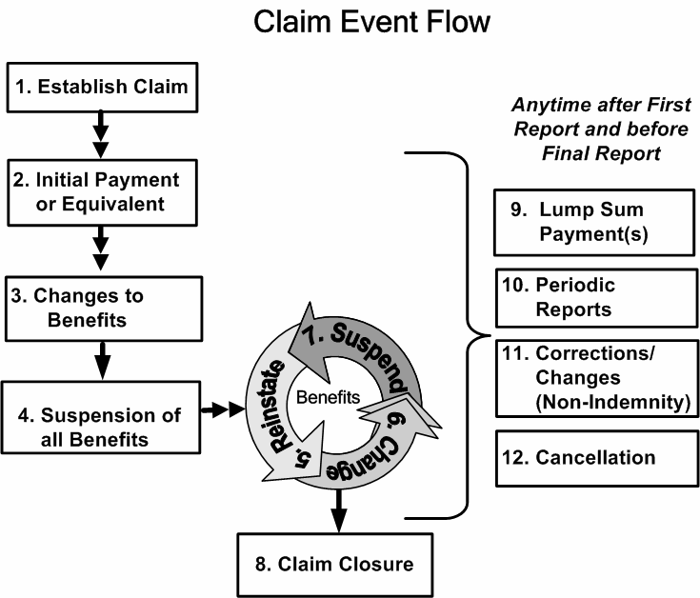
Claim Lifecycle
Source: IAIABC

Slide 16
FROI/SROI Data Obtained
Employee data
Employer data
Insurer data
Claim administrator data
Injury data
Accident data
Claim data
Wage data
Benefit data
Payment data
Suspension data
Return-to-work data

Slide 17
Reporting Data
Claim administrators should always submit the most current data on each MTC.
Data may be removed in BWC’s system if a space is sent on the MTC where data had previously been sent.
There are four flat file batches a day (9am, 1pm, 9pm, & 11:59:59pm). The cut-off time for the last batch of the day is 11:59:59 PM Eastern Time. All files located in the “IN” directory will be processed by BWC. Data that arrives after this cut-off time will be processed with the next day’s files.

Slide 18
EDI Claims Tables
EDI Reporting requirements are defined on the following tables:
Element
Requirements Table
Event
Table
Edit Matrix
2. Data needed on
the report(s)
Required
report(s)
3. Applied
editing

Slide 19
Event Table tells you:
The events to report
What triggers the transaction
When the transaction is due
The paper forms that must be sent, and to which parties
Event
Table

Slide 20
Element Requirements Table tells you:
The information required in a transaction by data element and report type.
The requirement codes, which are:
M – Mandatory
MC – Mandatory/conditional
IA – If applicable/available
N/A – Not applicable
F – Fatal
FY – Fatal yes change
X – Exclude
Y – Change allowed
N – No change
Element
Requirements Table

Slide 21
Edit Matrix Table contains:
The specific edits applied to reports to determine acceptability by BWC and the standard error messages for those edits when the data is not acceptable.
The proper sequence of submissions, acceptable code values, data used for matching to existing claims and error messages associated with these edits.
Edit Matrix

Slide 22
PA EDI Claims Implementation Guide
Provides technical information, procedures and explanations to help claim administrators prepare and navigate future EDI processes.
The guide and EDI tables are available on our website at:
http://www.dli.pa.gov/edi

Slide 23
Acknowledgment Record
The acknowledgement record is a transaction returned by the jurisdiction as a result of an EDI report sent.
It contains enough data elements to identify the original report sent and communicates any technical business issues found.
Transactions are either accepted or rejected:
TA – Transaction accepted – no errors.
TR – Transaction rejected – errors were found and the transaction was NOT accepted.
HD – Batch rejected

Slide 24
Acknowledgment Record, continued
Submitter is responsible for reviewing all acknowledgement files.
Rejected transactions must be analyzed so the appropriate data can be sent in the next file.
Even accepted transactions must be reviewed to retrieve the appropriate jurisdiction claim number (JCN), which must be used on subsequent transactions.

Slide 25
EDI Reporting Overview
Report is submitted to BWC through one of the three options available to Trading Partners.
BWC identifies the report as either new or duplicate.
BWC runs technical and business edit checks on the report.
BWC accepts or rejects the report (TA or TR).
BWC sends an acknowledgment of the report(s) status back to the sender (Web Portal user will instead receive an on-screen confirmation).

Slide 26
Statutory Requirements
The First Report of Injury transaction is required to be electronically filed within seven days of the alleged injury.
A transaction to accept or deny a claim must be submitted to BWC no later than 21 days after the employer has notice or knowledge of a claimant’s disability.

Slide 27
Statutory Requirements, continued
If benefits are being paid under a TNCP, a transaction to accept or to stop and deny the claim must be received within 90 days of the disability begin date or the claim becomes compensable.
* For specific statutory requirements, refer to Section 2.5, Information and Data Reporting, of the PA EDI Claims Implementation Guide.

Slide 28
Paper Forms
EDI eliminates most paper reporting to BWC. There are exceptions as required by Pennsylvania law:
Statement of Wages, Agreements, and Notices of Suspension or Modification must be filed with BWC.
*For specific form requirements, refer to Section 2.2, BWC Forms Required, of the PA EDI Claims Implementation Guide.

Slide 29
Paper Forms, continued
Paper forms, either the existing BWC form or the FROI (LIBC-90) MUST be sent to the claimant for ALL transactions. Written notice to the employee has not changed due to EDI and is still required.
The LIBC-91 cannot be used in place of the Notice of Compensation Payable (LIBC-495), Notice of Workers’ Compensation Denial (LIBC-496) or the Notice of Temporary Compensation Payable (LIBC-501). These forms must be submitted to BWC by EDI.
Paper forms do not update the claim status and must therefore be accompanied by an EDI transaction.
Paper forms should be submitted to BWC as close to the EDI transaction date as possible, preferably the same day.

Slide 30
Next Steps for Trading Partners
Business staff and IT staff should work together to determine if you are going to file directly, use a Transaction Partner, or use the PA Web Portal.
Understand the EDI reporting requirements and verify that you collect this data. Note: Web data entry application has same edits as flat file.
Review and prepare for testing and implementation.
Complete Trading Partner agreements and corresponding documents and keep them up to date on a yearly basis by submitting updated versions to BWC.

Slide 31
Next Steps for Trading Partners, continued
If you haven’t already done so, go to our PA EDI Claims Implementation Guide Web page: http://www.dli.pa.gov/edi
Our Implementation Guide, claims EDI tables and trading partner forms are all available on this Web page.

Slide 32
Questions/Comments
Contact us using the WCAIS Customer Service Center “Submit a Question” feature (category= EDI).

